Slide 1
EHR Dream Challenge
Machine Learning
Brian Chang, Taitea Dykstra, Michael Chen, Allen Zhu

Slide 2
Outline
What is the EHR Dream Challenge?
Data Wrangling
Methods and Outcomes
Challenges
Next Step

Slide 3
EHR Dream Challenge
Design machine learning algorithms to predict if a patient will die within 6 months of his/her last clinical visit
Dataset
Synthetic Public Use File (Synpuf) created by Centers for Medicare and Medicaid Services
Converted to OMOP Common Data Model by the CMS Working Group of the Observational Health Data Sciences and Informatics (OHDSI)

Slide 4
Data Wrangling
Big Purple
Sampling to amplify outcome
Get_Dummies and Pivot()
Merging DataFrames using Patient ID#
Drop NA
16000+ variables
Dropped all columns with ≥55% NA
Imputation
5343 variables
Median
Notes:
Sampling to amplify outcome to about 10000 patients

Slide 5
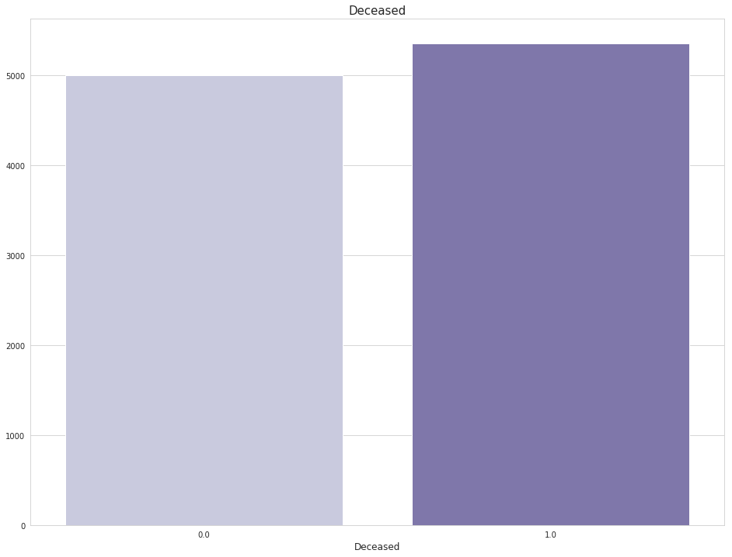
Distribution of Outcome of Interest
Original outcome frequency:
5,383/979,184 = 0.55%

Slide 6
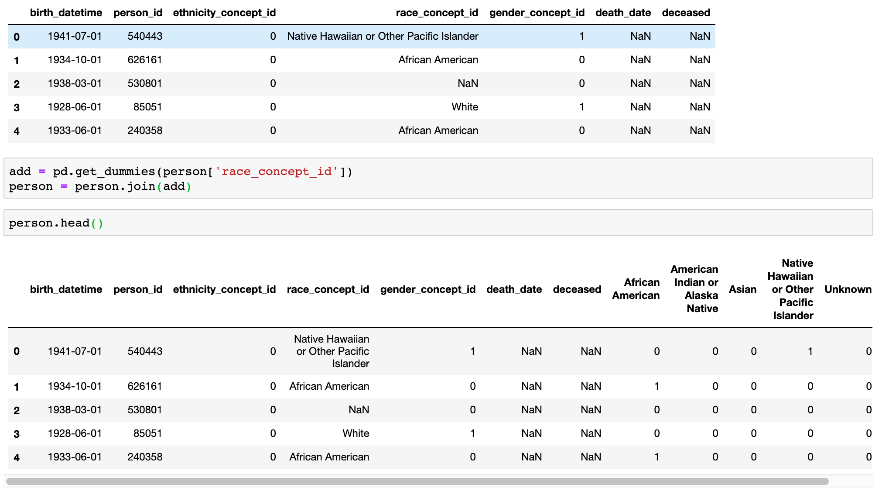
get_dummies()

Slide 7
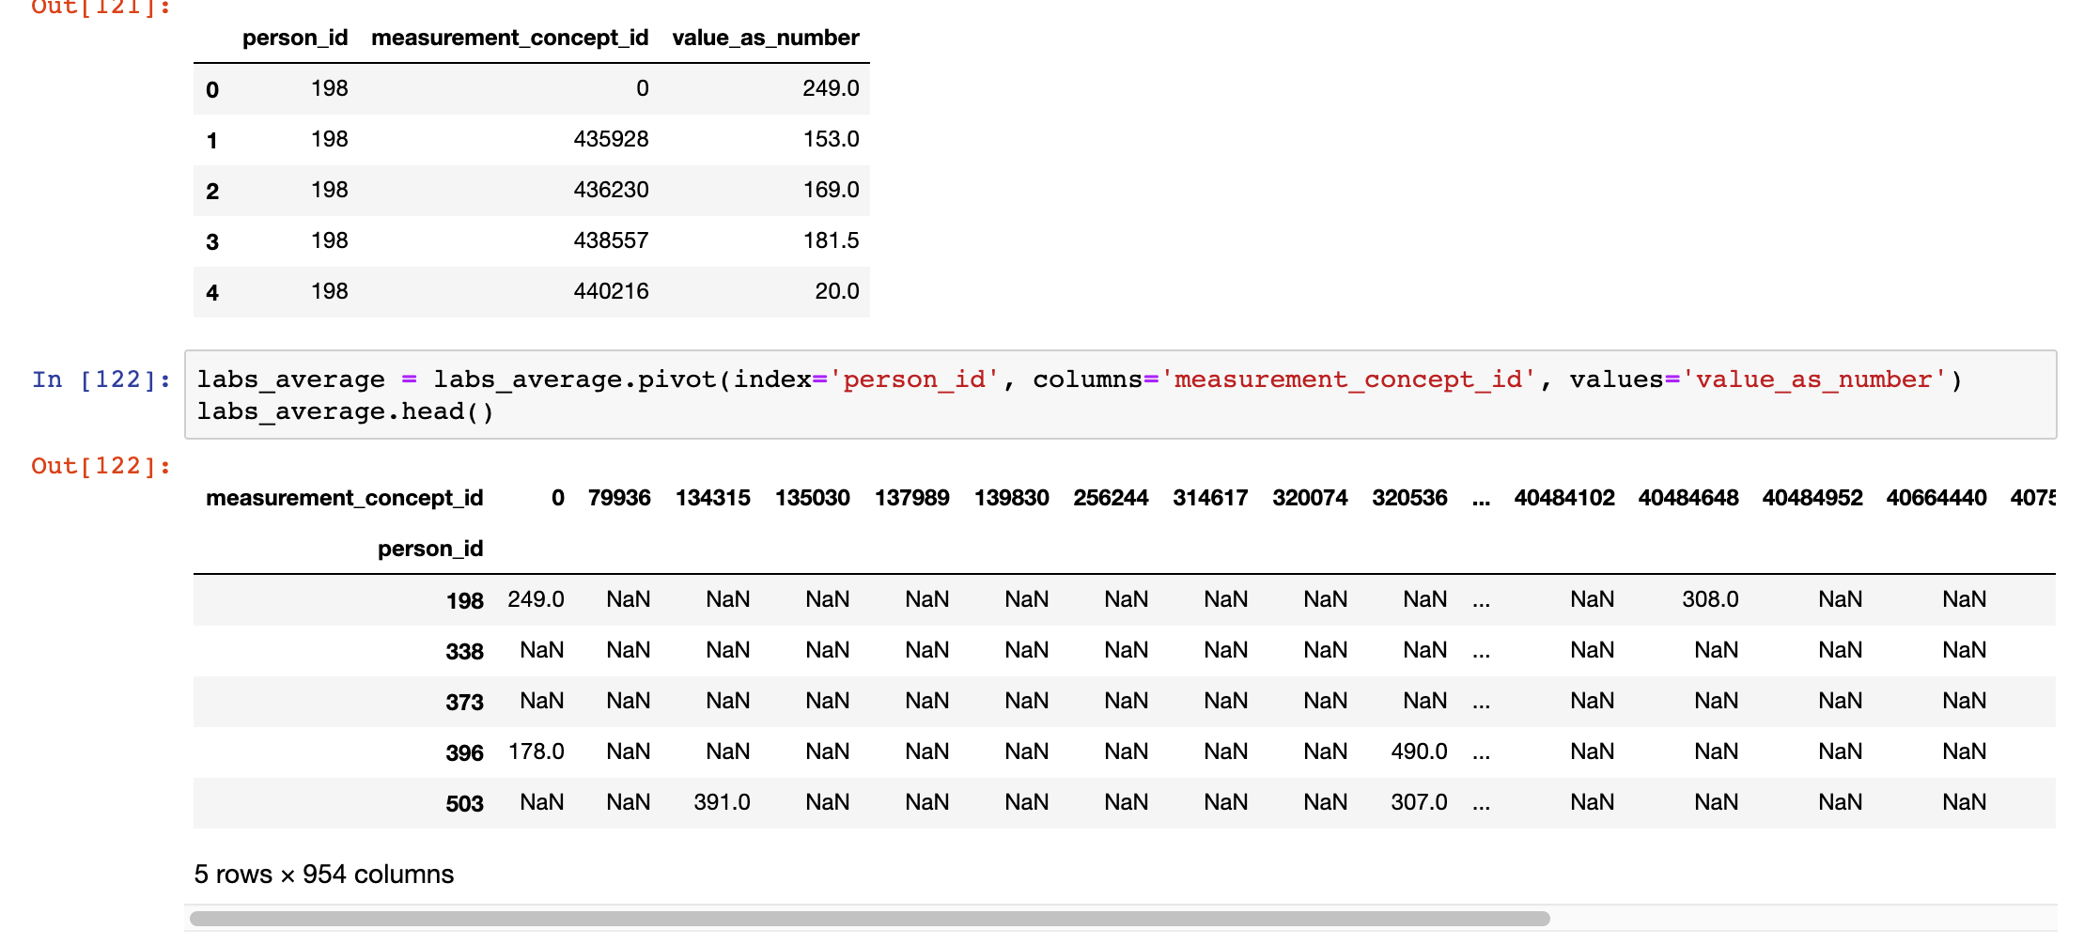
pivot()

Slide 8
Methods
Logistic Regression
L1 penalized
XGBoost
Support Vector Machine
Feature selection
Various kernels
Hyperparameter tuning
Random Forest
Feature selection
Hyperparameter tuning

Slide 9
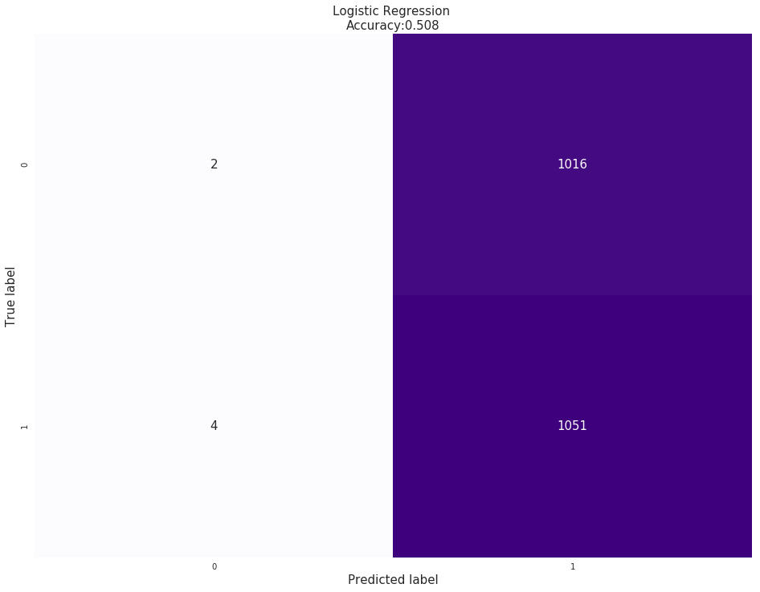
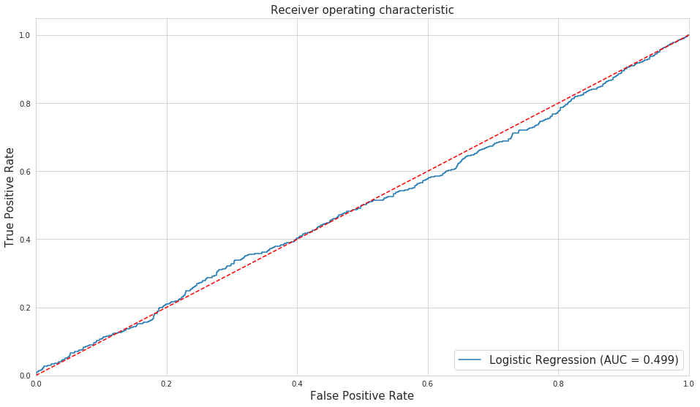
Logistic Regression

Slide 10
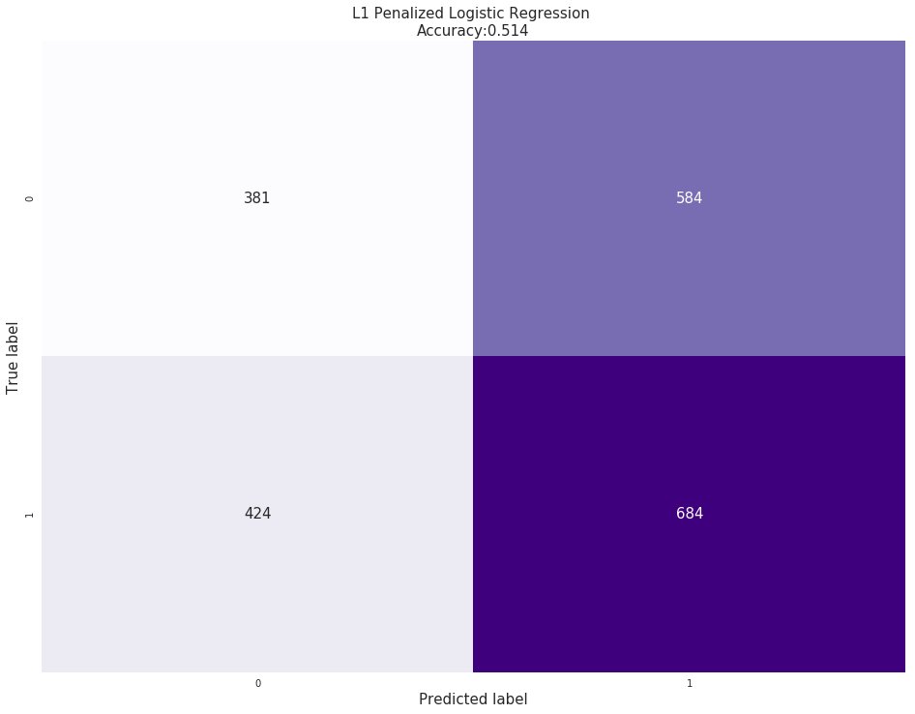
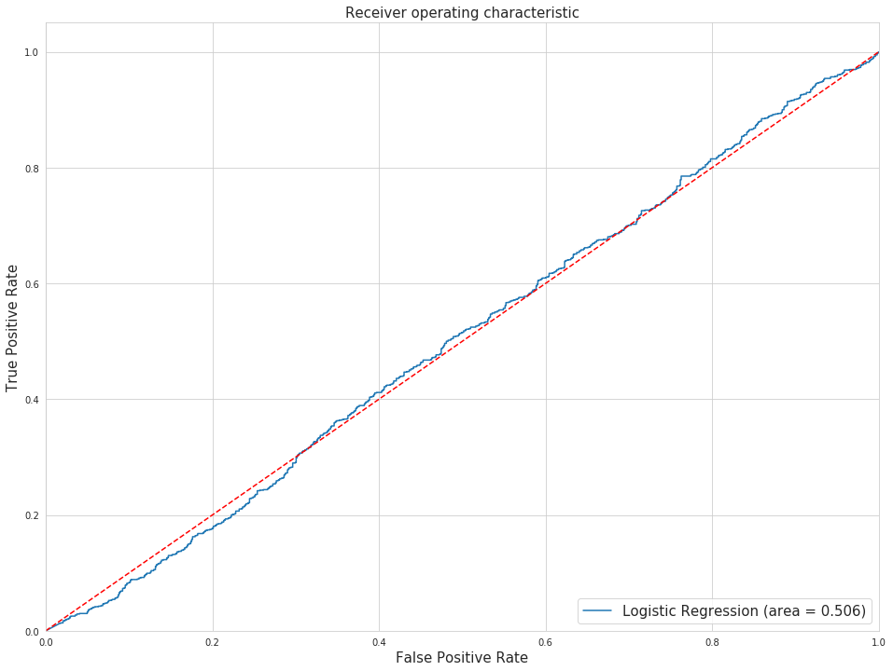
Logistic Regression with L1 Penalty

Slide 11
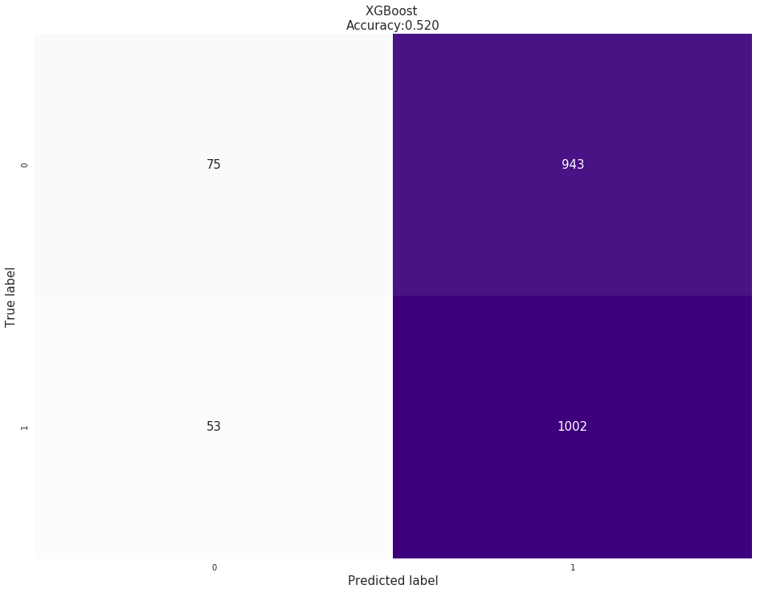
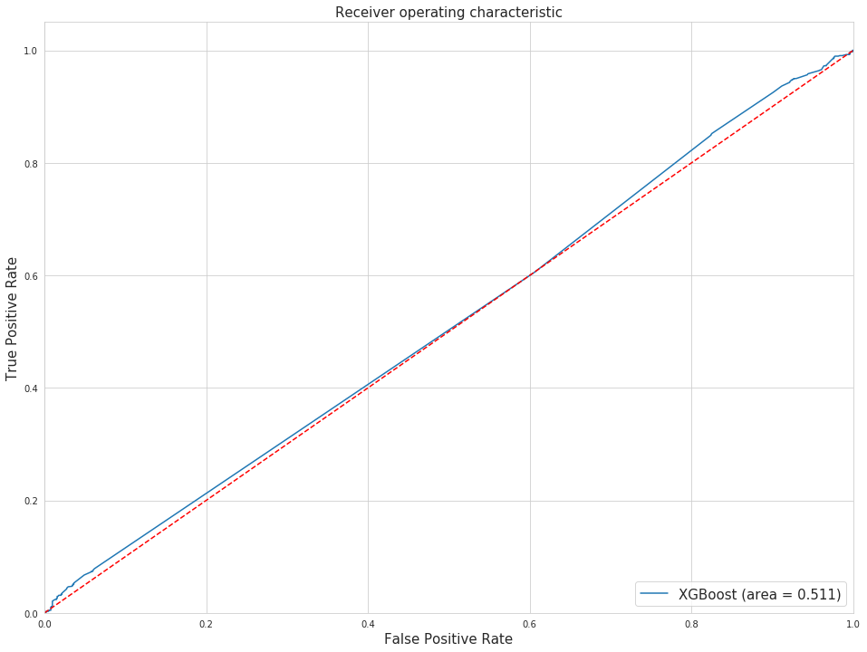
XGBoost

Slide 12
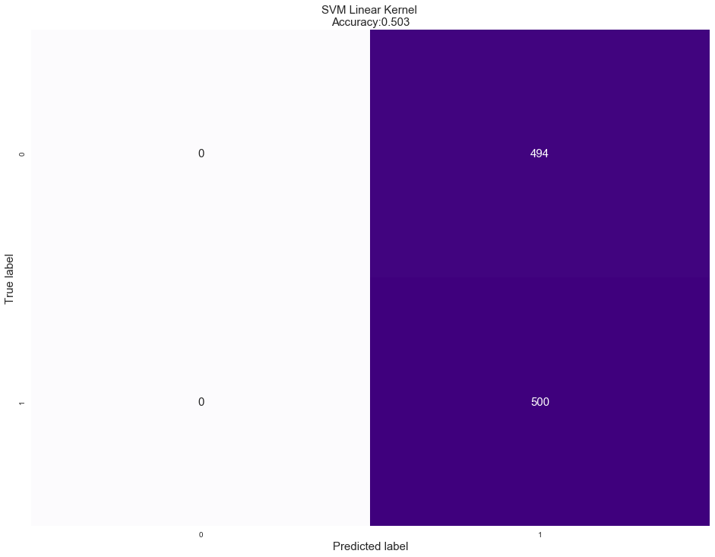
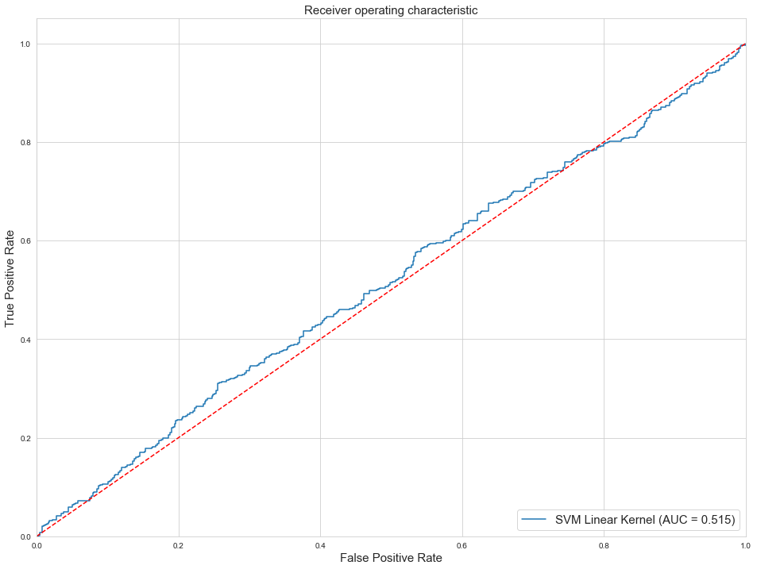
Support Vector Machine
Notes:
Here is our SVM model using all of the default hyperparameters.
The AUC is close to 0.515, which is not good.

Slide 13
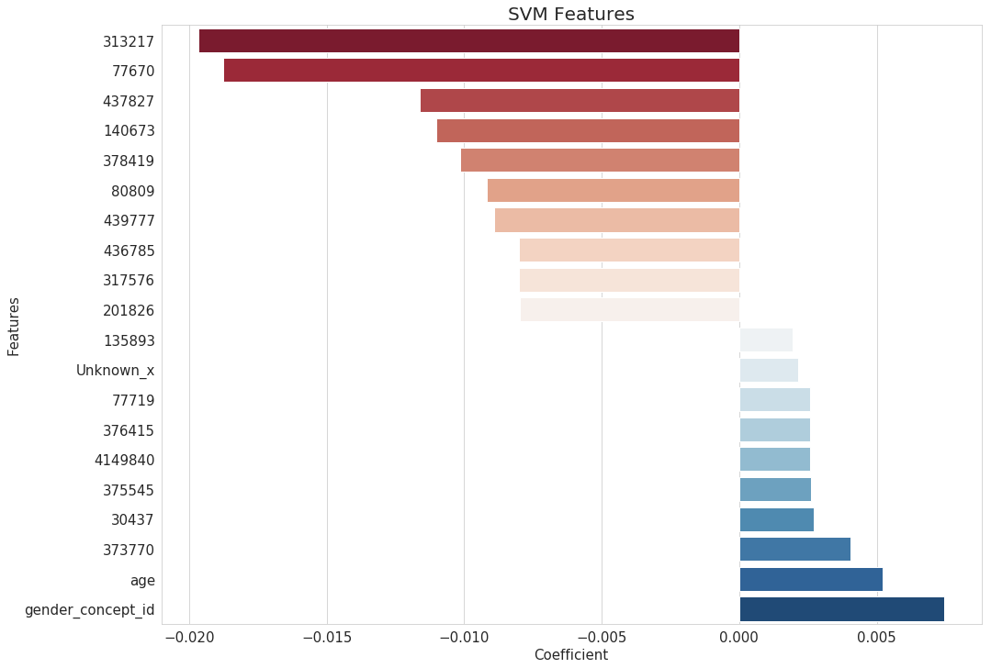
Support Vector Machine Feature Selection
Notes:
These are the coefficients, or the coordinate vectors orthogonal to the hyperplane (from the linear kernel)
Positive vs. Negative class (which side of hyperplane) is determined by the dot product of points with the coefficients. Best coefficients are not positive or negative, but the coefficients with the biggest absolute values.
313217 A-fib (heart disease)
77670 Chest pain (heart disease)
437827 Pure hypercholesterolemia (heart disease)
140673 Sumatriptan 25 MG Oral Tablet
378419 Alzheimer’s Disease (usually age-related)
80809 Rheumatoid Arthritis
436785 Spinal stenosis in cervical region (commonly age-related)
317576 Coronary arteriosclerosis (heart disease)
Other sources have suggested that enormous datasets with high dimensions work best with linear kernel because other kernels would be too computationally expensive.
Nonetheless, since we were working with a subset of the full training data, we found a way to try many different kernels and hyperparameters.

Slide 14
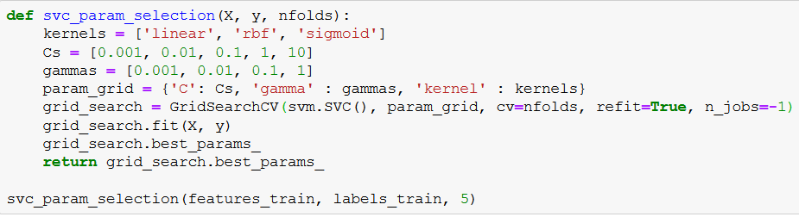
Support Vector Machine Hyperparameter Tuning
Notes:
Still running on Big Purple as of 12/10/2019
This function tries every combination of hyperparameters, compares the outcomes, and returns the hyperparameters that gave the best result.
C = cost of misclassification. Smaller C → higher bias and low variance (wider margin in the hyperplane)
The gamma parameter defines how far the influence of a single training example reaches, with low values meaning ‘far’ and high values meaning ‘close’. The gamma parameters can be seen as the inverse of the radius of influence of samples selected by the model as support vectors.
If gamma is really small, it basically behaves as a linear kernel. Hyperplane separates the centers of high density
refit=True just refitting the estimator using the best found parameters on the whole dataset
n_jobs = -1 is imorptant for parallelizing on all CPU threads you call.

Slide 15
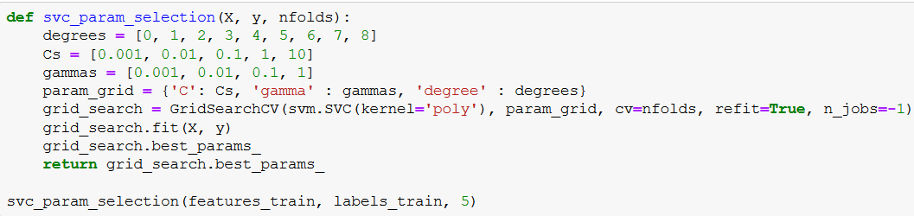
Notes:
Here is the same function, but for polynomial kernel
The only difference is that you have to specify degree
If 1 is the best degree, linear is still the best.

Slide 16
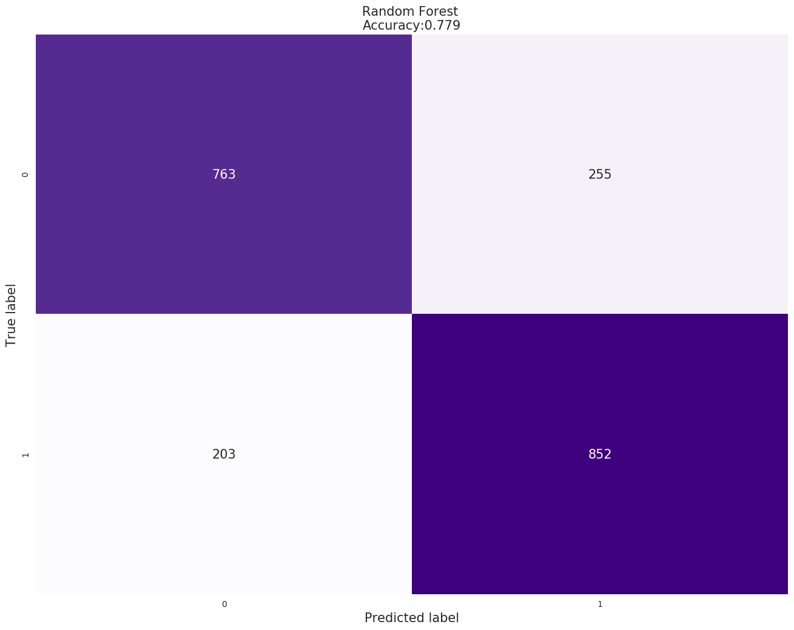
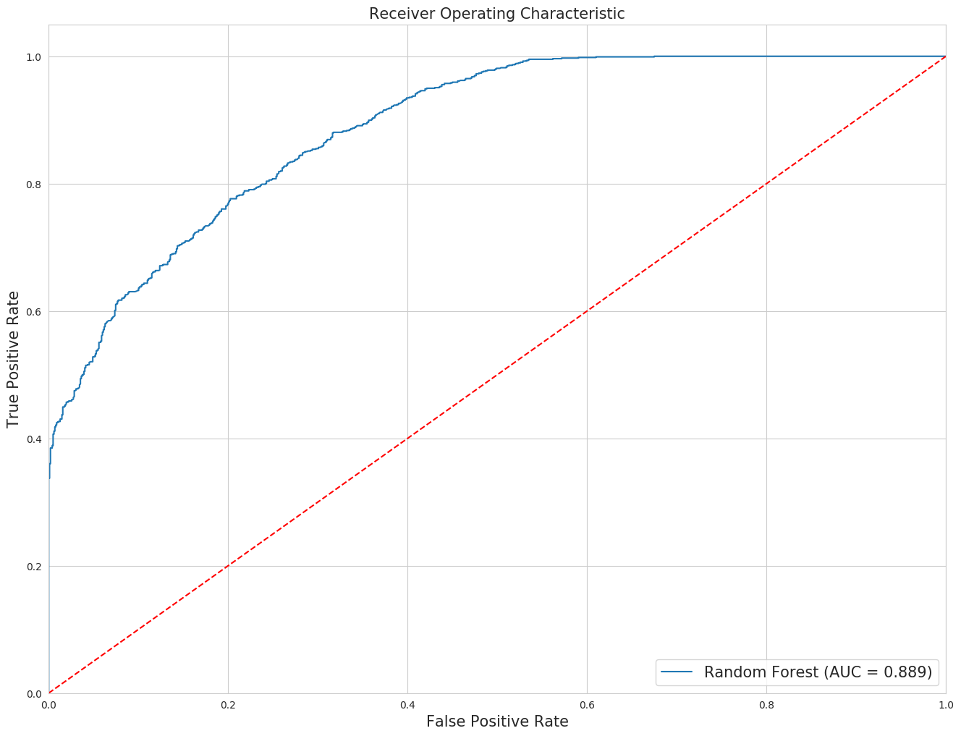
Random Forest
Notes:
n=10000 trees
bootstrap=True
max_features=’sqrt’
Given number of features and size of dataframe we thought it’d be worth trying many trees
Don’t think it’s overfitting because this is performance on the test set

Slide 17
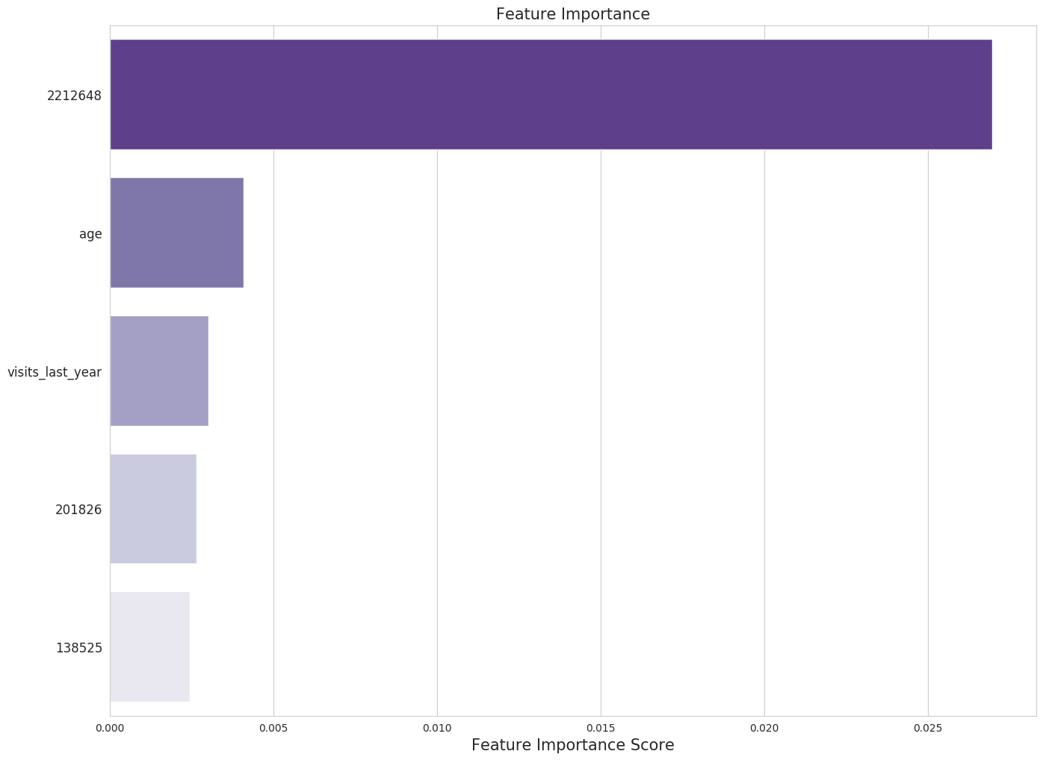
Random Forest Feature Importance
Notes:
When training a tree we can compute how much each feature contributes to decreasing the weighted Gini impurity.
Biased approach, as it has a tendency to inflate the importance of continuous features or high-cardinality categorical variables
2212648 Blood count; complete (CBC), automated (Hgb, Hct, RBC, WBC and platelet count) and automated differential WBC count
201826 Type 2 DM
138525 Pain in limb

Slide 18
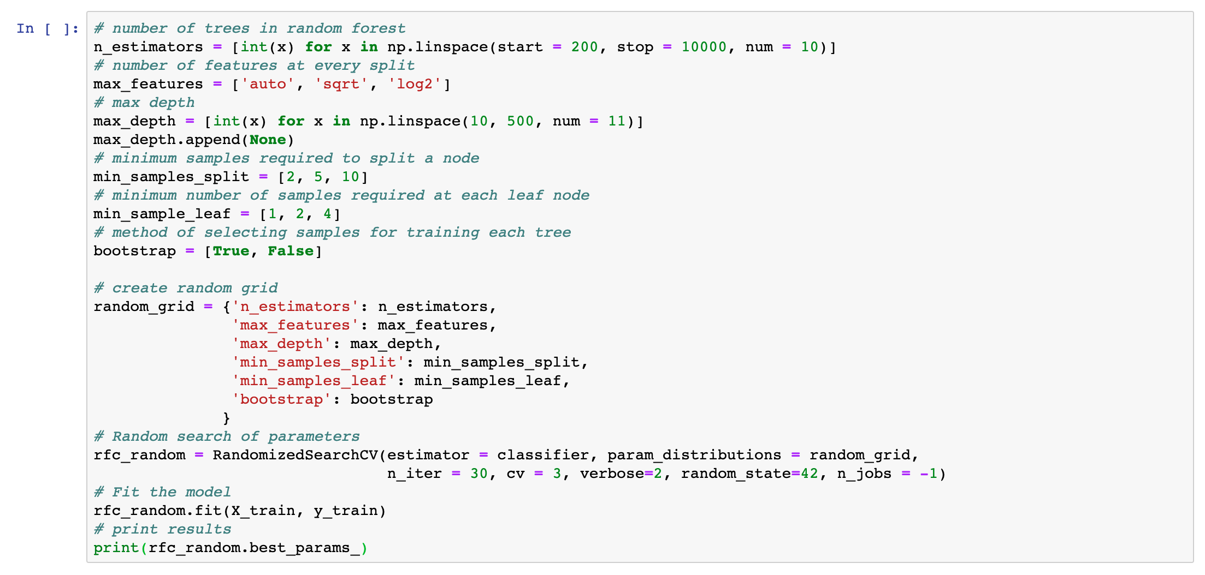
Random Forest Hyperparameter Tuning
Notes:
Still running on Big Purple

Slide 19
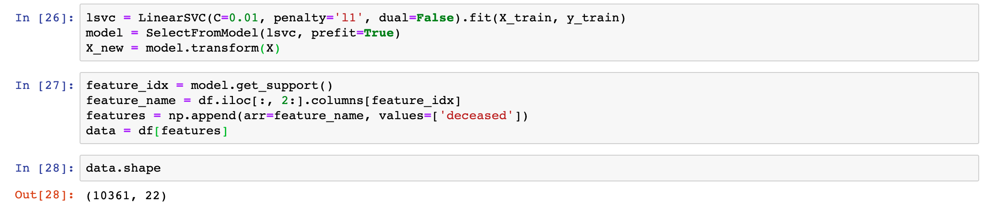
Random Forest with SVM Feature Selection
Notes:
Top 10 Features from previous slide

Slide 20
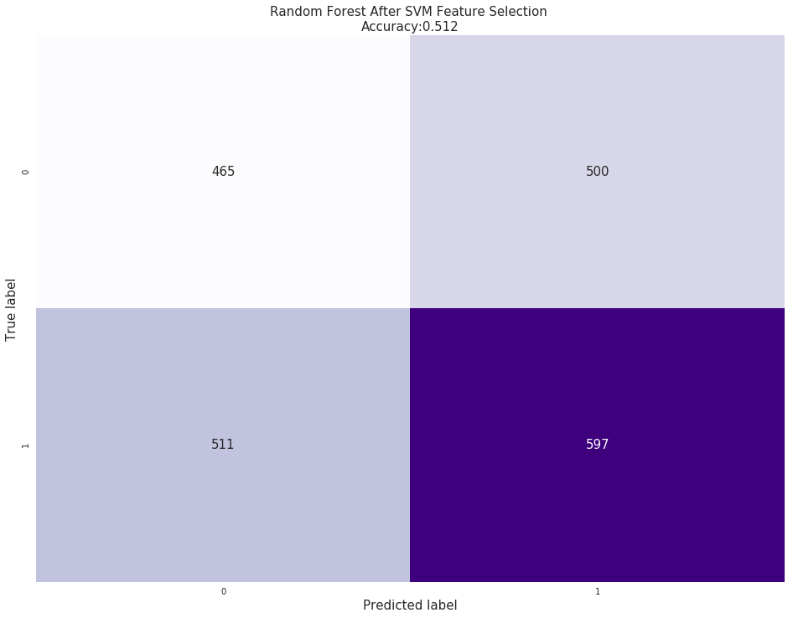
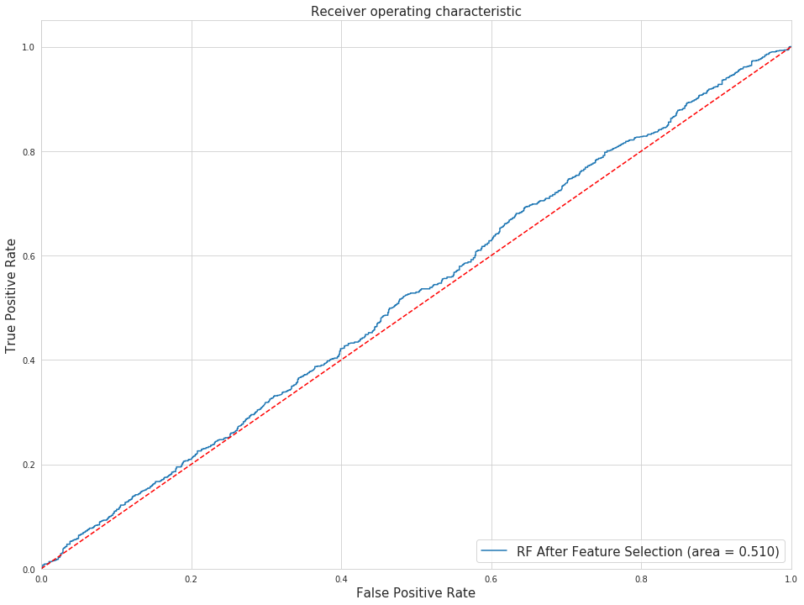
Random Forest with SVM Feature Selection
Notes:
Top 10 Features from previous slide

Slide 21
Comparison of Models
MODEL | ACCURACY | AUC
LOGISTIC REGRESSION | 0.508 | 0.499
RANDOM FOREST | 0.779 | 0.889
SVM (LINEAR) | 0.509 | 0.518
SVM (LINEAR) SELECT FEATURES | 0.519 | 0.510
SVM (RBF) | 0.509 | 0.497
SVM (POLY) | 0.509 | 0.492
SVM (SIGMOID) | 0.505 | 0.503
XGBOOST | 0.520 | 0.511

Slide 22
Challenges
Synthetic Dataset
Very sparse
Many clinically “useless” predictors (i.e. 42114956 - history of clinical finding in subject)
Unable to merge other useful information (i.e. drug dosage and frequency)
Sampling of training set
Potentially missing “key” predictors
Imputation
Unable to get KNNImputer working on Big Purple
Assumption that if patient did not have a lab measured it was “normal”
Other things we tried but just timed out
Recursive Feature Elimination using SVC linear kernel estimator

Slide 23
Next Step
Finalize hyperparameter tuning for random forest and SVM
If the model performance doesn’t improve, maybe revisit data wrangling methodology
Add visits in last 6 months, 30 days, etc.
Test models against the full dataset

