Slide 1

Breast Cancer Prediction
Ying Liao
2019.12.12

Slide 2

Dataset
Name of dataset: Wisconsin Diagnostic Breast Cancer
Number of instances: 569 (357 benign, 212 malignant)
Number of attributes: 32 (ID, diagnosis, 30 numeric features)

Slide 3
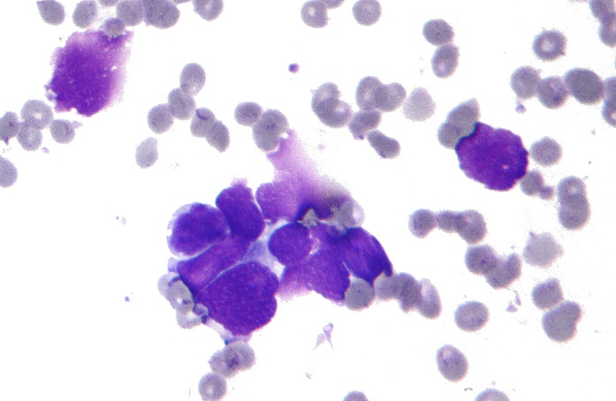
Dataset
Segmentation of cells
Extraction of features
Statistics of numbers
Radius
Texture
Concavity
…
10) Symmetry
Mean
Standard Deviation
Mean of three largest

Slide 4
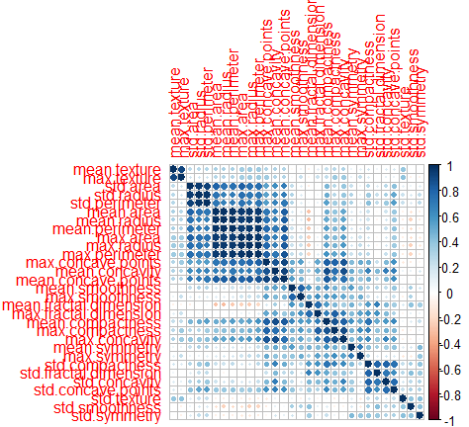
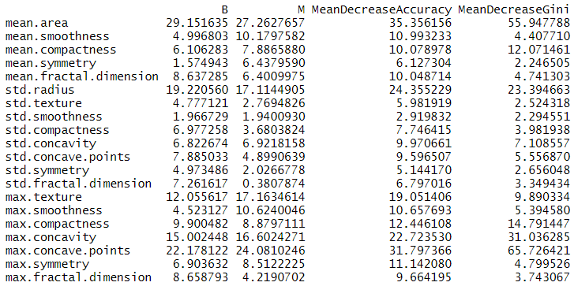
Feature Selection
Remove one feature from each highly correlated pair (correlation > 0.9)
30 – 10 = 20
Remove features with low importance shown from random forest (mean decrease Gini < 10)
20 – 13 = 7

Slide 5
Feature Selection

Slide 6
Method Comparison

Slide 7
Conclusion
The dataset is essentially a manual feature extraction from images of breast cells. It is intriguing to see how well convolutional neural network can do with those images compared to the current result.
Removal of redundant or insignificant features increases the accuracy overall and reduces the overfitting.
Logistic regression (LR) and support vector machine (SVM) perform almost equally well and better than random forest (RF). It makes sense because LR and SVM both serve as a dividing hyperplane in the parameter space while RF can only divide the space into rectangular boxes.

