Slide 1
Psychosis classification using diffusion MRI
and cognitive-behavioral data
Yu Veronica Sui

Slide 2
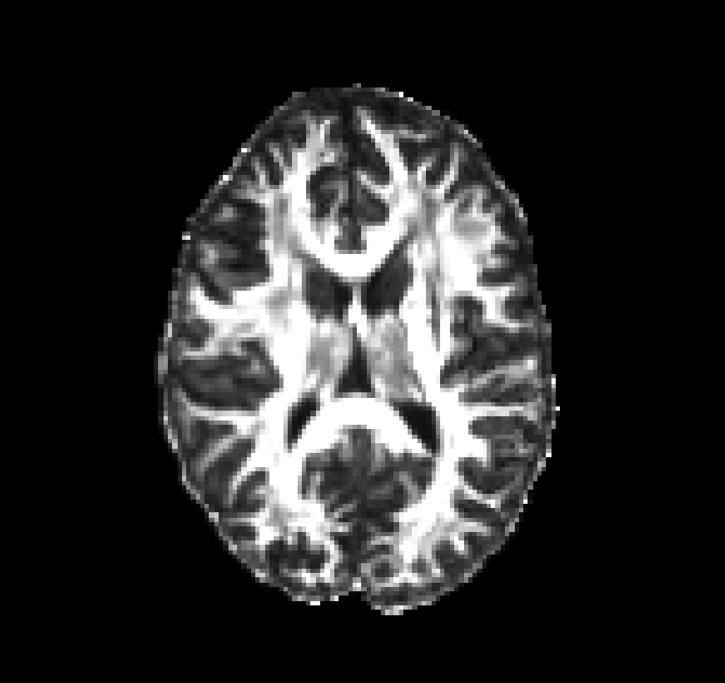
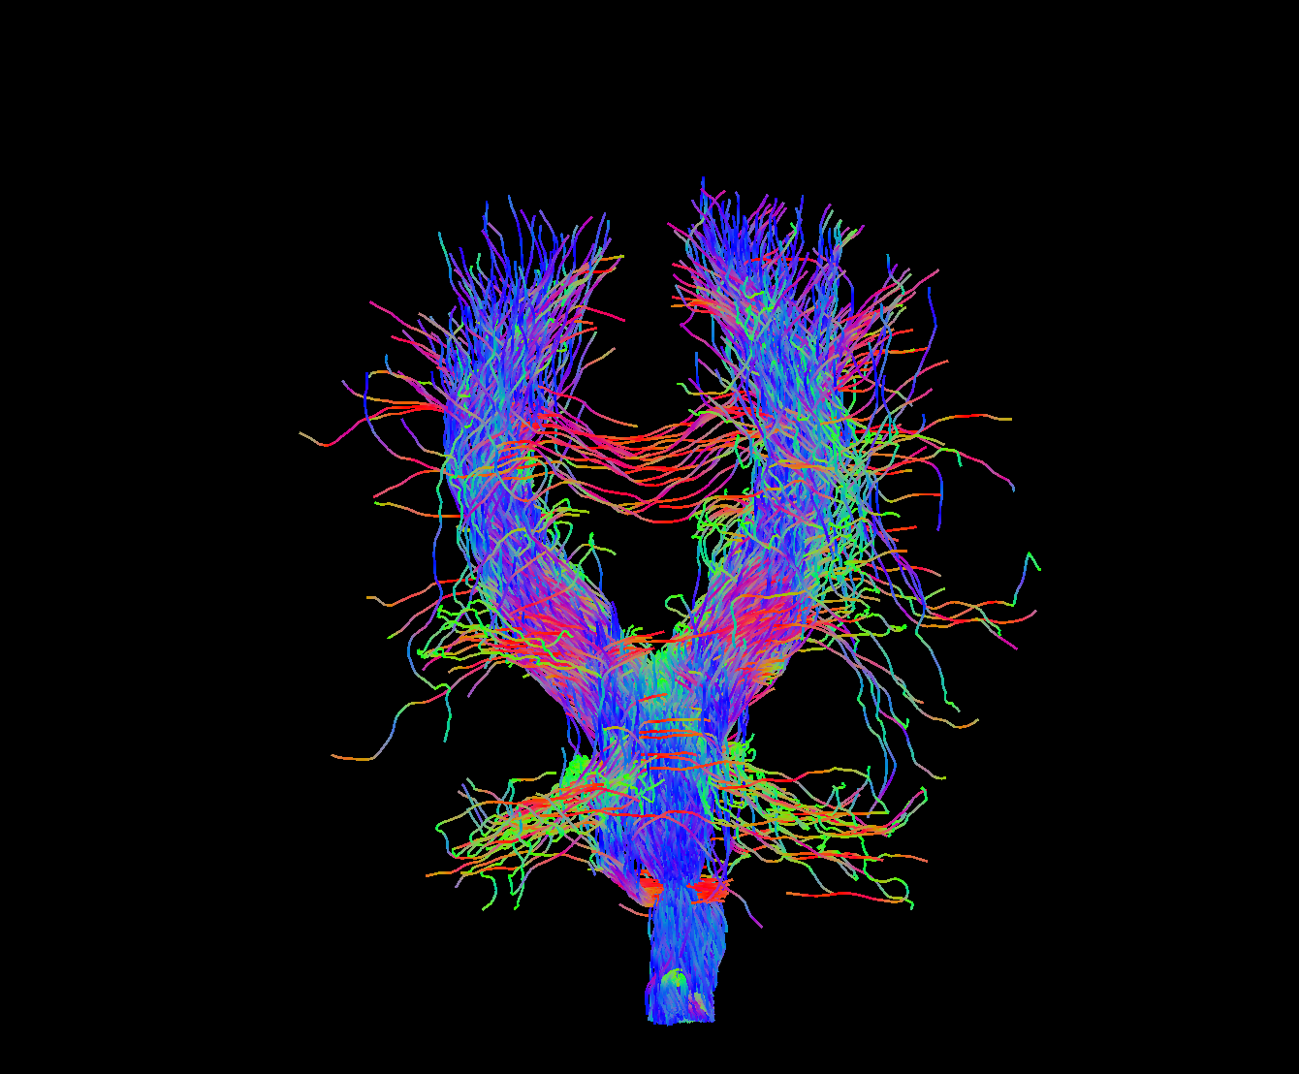
Neuropathology of psychosis
Candidates
Axonal abnormalities (structures, arrangements); myelin damage; inflammation…
Diffusion imaging
Good for probing tissue microstructure in vivo
Cognitive-behavioral outcomes
Working memory
Processing speed…

Slide 3
datasets
Diffusion imaging metrics
Fractional anisotropy; mean/radial kurtosis…
180 brain regions
Cognitive test performance
IQ scores
The MATRICS consensus cognitive battery (MCCB)
35 healthy controls
32 patients with psychotic features
… and more being acquired
(70% for testing, 30% for training)

