Slide 1
Ride Share
Team: praveen, alex, kushal, era

Slide 2
Ride share
RIDESHARE APP CONNECTS DRIVERS AND PASSENGERS WHO SHARE SIMILAR ROUTES.

Slide 3
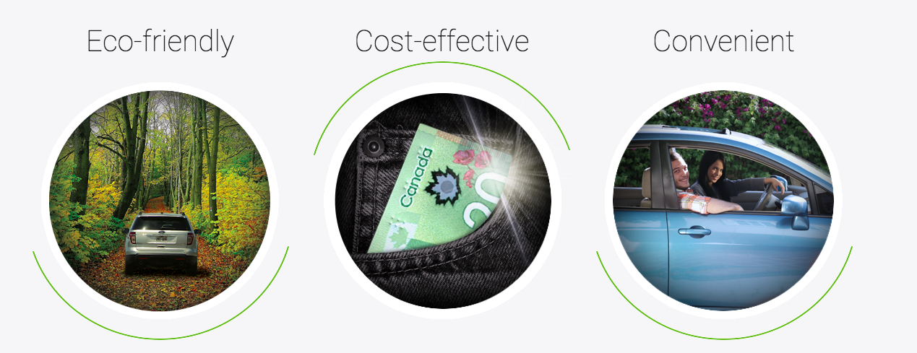
MOTIVATION

Slide 4
WHY USE RIDESHARE?
REDUCE YOUR CARBON FOOTPRINT WHILE SIMPLIFYING YOUR DAILY COMMUTE.
FEWER CARS, FEWER POLLUTANTS, BETTER ENVIRONMENT
DRIVERS SAVE MONEY BY SPLITTING THE COST OF THE RIDE.
THE CONVENIENCE OF A TAXI AT A FRACTION OF THE COST.

Slide 5
Competition?

Slide 6
Design and Architecture

Slide 7
Problems faced

Slide 8
Possible improvements

Slide 9
Questions ?

