Slide 1
Company Layoff Risk Prediction
INFO 6105 Final Project
Yuwei Ni & Ruixuan Xu
https://github.com/NYW114514/INFO-6105-Final-Project_002507246.git
https://github.com/xuruixuan3/INFO-6105-PROJECT-002593456.git

Slide 2
01
Problem
02
Solution
03
Training
&Results
04
Demonstrate
05
Conclusion

Slide 3
Problem Definition
Ruixuan Xu
Layoff risk prediction: what it means
Why it matters: early instability detection
Goal: identify high‑risk companies

Slide 4
Dataset Overview
Ruixuan Xu
Source: Kaggle Layoff Dataset
1,210+ companies, across 30+ countries
Each row represents a single layoff event
Columns: industry, location, layoffs, %, funding, stage

Slide 5
Event-Level → Company-Level
Ruixuan Xu
Raw dataset records individual events
Prediction target is company‑level risk
Aggregate all events by company
Create company‑level statistics

Slide 6
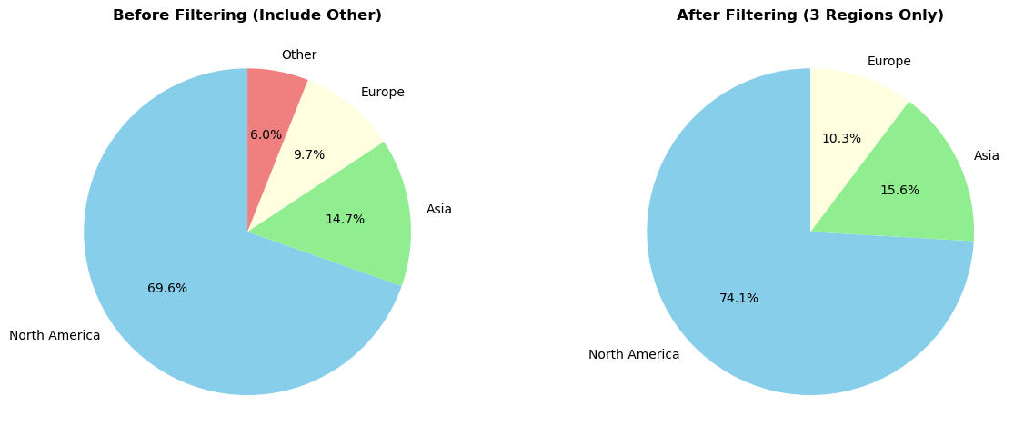
Feature Engineering: Region Grouping
Ruixuan Xu
30+ countries → too sparse
Grouped into NA / Europe / Asia
Reduces noise and variance

Slide 7
Feature Engineering: Recency
Ruixuan Xu
Recency = years since last layoff
Recent layoffs suggest instability

Slide 8
Feature Engineering: Deviation Features
Ruixuan Xu
events_deviation: event count vs industry avg
recency_deviation: recency vs industry avg
Capture abnormal company behavior

Slide 9
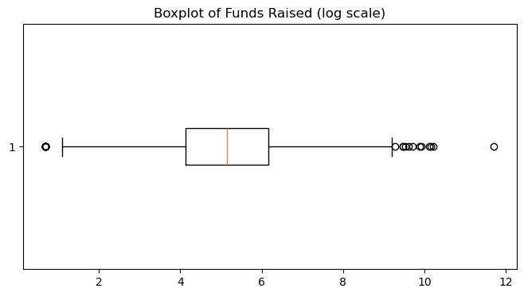
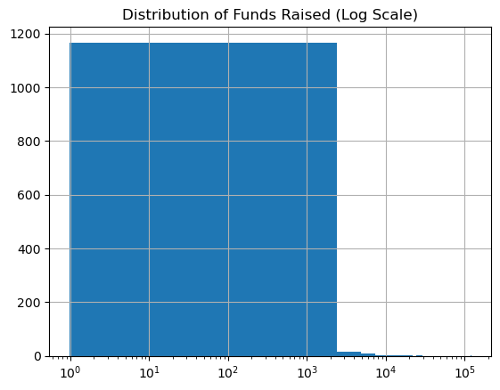
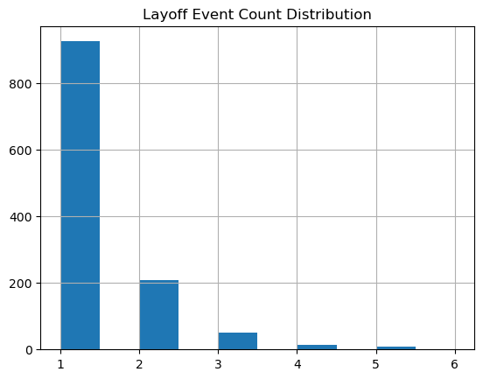
Feature Engineering: Binning
Ruixuan Xu
Funding values extremely skewed
Raw numbers introduce noise
Binned into small / medium / large

Slide 10
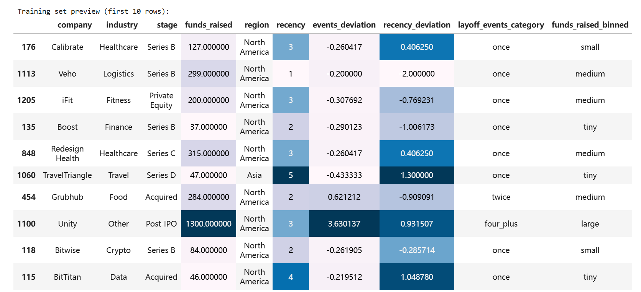
Ruixuan Xu

Slide 11
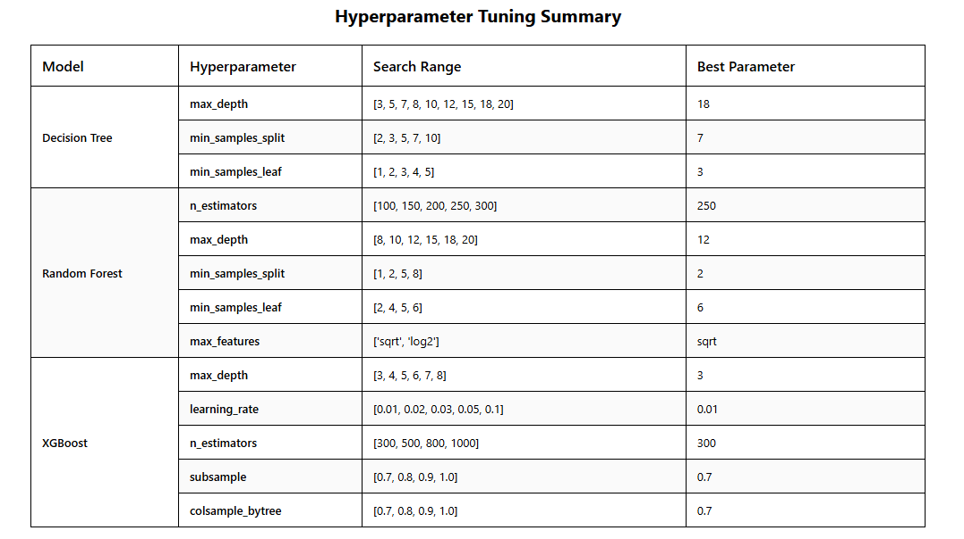
Trainning&Results
Yuwei Ni
Method: GridSearchCV with 5-Fold StratifiedKFold CV
Metric: F1-Score

Slide 12
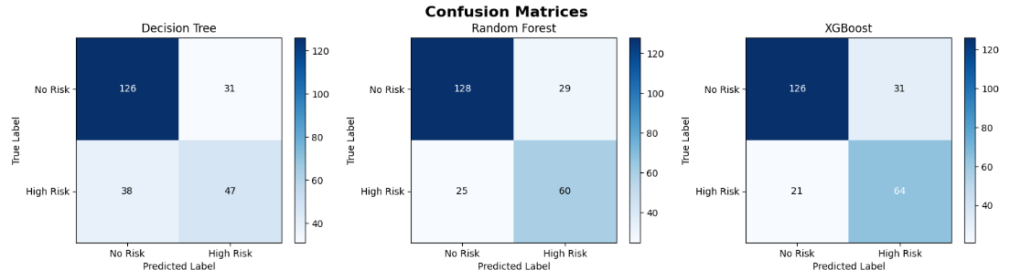
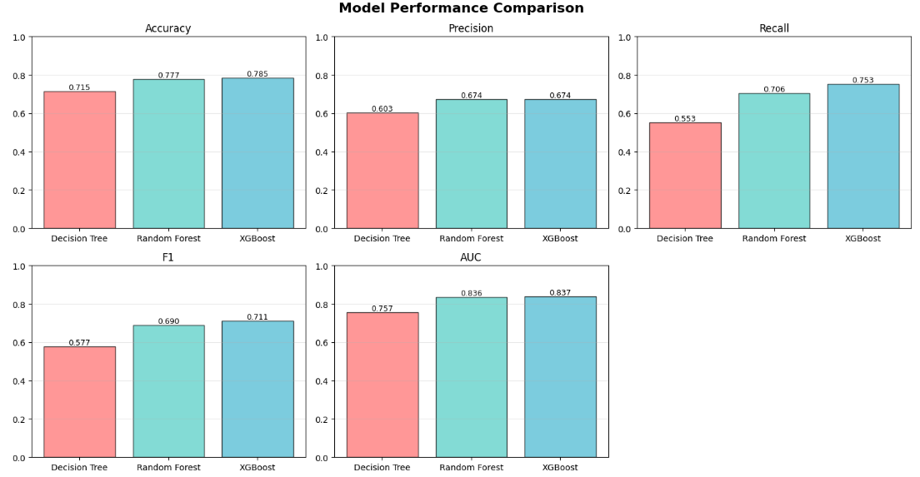
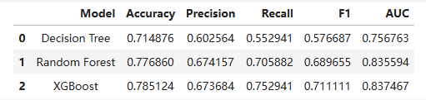
Results Analysis
Yuwei Ni

Slide 13
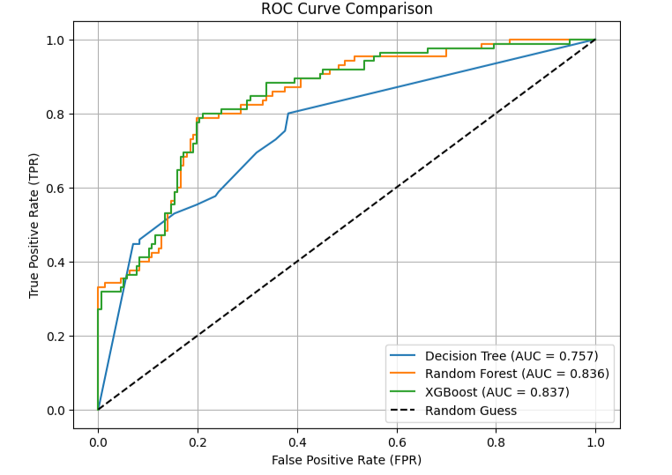



Results Analysis
Yuwei Ni
Best Model: XGBoost
Second: Random Forest
Accuracy: 78.51%, Precision:67.37%, Recall: 75.29%
Accuracy: 77.69%, Precision:67.37%, Recall: 70.59%
F1-score: 0.7111, AUC: 0.8375
F1-score: 0.6746, AUC: 0.8356

Slide 14
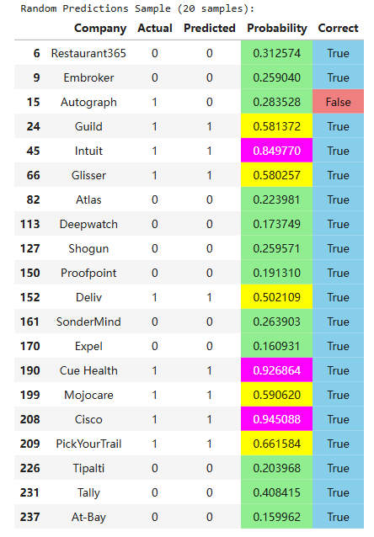
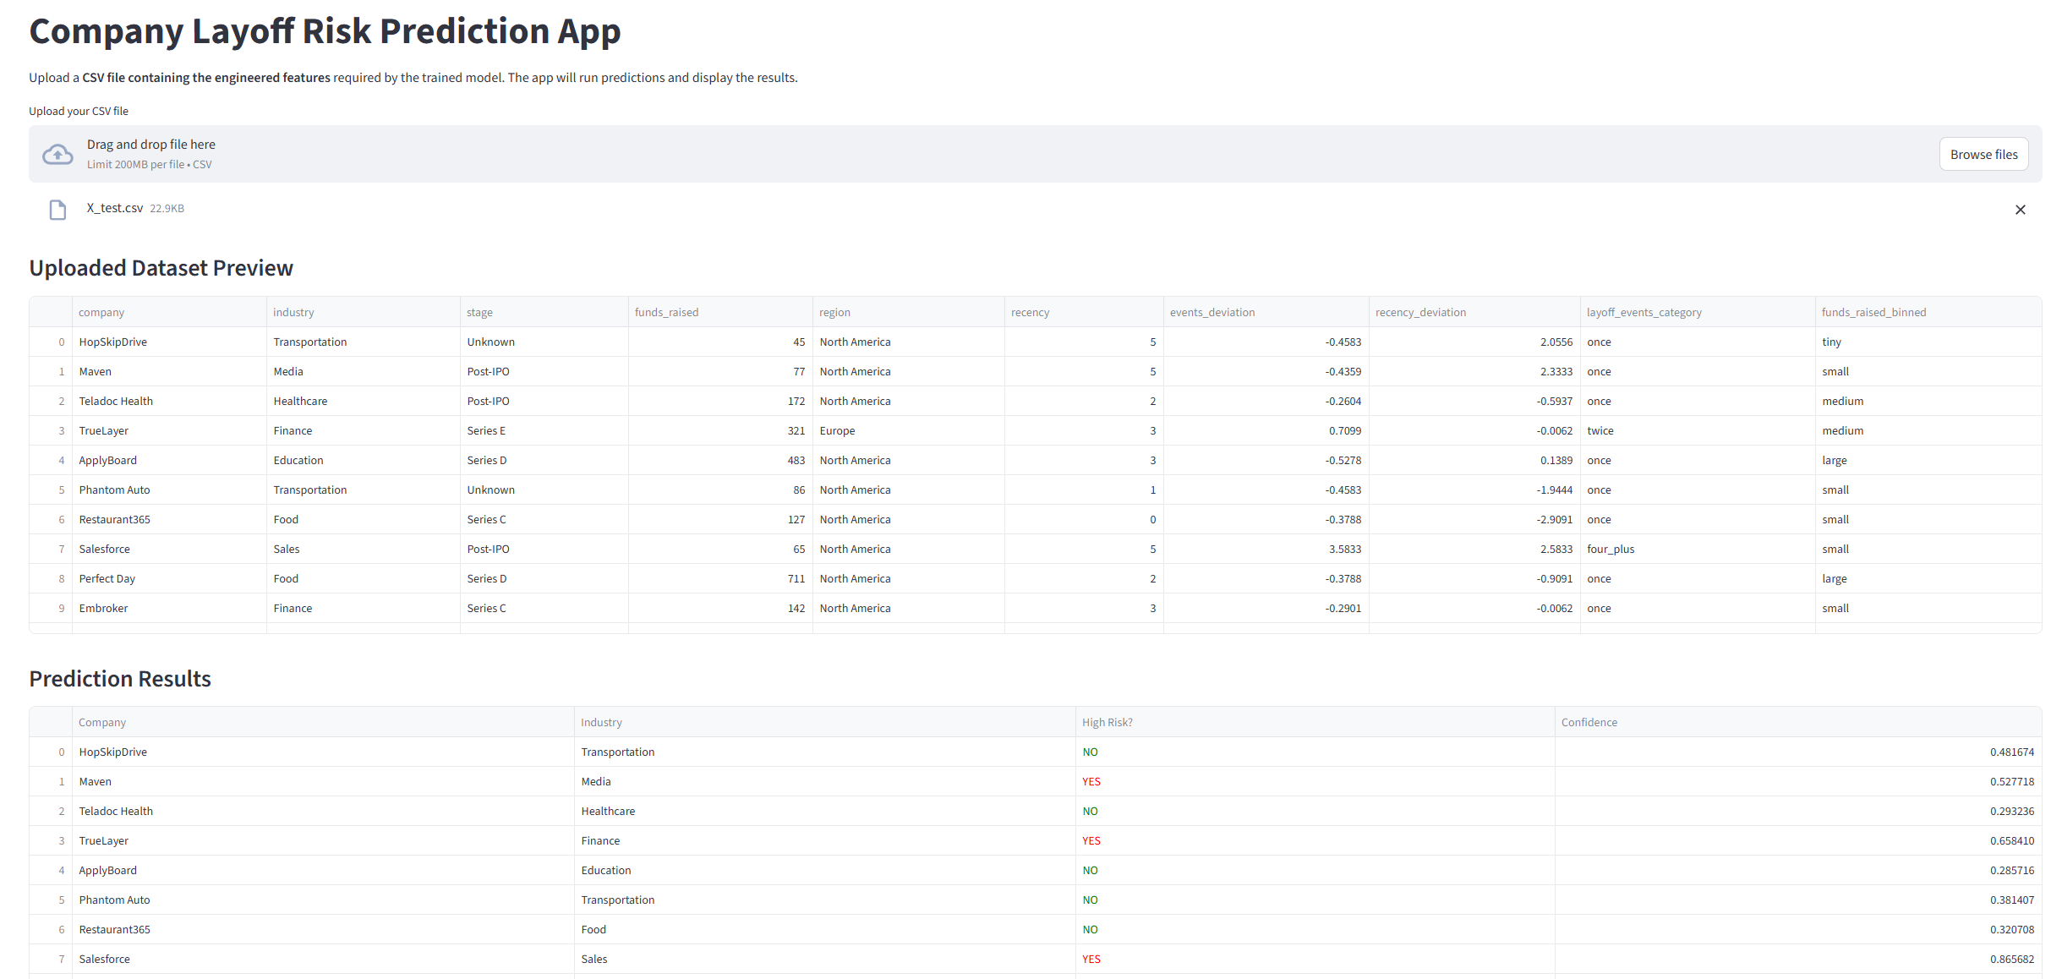
Demonstrate
Yuwei Ni

Slide 15
Users & Usefulness
Yuwei Ni
Investors and analysts. They can use this model to quickly screen their portfolios, identifying which companies face elevated layoff risk. This helps them better assess investment exposure.
HR professionals. Even without access to internal data, they can identify industry-wide risk signals early, preparing their organizations for potential market shifts or talent movement.
Business decision-makers. By benchmarking against similar companies in their industry, they can understand their relative risk position.

Slide 16
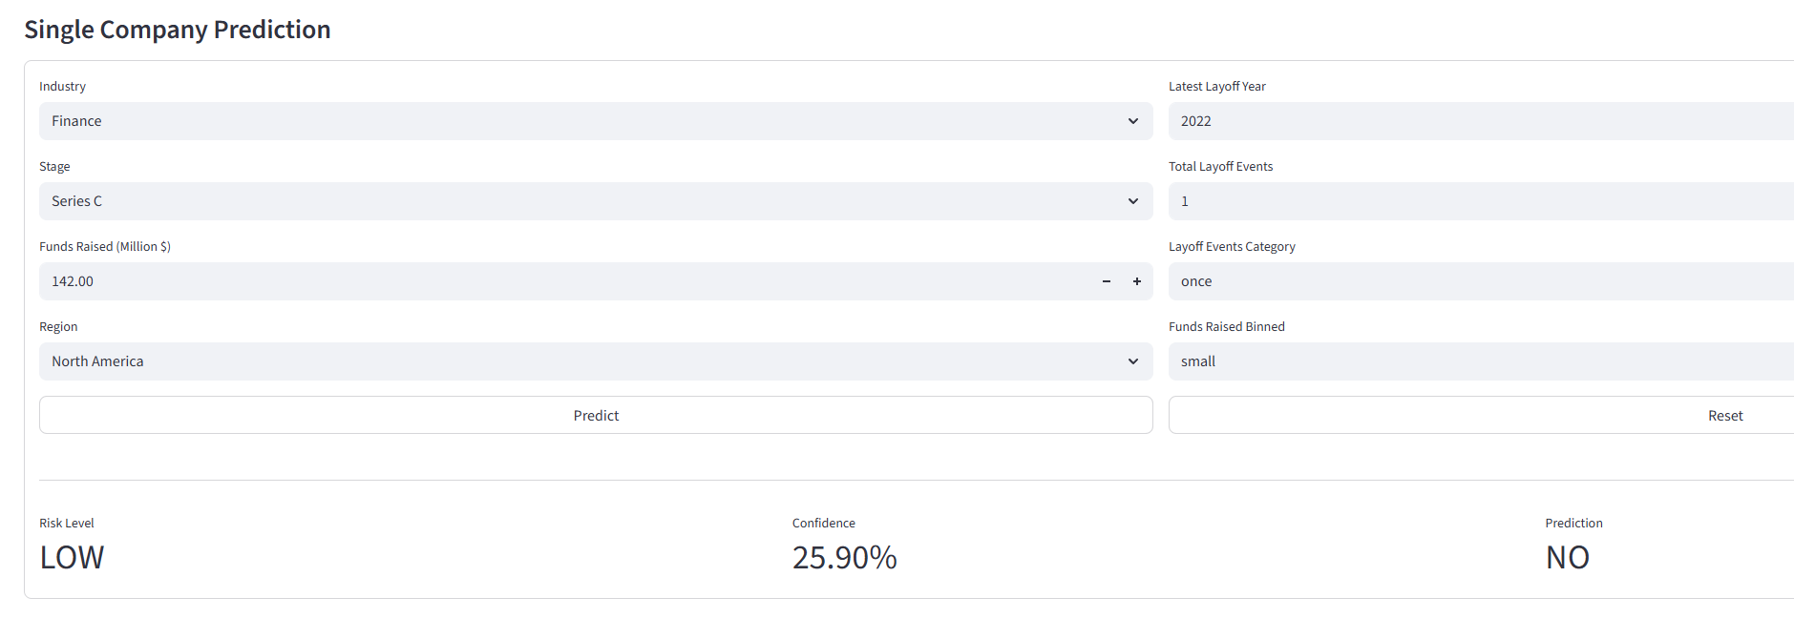
Conclusion
Yuwei Ni
The final XGBoost model achieves acceptable performance.
It correctly classifies most companies and identifies more than 75% of truly high-risk firms.
Our results demonstrate that meaningful layoff-risk signals can be extracted from publicly available business attributes. The model can support investors, analysts, and HR professionals in making early layoff-risk assessments, offering a practical decision-making tool that works even when historical layoff records are unavailable.

Slide 17
Yuwei Ni
Limitations & Future Work
Although performance is promising, several limitations remain:
Limited features: richer financial and operational data could improve accuracy.
Dataset size: additional companies and longer time periods would enhance robustness.
Risk threshold: the current 35% split is manually defined and may not be optimal.
Decision threshold: probability cutoff can be tuned based on real-world priorities.
Hyperparameter space: advanced optimization methods (e.g., Bayesian) may further refine the model’s performance and stability.
Future work will explore these areas to build a more accurate and generalizable layoff-risk prediction model.

Slide 18
THANK YOU

