Slide 1
Company Layoff Risk Prediction
INFO 6105 Final Project
Yuwei Ni & Ruixuan Xu

Slide 2
01
Problem
02
Solution
03
Training
&Results
04
Demonstrate
05
Conclusion

Slide 3
Problem Definition
Ruixuan Xu
Layoff risk prediction: what it means
Why it matters: early instability detection
Goal: identify high‑risk companies

Slide 4
Dataset Overview
Ruixuan Xu
Source: Kaggle Layoff Dataset
1,210+ companies, across 30+ countries
Each row represents a single layoff event
Columns: industry, location, layoffs, %, funding, stage

Slide 5
Event-Level → Company-Level
Ruixuan Xu
Raw dataset records individual events
Prediction target is company‑level risk
Aggregate all events by company
Create company‑level statistics

Slide 6
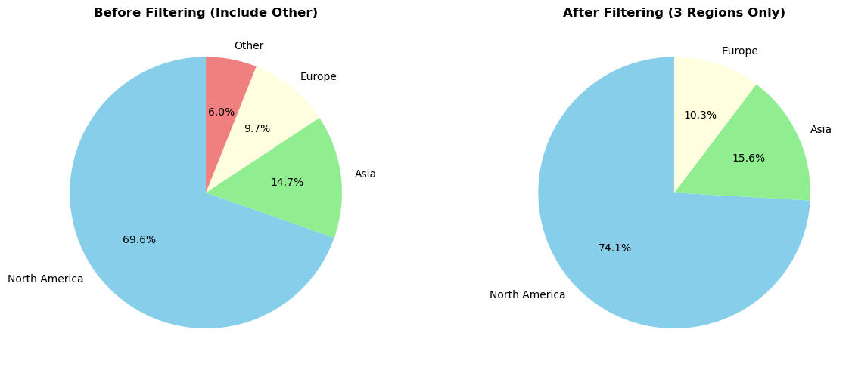
Feature Engineering: Region Grouping
Ruixuan Xu
30+ countries → too sparse
Grouped into NA / Europe / Asia
Reduces noise and variance

Slide 7
Feature Engineering: Recency
Ruixuan Xu
Recency = years since last layoff
Recent layoffs suggest instability

Slide 8
Feature Engineering: Deviation Features
Ruixuan Xu
events_deviation: event count vs industry avg
recency_deviation: recency vs industry avg
Capture abnormal company behavior

Slide 9
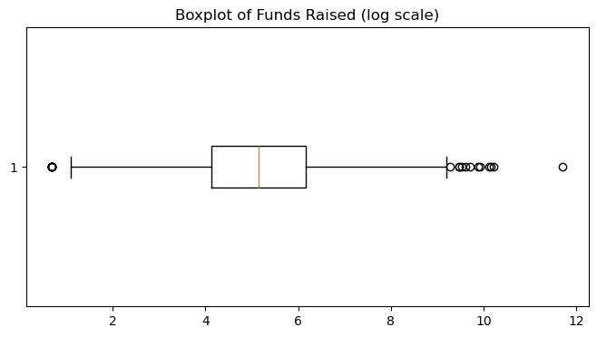
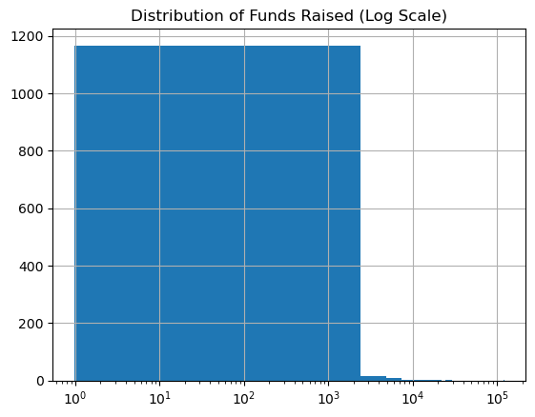
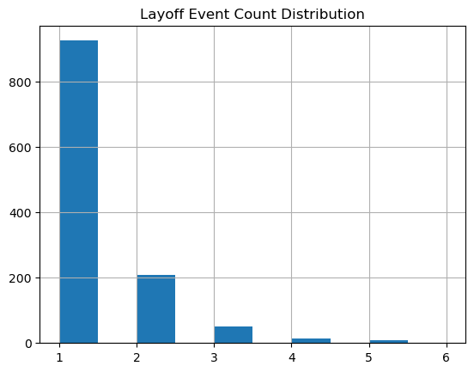
Feature Engineering: Binning
Ruixuan Xu
Funding values extremely skewed
Raw numbers introduce noise
Binned into small / medium / large

Slide 10
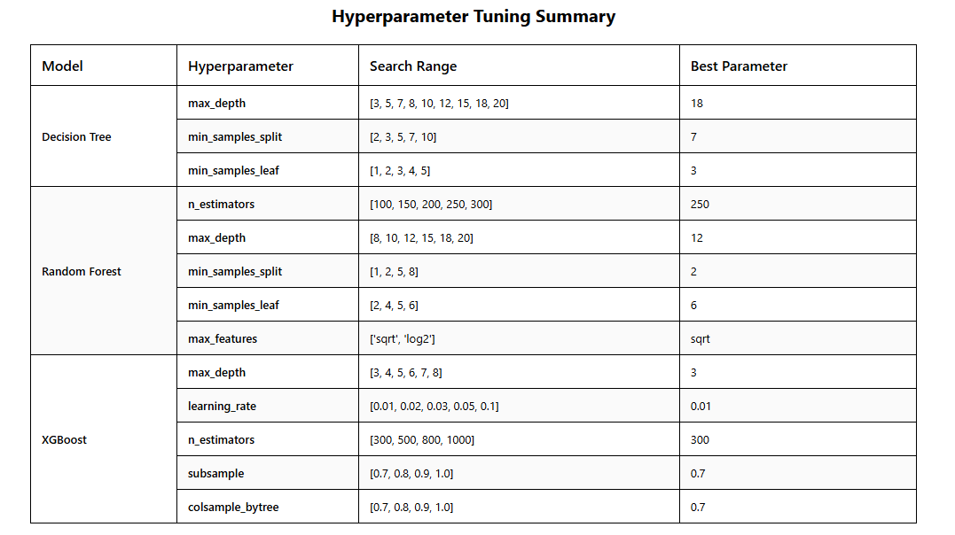
Trainning&Results
Yuwei Ni
Method: GridSearchCV with 5-Fold StratifiedKFold CV
Metric: F1-Score

Slide 11
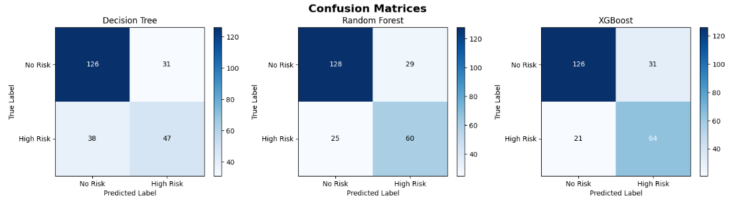
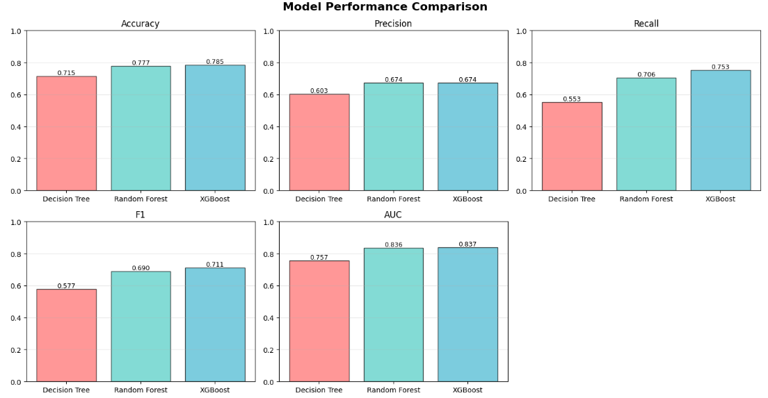
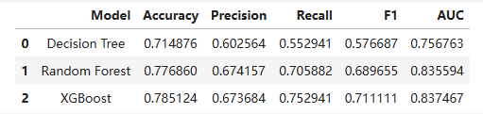
Results Analysis
Yuwei Ni

Slide 12
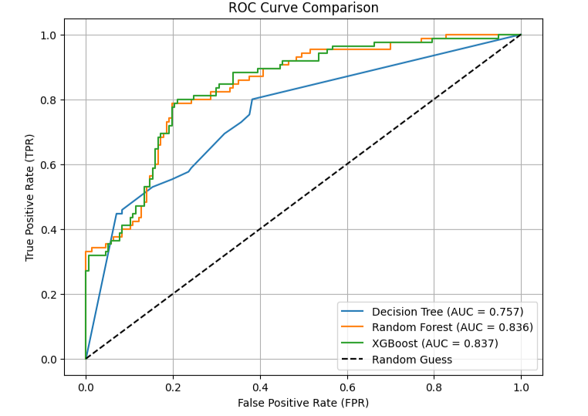



Results Analysis
Yuwei Ni
Best Model: XGBoost
Second: Random Forest
Accuracy: 78.51%, Precision:67.37%, Recall: 75.29%
Accuracy: 77.69%, Precision:67.37%, Recall: 70.59%
F1-score: 0.7111, AUC: 0.8375
F1-score: 0.6746, AUC: 0.8356

Slide 13
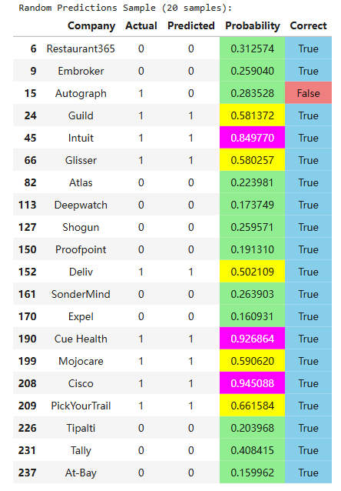
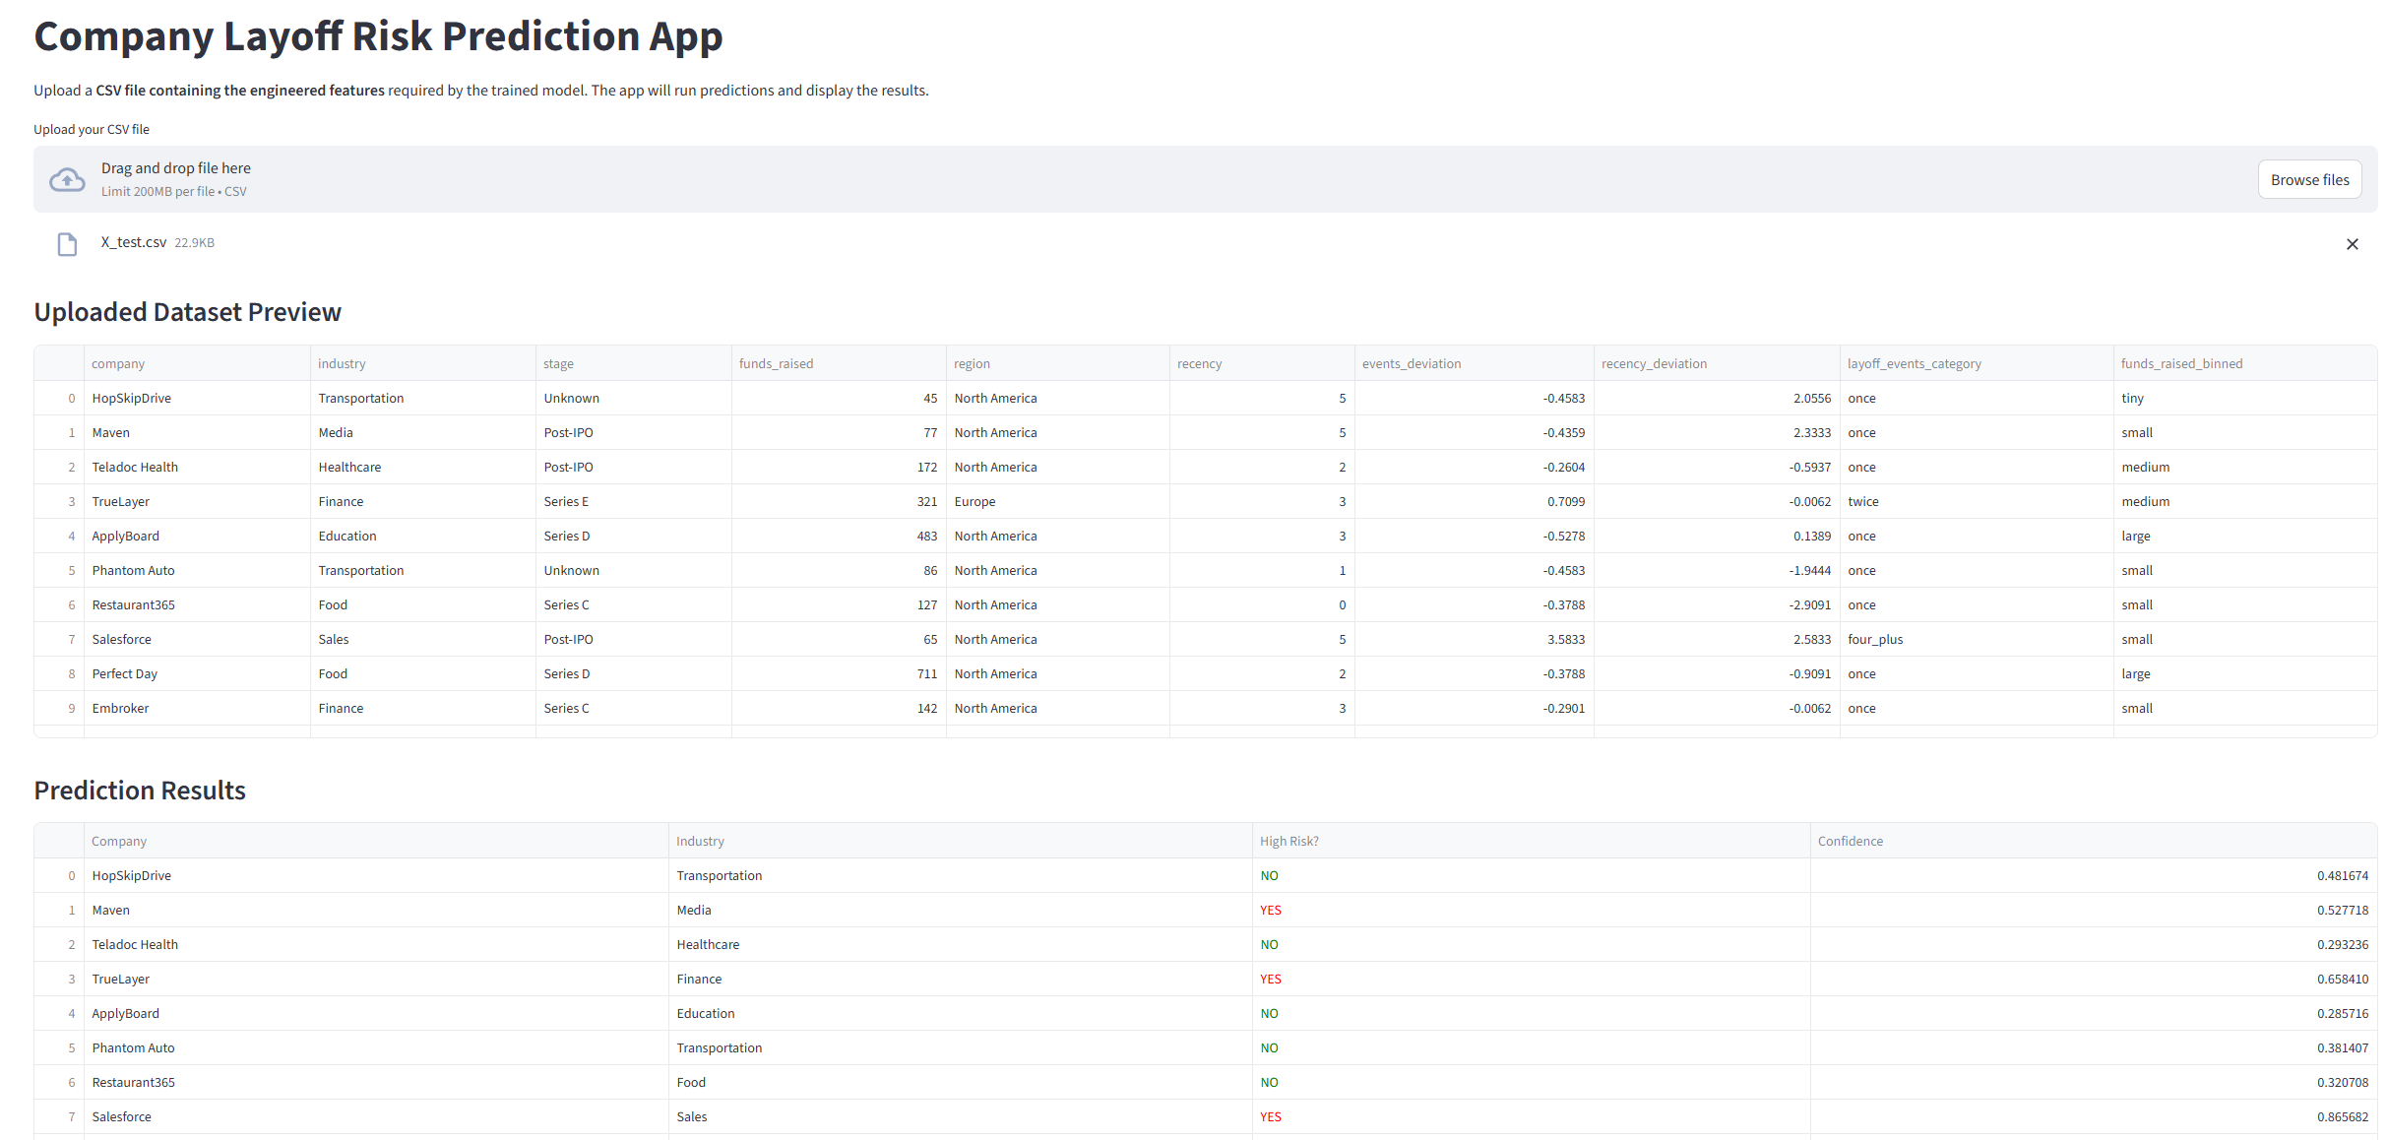
Demonstrate
Yuwei Ni

Slide 14
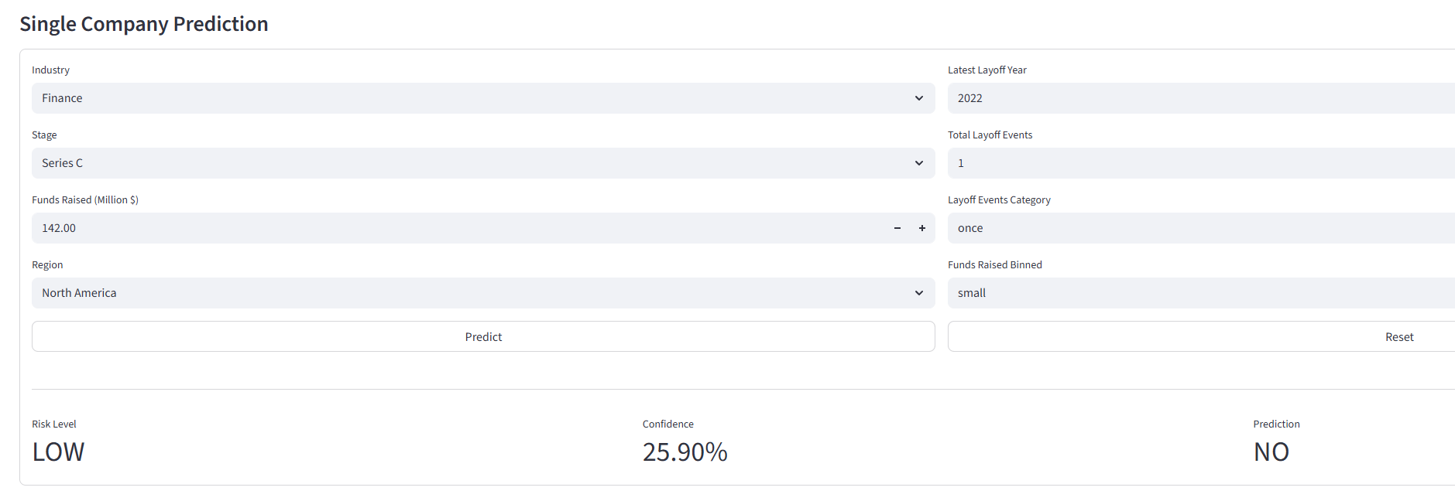
Conclusion
Yuwei Ni
The final XGBoost model achieves acceptable performance.
It correctly classifies most companies and identifies more than 75% of truly high-risk firms.
Our results demonstrate that meaningful layoff-risk signals can be extracted from publicly available business attributes. The model can support investors, analysts, and HR professionals in making early layoff-risk assessments, offering a practical decision-making tool that works even when historical layoff records are unavailable.

Slide 15
Yuwei Ni
Limitations & Future Work
Although performance is promising, several limitations remain:
Limited features: richer financial and operational data could improve accuracy.
Dataset size: additional companies and longer time periods would enhance robustness.
Risk threshold: the current 35% split is manually defined and may not be optimal.
Decision threshold: probability cutoff can be tuned based on real-world priorities.
Hyperparameter space: advanced optimization methods (e.g., Bayesian) may further refine the model’s performance and stability.
Future work will explore these areas to build a more accurate and generalizable layoff-risk prediction model.

Slide 16
THANK YOU

