Slide 1
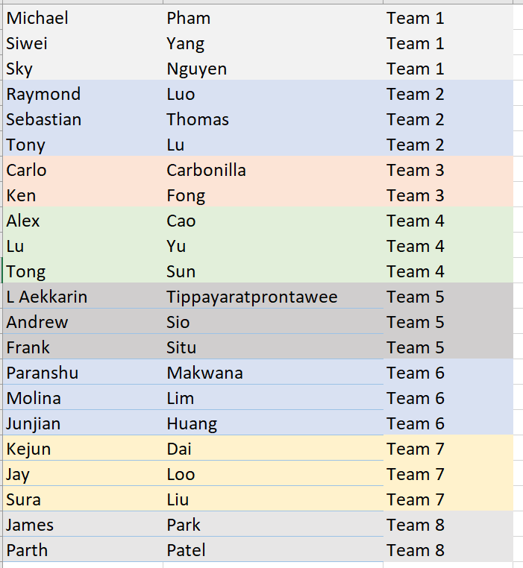
Before we start
Discord:
https://discord.gg/MbYa5X93aY
It’s Your Team!
Important Link ↑↑↑

Slide 2
Soft Skill Day 2021
MSA team 2021

Slide 3
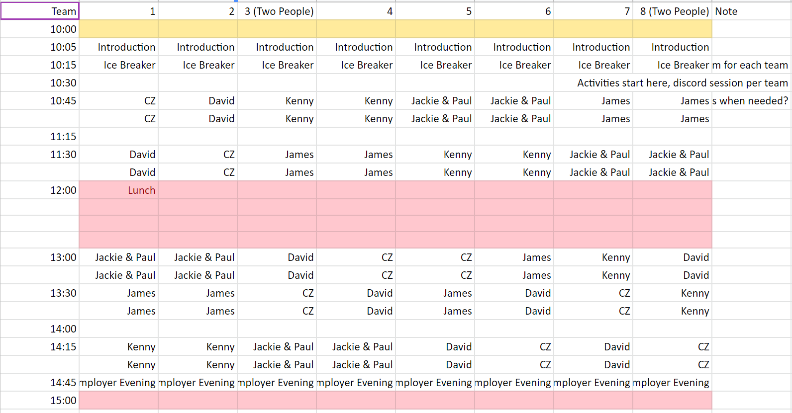
Today’s Agenda
10:00 – 15:00 (Lunch break from 12:00 – 13:00 😃)
Notes:
Explain the backend code here

Slide 4
Today’s Agenda
10:00 – 15:00 (Lunch break from 12:00 – 13:00 😃)
Fun activates on discord
8 discord channels, MSP’s will go in like Round Robin
MSP will rank your team, and the highest overall will win prizes 😍
Notes:
Explain the backend code here

Slide 5
What you need
Water, cookies, and coffee?
Your Camera & Microphone
A discord account!
Notes:
Explain the backend code here

Slide 6
Icebreaker!
2 Truth 1 Lie within your team
Choose the best one
Shout out back in the general channel
Notes:
Explain the backend code here

Slide 7
Time to get more fun!!!
Go into the your discord channel
MSP will go in to the channel for some fun activities
Your will learn and get some feedback on your performance
Collect points to win prize!

Slide 8
Remember there are prizes?
Congrats to….
Team 1
Team 8
Team 2

Slide 9
What’s next
Make sure you have a way to connect to your teammates
Facebook, LinkedIn, WeChat?, Discord, WhatsApp, telegram, blabala
Employer's night!!!!
Alll the best for everything!

Slide 10
That’s a wwrap
Any Questions?!

