Slide 1
Employers Evening Information

Slide 2
Soft Skills Day
Meet each other
Work together
Step outside of your comfort zone

Slide 3
Employers Evening
Meet the employers as a team
Choose project preferences

Slide 4
Employers Evening Dates
Aiming to host it on the week of 15/11/2021
Post-exam for the most of us
Will confirm the dates by the week of 08/11/2021 at the latest
Virtual Event over Microsoft Teams, have your webcam ready!

Slide 5
Timeline of the Night
Registrations
Welcome and briefing
Employers to give a company introduction/project pitch (Up to 2 minutes per project)
Speed Dating with MSA student teams
Preference Form Submission & Wrapping up

Slide 6
What’s happening afterward?
Employers and Student Teams are matched.
Employers to contact students to sort out contracts etc.
Placement begins at around 1st December

Slide 7
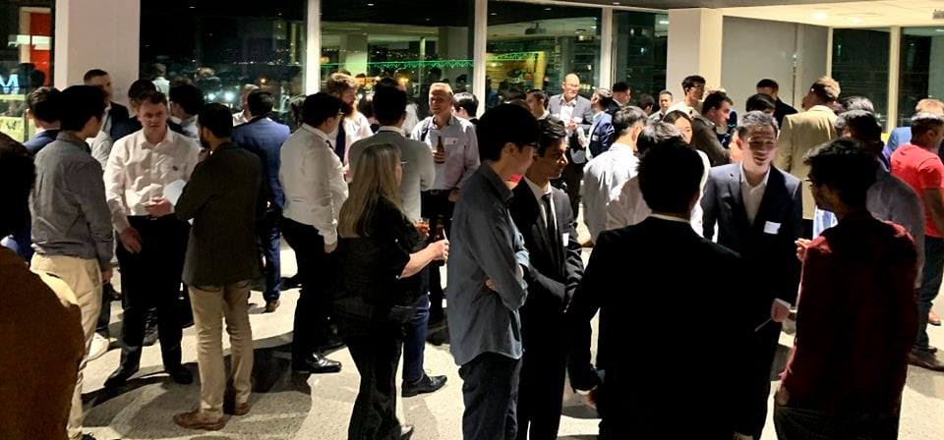
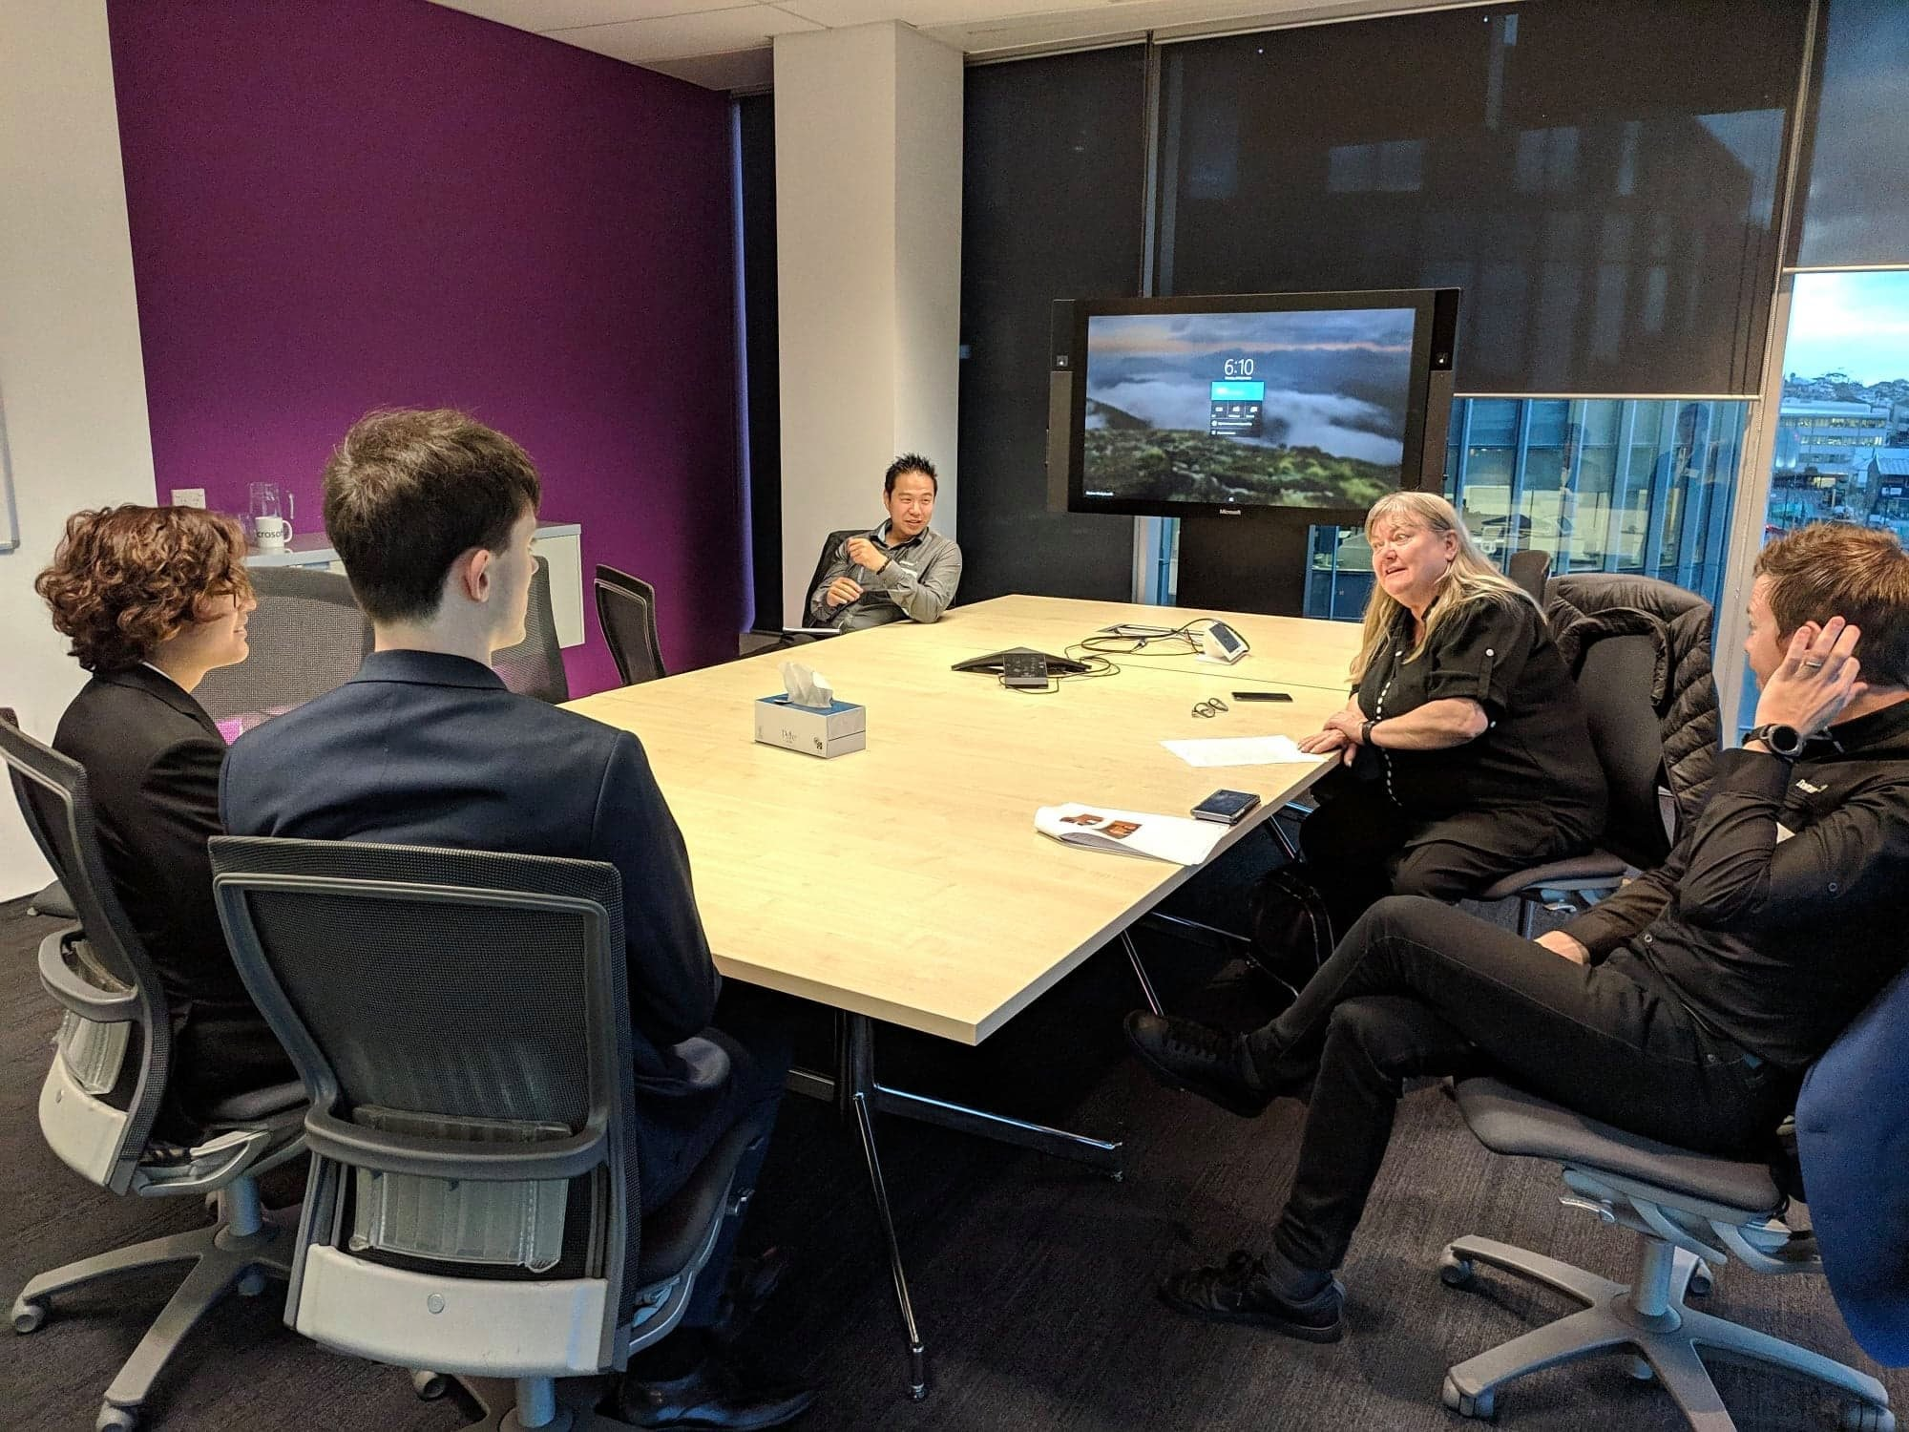
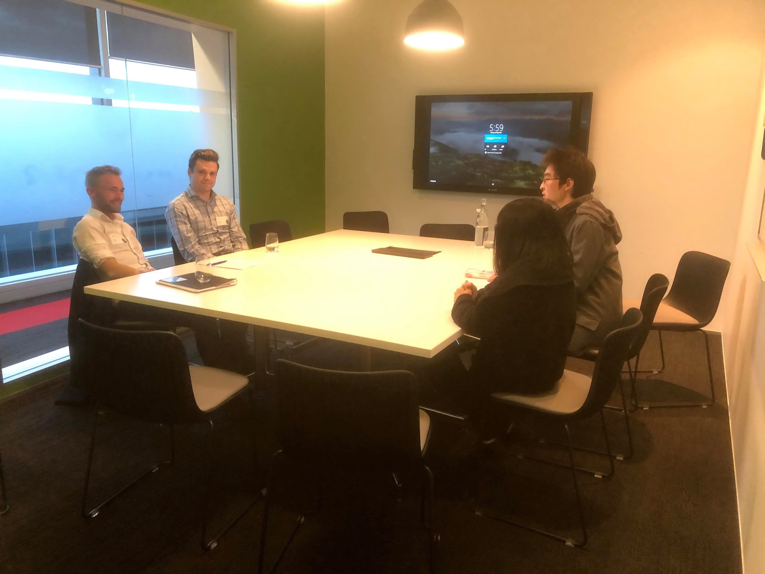

Slide 8
Companies that have shown interest
LAB3
DEFEND Limited
asBuilt Digital
9Spokes
ProWorkflow

Slide 9
Question?

