Slide 1
Introduction to GIT
Paul Tanchareon

Slide 2
Prerequisites
Install the following tools now if you haven’t already. ⚠
Visual Studio Code- https://code.visualstudio.com/
Git – https://git-scm.com
Get a GitHub Account
Register for an account – https://github.com
NZMSA GitHub – 2021-introduction-to-general-software-development
https://github.com/NZMSA

Slide 3
Learning Outcomes
Basic understanding of Git and GitHub.
Concepts of git repository, commits, branches and pull request.
Managing code changes using basic git commands.

Slide 4
The problem?
Where to store your code?
How do we track code changes?
How do we manage working with other people?

Slide 5
Git – Version control system
“Git is an open-source version control system. A powerful content-tracker that allows us to document code, track changes and easily collaborate with other developers.”

Slide 6


Git – the stupid awesome content tracker
Git – Version Control System
Document our code.
Track changes history.
Collaborate with other developers.
GitHub - Microsoft git repositories hosting service
Store our project in the cloud.
Manage our portfolio of projects.

Slide 7
A few basic concepts
A Git repository – A project directory being tracked by git.
Commits – A snapshot of your directory.
git clone – create a copy of the repository locally on your device.
git status – display the current state of the directory.
git log – To see commit history of the repo.

Slide 8
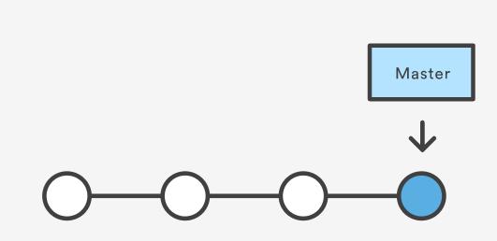
Making a commit
Commits – A snapshot of your directory, recording changes permanently to the repository history.
git status : display the current state of the directory.
git add . or git add --all : Add changes to the staging area, to be included in the next commit.
git commit –m “description of your changes” : Record your staged changes to commit history.
git push : exports commits to remote branches on our GitHub account.
git log : To see commit history of the repo.
To undo changes
git checkout . : To undo your changes.
git reset –f : To unstage your changes.

Slide 9
Exercise 1: Making our first commit
Challenge: Make 2 commits and push to the remote repository.
git status – display the current state of the directory.
git log – To see commit history of the repo.
Making a commit workflow.
git add . or git add --all – Add changes to the staging area, to be included in the next commit.
git commit –m “changes description” – Record your staged changes to commit history.
git push - exports commits to remote branches on our GitHub account.
To undo changes
git checkout . : To undo your changes.
git reset –f : To unstage your changes.

Slide 10
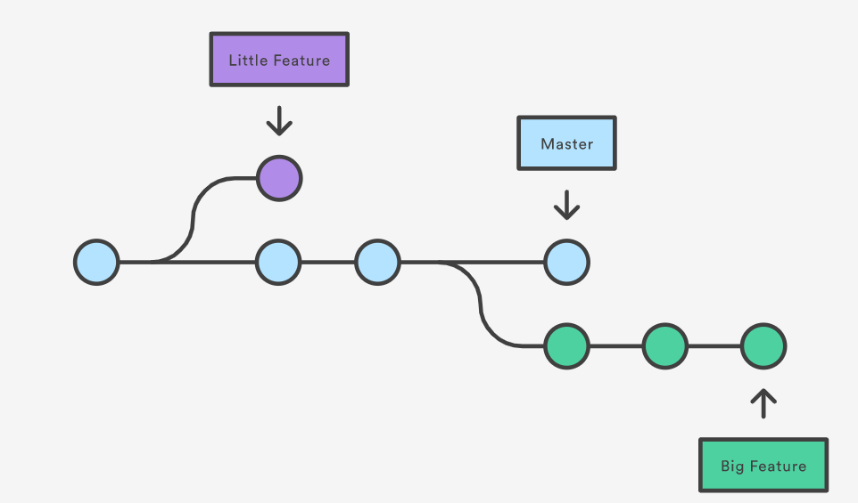
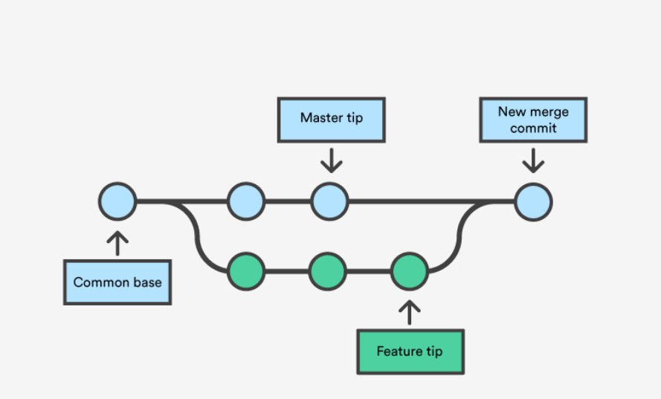
Branches
“A branch represents an independent copy of your repository”

Slide 11
Exercise: Creating a feature branch
Challenge: Create a new feature branch, make 2 commits then merge to main branch.
git checkout –b “feature/new-header” : To create a new branch for feature we want to develop.
git push : Push our new branch to the remote repository
Make 2 new commits on feature branch. Push to remote branch.
git checkout [branch name] e.g., git checkout main – To switch between branches.
Git merge “feature/new-header” : This merge feature branch into current branch.
git branch : View our local branches.
git branch –r : View remote branches.
git branch –d “feature/new-header” : To delete branches from a local repository.

Slide 12
Pull Request
“Pull request is simply requesting your team to review the code changes, a feature you've implemented, and whether it can be merged to the main branch.”

Slide 13
Final Exercise: Merge using a pull request
Challenge: Create a new feature branch, make a commit then merge to main branch using pull request on GitHub.
git checkout –b “feature/new-header” : To create a new branch for feature we want to develop.
git push : Push our new branch to the remote repository.
Make new commits on feature branch. Push to remote branch.
File a pull request from GitHub, merge your changes and delete feature branch.
git branch : View our local branches.
git branch –r : View remote branches.
git branch –d “feature/new-header” : To delete branches from a local repository.

Slide 14
Summary
A Git repository – A project directory being tracked by git.
Commits – A snapshot of your directory.
Branch - Represents an independent copy of your repository.
Pull Request – A request to review your code changes.

