Slide 1
Personal Assignment 2
Mobile App Programming
Spring, 2021
Notes:
This is explanation Video for your personal Assignment 2. I’m your TA SH Lee.

Slide 2
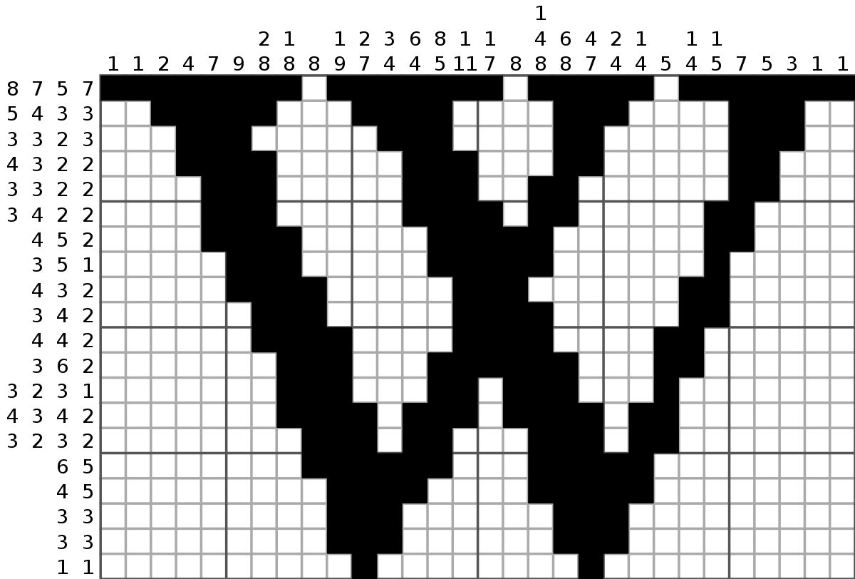
Personal Assignment 2 : Nonograms
- Goal : you should make Nonogram game for android.
- Before implementation, please watch PA2 video on ICAMPUS.
https://en.wikipedia.org/wiki/Nonogram
Notes:
The main goal of PA2 is implementing Nonogram or PiCross, in Korean 네모로직.
Here’re some example gif and image of nonogram. Briefly there’re some numbers and white blocks. The main goal of this game is that you should click proper block according to side’s numbers so that you can make specific pixel images..
I don’t explain whole details about how to play nonogram in this video, so if you don’t know about how to play this game, please refer below links or play another nonogram game in playstore.

Slide 3
Before you start PA2…
There are many ways to implement this assignment, you can use anything you want.
We will check copy thoroughly. If you cheat, you will get 0 point or ‘F’ grade.
You don’t have to think about design(space, color, etc.,) of application. If it works well at Pixel 3a phone, you will get full points.
In PA2, you have to use Naver API for searching images. (Detail usages are followed)
After extract your project to .zip file, submit it on ICAMPUS.
Minimum sdk is API 16, we test on AVD with API 29.
Notes:
So… as PA1, you can use any implement stuffs as you want to build this game. You just make a nonogram application with specific details that we give you.
And also we doesn’t judge your app’s design, but at least your application has those components, and game should be playable by users.
And.. Don’t copy.. Or you will get F grade.
And Especially you have to use Naver API for searching images from internet. Some details are followed and most of usages are similar with WA in this week.
And there’s an info about API level and submission guidelines, so please refer those.

Slide 4
Main Activity component
Main Activity has a nonogram board, 2 buttons, and EditText.
EditText (Type query) : EditText to type the query that you want to find on Naver.
Button 1 (Search) : If you click this button, your application should find the first image that corresponds to the query. And then, nonogram board should be made and shown on Puzzle board part.
Button 2 (Gallery) : If you click this button, your application should open gallery so that you can choose a picture. And also, nonogram board should be made and shown on nonogram board part.
Notes:
So, from now I will explain you about detail descriptions of PA2.
In MainActivity there’re 4 components, nonogram board, 2 buttons and EditText.
In this application, there’re two ways to retrieve image and build nonogram board. Searching on Naver and Retrieving from gallery.
The first way, getting from Naver.
EditText is for getting query, keywords from user.
When user click Search buttion after typing keyword on EditText, your application should retrieve the first image that corresponds to that keyword from Naver.
And then your application should build proper nonogram board with several steps. (those details will be explained later)
And the second way is getting from your gallery.
So, when you click gallery button, your application should open your smartphone’s default gallery app. Or ask your whick app. Do they want to use.
After picking images, next steps are same as Searching part.

Slide 5
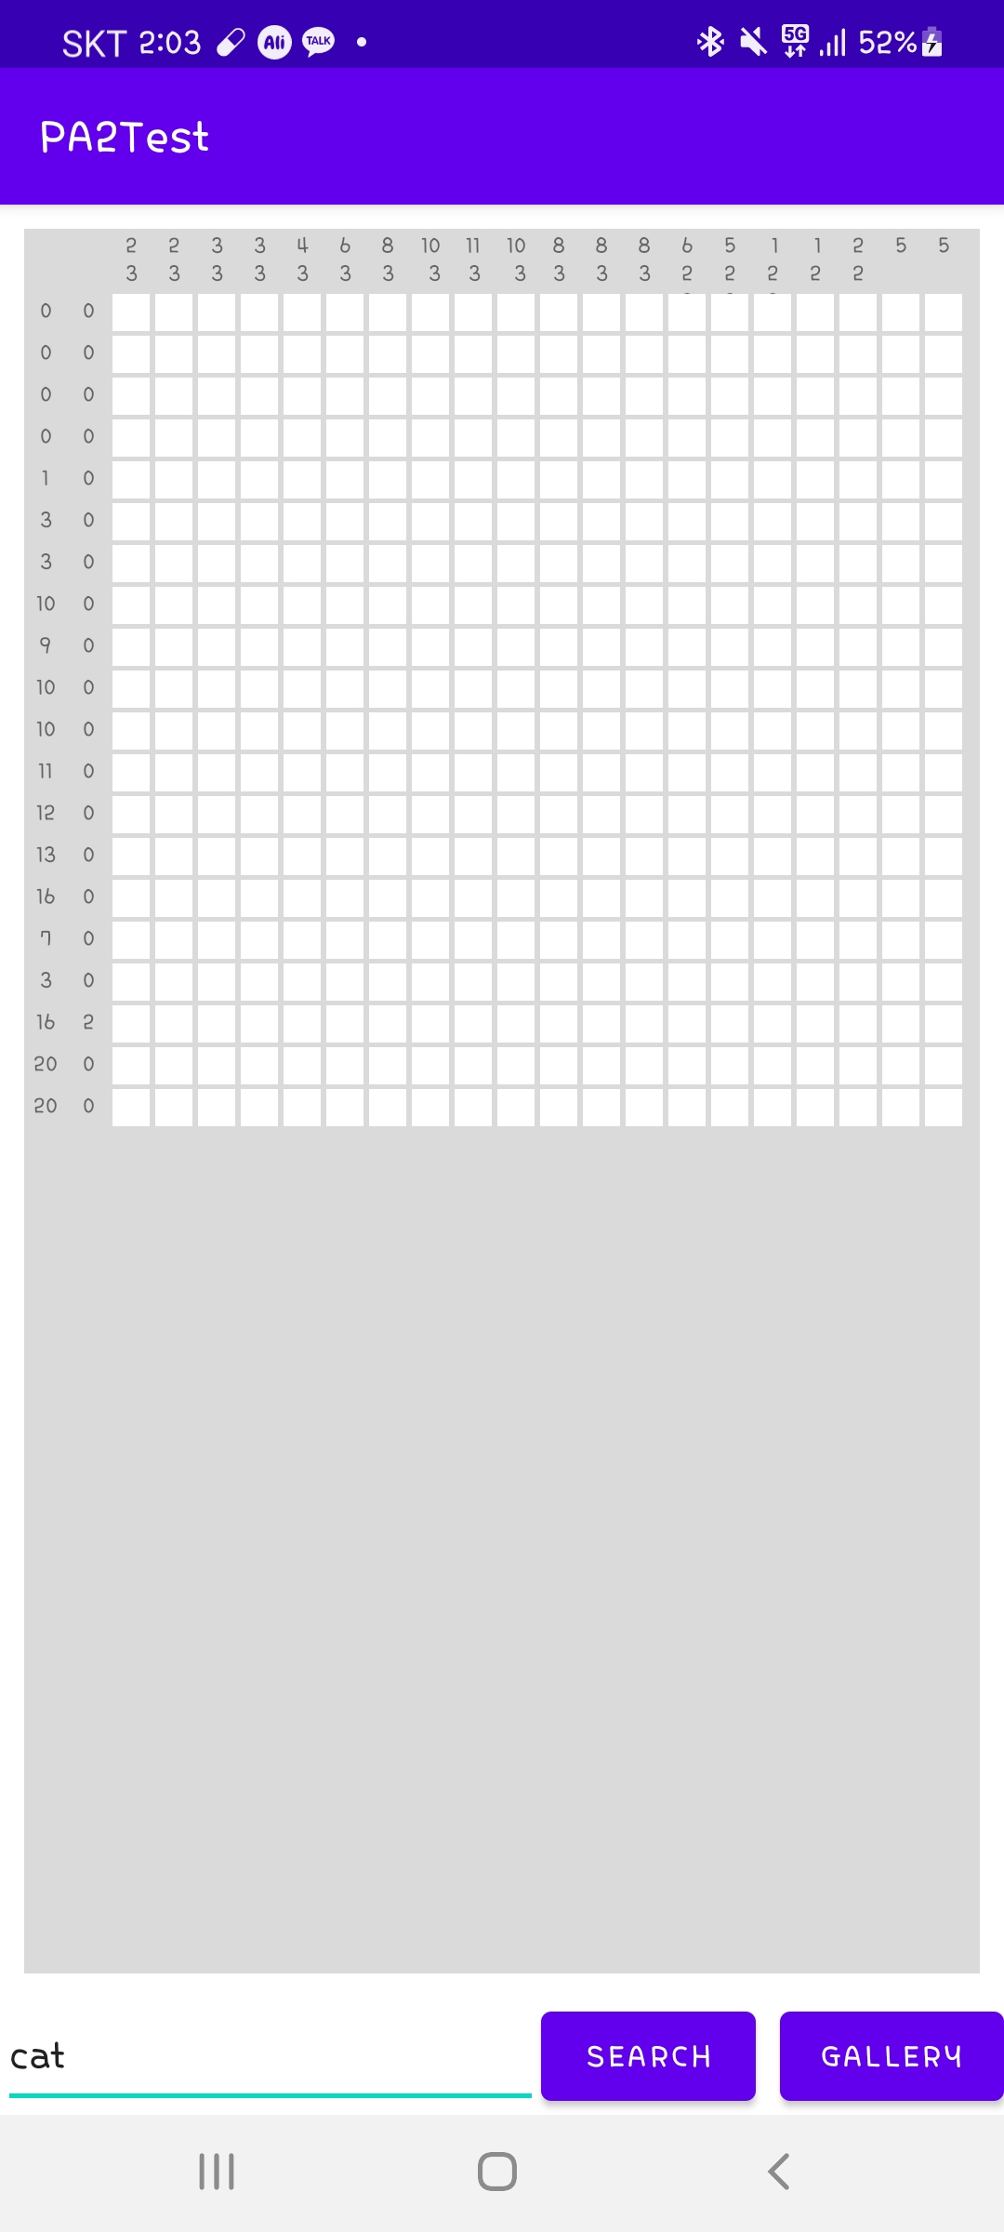
Main Activity component
nonogram board : There’re 20 * 20 clickable white boxes for nonogram game. And on the top and left of the board, there’re a set of numbers for the game.
You can also you gridView to implement this part, but you can also use other Views if you want…
Notes:
And.. Here’s details of nonogram board.
There’re some numbers on the top and left side of board that indicates the number of consecutive colored blocks in board.
As like PA1, we recommend to use gridview to implement this board part, but you can also use other Views. That’s OK.
And more details will be explained later slides.

Slide 6
App component 1 : EditText and Search Button
EditText and Search Button
You can type certain keyword on EditText.
When you click search button, you have to search keyword on Naver and get the first image of searching result. For this function, you have to use Naver API.
You can use Naver API using your Naver ID.
More details have already been covered on class, and please refer the documentation of Naver API for other detailed instructions.
After getting images from Naver, your application should perform App component 3.
https://developers.naver.com/products/service-api/search/search.md
Notes:
As I explained before. The first way to retrieving image is using Naver API.
By using keyword typed on EditText and Naver Searching API, you should retrieve certain one image from Naver.
For more details about implementation, please refer below documents and this week’s class material which deals with gson API, HttpConnections, and Using API.
Following steps after this jobs are described in Component 3.

Slide 7
App component 2 : Gallery Button
2. Gallery Button
When you click this button, your application should open gallery app. (or your phone’s default gallery application) so that you can choose one picture.
After picking a picture, your application should go back to nonogram application’s main page. (With picked image resource)
After getting images from gallery, your application should perform App component 3.
Notes:
The second way is using gallery.
As I explained before, when this button is clicked your application should open gallery app. So that you can choose a picture from there.
And after picking image, your app should go back to nonogram’s main page with picked image.
And also, next steps are described in Component 3.

Slide 8
App component 3 : Setup Nonogram
3. Setup Nonogram
After clicking and retrieving image, you have to make nonogram Board.
There are several core steps to do this.
Resizing image into square (with proper length)
Convert image into black-and-white photos. (grayscale value > 128 : white, or black)
Split images into 20 * 20 pieces. And then, determine the block’s color.
(average grayscale value > 128 : white, or black)
Setup 20 * 20 empty white boxes. (Box size are configurable yourself.)
Setup numbers on the left and top side.
Notes:
So, the next part is the most important part of this PA. The details about nonogram board.
After clicking both search button or gallery button, your app should make nonogram board based on retrieved image.
And here’re the core steps that you should follow to build nonogram board.
First, please resizing your image into square shape. (with proper length)
And convert image into black-and-white photo. (The rule for this converting step is that if grayscale value of pixel is larger than 128, set that pixel into white, or set as black)
Third step is splitting image into 20 * 20 pieces. And then, determine each block’s representative color (black or white) to make the answer shape.
The rules are same. If the average pixel values of that block is larger than 128, set 0 or 1.
And then you should setup 20 * 20 clickable white boxes which sizes are configurable yourself. (It means that you can use any size, we don’t give you the guideline.)
And Last step is setup numbers on the left and top side.

Slide 9
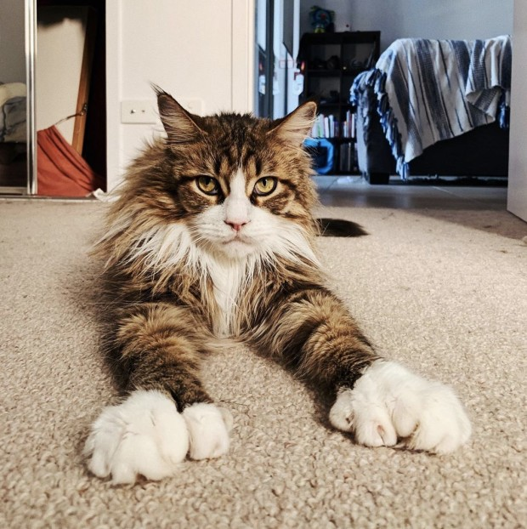


App component 3 : Setup Nonogram (Example)
20
…
…
…
…
…
20
Notes:
Here’s the examples images for previous core steps.
Suppose that retrieved image is here.
Then, first resizing, and then convert It into white-black image.
And then you should split image into 20 * 20 pieces and make answer board.
And at last, your app’s result should look like this image. 20 * 20 blocks and corresponding numbers.

Slide 10
App component 3 : Setup Nonogram
3. Setup Nonogram
Your nonogram board items is clickable component.
When you click short time, nonogram item turns black if that place is the right place. Or your application should pop up toast message and refresh board.
When you complete puzzle (the whole answer boxes are clicked), app should shouw toast message “FINISH!” with long term option.
Notes:
And the last core function of nonogram boards are explained here.
Your nonogram board’s white boxes should be clickable.
So, when you click a box short time, nonogram items turns black if that place is the right place. (it means that that place is also black on answer board.)
If user clicks wrong place, then your app should pop up “Some message” and refresh board.
And When whole answer boxes are clicked, your app should show FINISH message with LONGTERM toast message.

Slide 11
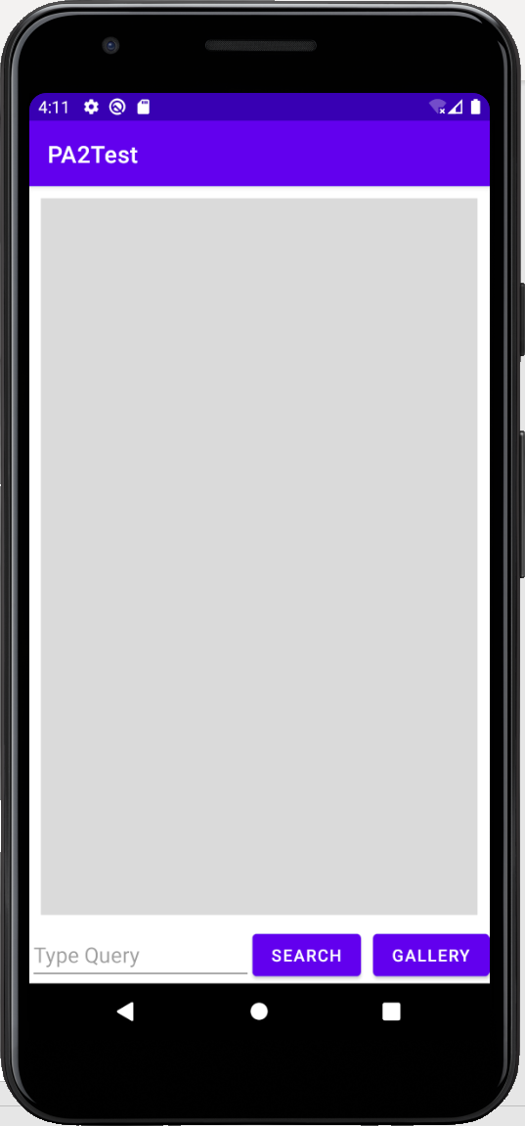
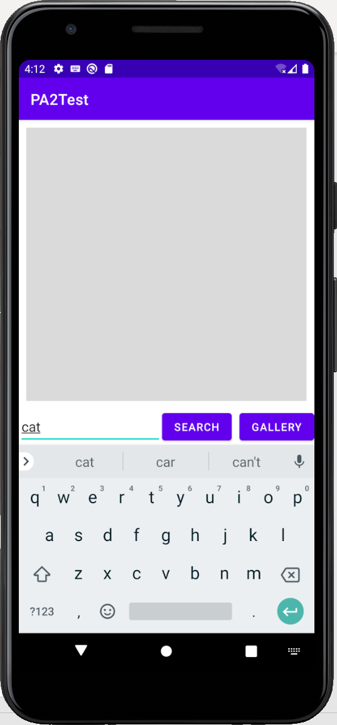
App component Examples
Retreive images from Naver
Search Keyword from Naver
Generate nonogram Board
w/ proper number.
Notes:
And here’s the sample app sequence of targeted nonogram application.
First, there’s no nonogram board. When user type a query and click a button, this gray part is filled with proper nonogram board.

Slide 12
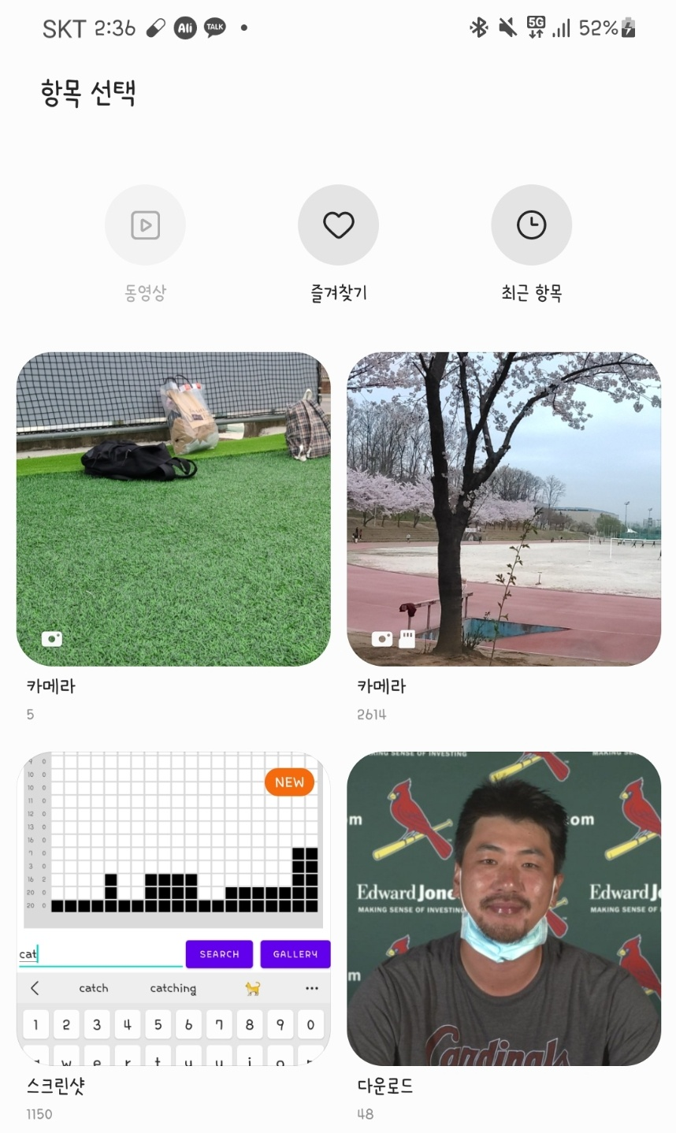
App component Examples
Enter gallery app.
Generate nonogram Board
w/ proper number.
Notes:
When user clicks gallery button, app may be opened and user can pick any image from there.
After picking image, then the following steps are same. Process image and create proper nonogram board.

Slide 13
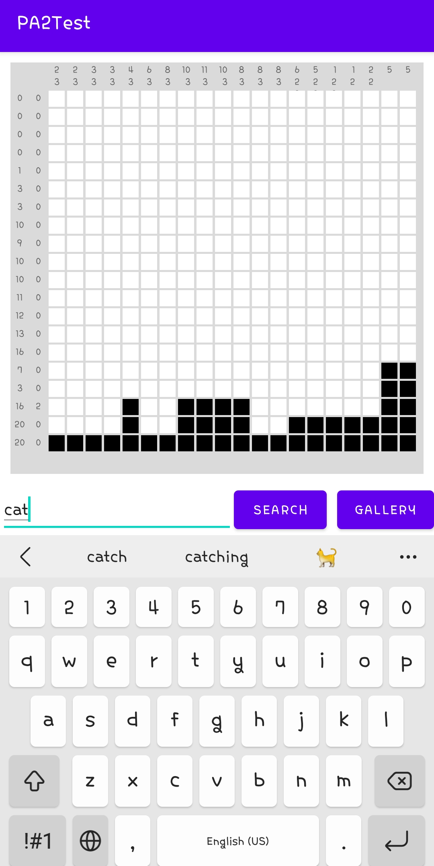
App component Examples
This part should not be the answer, so if we click this part,
Board will be initialized.
This vertical line’s number is 4 3, so last three blocks should be correct
Examples of Clicking blocks
20 0 means all blocks are answer (correct place)
Notes:
And last part are described here.
In this case, in last row, the number is 20 0, so all blocks in this row are clickable. So, all blocks are colored.
And the case of fifth vertical line, its corresponding numbers are 4 3. so in this case last row’s blocks are already colored, so following two blocks should be the anser.
Like this, when you click proper part, the. Blocks are colored, or… when wrong parts are clicked, like this part, the board should be refreshed.

Slide 14
Grading Policy
Basic Layout (15 pt)
If you show all component properly, you will get default points.
1 error is -5 points
Search button & EditText & Search Functions(25 pt) – no partial points
Gallery button (20 pt) – no partial points
Setup Nonogram board(60 pt)
Just setup board (30 pt)
ClickListener & Checking validation (15 pt)
Refresh board when wrong places are clicked (10pt)
Check End state well and print toast message (5pt)
Total 100 points
Notes:
And here’s the most important part for you guys. Grading Policy.
First, when you implement Basic Layout well, you will get 15pt.
And when you properly implement search button, EditText components and Searching function, you will get 25pt.
Notes that if you only implemented this function, please print retrieved image on nonogram board part instead of real board.
If you’re not implement like this, you will be get 0 pt even if you build this function.
Gallery button’s partial points is 20pt, and also if you don’t implement nonoboard part, please print retrieved image on nonogram board part as same as Searching Result.
And Setup nonogram board is 60pt. In precisely, when you just setup board, the 20 * 20 white boxes, proper number, you will get 30pt.
When you setup ClickListener, and proper validation checking logic, you will get 15pt.
Refreshing board when wrong places are clicked and Checking end state functions are 10pt and 5pt each.
So that, the total points are 100pt.
And.. That’s all, and good luck.

