Slide 1

Automated Review Analysis System
Developed by:
Nada Alnemari

Slide 2

Dataset
I use Primary Dataset: Amazon Product Reviews
This dataset is a list of over 28,000 consumer reviews for Amazon products

Slide 3
Hypothesis:
By classifying and clustering reviews and summarizing them into readable articles — we can help customers make better purchase decisions and help businesses improve products.
Approach:
Classification: Sentiment analysis (Positive, Negative, Neutral)
Clustering: Grouping products into 4-6 meta-categories
Summarization: Generating articles recommending products

Slide 4
Data Wrangling & Cleaning
Challenges:
Missing values in review text & product categories
Duplicate product listings
Techniques Used:
Dropped rows with null essential values
Removed duplicates
Clustered product categories into meta-categories

Slide 5
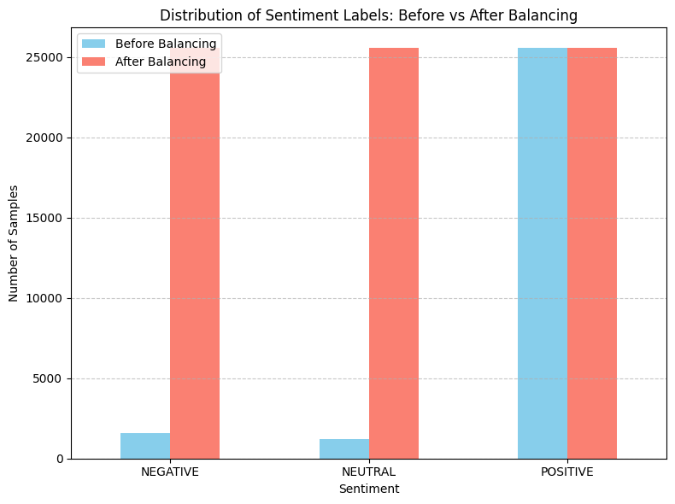
Notes:
After I did the Map Star Ratings to Sentiment Classes I saw that the data is imbalanced, so I balanced the data using over sampling

Slide 6
Models

Slide 7
Compared DistilBERT, BERT and DeBERTa
Model | Test Accuracy | Test F1 | Training Time | Model Size/Speed
DistilBERT | %99.40 | %99.40 | ~533s | Lighter and faster
BERT | %99.25 | %99.25 | ~787s | Slower than DistilBERT
DeBERTa | %96.06 | %96.05 | ~1057s | Slower and more complex
Notes:
I tried these three models and these are the results.
Final Conclusion:🔥 DistilBERT is the best overall in terms of the balance between:Very high accuracy, Training speed and Light weight (suitable for production or cloud deployment)🧠 BERT is suitable if we are looking for superior accuracy regardless of the time and resource cost.🤔 DeBERT was somewhat disappointing here, not outperforming either DistilBERT or BERT on this particular task.
So I chose DistilBERT model as the best model.

Slide 8
DistilBERT
Epoch Training Loss Validation Loss Accuracy F1
1 0.082500 0.072922 0.981602 0.981592
2 0.026600 0.039157 0.989170 0.989162
3 0.008700 0.031669 0.994259 0.994253
The results I got from training the model demonstrate very high performance in sentiment classification.

Slide 9
Classification Report:
precision recall f1-score support
0 1.00 1.00 1.00 5109
1 0.99 1.00 0.99 5109
2 1.00 0.98 0.99 5109
accuracy 0.99 15327
macro avg 0.99 0.99 0.99 15327
weighted avg 0.99 0.99 0.99 15327
Notes:
The sentiment classification model based on DistilBERT achieved outstanding performance with a 99% overall accuracy. Both precision and recall scores exceeded 98% across all three sentiment categories, indicating highly reliable predictions.

Slide 10
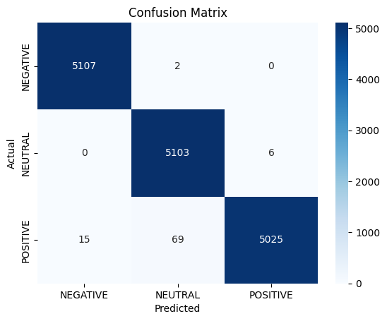
Confusion Matrix DistilBERT
Notes:
Most predictions were accurate, with very few errors. The most errors occurred between positive and neutral reviews. This makes sense because the difference between positive and neutral reviews can be subtle.

Slide 11
Conclusion:
The model is very robust and achieves near-perfect performance.
The accuracy and F1 are close, indicating that the model does not suffer from a bias toward a particular class.
The training is balanced, and the validation loss is steadily decreasing, meaning there is no obvious overfitting.

Slide 12
Bert
Epoch Training Loss Validation Loss Accuracy F1
1 0.028400 0.024880 0.994128 0.994121
2 0.013100 0.025017 0.993998 0.993995
3 0.007500 0.027508 0.994911 0.994907
The results I got after training the full BERT model are also amazing and provide a great opportunity to compare it with the previous DistilBERT model.

Slide 13
Classification Report:
precision recall f1-score support
0 1.00 1.00 1.00 5109
1 0.98 1.00 0.99 5109
2 1.00 0.98 0.99 5109
accuracy 0.99 15327
macro avg 0.99 0.99 0.99 15327
weighted avg 0.99 0.99 0.99 15327
Notes:
The BERT-based sentiment classification model also performed exceptionally well, achieving 99% overall accuracy. Precision, recall, and F1-scores for all sentiment categories were consistently high, confirming the model's robustness and reliability for sentiment analysis tasks.
4o

Slide 14

Confusion Matrix Bert
Notes:
Accuracy is still very high, and errors are mostly between POSITIVE and NEUTRAL, which is expected given the closeness of texts in these categories.

Slide 15
Overall Conclusion:
BERT performed slightly better in Validation Accuracy, but DistilBERT performed slightly better in Test Accuracy and had a faster training time.The difference between the two models is very small in terms of accuracy, but DistilBERT is faster and lighter, so it is often preferred for productivity or when resources are limited.BERT is slightly more powerful but takes longer and consumes more resources.

Slide 16
DeBERTa Classification Report:
precision recall f1-score support
0 0.98 0.98 0.98 5109
1 0.93 0.98 0.95 5109
2 0.98 0.92 0.95 5109
accuracy 0.96 15327
macro avg 0.96 0.96 0.96 15327
weighted avg 0.96 0.96 0.96 15327
Notes:
The DeBERTa model achieved strong performance with an overall accuracy of 96%. While it slightly underperformed compared to BERT and DistilBERT, especially in recall for the neutral category, it still maintained high precision and balanced F1-scores across all classes.
4o

Slide 17
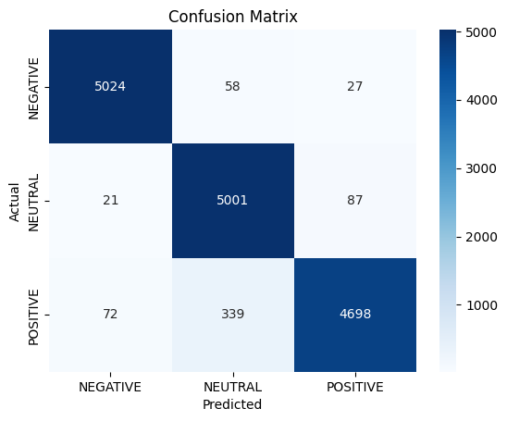
Confusion Matrix DeBERTa
Notes:
Confusion Matrix Analysis (DeBERT):The greatest degree of confusion occurred between POSITIVE → NEUTRAL (339 cases).A significant decrease in correct predictions for the POSITIVE class was evident compared to BERT and DistilBERT.

Slide 18
Clustering

Slide 19
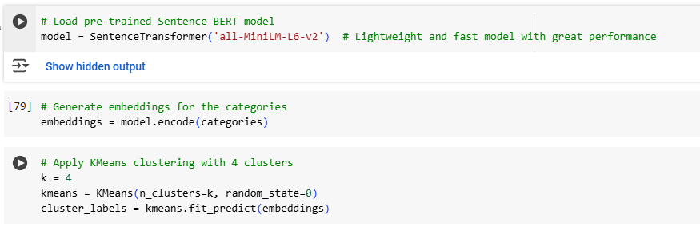
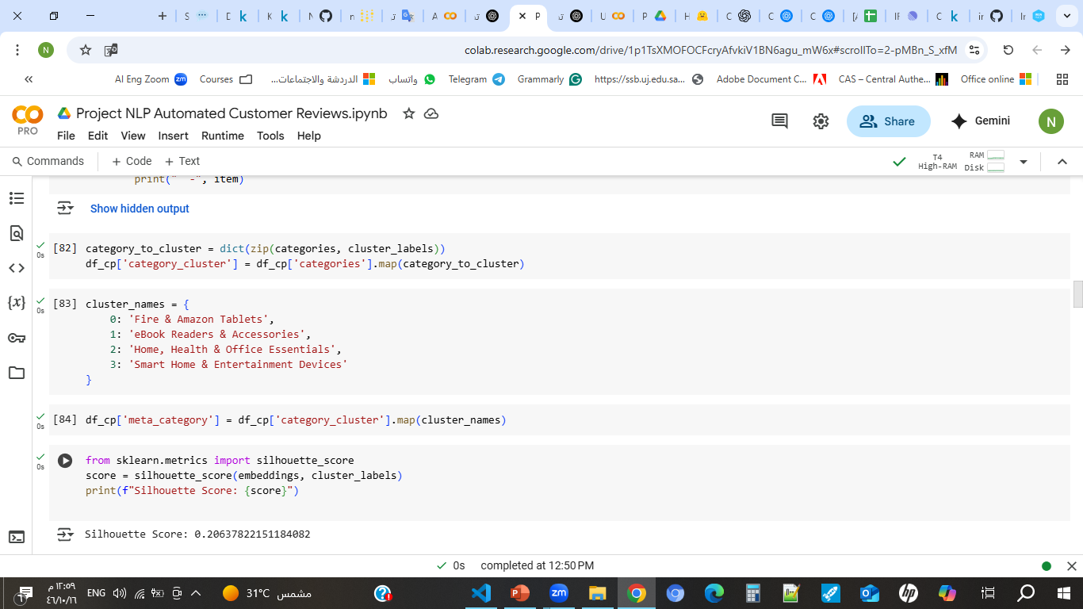

Slide 20
Summarization

Slide 21
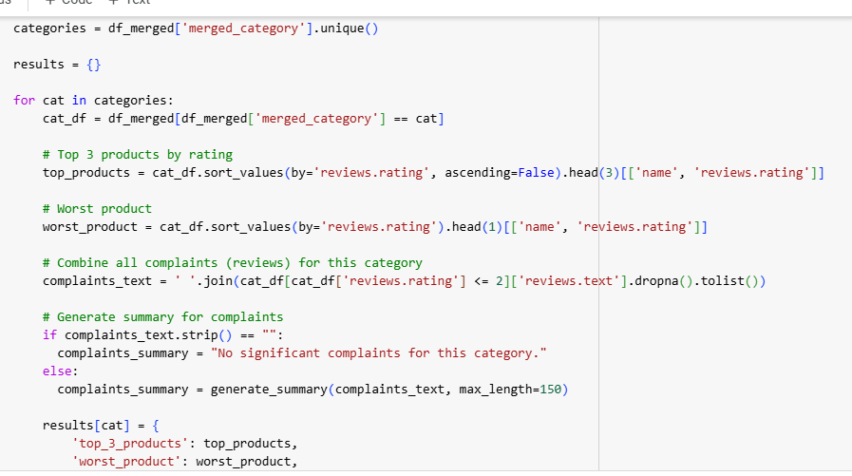

Slide 22
📦 Category: Fire & Amazon Tablets
⭐ Top 3 Products:
name reviews.rating
28330 Fire HD 8 Tablet with Alexa, 8 HD Display, 16 ... 5
12086 AmazonBasics Ventilated Adjustable Laptop Stand 5
28329 Fire HD 8 Tablet with Alexa, 8 HD Display, 16 ... 5
💔 Worst Product
name reviews.rating
16798 Fire Kids Edition Tablet, 7 Display, Wi-Fi, 16... 1
📝 Complaints Summary:
The two guard stops at the bottom are WAY TOO high. They dig into my wrists are are painful after only 5 minutes. If ads dont bother you, then this may be a decent device. Tablet had trouble from the begging it kept restarting and rebooting I had to return it. The screen breaks way to easy it drop one time broke Does not let me connect with my library.
--------------------------------------------------

Slide 23
Deployment

Slide 24
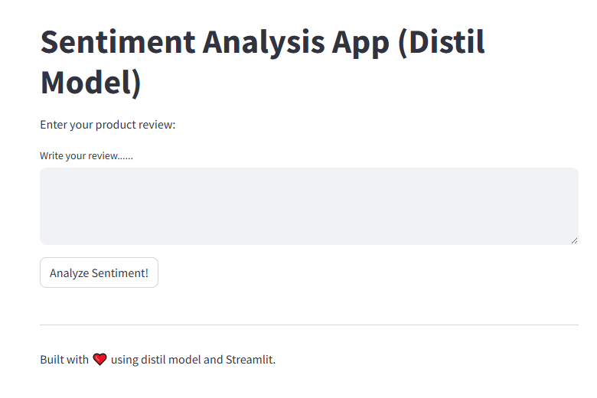
Positive: "Absolutely love this product! Exceeded my expectations.“
Negative: "Terrible quality, completely disappointed.“
Neutral: " It’s okay, nothing special.”

Slide 25
Thank You!
Automated Review Analysis System Presented by: Nada

