Slide 1
Traffic at the Eisenhower Tunnel
I-70 Colorado
Natalie Stier
NYC DSA - Python
November 17, 2023

Slide 2
Background information:
Traffic is a constant issue on the I-70 corridor between Denver, CO and Vail, CO for both locals and tourists.
The driving conditions are also very unpredictable as you go over several mountain passes and weather can change dramatically.
Google maps is not always accurate in this area likely due to the number of variables.

Slide 3
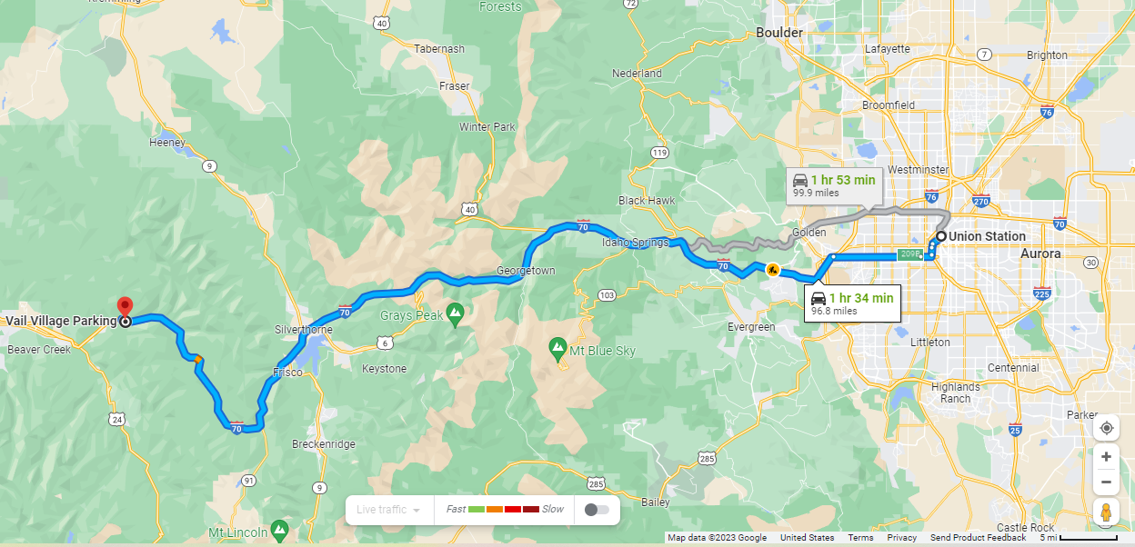
I-70 Colorado corridor between Denver and Vail
Denver
Eisenhower Tunnel
https://www.google.com/maps/dir/Union+Station,+Denver,+CO/Vail+Village+Parking,+North+Frontage+Road+West,+Vail,+CO/@39.4459739,-106.1233407,9z/data=!3m1!4b1!4m14!4m13!1m5!1m1!1s0x876c78c309781fbb:0xfa51804416e57e70!2m2!1d-104.9988948!2d39.752156!1m5!1m1!1s0x876a705e08eeb627:0x27e3b116e6a460e4!2m2!1d-106.3716696!2d39.6422753!3e0?entry=ttu

Slide 4
Research Questions:
When are the best times to travel between Denver and Vail in order to avoid traffic?
How does traffic vary going westbound vs. eastbound on different weekdays?
What are the seasonal variations in traffic?
Is there a statistical increase in traffic post-covid?
Knowing high-probability traffic times can help people save time. Additionally, it can show when the ideal times are to add more public transportation to and from Denver.

Slide 5
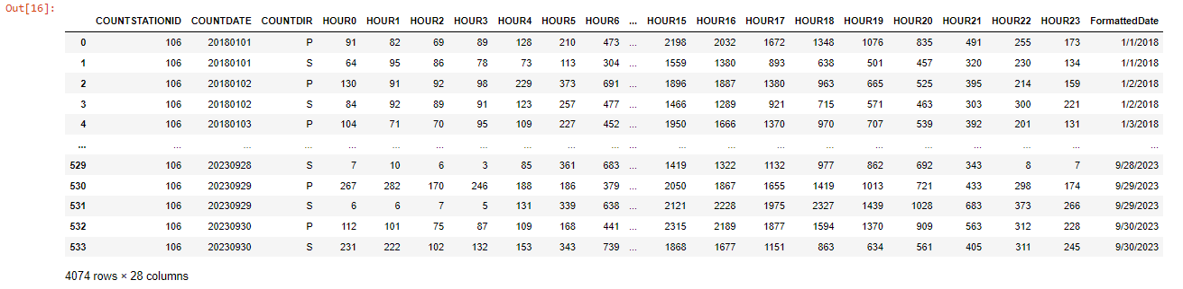
Data: CDOT (Colorado Department of Transportation)
OTIS (Online Transportation Information System)
https://dtdapps.coloradodot.info/otis/TrafficData#ui/1/1/0/station/000106/criteria/070A/0/449.589/false/true/
Converted the COUNTDATE column to a pandas datetime
Changed the index to COUNTDATE
Used COUNTDATE to add a day of the week column called Weekday and a month column called Month
Split the dataframe into eastbound and westbound
Six csv files of continuous hourly traffic counts at the Eisenhower Tunnel from January, 2018 to September, 2023
Date - 9/29/2023
Direction - S (West)
- - - - - - - - - - - - - - - - - -
Count - 2228
Hour - 16 (4 pm)
Month - September
Weekday - Friday
Season - Shoulder
Covid - Post- covid

Slide 6
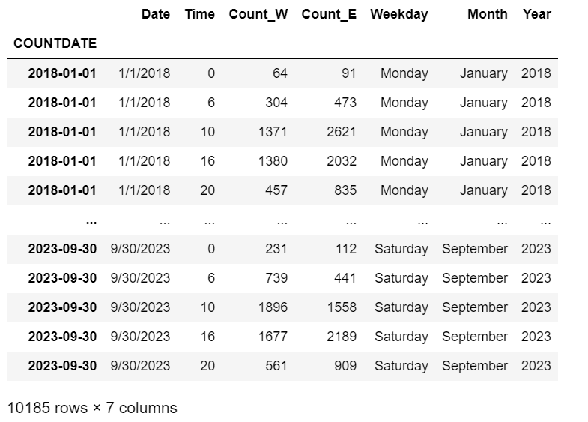
Overall trends in traffic through the Eisenhower Tunnel:
Included in this dataframe:
All traffic counts, both eastbound and westbound, from 12 am, 6 am, 10 am, 4 pm, and 8 pm.

Slide 7
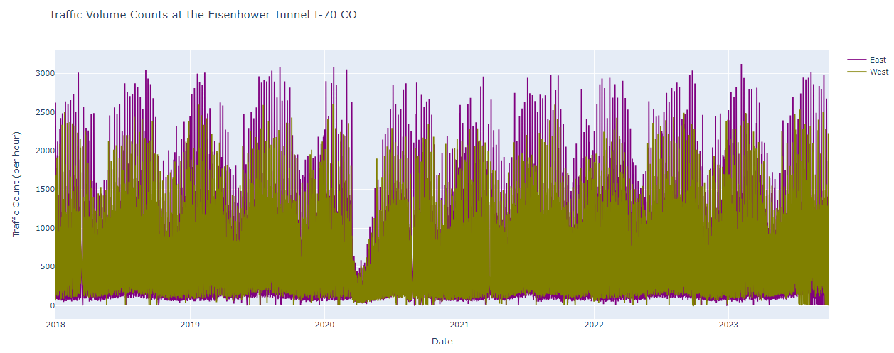
Overall trends in traffic through the Eisenhower Tunnel:

Slide 8
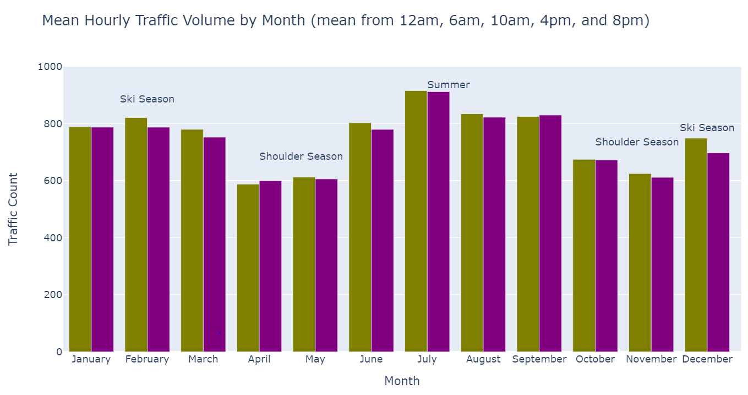

Monthly mean hourly traffic through the Eisenhower Tunnel:
Monthly variation is a result of the number of people recreating. Ski season and the summer are very busy while what is called the shoulder season (April, May, Oct. and Nov.) is not a busy.
West
East

Slide 9
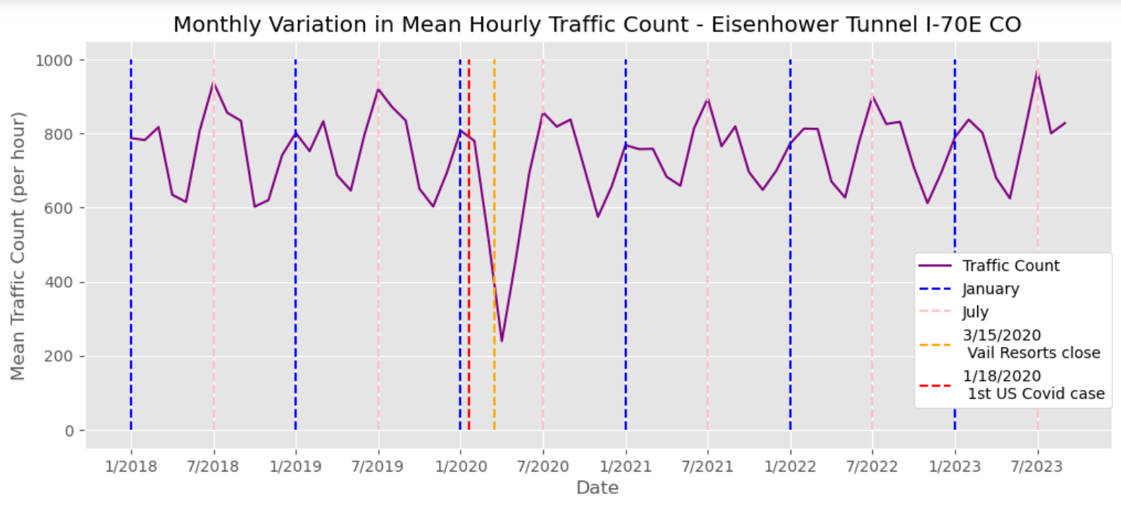
Trend in mean hourly traffic data grouped by year and month
Having just one point for each month illustrates the cyclical changes in traffic based on the seasons and the dramatic pandemic dip followed by a quick recovery.

Slide 10
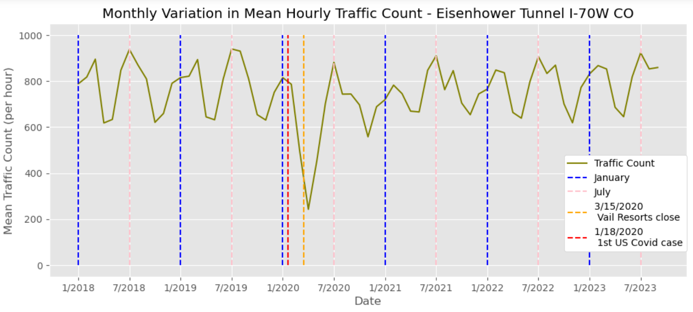

Slide 11
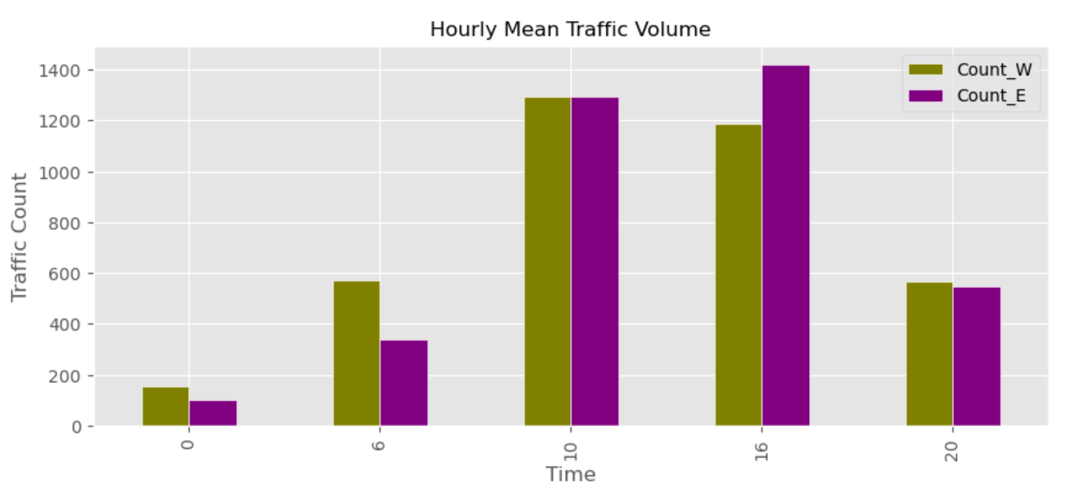
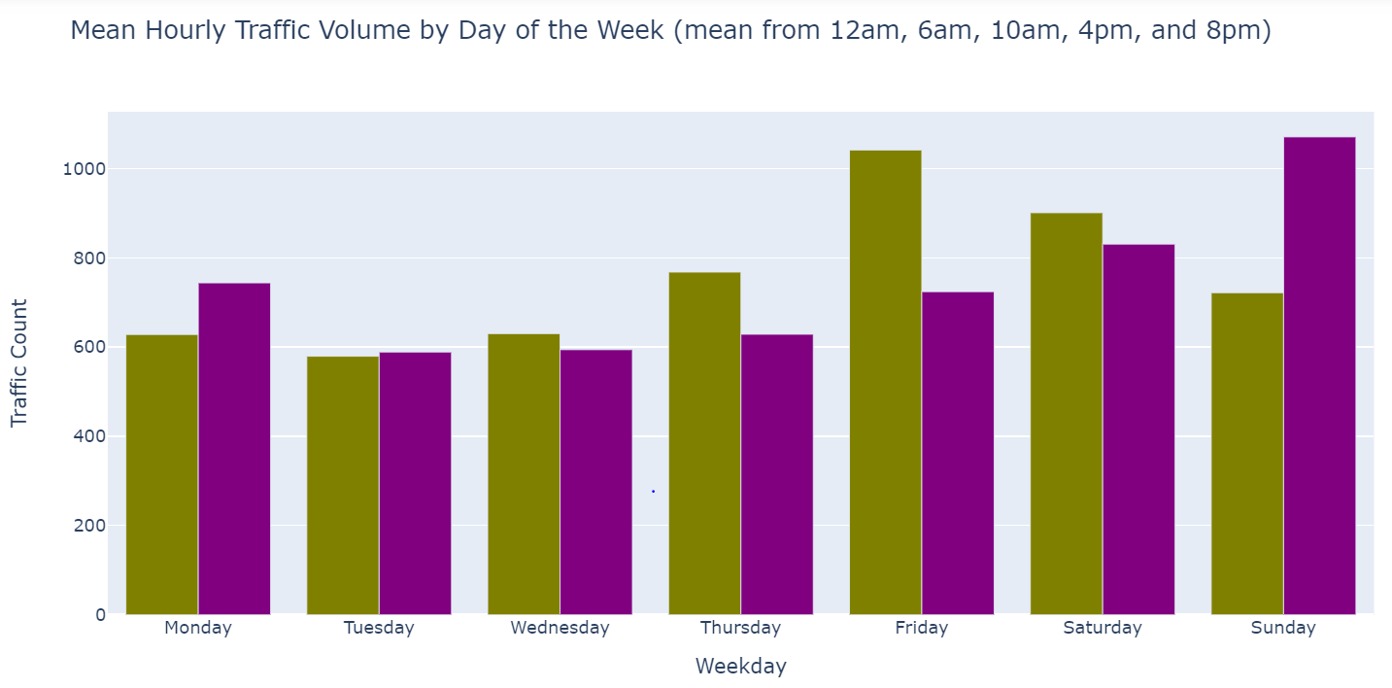
Weekly and hourly traffic through the Eisenhower Tunnel:
West
East
Higher volume going west on Thursdays, Fridays, and Saturdays particularly in the morning.
Higher volume going east on Sundays and Mondays particularly in the afternoon.
West
East

Slide 12
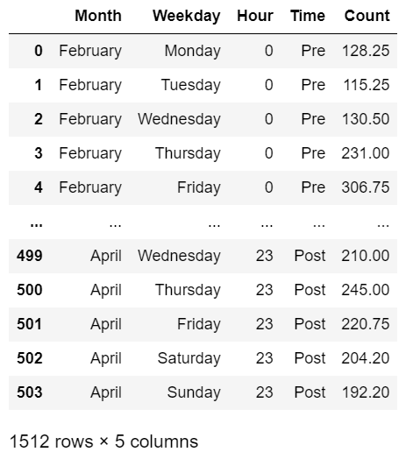
Traffic pattern changes relating to the Covid-19 pandemic:
Dataframe shows the average hourly traffic count for each hour of each weekday from February to April of 2018, 2020, and 2023.
So there are 24 counts for each weekday of each month.
24 hours x 7 days x 3month x 4 years
= 1512 traffic counts

Slide 13
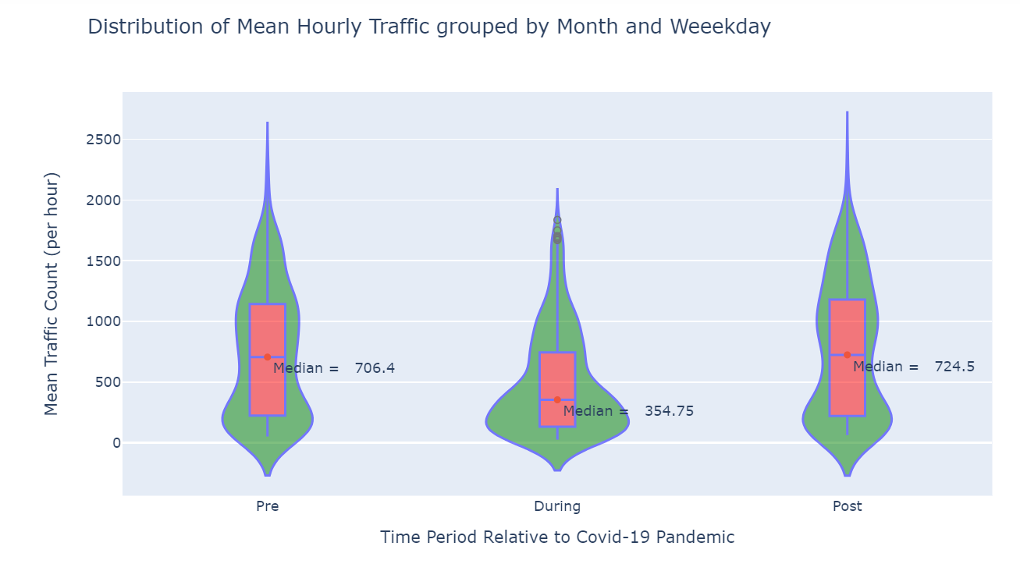
Traffic pattern changes relating to the Covid-19 pandemic:
Very clear difference in the distribution of hourly traffic count going westbound from February to April of 2020.

Slide 14
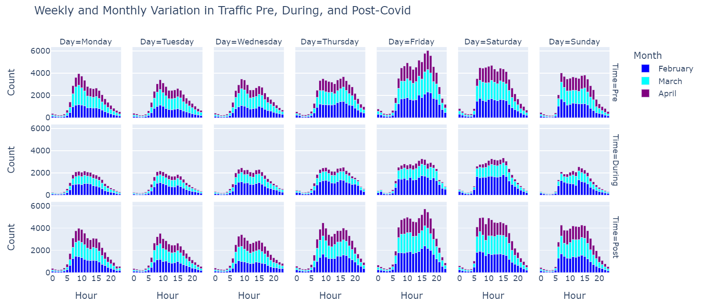
Traffic pattern changes relating to the Covid-19 pandemic:
Very little observable difference pre and post-pandemic, but clear decrease in traffic particularly during March and April of 2020 (During).

Slide 15
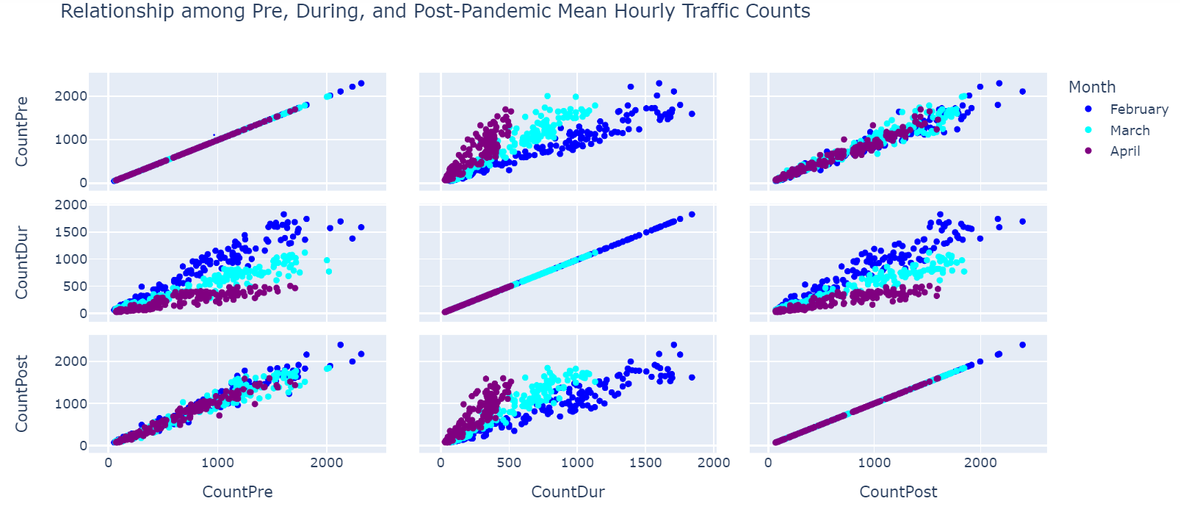
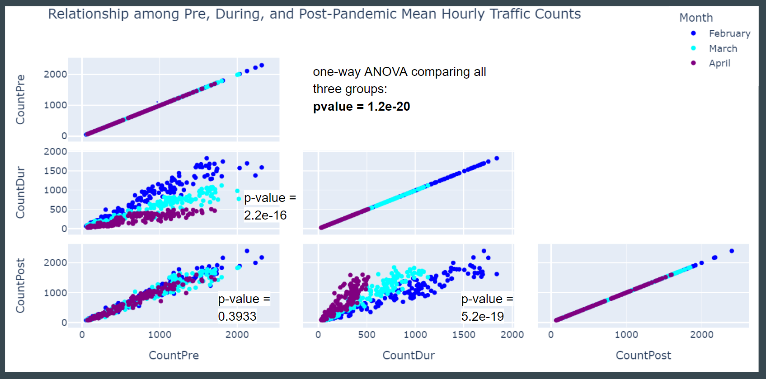

Traffic pattern changes relating to the Covid-19 pandemic:
one-way ANOVA comparing all three groups:
p-value = 1.2e-20
Statistically there is a difference among the pre, during, and post-pandemic groups. However there is not a statistically significant different between the pre and post-pandemic group.
p-value =
2.2e-16
p-value = 0.3933
p-value =
5.2e-19

Slide 16
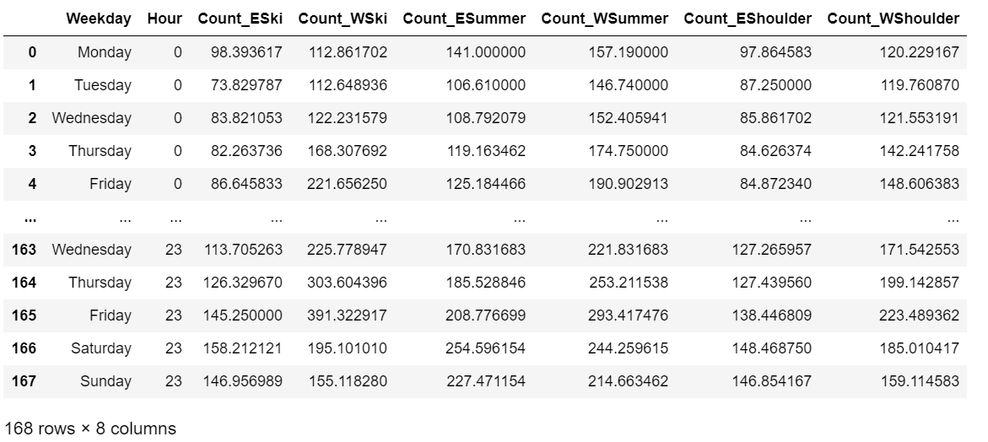
Daily and seasonal trends in traffic through the Eisenhower Tunnel:
Dataframe shows mean hourly traffic for each weekday during each season going both eastbound and westbound.
7 days x 24 hours = 168 traffic counts for each season
Ski season- (Dec., Jan., Feb., March)
Summer -
(June, July, Aug., Sept.)
Shoulder season -
(April, May, Oct., Nov.)

Slide 17
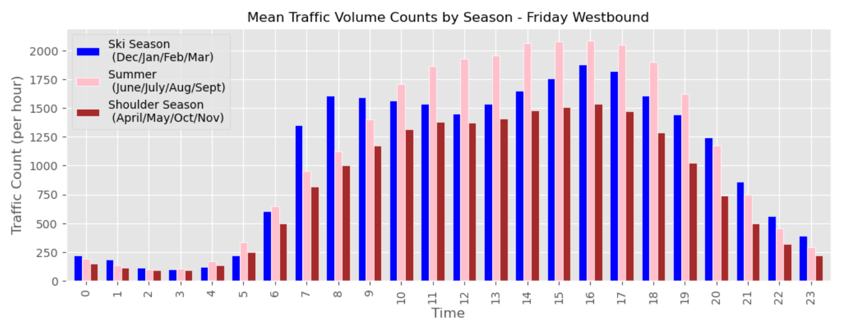
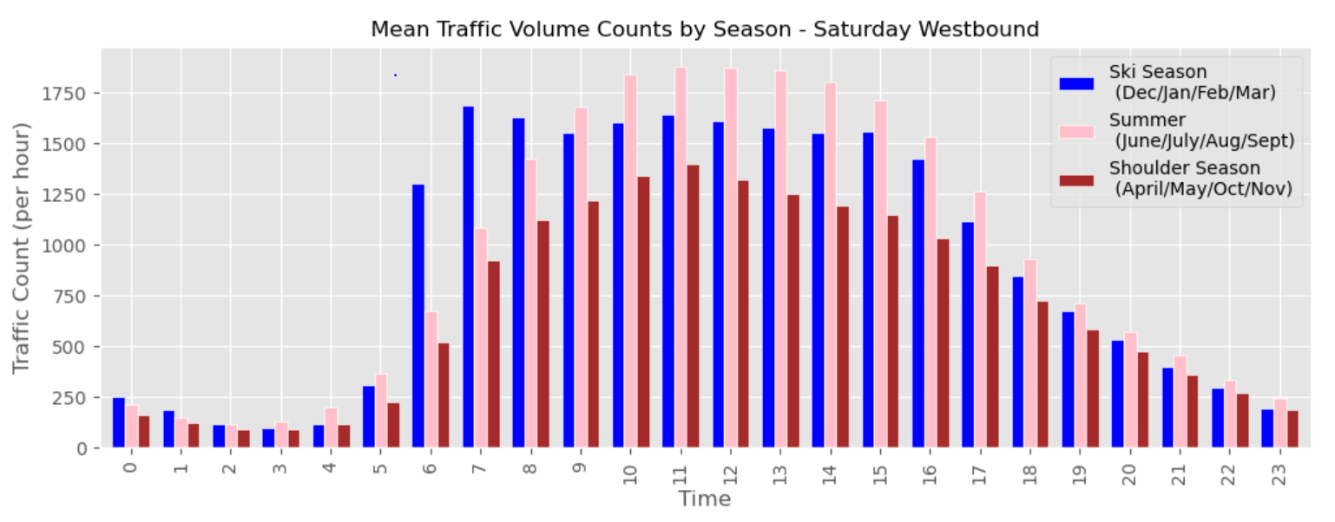
Daily and seasonal trends in westbound traffic through the Eisenhower Tunnel:
High volume in the morning during ski season on Fridays and Saturdays.
High volume on Friday afternoons in both ski season and the summer.

Slide 18
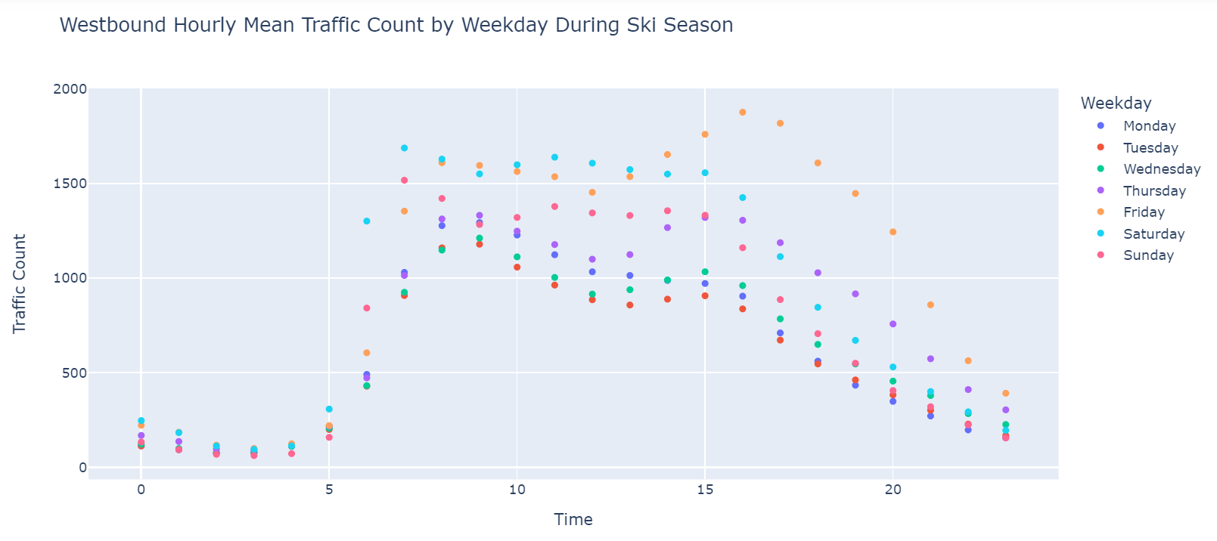
Daily trends westbound during ski season

Slide 19
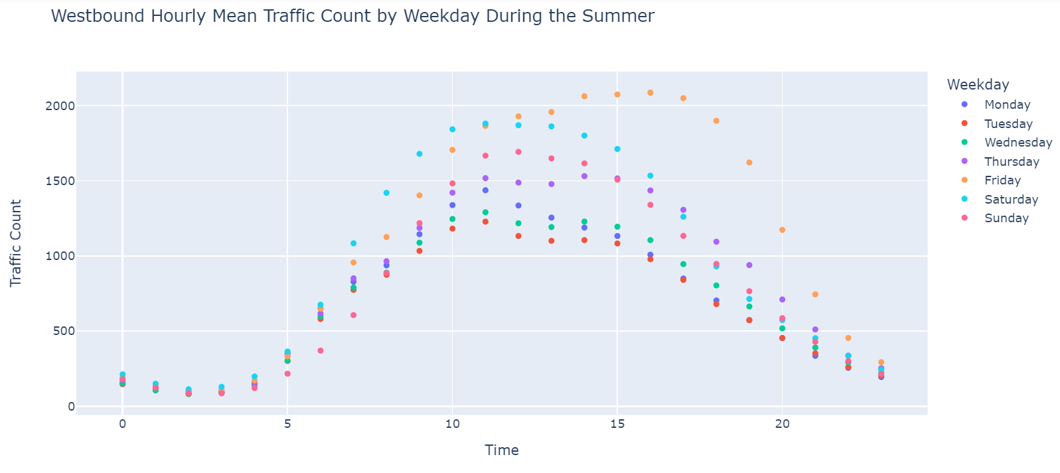
Daily trends westbound during the summer

Slide 20
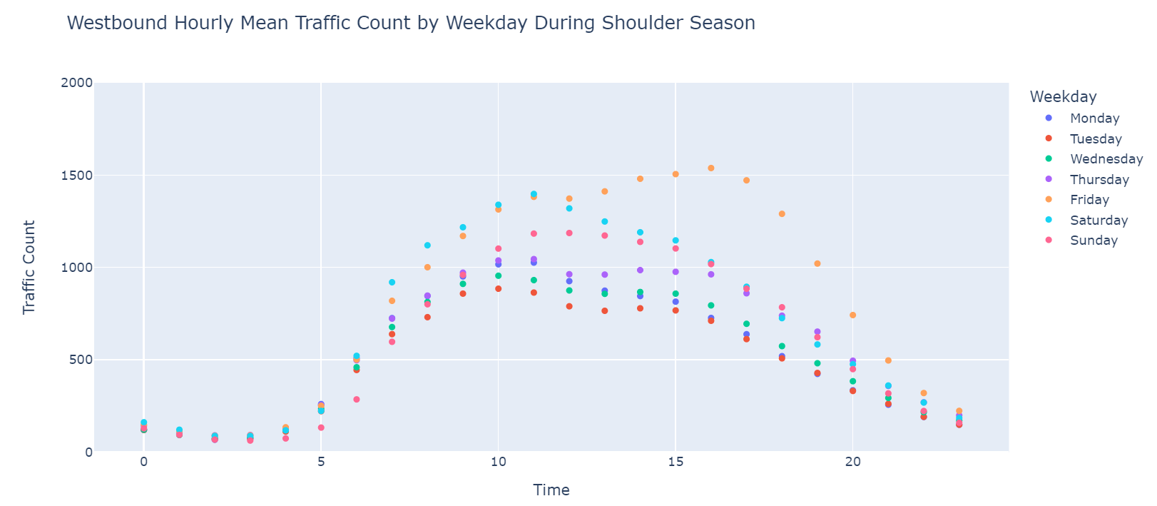
Daily trends westbound during shoulder season

Slide 21
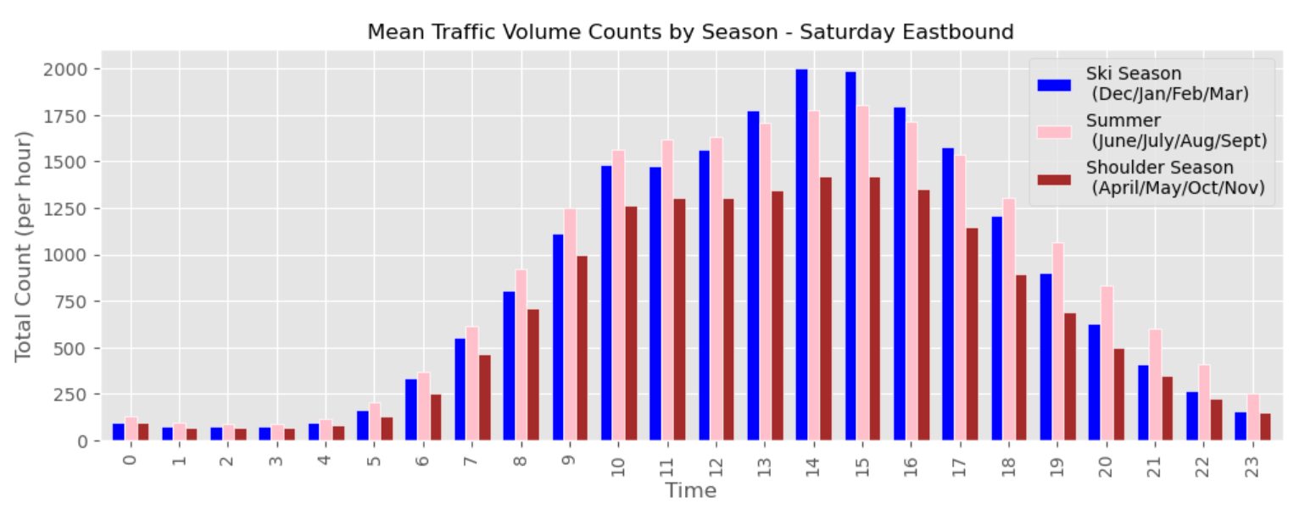
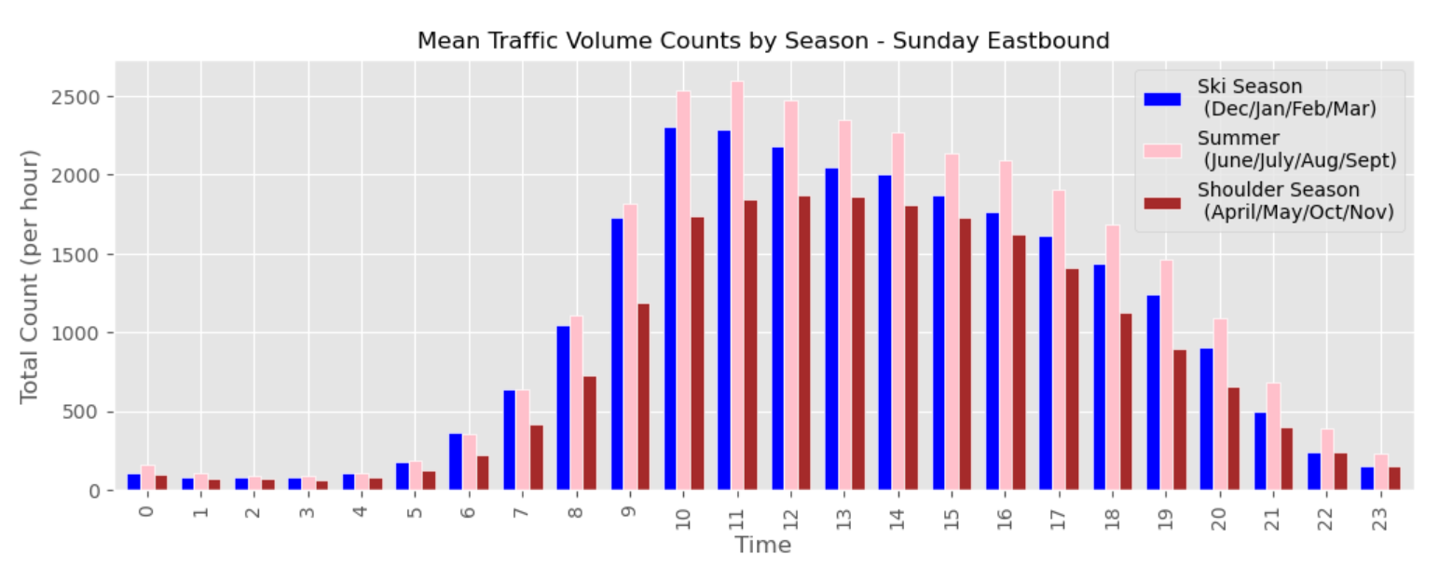
Daily and seasonal trends in eastbound traffic through the Eisenhower Tunnel:
High volume Saturday and Sunday afternoons
Extremely high volume during ski season and the summer on Sunday mornings from 9 am to 12 pm.

Slide 22
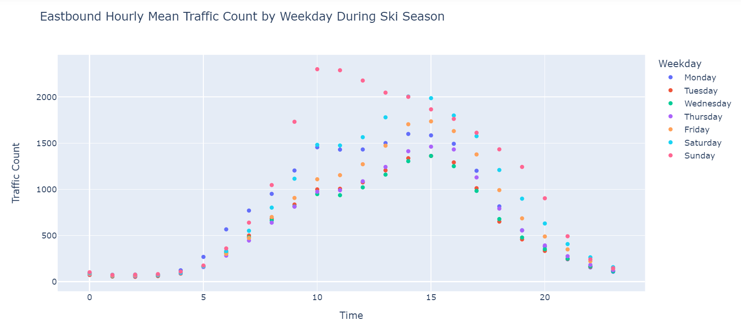
Daily trends eastbound during ski season

Slide 23
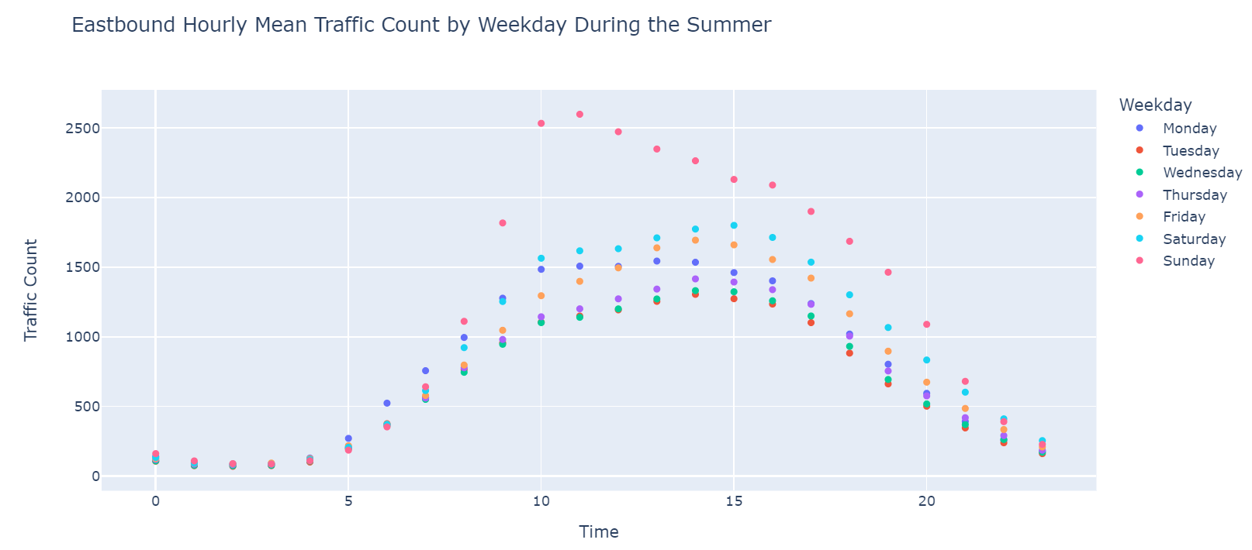
Daily trends eastbound during the summer

Slide 24
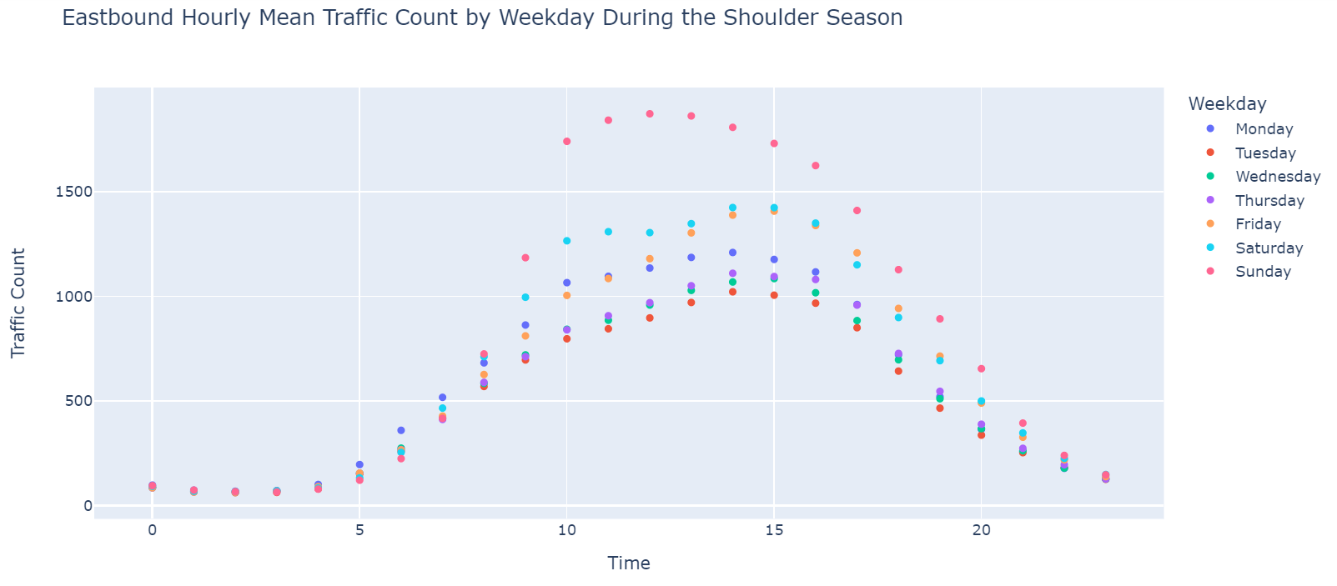
Daily trends eastbound during shoulder season

Slide 25
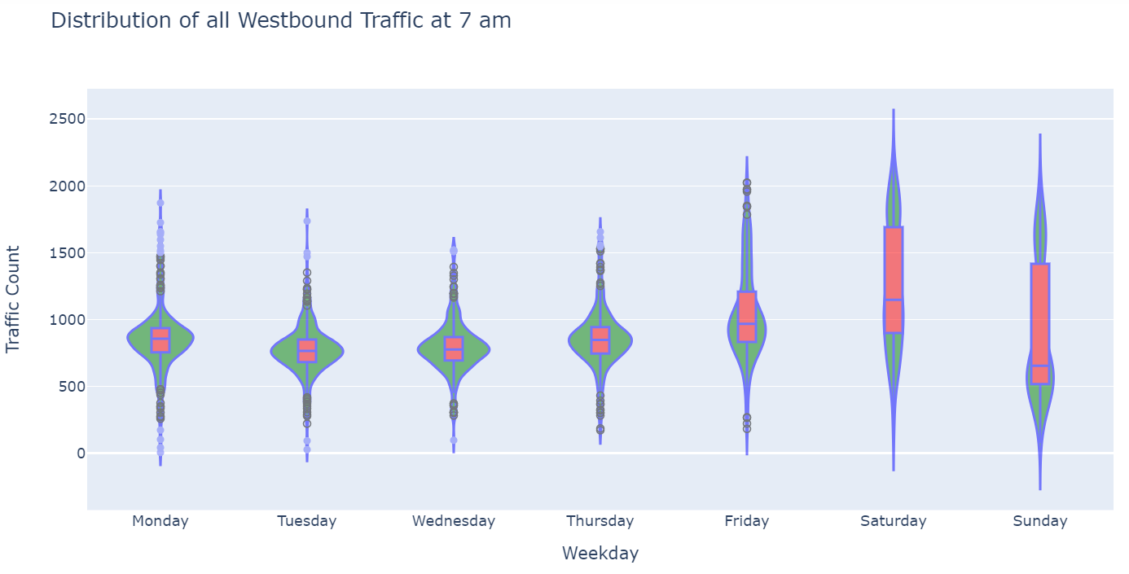
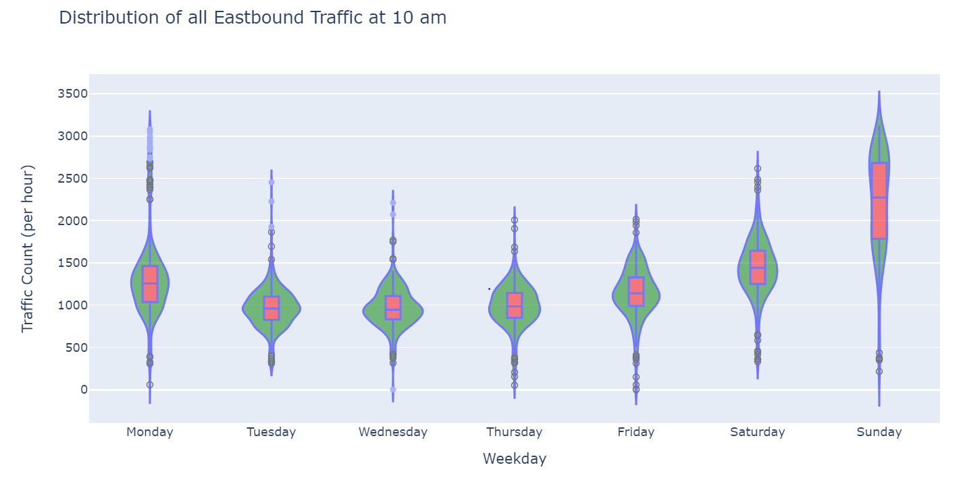
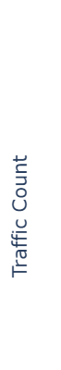
Violin plots at two high volume traffic times:
Weekend mornings are potentially high volume times going westbound depending on the season.
Sunday morning is always a high volume time going eastbound but how bad the traffic will be is unpredictable.

Slide 26
Conclusions:
There is no statistical difference in westbound winter traffic pre and post-pandemic, but a very clear difference during covid.
When driving westbound:
Avoid leaving Denver between 2 and 6 pm on Fridays. Even during shoulder season there is likely to be traffic.
Try to leave Denver by 5 am on Saturdays and Sundays during ski season.
When driving eastbound:
The huge spike in Sunday morning traffic (particularly in the summer) is likely visitors on their way to the airport. If you need to be on the road between 10 am and 2 pm make sure you leave with plenty of extra time to be at the airport.
Expect heavy traffic between 2 pm and 6 pm on Saturdays and Sundays.
Adding more public transportation to and from Denver at peak travel times could reduce traffic (Bustang and Vail Mountain Express could both expand).
A toll at the Eisenhower Tunnel at peak travel times could alleviate traffic and generate revenue for roads.

Slide 27
Future Work
Analyze other continuous traffic stations in the area to see if the patterns correlate with those at the Eisenhower Tunnel.
Analyze traffic stations near Winter Park, CO where they have introduced a commuter train to see if there is a difference in their traffic patterns.
How to decrease commuter traffic on CO I-70 between Denver and Vail?
Right now there is not a good public transportation option and there are no existing train tracks.
How many buses would be needed to make a difference, and more importantly, how could people be motivated to use them?
“The key is that people will use public transportation if it is fast, comfortable and has a reliable schedule. Modern commuter rail has these properties while buses do not, and during bad weather, rail is often reliable while roads are not.” -Christof Stork
https://coloradonewsline.com/2023/11/01/return-of-vail-area-passenger-rail-gains-support-among-some-leaders/

