Slide 1

TO B.S.N.L.(WEST ZONE) 3G AND G.P.R.S.SERVICES
LIGHTNING FAST INTERNET SPEED ON YOUR MOBILE AND PC

Slide 2
ACESS POINT NAMES AND USEAGE
1)BSNLNET : To browse internet at faster rate.
2)BSNL MMS:To send and receive MMS/VIDEO CLIP
(Multi Media Messaging)
3)BSNL STREAM : To watch LIVE TV Channels/ Programs on Mobile.(with handsets having real player)
4)BSNL LIVE : To download the contents.i.e. MOVIES,WALL PAPERS,MOBILE GAMES,
AUDIO & VIDEO SONGS ,VIDEO CLIPS etc.

Slide 3
MOBILE HANDSET SETTINGS FOR 3G,GPRS/MMS
Go to internet site: http://www.cellone.in
(Any body can send the setting having internet access.Just 6 clicks.)
This method works for almost all mobile handsets of all mfg. companies
specially NOKIA,SONY ERICSSON,SAMSUNG,LG etc.handsets.
This method does not work for the Palmtops/Smart Phones/Pocket PC
i.e.windows base handsets.Mobiles of the companies ‘DOPOD’,O2’,
HP,i-mate,Treo,HP iPAQ,HTC touch-flow,APPLE I-PHONE etc.
(In these types of handsets,setting is very simple.)You have to manually write only
Access point name(APN) as bsnlnet
and select modem as CELLULAR LINE(GPRS).
Click on Next and then click on Finish.
Detail procedure give in the slides.

Slide 4
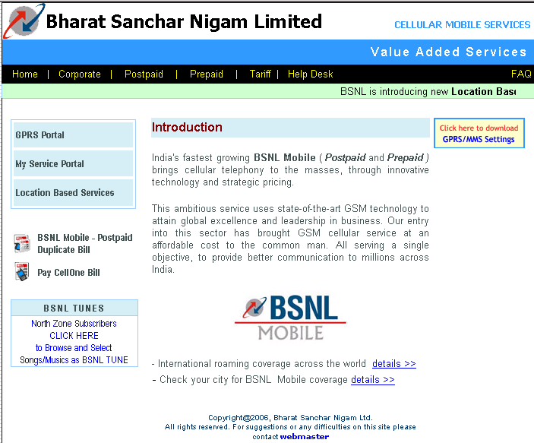
Click on GPRS/MMS Settings(Red arrow).

Slide 5
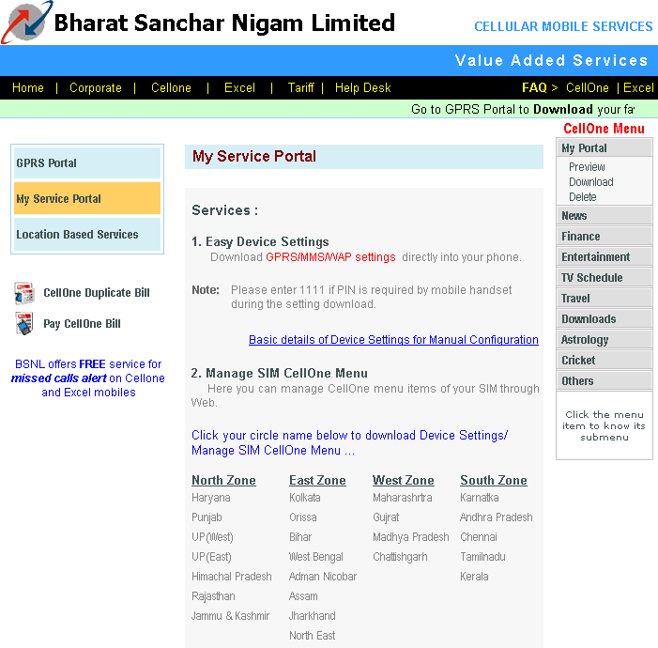
Select states to which subscriber belongs under West Zone(Red arrow).

Slide 6
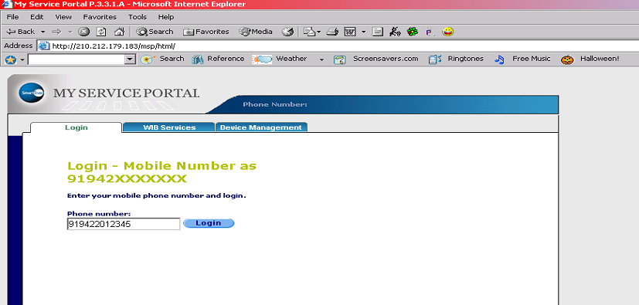
Enter the subscriber mobile no.prefixing 91
(Ex. If sub. No is 9422012345 then it should be 919422012345)
And click on Login.

Slide 7
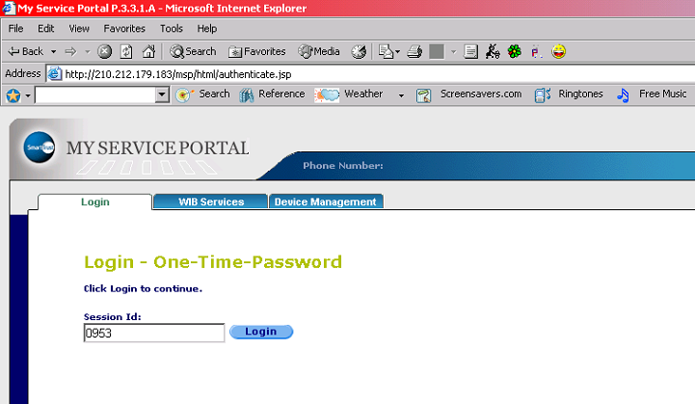
Click on Login (Just ignore Session Id).

Slide 8
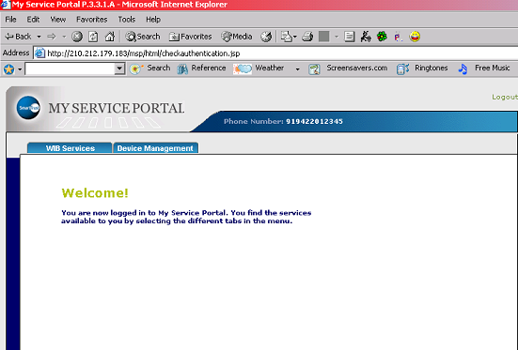
Click on Device Management.

Slide 9
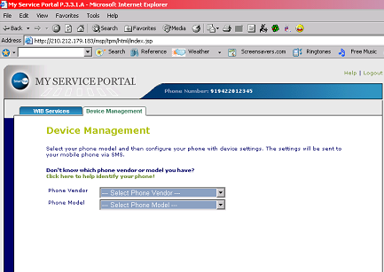
Select the mobile manufacturing company which subscriber is
using from the drop down list of Phone Vendor (Red arrow).
Then select Phone Model from drop down list (Green arrow).
(EX.Subscriber using Nokia 6630) Go to next slide.

Slide 10
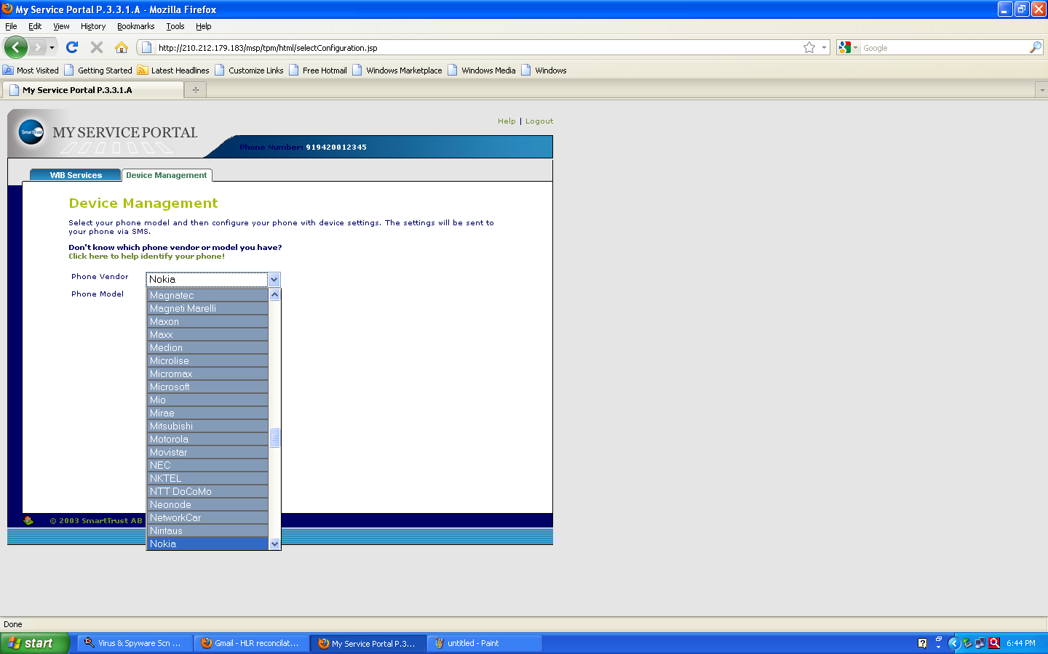
Pl select the handset make of your mobile from drop down list.

Slide 11
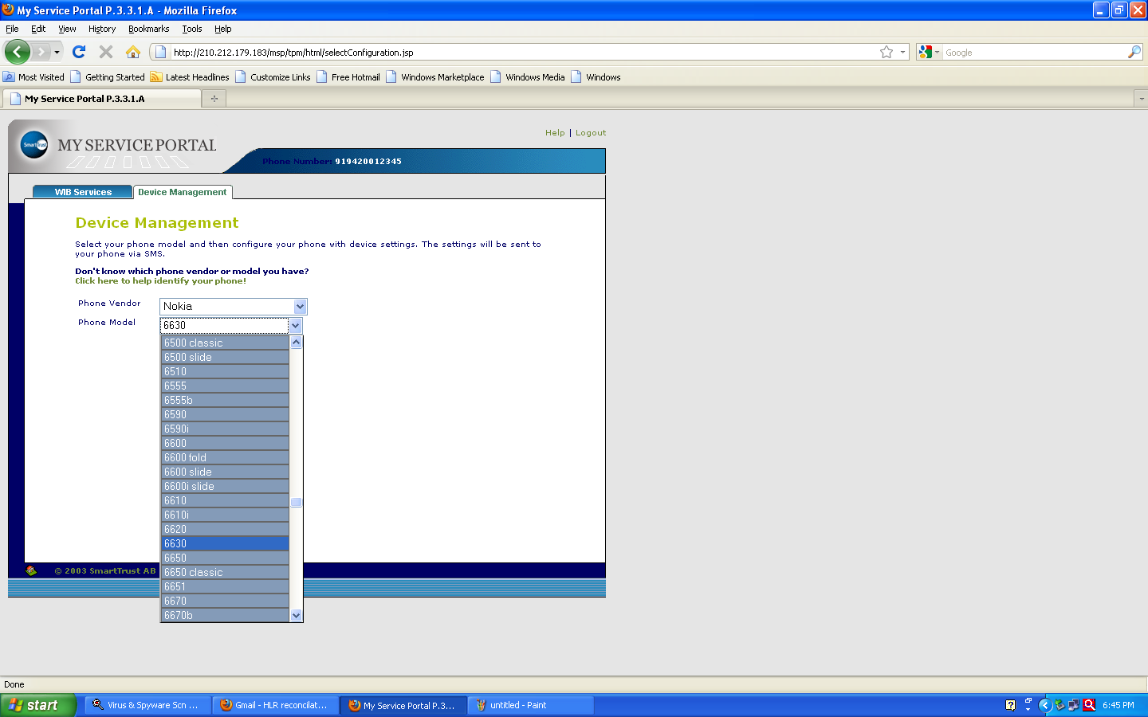
Pl select the exact handset model.
Notes:
Pl selects exact handset model from the drop down list

Slide 12
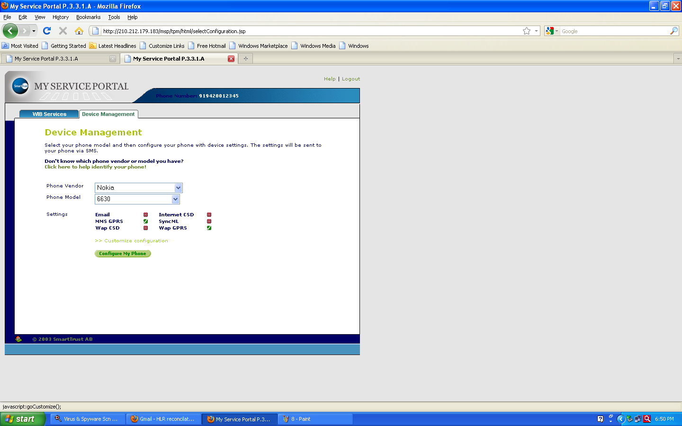
(Now you can click on Configure My Phone four settings will be received by sub. but
it is advisable to send settings one by one to avoid confusion of subscriber in making
Default profile.)Click on Customise configurations. Click on checkbox of BSNL LIVE,BSNL STREAM,BSNL MMS to unmark so that sub will get only BSNLNET(Next slide).

Slide 13
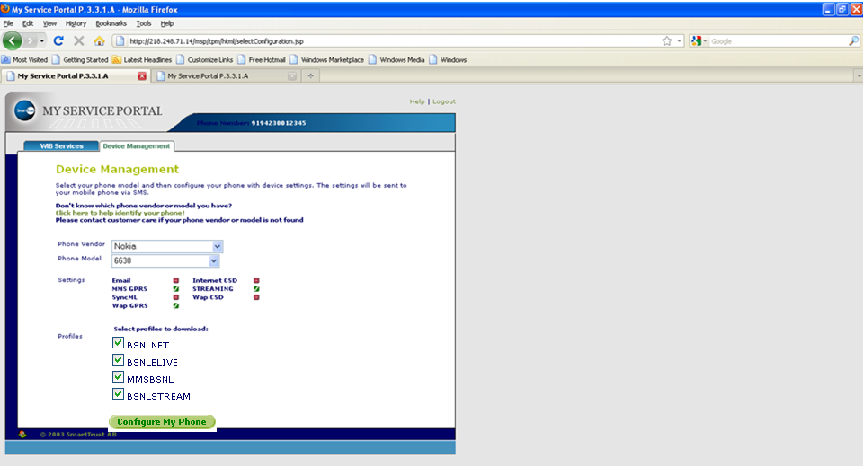
Pl see that BSNLNET is checked with green right mark in box.

Slide 14
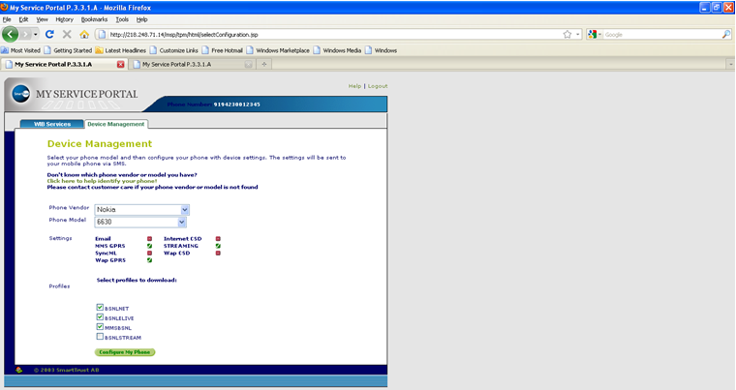
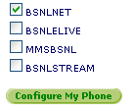
Click on Configure My Phone (Subs will receive one
CONFIGRATION MESSAGE) Please wait for some time.

Slide 15
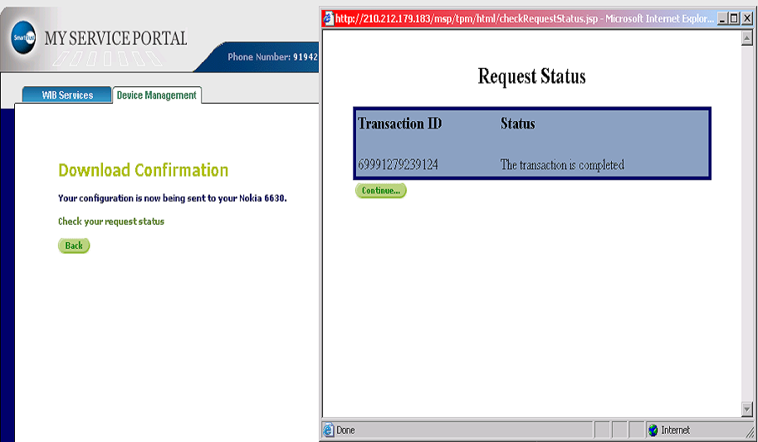
(You can check the status whether sub got the Confg.Message)
Click on Check your request status(Red arrow).Please see The
transaction is completed meaning sub.got the confg.message.

Slide 16
Subscriber will receive one configuration message.In most of the handsets while opening configuration massage handsets ask to enter configuration pin.
Configuration PIN Code is always :1111 (Password protected message.Always same for all types of handsets.)
Please enter the pin code 1111 and press OK
The massage will be open press options to
Open it, press options for SAVE/INSTALL/UPDATE
press YES/OK.
THE SUBSCRIBE CAN SET ONLY ONE DEFAULT PROFILE AT A TIME IN HIS/HER HANDSET.
HE/SHE CAN BROWSE ONLY VIA DEFAULT PROFILE.

Slide 17
FOR NOKIA HANDSETS
(In most of handsets):After saving the massage handset will ask
“Set as DEFAULT SETTINGS?” Press YES
(Press the button on which marked by RED to return normal screen)
Here finish the settings part.
TO BROWSE INTERNET…
“PRESS AND HOLD ZERO BUTTON KEY”(key on which zero number
is printed.This shortcut is available in NOKIA ONLY)
On the screen appears “connecting via BSNLNET” or connecting via
“bsnlnet” This is cross test to verify that subscriber had done
correct Default setting.
OPENS THE FANTASTICK WORLD OF FAST INTERNET ON MOBILE DIVICE.
If handset does not ask to set as Default(very few handsets).
Then Go to next slide.

Slide 18
SAVE MESSAGE
Go to WEB/SERVICES menu→OPTIONS→SETTINGS→ACTIVE ACESS POINT/DEFAULT ACCESS POINT→Select →bsnlnet→ACTIVATE/ SELECT and return to normal screen then PRESS AND HOLD ZERO BUTTON KEY.
ALWAYS USE GPRS SETTINGS EXCLUSIVLY FOR BROWSING THE INTERNET ON MOBILES HAVING BROWSER WAP 2.0 HANDSETS.IT’S FASTER THAN WAP.
WAP SETTINGS IS FOR BROWSING INTERNET AND DOWNLOAD THE CONTENTS i.e. WALLPAPERS,GAMES,PICTURES ETC.
Repeat the above procedure and send BSNL LIVE settings to download WAP contents. Ask subscriber to save but NOT DEFAULT.When subscriber wants to download the content he/she should make the BSNL LIVE setting as Default.He/She can change as per the need.
TO CHANGE DEFAULT SETTINGS:Main MENU→WEB→OPTIONS→SETTINGS→Select DEFAULT ACCESS POINT→OPTIONS→SELECT CHANGE→bsnllive
Come to normal screen press and hold zero button key and browse and/or download what he/she wants.

Slide 19
WAP SETTING FOR THE HANDSETS HAVING WAP BROWSER 1.2.1 OLD VERSON HANDSETS e.g.NOKIA 6510,2626,2650,2652,Motorola V3i,L6,L6i,L7,L7i etc.
(For these types of handsets gprs settings will not work but sub can browse internet sites connecting to PC/Laptop. Please refer our PC connectivity slide shows.
Send the wap settings save the MASSAGE →GO TO WEB/INTERNET SERVICES→OPTIONS→SETTINGS→ACTIVE ACCESS POINT→OPTIONS→SELECT→ bsnllive
Browsing procedure is same as stated earlier.With these types of handsets sub can browse only wap sites which are very few in numbers.
Ex. wap.cellone.in ,wap.bsewebx.co.in , wap.kalnirnay.com ,wap.hungama.com
Repeat the above procedure for MMS.Send the MMS setting and activate as default.
For MMS: Go to MASSAGE →OPTION→SETTINGS→MULTIMEDIA MASSAGE→SELECT ACCESS POINT IN USE→ bsnlmms
Return to normal screen and send MMS to self for testing.

Slide 20
FOR SONY ERICSSON HANDSETS
New settings received Install?
Press Yes
Press MENU→SETTINGS→CONNECTIVITY→INTERNET
SETTINGS→INTERNET PROFILES→SELECT bsnlnet
as default (Default will be marked as black spot inside the hallo white
circle like this )
Again select Internet profiles take curser on bsnlnet
and press More→Select Settings→(it will show)
Connect using: bsnlnet
Internet mode: HTTP
Use proxy:NO(If it is YES for gprs make it NO MANUALLY.This has to
be done only for GPRS for Sony Ericsson.For wap and mms no need to
change anything).Come back to normal screen.

Slide 21
TO BROWSE INTERNET on mobile press Menu→select Internet Services→(most of the People tries to browse here.)Press More→
Go to: bsnlnet (select to go to home page or go to Enter address FOR THE SITE YOU WANT TO BROWSE you can make bookmark for frequently Useful sites you visit).
OPENS THE FANTASTICK WORLD OF INTERNET ON MOBILE
DIVICE.
FOR WAP: Send the message and select it as default and repeat the above procedure to browse/download contents.
MMS:MENU→SELECT MESSAGING→SELECT SETTINGS→
PICTURE MESSAGE→MESSAGE SERVER: http://mms/mmsc
INTERNET PROFILE: SELECT bsnlmms

Slide 22
MOTOROLA V3i,V3,L6,L6i,L7,L7i &
ROKR,A1200 etc.
Please repeat the procedure given above for sending the message from the site www.cellone.in
Phone will received massage.The phone will ask “ New setting received,Install?” press Yes then go to web access
then web session and make the bsnllive as default for Motorola,specially for V3,V3i,L6,L6i,L7,L7i(wap handsets only).
For L6i & L7i Please send the setting of L6 & L7 from the site.
The default profile will marked as [.Com e to normal screen there is shortcut/wap key Available on the phone it self press it.
For ROKR,A1200, bsnlnet will be received set it default and browse any internet site on the handsets.

Slide 23
GPRS SETTINGS ON SMS
(type SMS send to 19000 configurations messages will RECEIVED, save it start browsing)
Take the handset and type message
“Handset make i.e.(company name) space model no” and send the
message to “58355” For example “Nokia 6600”------>58355
Nokia n72 type message “Nokia n72”
For Sony Erricsson k750i type message “Sonyerricson k750i”
For lg3200 type message “Lg 3200”
Wait for some time and you will receive four Configuration message
from 58355 .If it opens directly no problem, but if the handset ask
PIN CODE then it is always “1111” named
1)“bsnlnet”
2) “bsnllive”
3) “bsnlstream”
4) “bsnlmms”
After receipt of the messages the procedure is SAME as described in slide
No.11,12 and 13 for the respective mobile mfg.There is chance of mistake in
sending SMS so first method of www.cellone.in is perfect one compare to sending message.

Slide 24
DOPOD,O2,HP,HTC I-MATE,SAMSUNG SGH-i710,X CINGULAR etc.I.e WINDOWS BASE MOBILES
Go to Start→Settings→Connections→Connection→(Under internet
settings select)Add a new modem connection →
Enter a name for the connection:BSNL (you can type any name as you like)
A modem(from the drop down list select):Cellular Line (GPRS)
(On the bottom of your screen select):Next
Access Point Name(APN): bsnlnet
Press : Next
User name: Leave it blank
Password: Leave it blank
Domain: Leave it blank
In the bottom line press: Finish
(Make the connection BSNL default indicated by this sign )
Here setting is finished.

Slide 25
TO BROWSE INTERNET . . . .
Method 1)
Press Start→internet explorer→enter url/site name which you want to browse.
OPENS THE FANTASTICK WORLD OF INTERNET ON MOBILE DIVICE.
Method 2)
Under internet settings click on Manage existing connection.On your screen BSNL (the name you had given will be shown)
with the Joystick/Stylus(the stick coming along with the handsets).
Tap and hold on the name i.e.BSNL,two sub menu will be displayed i.e.Delete and Connect,click on connect.
Please Observe the symbol of “E”or G .In HTC a small E comes out of E.
In O2 the symbol ‘G’ in the top center of your screen.The two arrows start coming out of ‘G’ in
the opposite direction.As soon as it got connected the moving arrows will get stable.
Now you can browse any internet site.In some companies,when it got connected
a symbol of small G coming out of symbol of big G.
Press Start→internet explorer→enter url/site name which you want to browse.
OPENS THE FANTASTICK WORLD OF INTERNET ON MOBILE DIVICE
Note:Always keep only one connection setting i.e.BSNL and use method 1 as it is simple.if you have only one connection directly start browsing by method 1 as and when you want to browse the internet.

Slide 26
PROBLEM & SOLUTIONS IN O2,HP,WHILE CONNECTING
Go to Settings →Connection→Connection→ Under internet settings select Manage existing connection.
The connection name you had made will be shown i.e. BSNL (as in this example.)
Select the connection and click on Edit
(Please delete another existing connections if any. It is advisable to have only one connection that you have made.When only one connection is there phone will always get connected via that connection.when you want to browse the internet just click on icon of internet explorer and open any internet site,the phone will have to connect with only one connection that you have kept.)

Slide 27
Check for the following parameter
Connection name :BSNL
A modem(from the drop down list select):Cellular Line (GPRS)
(On the bottom of your screen select):Next
Access Point Name(APN): bsnlnet (please check the APN.
Press Next
User name: Leave it blank
Password: Leave it blank
Domain: Leave it blank
Click on Advanced
(A black spot( ) inside the circle to show selected.)
Two sub menu TCP/IP and SERVERS will be shown.
First click on TCP/IP select and see ( )USE SERVER-ASSIGNED IP ADDRESS
Then click on SERVERS and see/select USE SERVER –ASSIGNED ADDRESSES SELECT USE SERVER –ASSIGNED IP ADDRESS
CLICK ON OK at the upper right hand top corner of the screen.And click on FINISH at the bottom left hand corner.
TRY TO OPEN THE INTERNET SITE.

Slide 28
If still problem persist the mobile has to give half reset or full reset specially
in O2,HP.But due care has to be taken because in giving reset subscriber
may lost the data partly or fully so unless until sub gives his/her consent
to reset do not give reset to the handset.
It is advisable to take back-up of the handset and then give half reset first and
try to browse.Most (90%) problems get resolve with the half reset and
For the remaining problem full reset should be given.
Subscriber should be made aware of the fact of data loss and
half/full reset should be given by the subscriber.
(Reset has to be done to get setting effective which you have made)
METHODS OF HALF RESET or FULL RESET
Half reset:Insert the stylus in the small aperture at the bottom of
handset and push it gently the phone will be reseted and try to browse
Internet site.
Full reset:The above method of half reset and switch off button should
be press together(at the same time) and phone will get reseted
Completely.Try to browse the internet.

Slide 29
i-mate sp-3/HTC S710
Go to START→SETTINGS→(PRESS CENTR BUTTON)→
MORE→DATA CONNECTION→ (right button press)→MENU→
select Edit connection→4 GPRS Connection Press Right hand bottom
Corner button →Menu→1ADD(SELECT):
DESCRIPTION: (ITS NAME ONLY) BSNL
CONNECTS TO:(SELECT) THE INTERNET
Access point: bsnlnet
User name: (Leave it blank)
Password: (Leave it blank)
Primary DNS: (Leave it blank)
Secondary DNS: (Leave it blank)
IP address: (Leave it blank)
Press: DONE (Left hand bottom corner button)
BSNL WILL BE SHOWN (Name will be shown which you had given)
Press: DONE
GPRS Connection will displayed
Press : DONE

Slide 30
Now on screen internet connection :already automatic will be
displayed select which you had made
i.e. BSNL (by right corner button of the center button)
and press :DONE
data connection press : DONE
now go to inter explorer
and open any site.
OPENS THE FANTASTICK WORLD OF INTERNET ON MOBILE DIVICE.
symbol G will displayed with square white background pl observe.

Slide 31
APPLE I PHONE
APPLE I PHONE
GO TO MAIN MENU→SETTINGS→GENERAL→NETWORK→
EDGE→
APN:bsnlnet
USER NAME: (Strike out/erase.It should be blank)
PASSWORD: (It should be blank)
NOTE:As and when the subscriber removes the SIM PL reenter the above settings as the removal of SIM reset the settings.

Slide 32
TREO 650
GO TO PREFS (PREFRENCES)
THEN SELECT: Network
SERVICE: BSNL (any name like your name say MOHAN)
CONNECTION: GPRS
USER NAME: (It should be blank)
PASSWORD: (It should be blank)
APN: bsnlnet
HERE FINISH THE SETTING FOR INTERNET.
Try to browse any internet site through internet explorer.
PL CHECK IN CASE OF PROBLEM.
ADVANCE: [ ]CHECK BOX AUTOMATICK
QUERY DNS: [ ] CHECK BOX AUTOMATICK
Open the internet explorer and browse.Please observe the symbol on
the screen

Slide 33
THANK YOU
Still if you have the problem please contact our 24 hours 365 days
Help line nos.:
18001801503
:
1503
NOTE:
You may not find settings for few handsets as it is difficult to cover all mobile
handset models in this short write up . Further new models are being introduce by the mobile mfg. companies. Suggestions/queries are most welcome specially regarding updating of this document so it will be helpful for others using same handset. Pl write us at customercare@celloneindia.com
This document will be updated as per the merits of suggestions
STRCTLY FOR INTERNAL CIRCULATION

