Slide 1
Paper:
Text-Driven Image Editing via Learnable Regions
Fatemeh Sadat Masoumi (TRF553)
Term Project
Supervisor: Dr. Paul Rad
Dec.2024

Slide 2
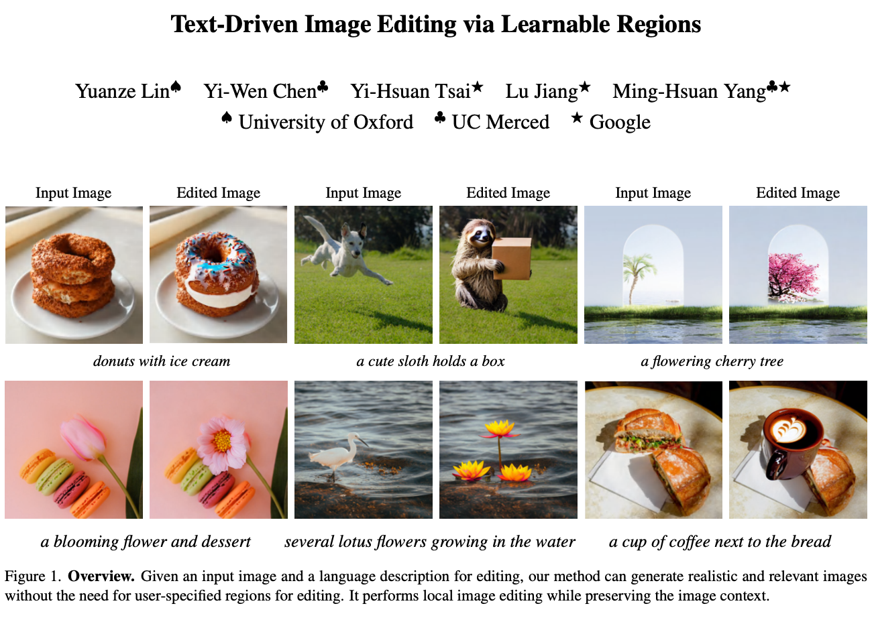
Outlines:
Introduction & Motivation
Method
Experiment
Reproducing Result
Computer Science Department

Slide 3
Introduction and Motivation
Realistic Image Editing Via Text:
Mask-based Approaches
Their Gap:
Laborious
Low user experience
Mask Free Approaches
Their Gap:
The precision of editing relies on accuracy of detailed mask at pixel level
Local modifications come into a headache (when dealing with less accurate mask)
Most current models work with pixel-mask, while some models like MUSE only use box-like mask
Authors’ Aim:
Introducing a component that enables the existing pre-trained mask-based model perform mask freely by incorporating this component (learnable region).
Computer Science Department

Slide 4
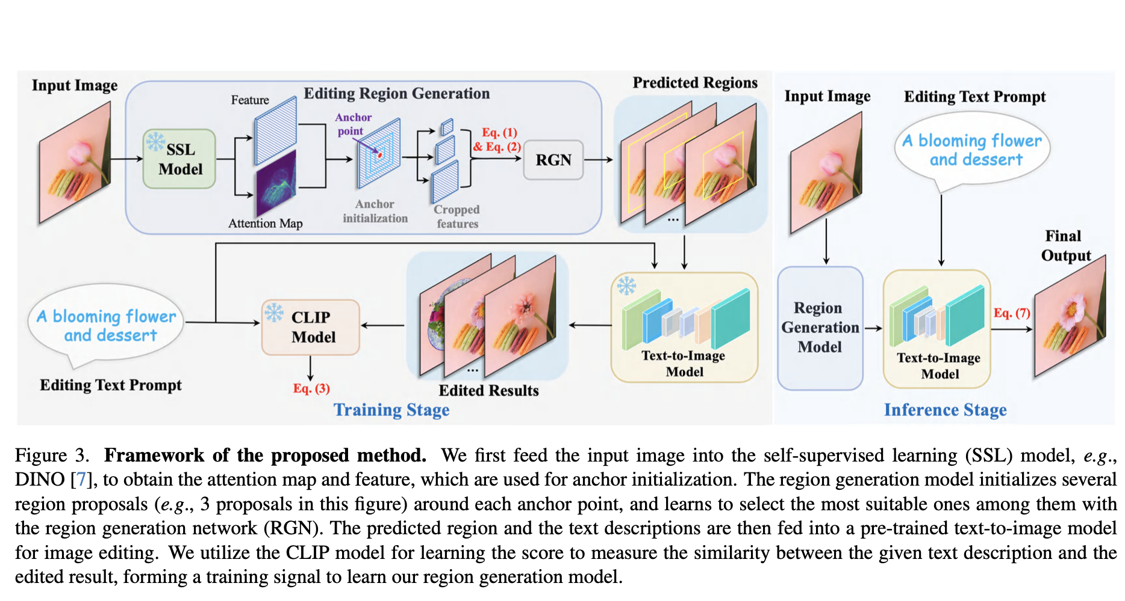
Method
Training:
Step 1: Feature Extraction
Input image is processed through a self-supervised learning model (e.g., DINO).
Outputs include an attention map and features for anchor initialization.
Step 2: Region Proposal
Region generation model initializes multiple proposals (e.g., 3 proposals per anchor).
Region Generation Network (RGN) selects the most suitable region.
Step 3: Image Editing
Selected regions and text descriptions are fed into a pre-trained text-to-image model.
Model performs image editing based on the input.
Step 4: Similarity Scoring
CLIP model measures similarity between the text description and the edited image.
The similarity score serves as the training signal for optimizing the region generation model.
Computer Science Department

Slide 5
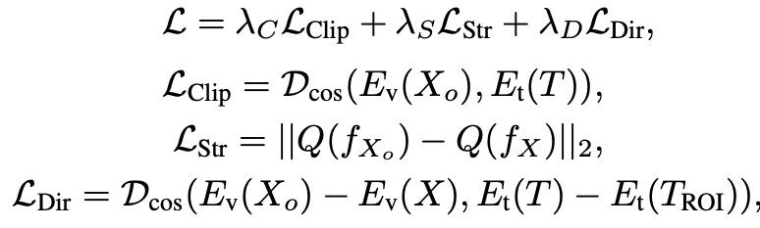
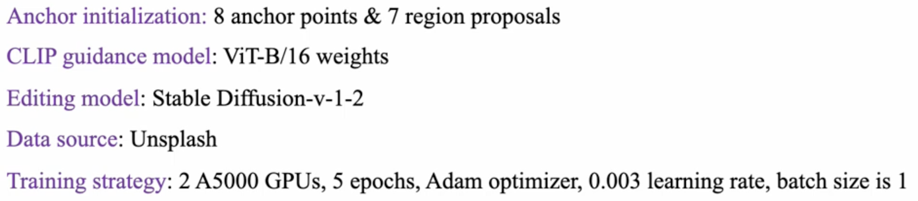
Method
Training:
Step 1: Feature Extraction
Input image is processed through a self-supervised learning model (e.g., DINO).
Outputs include an attention map and features for anchor initialization.
Step 2: Region Proposal
Region generation model initializes multiple proposals (e.g., 3 proposals per anchor).
Region Generation Network (RGN) selects the most suitable region.
Step 3: Image Editing
Selected regions and text descriptions are fed into a pre-trained text-to-image model.
Model performs image editing based on the input.
Step 4: Similarity Scoring
CLIP model measures similarity between the text description and the edited image.
The similarity score serves as the training signal for optimizing the region generation model.
Training Objective:
Training Setting:
Computer Science Department

Slide 6

Method
Inference:
Define a quality score to rank generated images.
Coefficients α and β control the influence of St2i and Si2i. Set α=2 and β=1 to prioritize faithfulness to text descriptions.
Use features from the last layer of CLIP encoders for similarity calculation. The image with the highest score S is selected as the final output for the user.
Computer Science Department

Slide 7

utsa.edu
Notes:
Add icons for each department.

