Slide 1
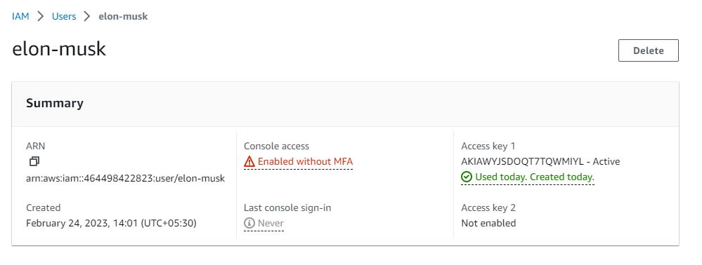

Slide 2

Login

Slide 3
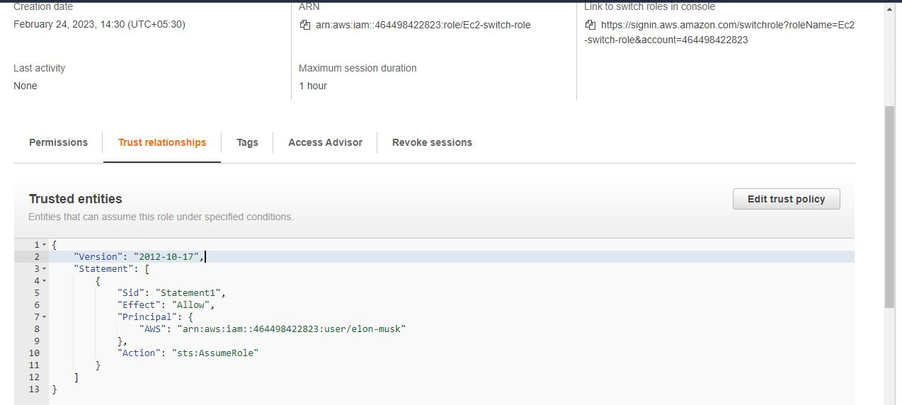
Trust Policy

Slide 4
Output

Slide 5
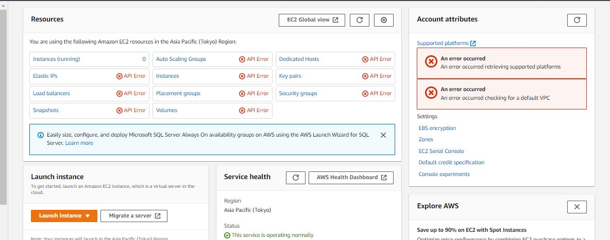
Before role switch

Slide 6
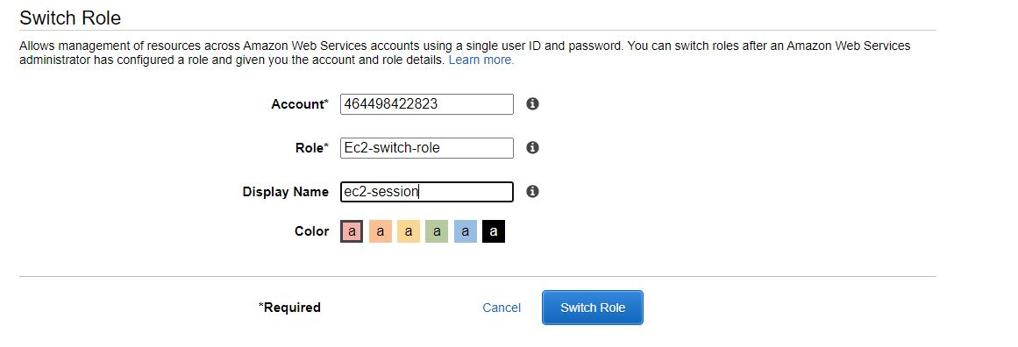
Switching role

Slide 7
Switching role

Slide 8
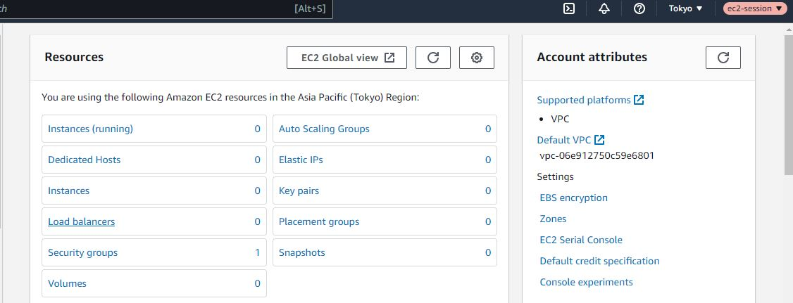
After role switch

