Slide 1


Roe
Nandalala
111719039152(DMCA)

Slide 2
Contents
Abstract
Introduction
Categories
Website URL
Screenshots
Software requirements
Hardware requirements
Languages and frameworks used.
References

Slide 3
Abstract
Roe is a news articles website where you find the news happening around the world.
Articles are taken from various sources depending upon the relevancy.
This site will give you day-to-day current affairs.

Slide 4
Introduction
This is a rest-api project where you get data source from from one site that is delivered to clients.
You will find the variety of newsarticles like business, entertainment, sports etc..
The news articles are updated time to time and does not remain the same.
Thumbnail, Title, ArticleURL, Published time and Source are the salient features of each article.

Slide 5
Categories
Top Headlines
Business
Entertainment
Technology
Health
Science
Science
Sports
Search Engine

Slide 6
Website URL
https://yourroe.herokuapp.com/

Slide 7
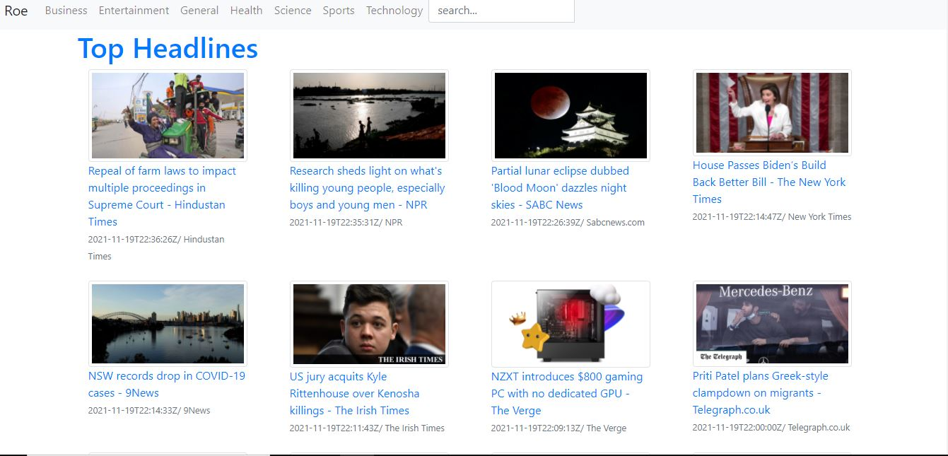
Top Headlines

Slide 8
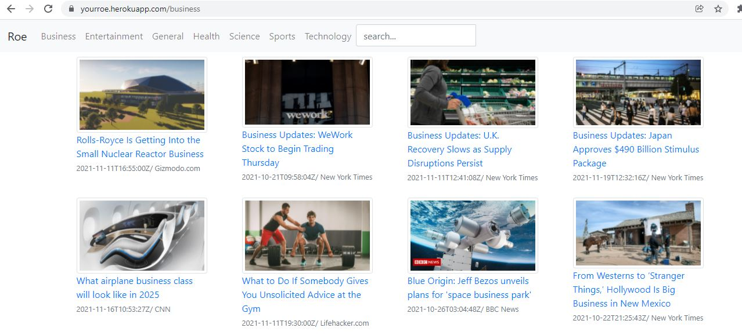
Business

Slide 9
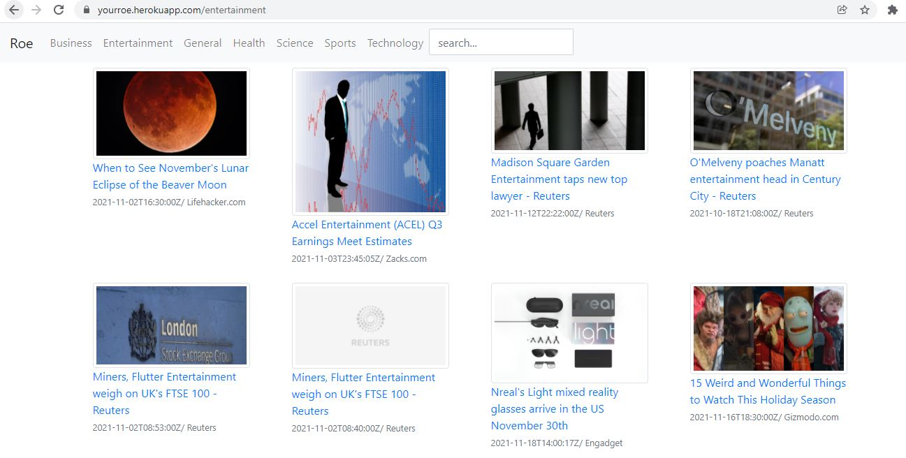
Entertainment

Slide 10
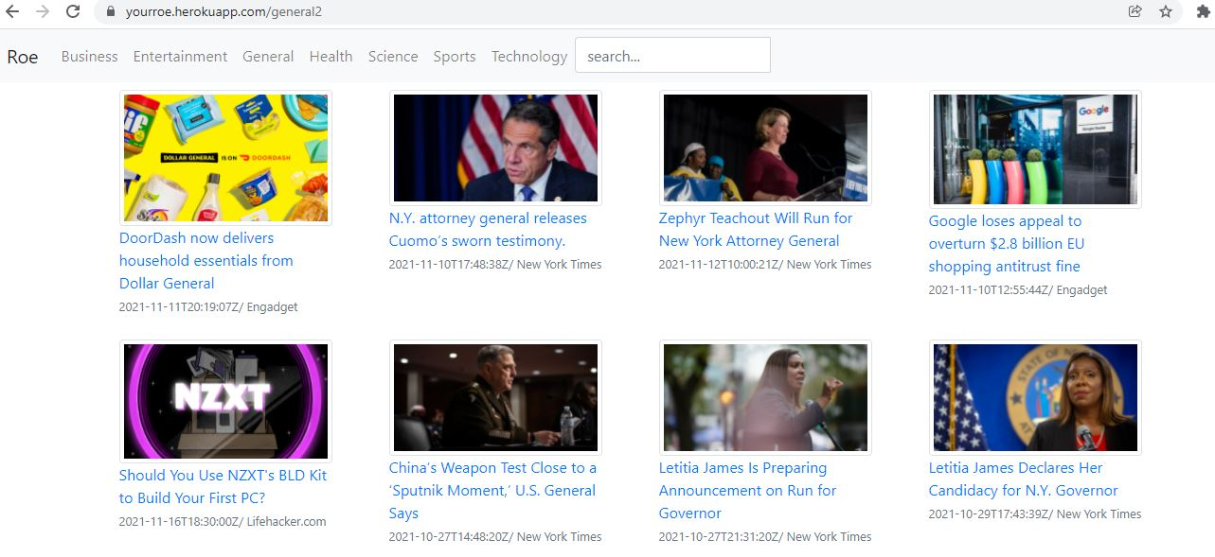
General

Slide 11
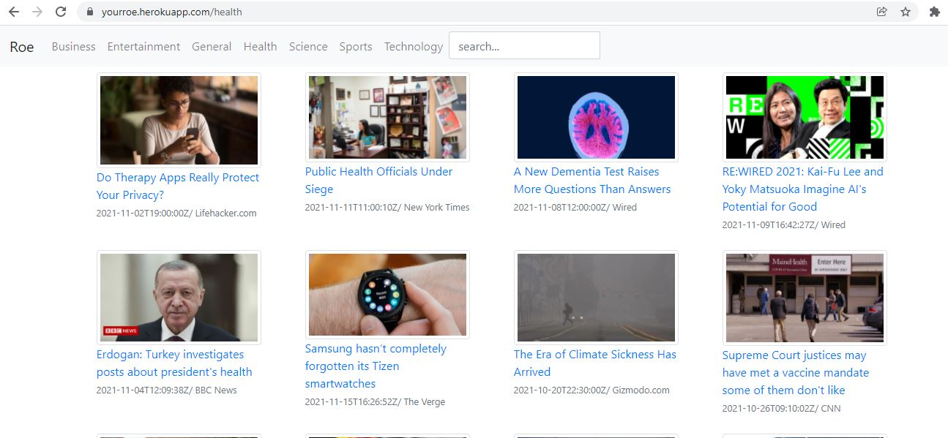
Health

Slide 12
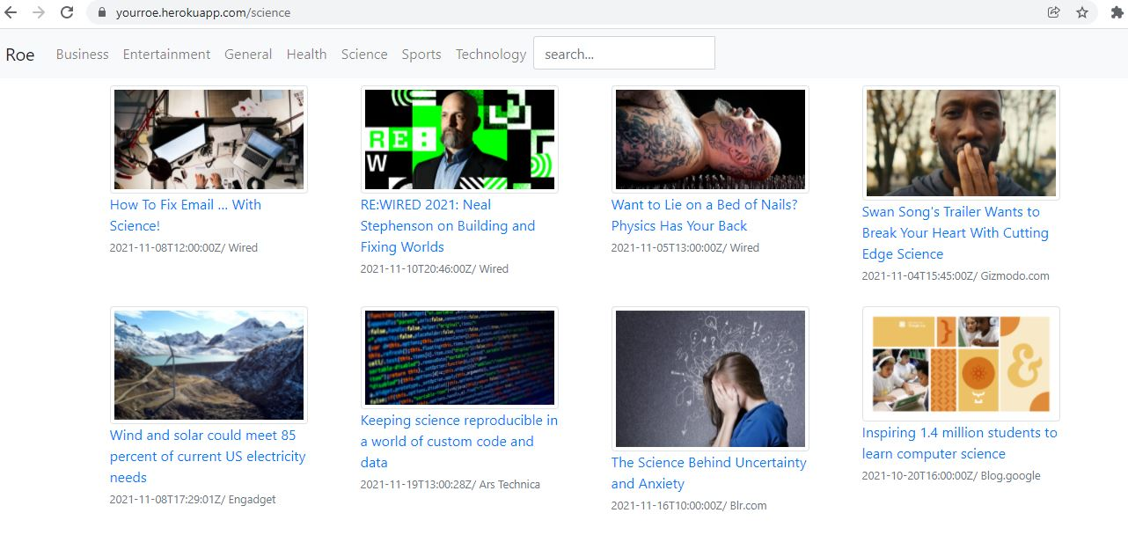
Science

Slide 13
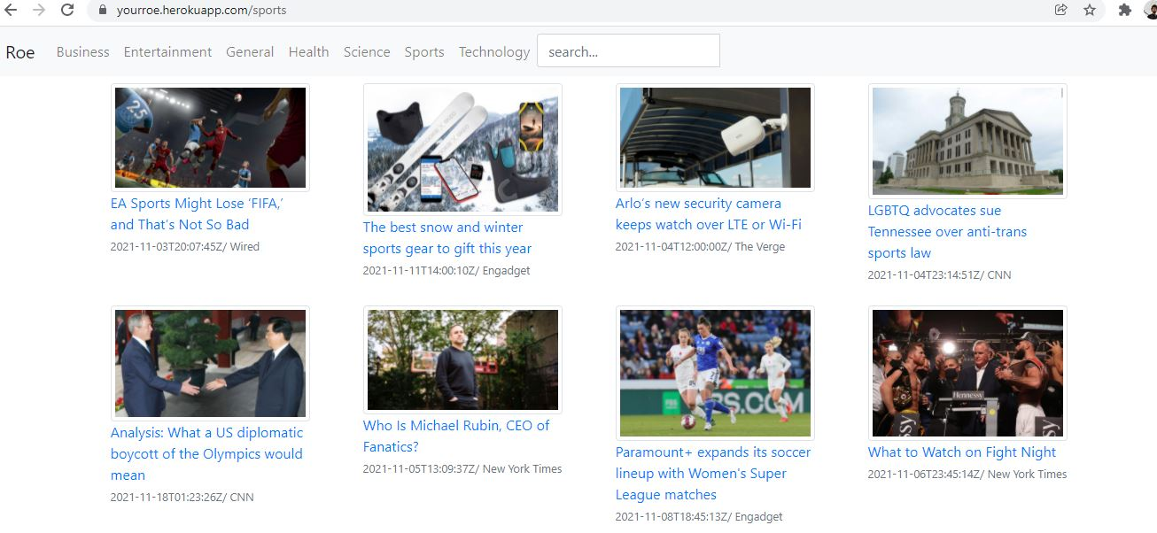
Sports

Slide 14
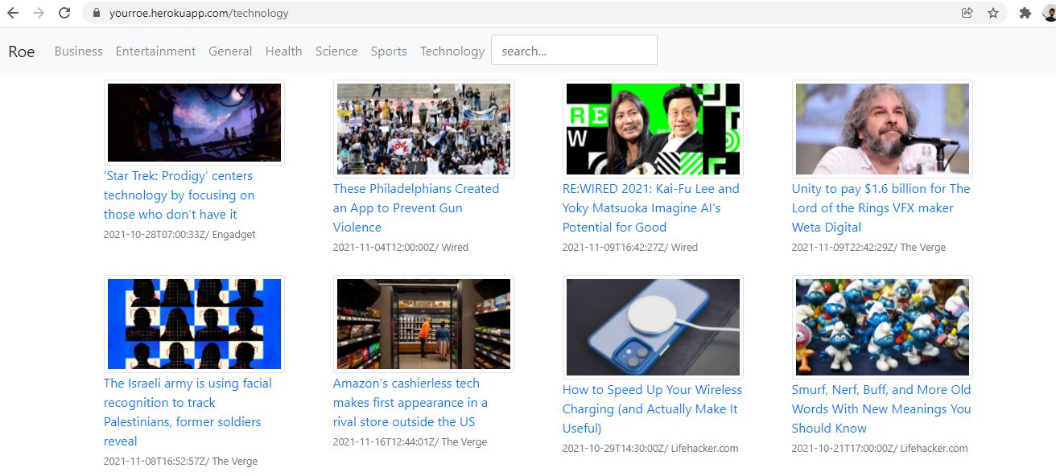
Technology

Slide 15

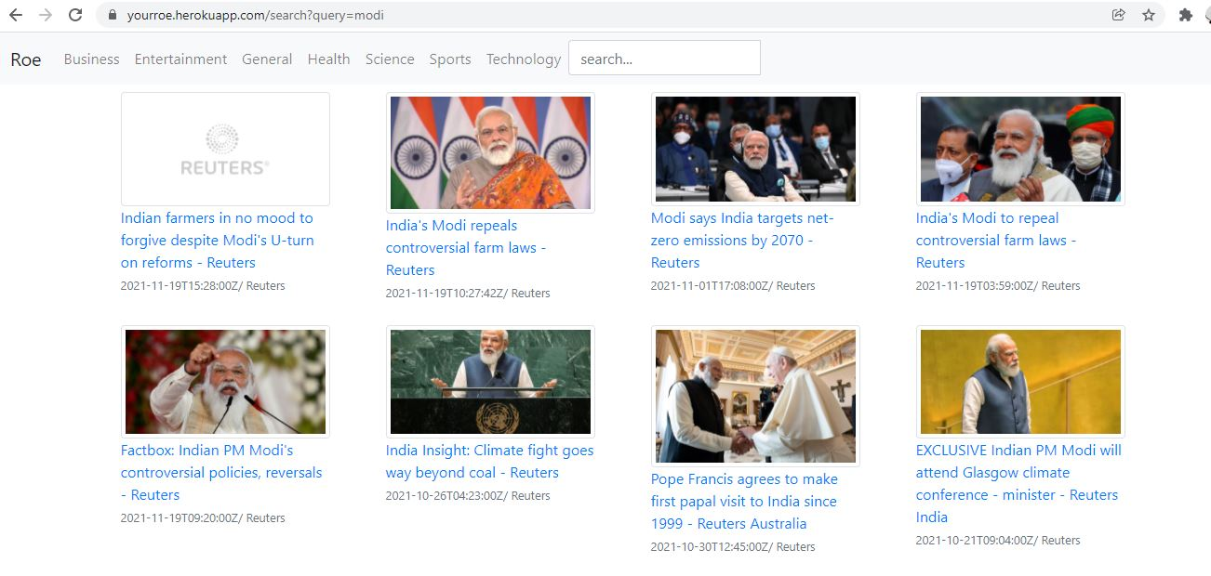
Search Engine

Slide 16
Software and Hardware requirements
4 GB RAM
Processor:Intel(R) Core(TM) i3-8130U
OS:Ubuntu 19.04 LTS

Slide 17
Languages and frameworks used.
Python
Django(backend)
HTML and Bootstrap
References
newsapi.org
youtube (netninja and corey schfar)

Slide 18
Thank You

