Slide 1

Polar Graph
Nour El Dine Morsy - Mohamed Sameh - Nada Samir
Arab Academy for Science and Technology
College of Artificial Intelligence
Supervised By: Eng Osama Hesham

Slide 2
Content
Introduction
Project goal
Project components
Design
Program software code
Applications
Life Demo
Conclusion

Slide 3
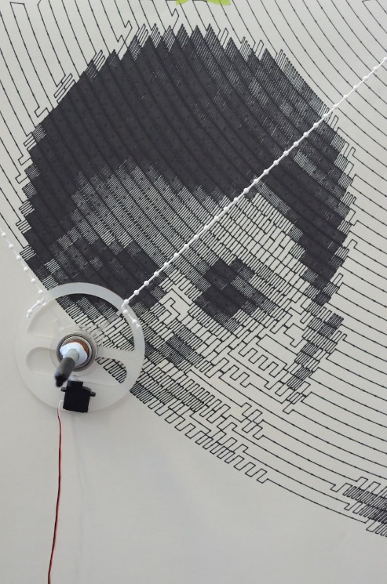
Introduction
Polar-graph is capable of drawing on any surface.
Software image to be stimulated.
Algorithm generates control signals to desired position.
Electric motors generates discrete angular movement to get to the position.
Movement of the belt attached with the motors.
Drawing image we wanted to stimulate

Slide 4
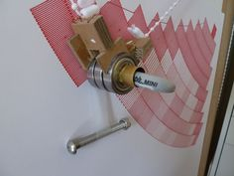
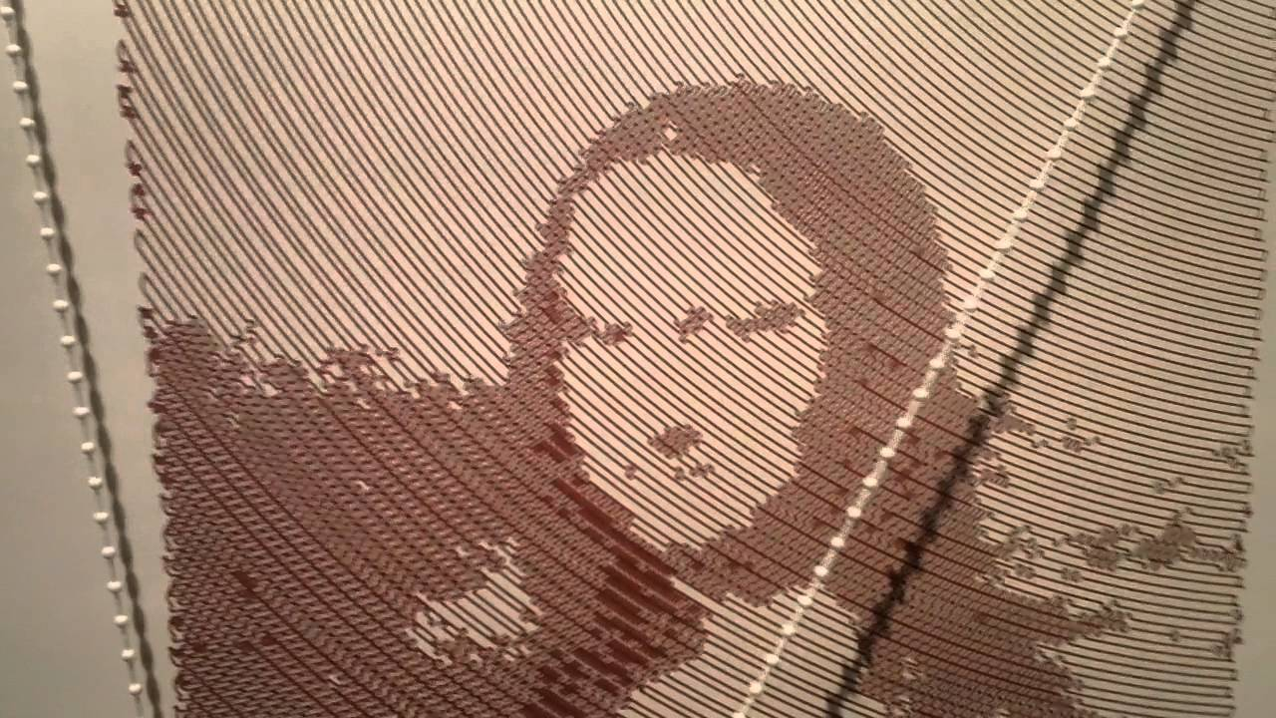
Project goal
Creates artistic, high resolution drawings over large areas ( distinguishing feature).
Helps Engineers and Artists.

Slide 5
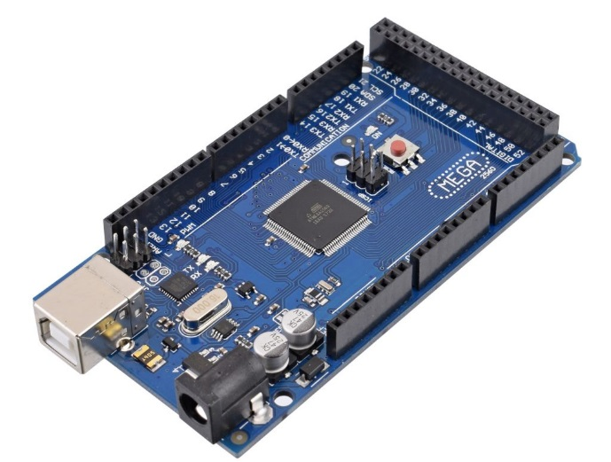
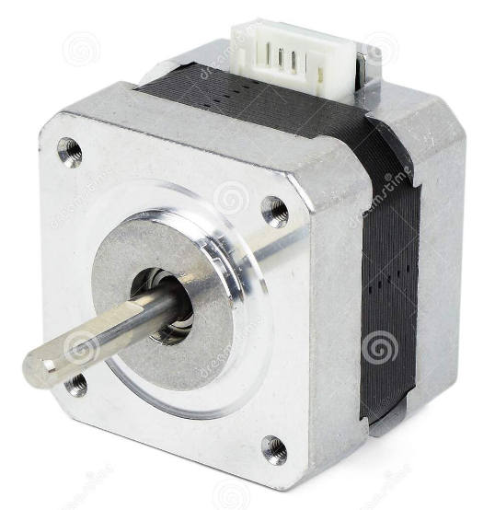
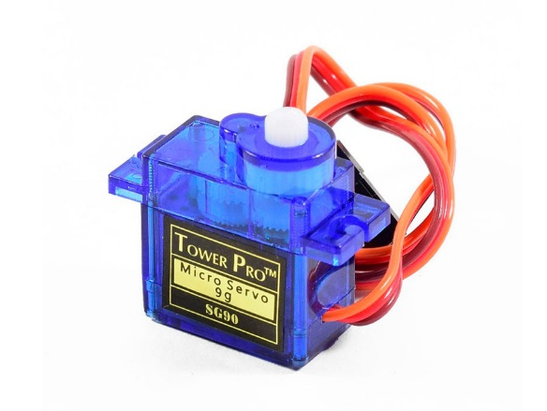
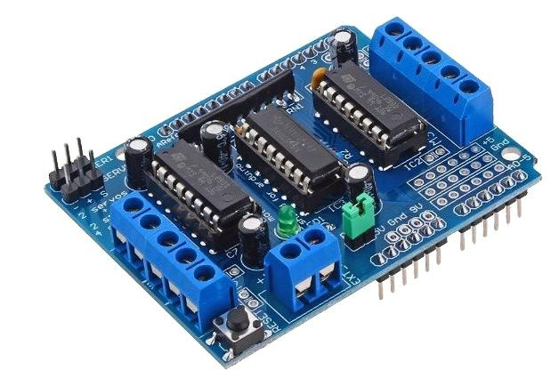
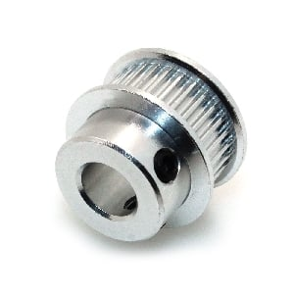
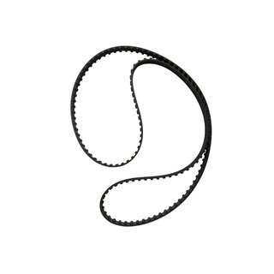
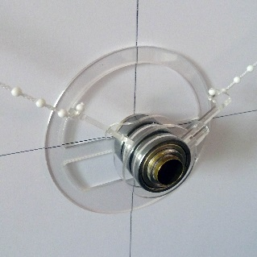
Project components
Microcontroller (Arduino)
Stepper
Servo
Motor Shield
Teeth
Belt
Gondola & Brackets

Slide 6
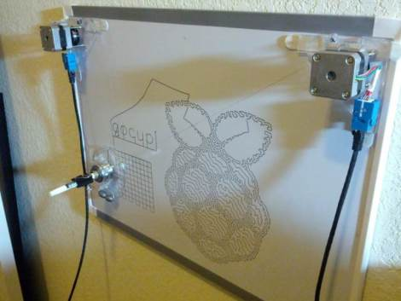
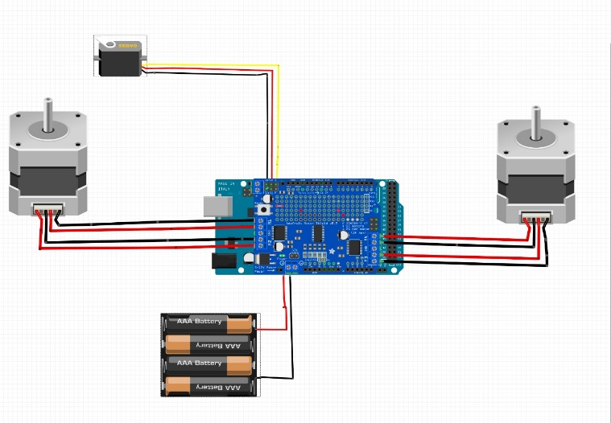
Design
Used 2 bipolar stepper motors.
The pen is hanged by GT2 timing belt attached to teeth.
Stepper motors connected to an Arduino using stepper motor driver l293d.

Slide 7
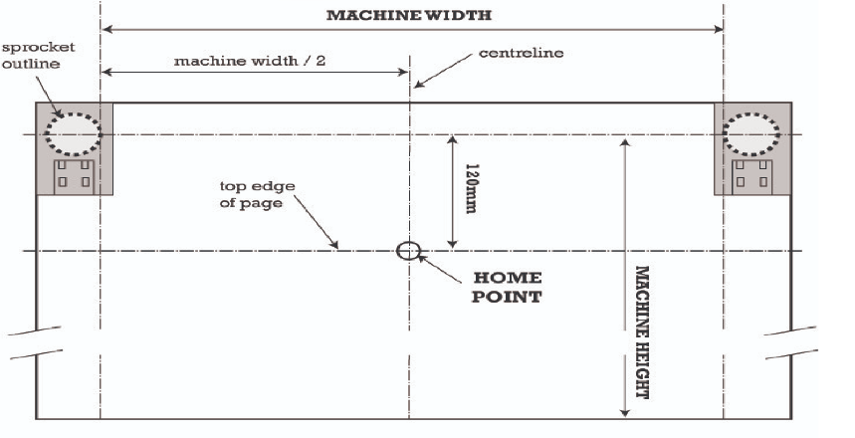
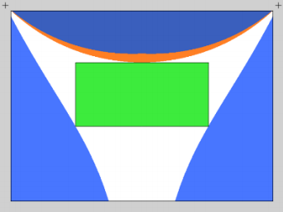
Hardware Design
Entering machine variables:
Machine height
Machine width
Home point
Stepper specifications
Degree of rotation to desired position is calculated
The device has to maintain, between the drawing area and machine size.

Slide 8
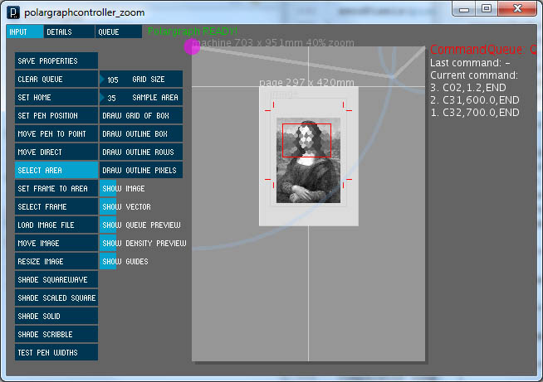
Processing program
Stimulates the image
Segmenting lines
Calculating the angle expected to get
Sending calculated coordinates to micro-controller

Slide 9
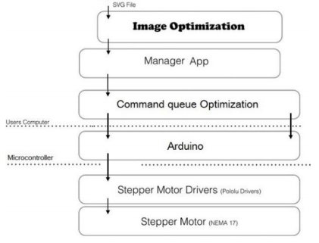
Phases of optimization
First phase: stippling input image using Lloyd’s algorithm getting SVG Format.
Second phase:
Stippling and TSP solver algorithm to obtain optimized vector path.
The core software “processing” )converts SVG image to G-code), maps positions, and generates the necessary stepper commands`.
Third phase: greedy algorithm to reorder drawing plan (command queue) and remove duplicate glyphs.

Slide 10
SVG format
Software Vector Graphics Format:
Mathematical equations, to draw images, that are translated into points.
Points are connected by lines or curves (vector paths)
Able to be scaled and manipulated at any size with clarity.

Slide 11
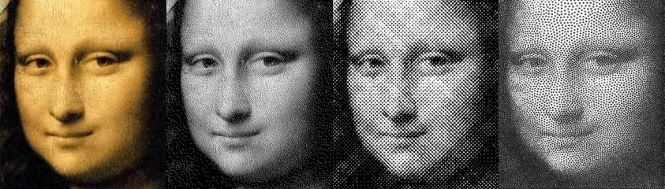
Gray scale
Drawing more stipples in darker regions of the image and fewer where the image is lighted.
An image's grayscale tonal quality is reproduced by drawing.

Slide 12
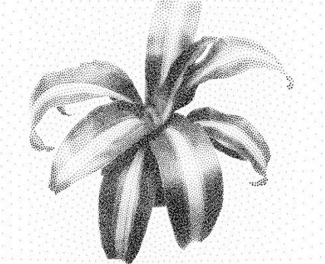
Phase 1: Stippling & vector path
Stippling is the production of continuous graduations of light and shade through the use of small, discrete dots or strokes:
Algorithm: Lloyd’s method

Slide 13
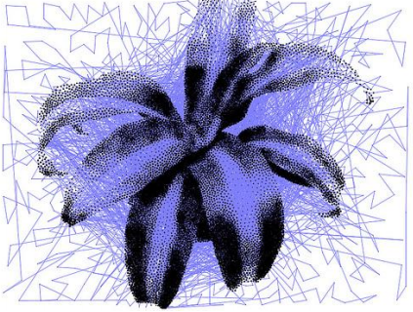
Phase 1: Stippling & vector path
Vector path generated by connecting all of the dots in a stipple diagram.
Vector paths are very efficient as they create an end-to-end path with a definite start point and endpoint.
Algorithm: “nearest neighbour” path selection which create extensive duplicate paths.

Slide 14
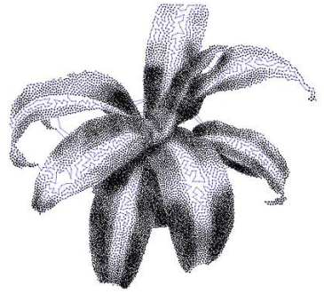
Phase 2: TSP solver
TSP or travelling salesman solver calculates an optimal route that visits each stipple exactly once and then returns to the starting point.
Drawing continuous paths, and preferably as few distinct paths as possible
The core software is used to create the corresponding stepper commands and are store in a queue.

Slide 15
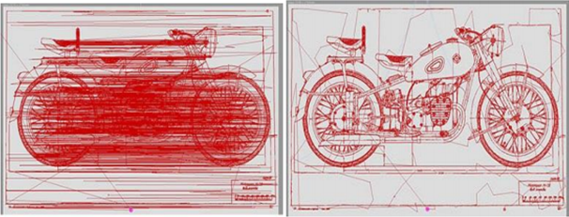
Phase 3: Path Optimization
A greedy algorithm is used to remove redundant glyphs and optimize the drawing plan.
By removing a node, if a Pen lift or pen down operation can be eliminated to generate a shorter path.
The reordered stepper commands are sent serially over to the Arduino for execution.

Slide 16
Program software code
Libraries used:
ControlP5: used in serial communication between processing program and Arduino.
Geomerative: used in displaying shapes as curves, lines, …, etc. in processing program.
Diewaldcv kit: computer vision libraries using in mapping movements by TSP and greedy algorithms.
Source code:
https://github.com/euphy/polargraphcontroller/releases/tag/2017-11-01-20-30

Slide 17
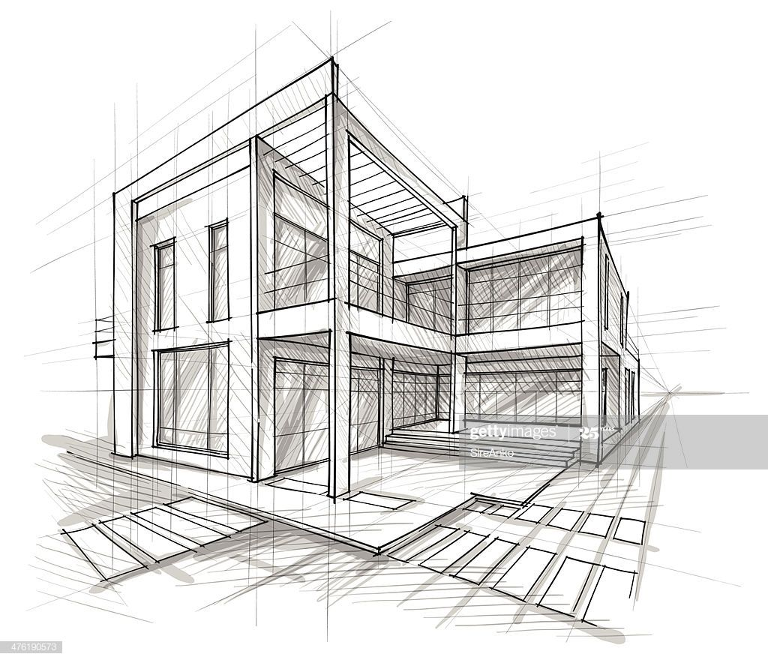
Applications
Variety of applications due to its scalability
Architectural drawings.
Maps.
Large signs or POP advertisements in shops and supermarkets.
Art gallery prints or large photographs.

Slide 18
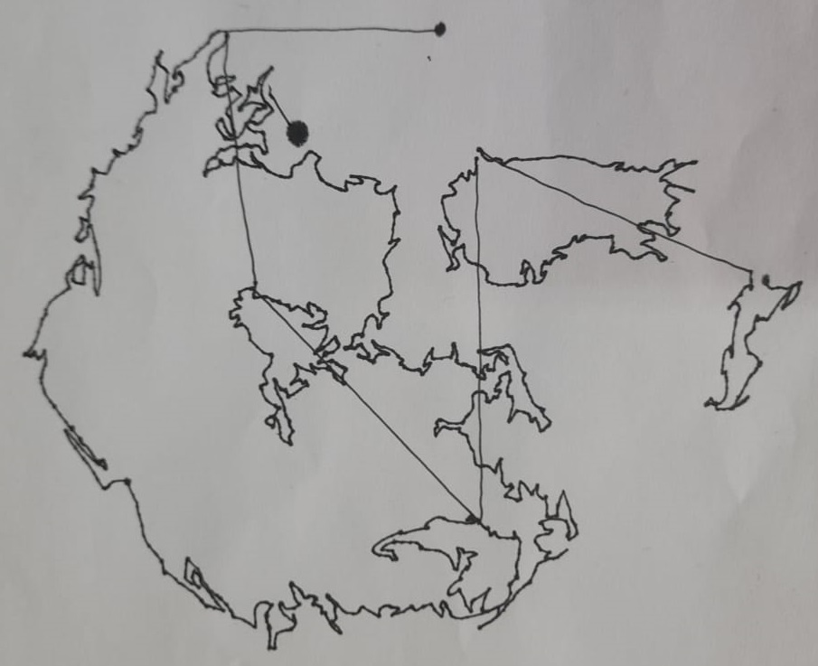
Life Demo

Slide 19
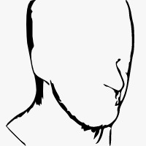
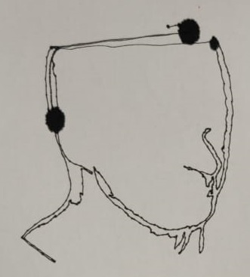
Life Demo

Slide 20

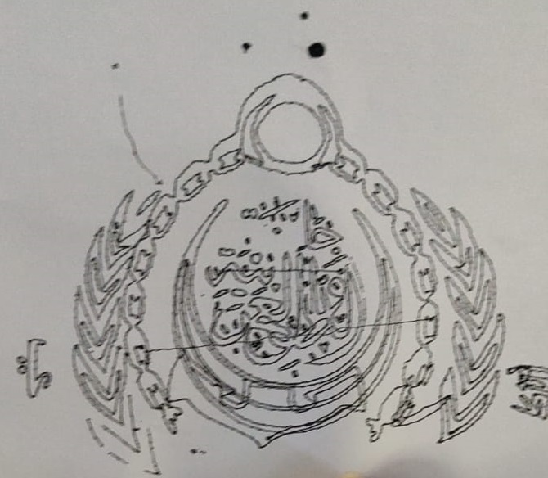
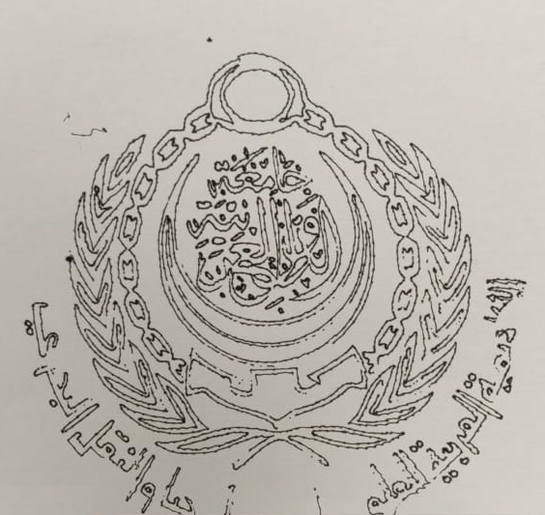
Life Demo

Slide 21
Conclusion
Results show up to a 5 times reduction in plotting time than normal plotting when implementing these algorithms.
In future, the technique can be built on a cloud machine with great computational capabilities, so vertical plotters could replace many other drawing machines.

Slide 22
Thank you
Any questions?

