Slide 1
Introduction to Data Analysis Using R
Nafiseh Sedaghat
PhD student School of Computing Science
nf_sedaghat@sfu.ca

Slide 2

Introduce yourself ☺
What is your name?
What do you study?
What is your field of research?
Are you familiar with R programming?
Why are you here?
etc.

Slide 3

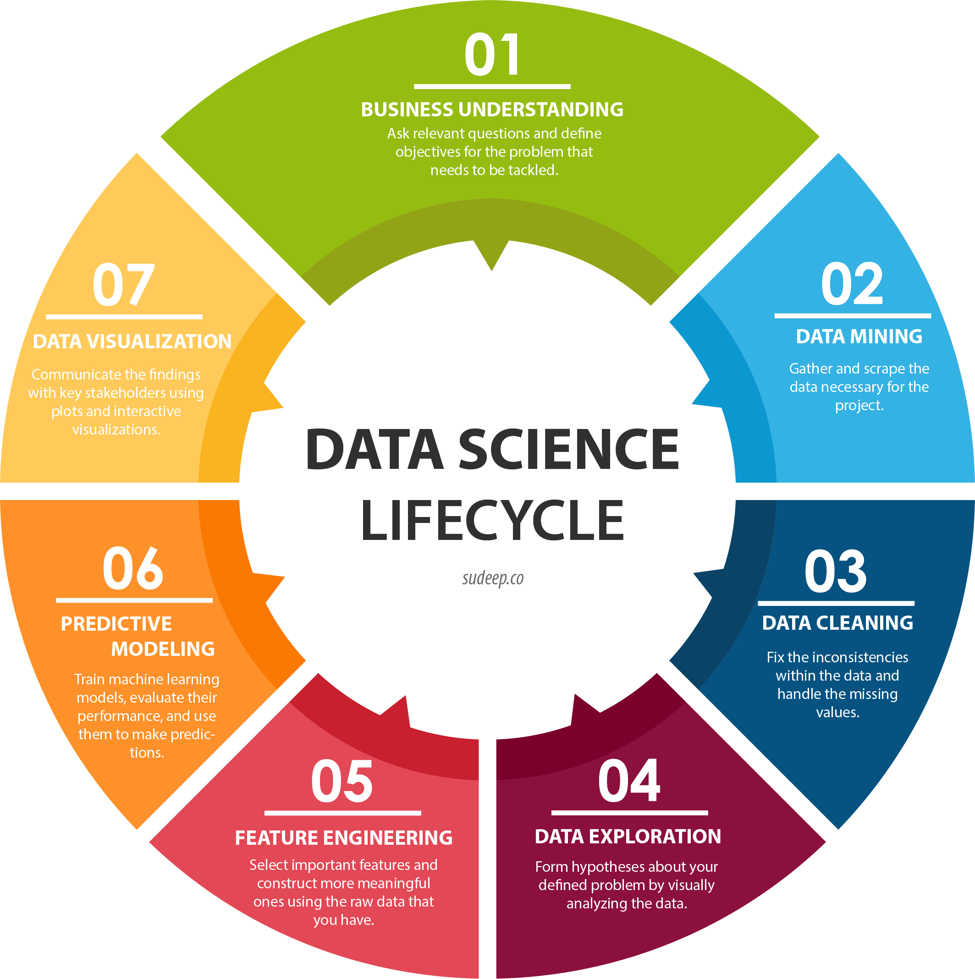
Data Science Lifecycle

Slide 4

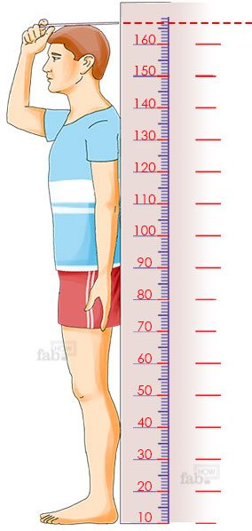
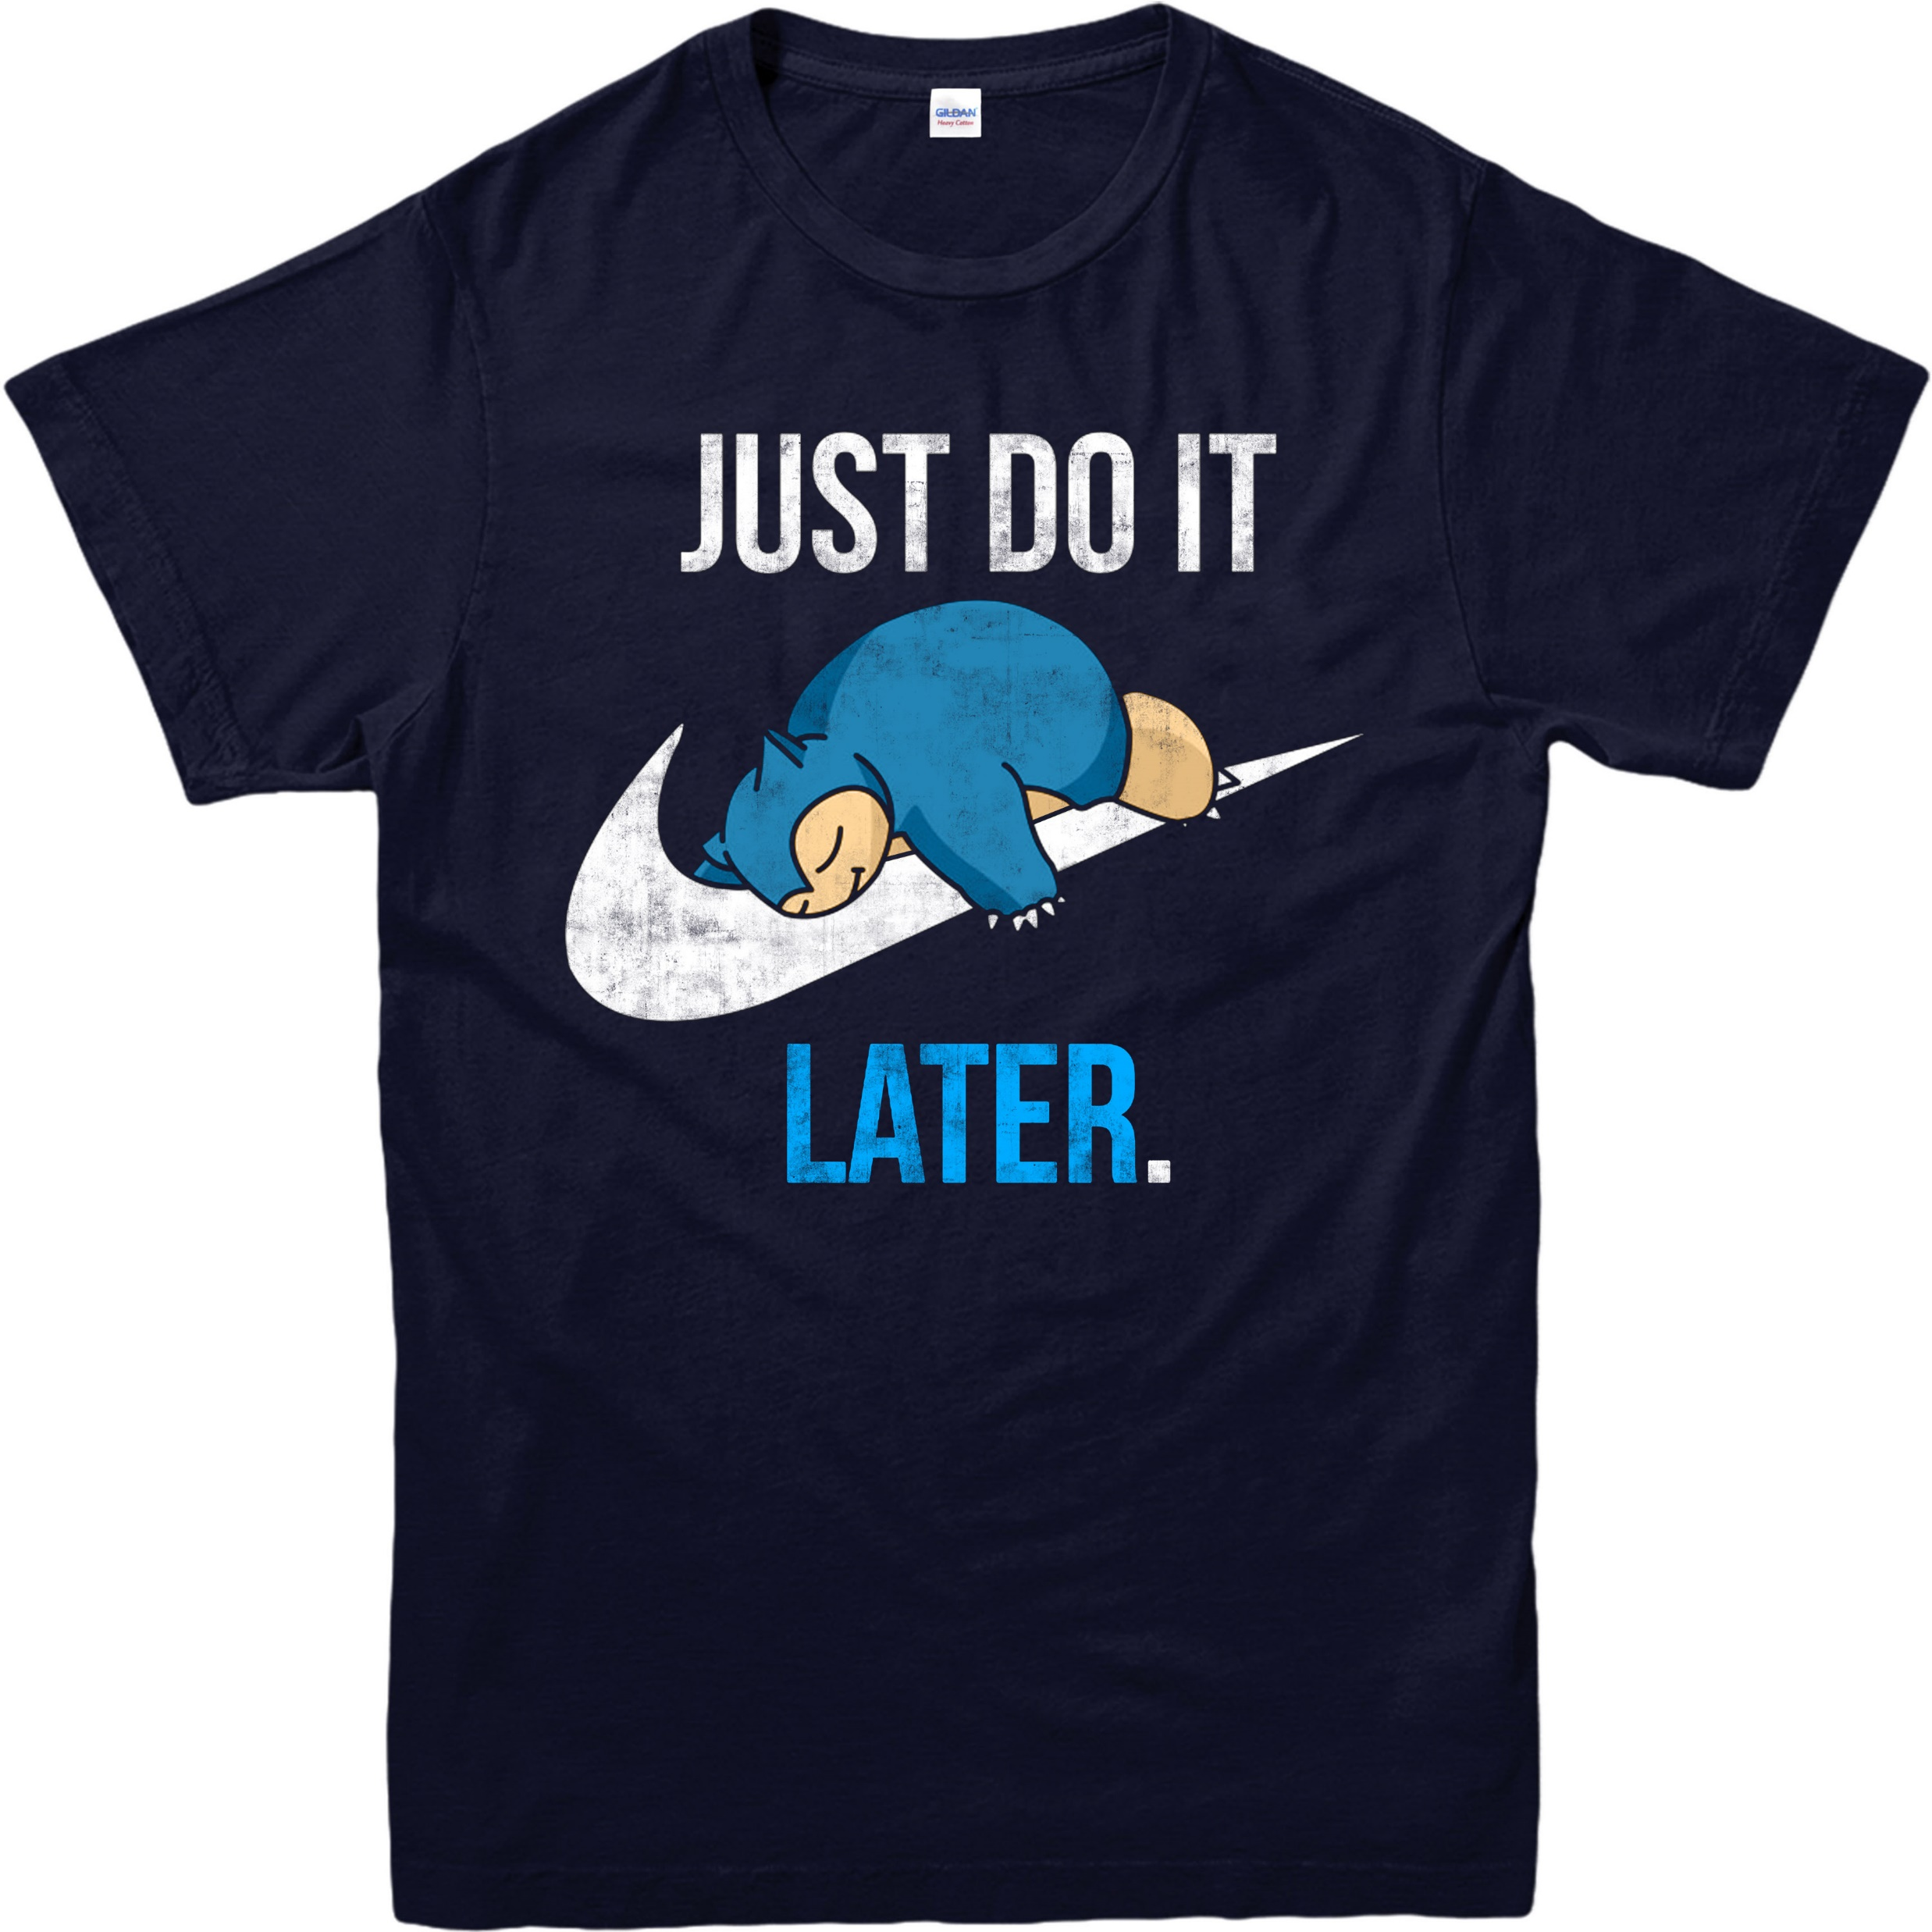
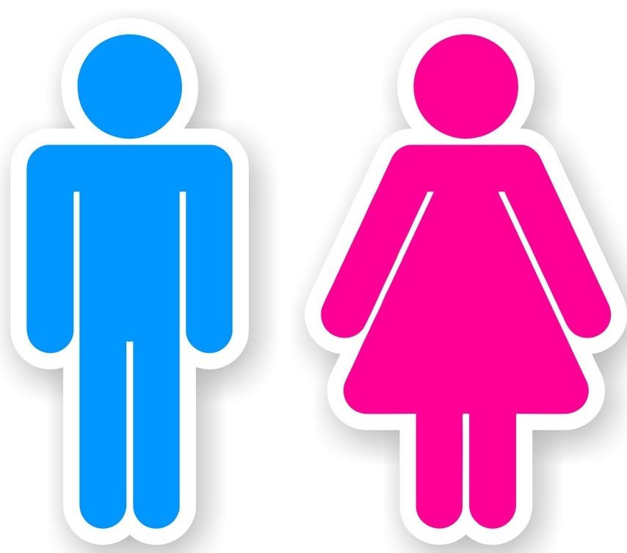
Types of Data
Numerical data or quantitative data
= numerical values
Categorical data or qualitative data
= categories
Discrete data
Continuous data
Nominal data
Ordinal data
If you can count it, then it is discrete
If you can measure it, then it is continuous
If you can brand it, then it is nominal
If you can order or rank it, then it is ordinal
Gender
Types of movies
 X-Small
 Small
 Medium
Large
 X-Large
 Comedy
Romance
Drama
 Action

Slide 5
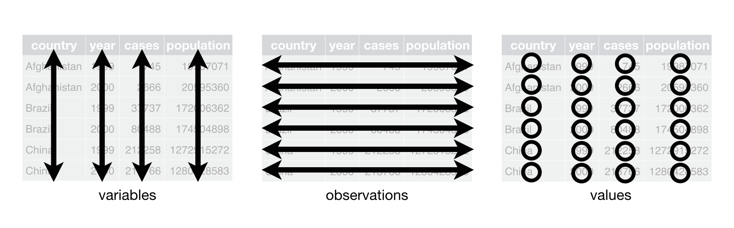
Data shape

Slide 6
Data Cleaning
Data in the real world is dirty
No quality data, no quality mining results!
incomplete: missing values, lack of certain attributes of interest, or containing only aggregate data
e.g., occupation=“-”
noisy: containing errors or outliers
e.g., Salary=“-10”
inconsistent: containing discrepancies in codes or names
e.g., Age=“42” while birthday is “03/07/1997”
e.g., Was rating “1,2,3”, now rating “A, B, C”

Slide 7
Data Exploration
The data exploration stage is like the brainstorming of data analysis. This is where you understand the patterns and bias in your data.
It could involve pulling up and analyzing a random subset of the data, plotting a histogram or distribution curve to see the general trend.
Notes:
In statistics, exploratory data analysis (EDA) is an approach to analyzing data sets to summarize their main characteristics, often with visual methods.

Slide 8
Data Exploration- Example
Problem: Find the variables which best predict the tip that a dining party will give to the waiter.
The variables available in the data collected for this task are:
the tip amount,
total bill,
payer gender,
time of day,
smoking/non-smoking section,
day of the week, and
size of the party.

Slide 9
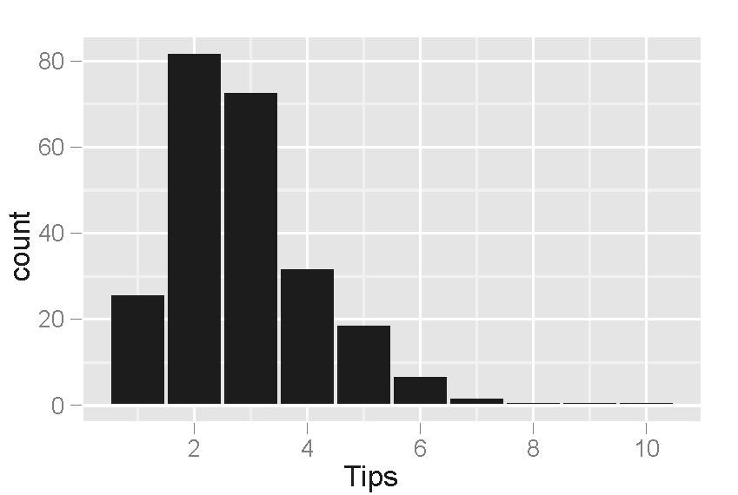
Data Exploration- Example
Histogram of tip amounts where the bins cover $1 increments.

Slide 10
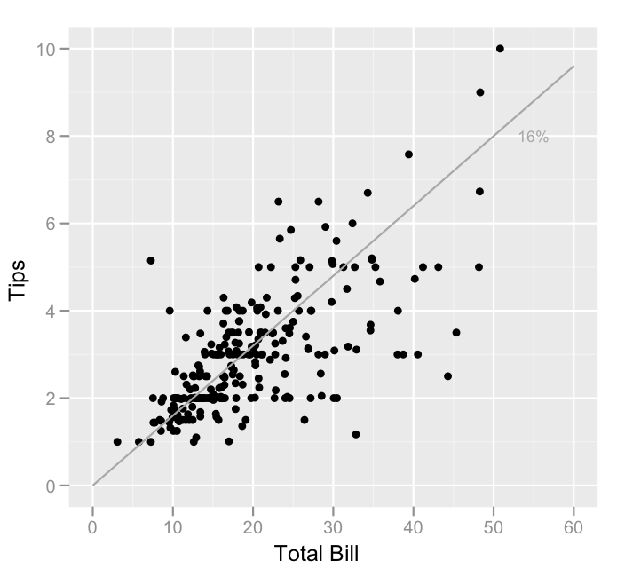
Data Exploration- Example
Scatterplot of tips vs. bill. Points below the line correspond to tips that are lower than expected (for that bill amount), and points above the line are higher than expected.

Slide 11
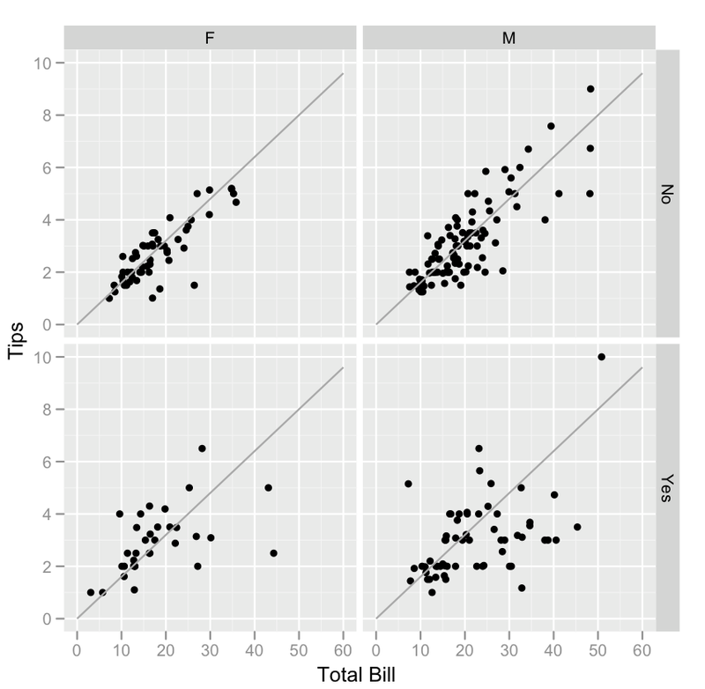
Data Exploration- Example
Scatterplot of tips vs. bill separated by payer gender and smoking section status. Smoking parties have a lot more variability in the tips that they give.

Slide 12
Feature Engineering
In machine learning, a feature (variable) is a measurable property or attribute of a phenomenon being observed.
Feature engineering is the process of using domain knowledge to transform your raw data into informative features that represent the business problem you are trying to solve.
This stage will directly influence the accuracy of the predictive model you construct in the next stage.

Slide 13
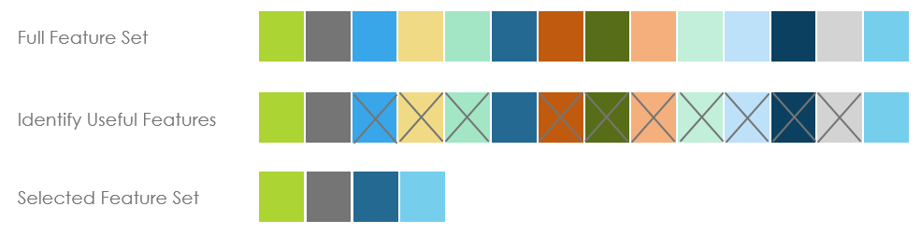
Feature Engineering
Feature Selection
Feature construction (extraction)
It is the process of cutting down the features that add more noise than information.
It involves creating new features from the ones that you already have (and possibly ditching the old ones) to increase the predictive power of the learning algorithm.
Gender | Age | Age range | Genre of movies
M | 12 | Minor | Adventure
M | 67 | Adult | Documentary
F | 56 | Adult | Drama
F | 8 | Minor | Cartoon
F | 23 | Adult | Romance
M | 33 | Adult | Drama
Gender | Age | Genre of movies
M | 12 | Adventure
M | 67 | Documentary
F | 56 | Drama
F | 8 | Cartoon
F | 34 | Romance
M | 33 | Drama
Filter methods
Wrapper methods
Embedded methods

Slide 14
Predictive Modeling
Training a machine learning model
Evaluate the performance
Make predictions

Slide 15
Choosing a Model
Predictive modeling is where the machine learning finally comes into your data science project.
Based on the questions you asked in the business understanding stage, this is where you decide which model to pick for your problem.
This is never an easy decision, and there is no single right answer.
The model (or models, and you should always be testing several) that you end up training will be dependent on the size, type and quality of your data, how much time and computational resources you are willing to invest, and the type of output you intend to derive.

Slide 16
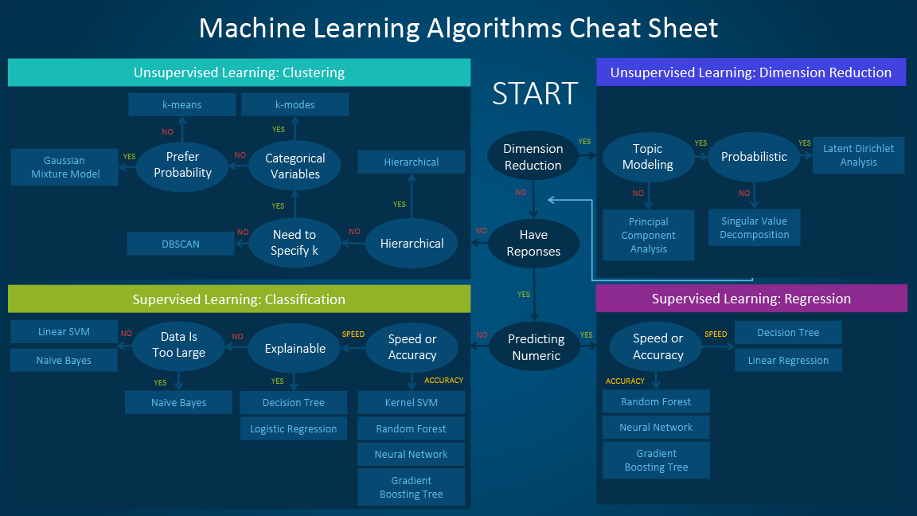

Slide 17
K-Fold Cross-Validation
Dataset
Training
Test
4-fold Cross-validation
Fold 1
Training
Validation
E1
Tuning model for different parameters
Fold 2
Validation
E2
Average
Fold 3
Validation
E3
Best model
Fold 4
Validation
E4
Final measure of performance
E

Slide 18
