Slide 1
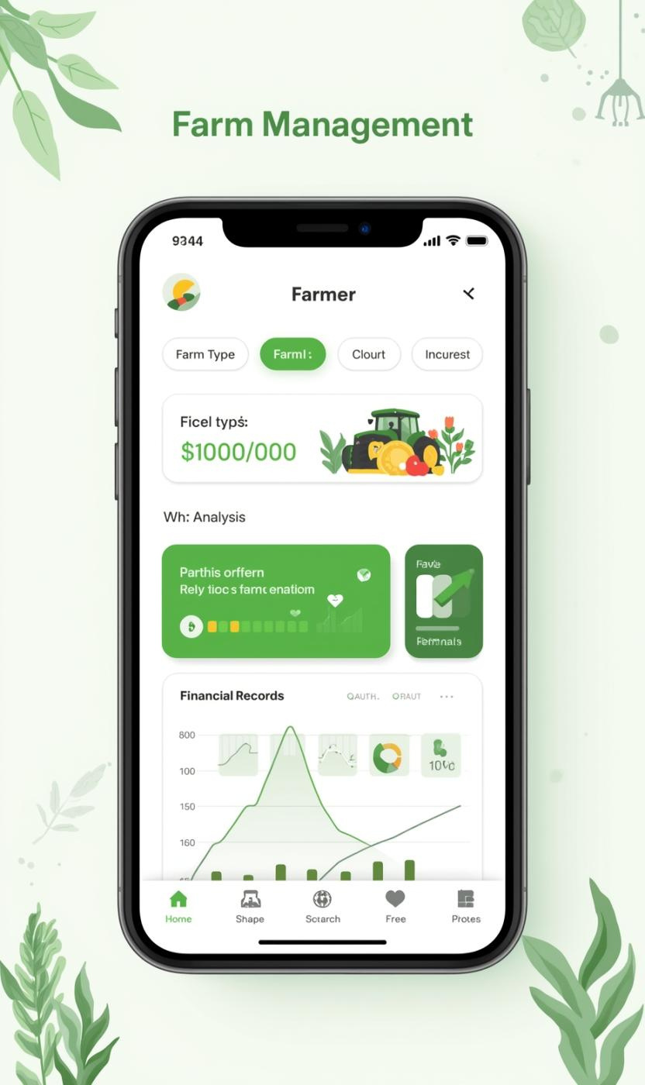
Digital Farm Management System
GROUP 1

Slide 2
Outline
Introduction
Problem Statement
Need Statement
Aims and Objectives
Conceptual Framework
Limitations
Future Improvements
Demo

Slide 3
Introduction
Agriculture is a key sector in Ghana’s economy
Many farmers rely on traditional knowledge rather than data
Lack of structured data reduces productivity and efficiency
Digital technologies are transforming agriculture globally

Slide 4
Problem Statement
Many farms lack a centralized inventory system to manage farm resources.
As a result:
Farm assets are poorly tracked
Input costs are not well recorded
Farmers cannot easily estimate farm value
Traditional inventory management is inefficient
Decision making becomes difficult

Slide 5
Need Statement
There is a need for a digital farm inventory system that can:
Track farm assets
Record farm inputs
Manage inventory efficiently
Calculate farm value and revenue
Provide a summary of farm resources
Such a system helps farmers make better management decisions.

Slide 6
Aims and Objectives
Aim of the Project
To design a Digital Farm Inventory Management System
Objectives of the Project
Record crops, animals, equipment, and farm inputs.
Allow adding, updating, and removing items.
Calculate asset values and operational costs.
Generate financial summaries of the farm.

Slide 7
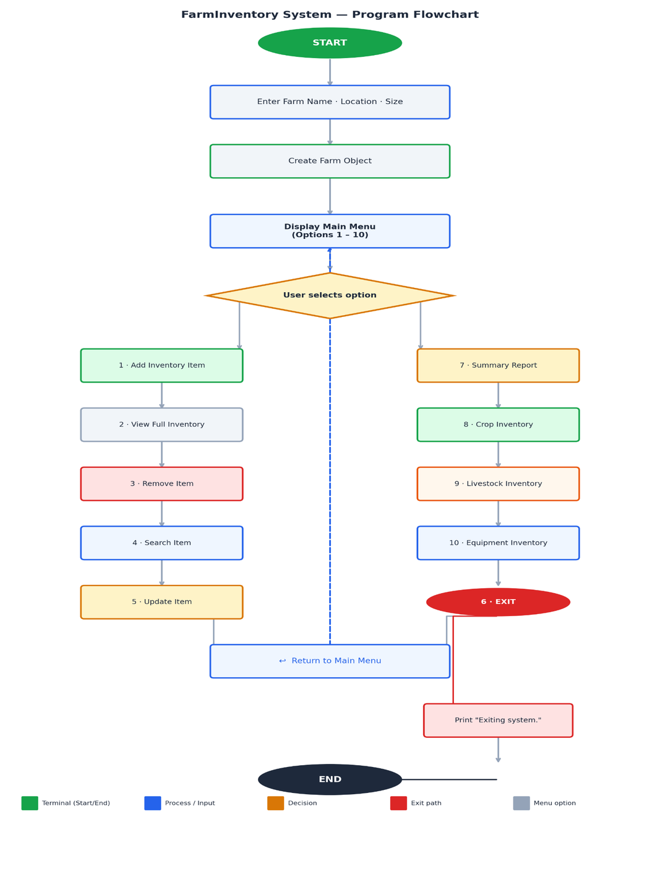
Conceptual Framework of DFMS

Slide 8
Main Interface of the Inventory System
Key features of the system
Add inventory items
Update items
Remove items
Display inventory report
Generate financial summary

Slide 9
Limitations
Requires basic computer literacy
Not yet connected to sensors
Data must be entered manually
Currently runs locally
Limited real farm dataset for testing

Slide 10
Future Improvements
Mobile application for farmers
Cloud database sensor integration
Transactional features
AI-based yield prediction
Multi-farm management

Slide 11
In Summary
The Digital Farm Inventory System provides a simple and effective way to manage farm resources.
It helps farmers:
Track assets
Monitor costs
Estimate farm value
Improve farm decision-making
This system can serve as a foundation for smart agriculture solutions.

Slide 12
Group Members
Henry Amoah
Edward Amenyaglo
Roseline Akrong
Priscilla Yayra Ewoade
Felicity Dugbazah

Slide 13
Thank you.

