Slide 1
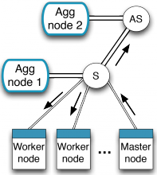

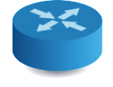



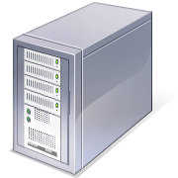



Network-as-a-Service (NaaS)
University of Cambridge
Imperial College London
University of Nottingham

Slide 2
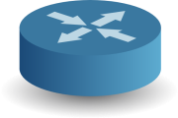
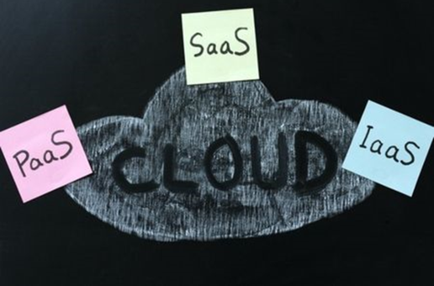
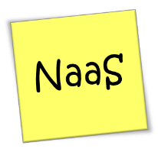
Problem Statement
Network is bound on
datacentre application
performance
Modern applications have complex network requirements

Slide 3
Challenges for NaaS
Performance:
Line rate data processing (10G initially)
Efficient use of network resources
Offload to hardware
Flexibility:
Very rapid development for new applications
Simple deployment, resource placement and resource allocation
Security:
Isolation of applications within shared hardware

Slide 4
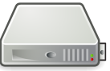


NaaS Vision
Switches / routers are increasingly becoming more programmable
NetFPGA, software routers, OpenFlow, …
“NaaS boxes” process data at line rate (10G) in network.
Exploits programmability for application-specific processing
E.g. in-network aggregation, caching, graph processing

Slide 5

NaaS box basics
NaaS box runs user-generated code for each application as “Task Processing Elements”.
Code written in our own domain-specific language compiled to efficient C++. Guarantee performance and application isolation.
Data enters “Task graph” for processing. NaaS box supports large numbers of simultaneous connections.

Slide 6
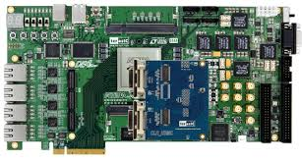
Hardware assisted NaaS box
Hard to get 10G line rate in software alone
Push certain features into hardware (NetFPGA)
NetFPGA as TCP endpoint and basic per app processing (e.g. serialisation/deserialisation)
Aids processing frees CPU cores for other compute tasks

Slide 7
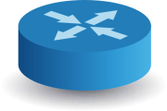



SDN controlled NaaS
SDN controller (initially OpenFlow) redirects app traffic via appropriate NaaS box
Directs queries to appropriate NaaS box for application
Balances both traffic and load on NaaS boxes
Distributed, reliable, application-aware SDN controller

