Slide 1
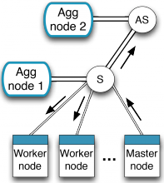





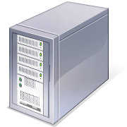



NaaS Box: Endpoint teleportation
University of Cambridge
Imperial College London
University of Nottingham
Funded by the UK Engineering and Physical Sciences Research Council (EPSRC)

Slide 2

© creativemarket.com

Slide 3


Slide 7




Slide 8



Goal: “Teleportation”
Less contention
Less latency

Slide 9
The Sorcerer’s Sandwich
Control
channel
S1
S2
Data channel
SWITCH
C

Slide 10
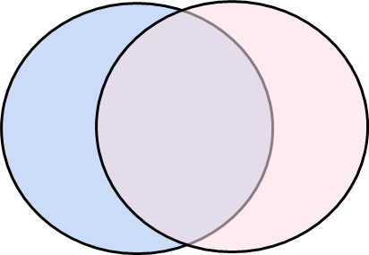
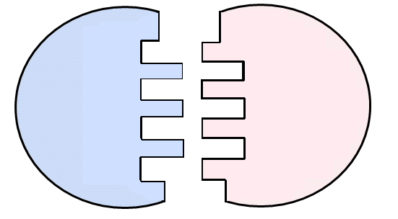
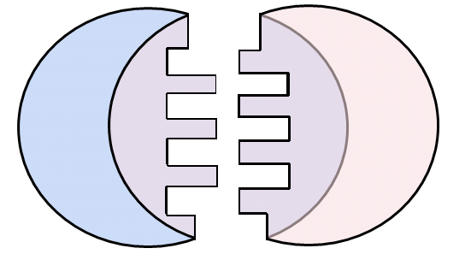
Goal: common source

Slide 11



Challenge of common source
Why is common code hard anyway?
Hardware is diverse.
Each variant has many positives…
NXP makes explicit the memory coherency
FPGA might be resource constrained but can be anything
x86 might have strong coherence models
ARM is super low power
switch fabric line-rate and lots of TCAM/CAM
GPU has lots of microengines (but strict memory models)

Slide 12

State of the art
EDSLs
Lava, Lambda-CCC, GenArrows, Clash, HardCaml, Chisel, …
BSV (Bluespec System Verilog)
not exactly common code
Kiwi (starting from C#/F#)
currently being rewritten into HardCaml
Other proprietary solutions (eg Vivado HLS) are useful for prototypes but ultimately strongly-coupled to combinations of tool-chain and hardware target.

Slide 13
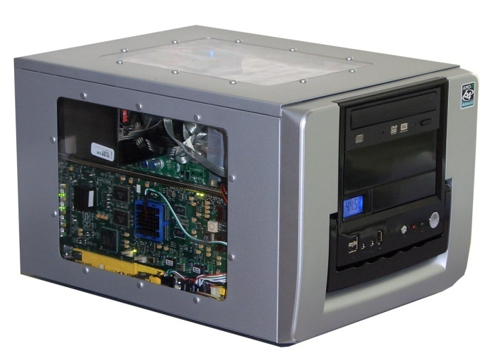
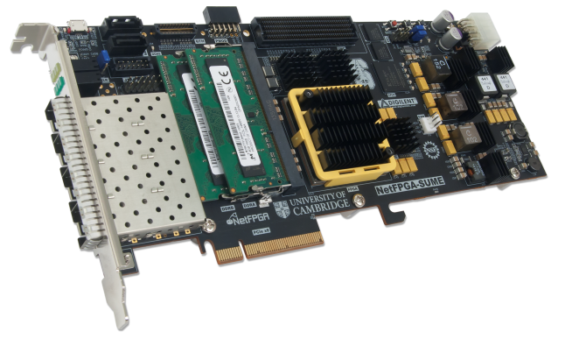
NaaS Box with NetFPGA
NaaS Box
running on a standard PC
CPU
Memory
PCI-e
PC with NetFPGA
A hardware accelerator
built with Field Programmable Gate Array driving 10GbE network links
10GE
FPGA
10GE
10GE
Memory
10GE

Slide 14
Challenges of the moment
Alongside developing the NaaS Box prototype and its programming model
We are developing:
1. DMA with SR-IOV support
2. Evaluation for session/endpoints in hardware
3. Virtualised channel support for programmable logic
Notes:
each can be brought out into a slide

Slide 15
1. DMA with SR-IOV support
High-performance DMA is highly needed for effective interaction between host and FPGA
Problem: Open cores for PCI-e / DMA is rare – it is hard to implement high-performance DMA
Open DMA core are needed for extensibility and community contributions
PCIe gen3 on x8 lanes supports up to 64Gbps, requiring careful HW design
Our approach: Writing open-sourced DMA & device driver
Full-line rate DMA w/ driver has been developed on NetFPGA 10G (gen1)
Kernel bypassing is supported for high-performance packet processing
DMA can be used not only for Ethernet, but also for general communication
Any data can be delivered between host and FPGA
Ongoing work
Supporting PCIe gen3 and SR-IOV on the new generation of NetFPGA (SUME)

Slide 16
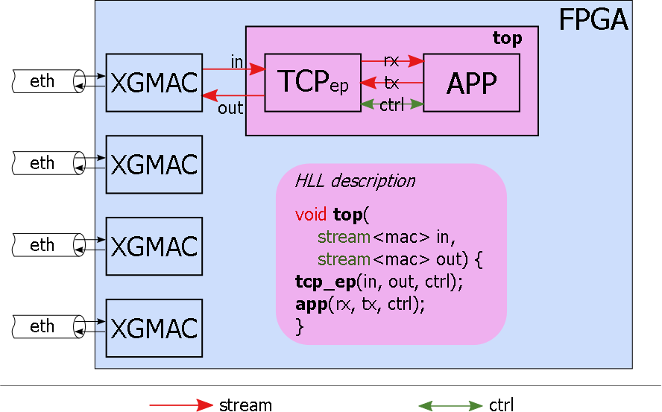
Evaluation for session/endpoints in hardware

Slide 17
3. Virtualised channel support for programmable logic
Problem: Any hardware needs to be shared and isolated among independent entities (e.g., tenants)
Challenge: Sharing FPGA is hard
Reprogramming is not fast nor effective → Bad time-sharing
Quantifying HW space for an implementation is hard → Bad space-sharing and fair-sharing
Our approach: Single Root Session Endpoint Virtualization
Offering of standard logic blocks (e.g., HTTP/TCP endpoint)
Akin to SR-IOV
Control VM
VM1
VM2
VM3
Allocation of requested
endpoints to each VM
based on sharing policy
Control plane
driver
Hypervisor
FPGA
HTTP/TCP endpoint
HTTP/TCP endpoint
DNS/UDPendpoint

Slide 18
NaaS Box with NetFPGA
NaaS Box
running on a standard PC
CPU
Memory
PCI-e
PC with NetFPGA
A hardware accelerator
built with Field Programmable Gate Array driving 10GbE network links
10GE
FPGA
10GE
10GE
Memory
10GE
Notes:
reminder slide.

Slide 19
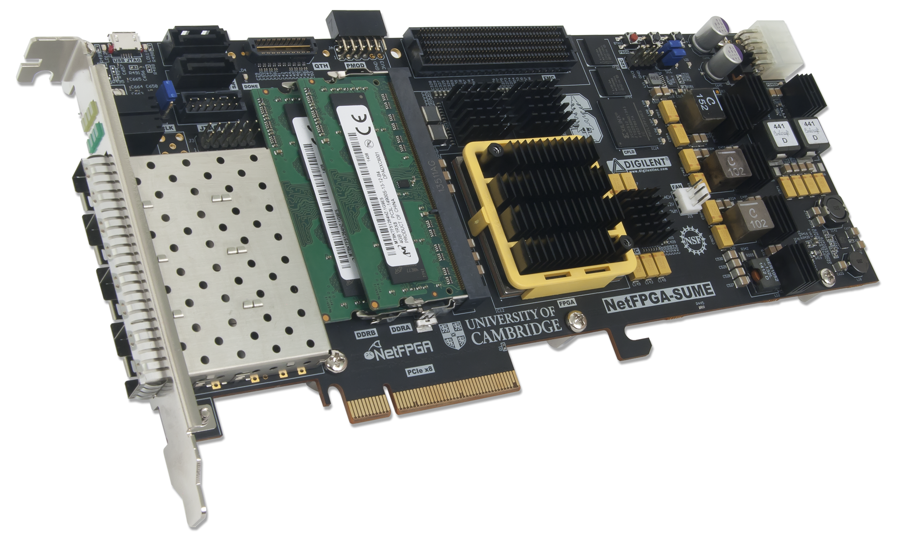
NetFPGA SUME the real deal

Slide 20
NetFPGA SUME status
While this project is not NetFPGA there is a certain amount of fate-sharing for this part of the project:
Board bring-up (still some manufacturing issues)
Cambridge NetFPGA team + Digilent Manufacturers
Tonnage of software to port
many people mostly at Cambridge.
Tool chain (Vivado in particular) to shake out
Xilinx
Board is now available for purchase!
(Perfect Christmas stocking stuffer)

Slide 21
Where next?
Next milestones
DMA engine for NetFPGA
TCP endpoint in HLS
TCP endpoint in EDSL
Applications:
Short-lived “sessions”: DNS, DNSSEC, other caches/proxies.
Long-lived: cluster computing (map/reduce), large downloads, VPN.
Comparisons
TCP endpoints: kernel, user-space, HLS, EDSL.
Applications linked to different endpoints
Latency
Number of instances
Different network topologies; placement of jobs on the network.
Thanks, questions?

