Slide 1
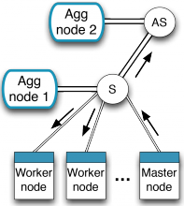









Progress to date NetAgg Box
University of Cambridge
Imperial College London
University of Nottingham
Paolo Costa, Microsoft Research / Imperial College London <paolo.costa@microsoft.com>
(slides based on Lukas’ awesome presentation at CoNEXT’14)

Slide 2
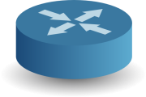











Problem Statement
Network often limits
performance of data centre applications
Modern applications have complex network requirements
Data-intensive applications
Dremel
Cloud data centres

Slide 3
NetAgg
Proof-of-concept of the NaaS vision
Focus on data-intensive applications:
MapReduce, Search, Graph Processing, Stream processing, …
In-network processing:
On-path aggregation
Goal:
Show the benefits of in-network processing
Immediate deployment
More details in the paper:
Luo Mai, Lukas Rupprecht, Abdul Alim, Paolo Costa, Matteo Migliavacca, Peter Pietzuch, Alexander L. Wolf NetAgg: Using Middleboxes for Application-specific On-path Aggregation in Data Centres. In Proceedings of ACM CoNEXT, 2014

Slide 4


How do data-intensive application scale?
Partition/aggregation pattern
Dremel
Sub-requests (search for “naas project” locally)
Frontend
Backends

Slide 5
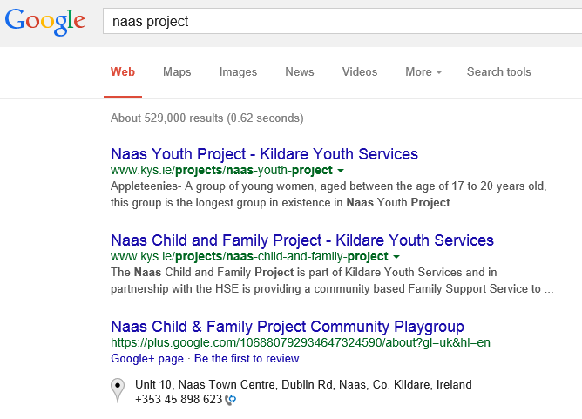
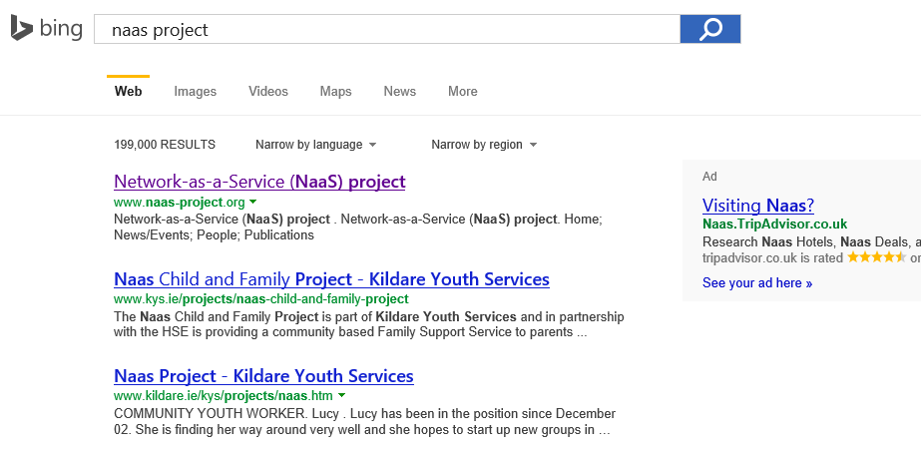
Partition/Aggregation Pattern
How do data-intensive application scale?
Partition/aggregation
Aggregate (Select top-k documents)
Frontend
Partial responses
Backends

Slide 6
Logical vs. Physical Network
Logical Network
Physical Network
Rack Switch
Incast

Slide 7
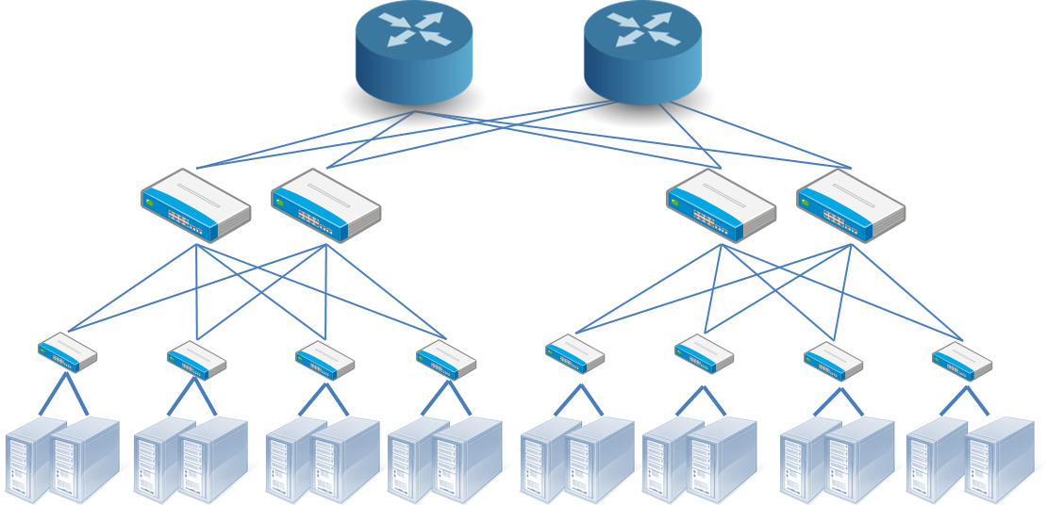
Logical vs. Physical Network
Logical Network
Physical Network
Network is one of the main bottlenecks for data-intensive applications
MapReduce @ Facebook: avg. 33% (up to 70%) job execution time due to the network
Bing @ Microsoft: avg. 12% → 34% outliers
Core oversubscription

Slide 8
Addressing the problem…
Traditional approaches:
Over-provision network resources
Fat-tree networks, 10/40Gbps NICs, …
Expensive
Traffic engineering, flow scheduling, …
Limited benefits
We explore a different (yet complimentary) approach…
Key insight:
Aggregation is often associative and commutative
e.g., COUNT, MIN, MAX, SUM, AVG
Aggregation often leads to significant data reduction
NetAgg:
Improve network performance of data-intensive applications by reducing traffic through on-path aggregation

Slide 9



NetAgg: A 10,000-feet View
How to implement on-path aggregation?
A middleboxes-based approach
Simple implementation
Ease of deployment
AggBox
10/40 Gbps
1/10Gbps

Slide 10
Evaluation (Testbed)
Questions
How fast can we process?
How much speed-up for different workloads?
Applications
Batch processing: Hadoop
Interactive processing: Solr (in the paper)
Testbed Topology
Single rack deployment
Ten 4-core servers with 8 GB RAM connected using 1 Gbps Ethernet
16-core AggBox with 32 GB RAM connected using 10 Gbps Ethernet

Slide 11
Hadoop Speedup
Speed-up from 2x to 4x
Better
No benefits for non-agg jobs
Worse

Slide 12
Impact of Output Ratio
Ouput ratio = Output size / input size
Better
2x-4x speed-up for typical values seen in production
Diminishing return for low aggregation jobs
Worse
Full aggregation
No aggregation

Slide 13
Large-scale Simulation Analysis
Questions
How does NetAgg work at data centre scale?
1024-server DC with 1:4 oversubscription
Typical data centre workload
mix of aggregatable and non-aggregatable flows
Baselines (edge-based aggregation)
Rack-level aggregation (today’s status quo)
Binary tree

Slide 14
Flow Completion Time
This includes all flows: agg. and non-agg
Most of the benefits come from in-network core aggregation
More than 3x in median
Better
Worse

Slide 15
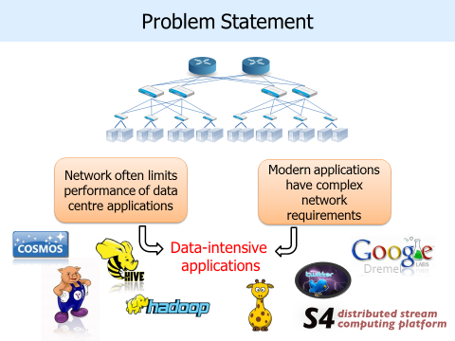
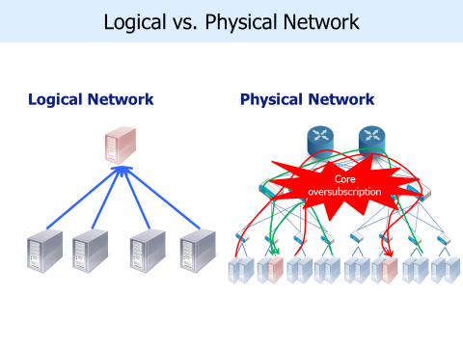
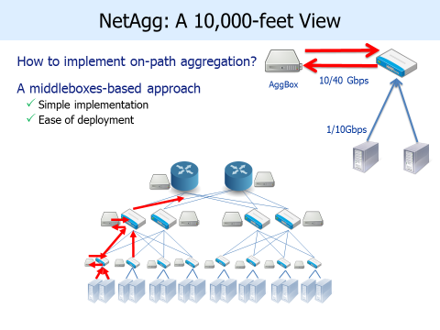
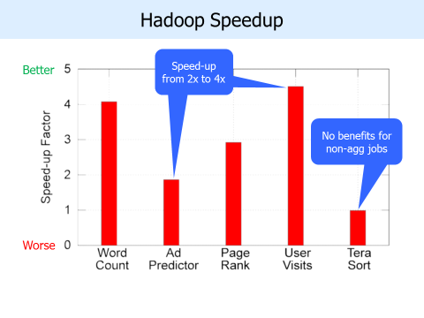
Summary

