Slide 1
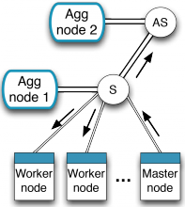





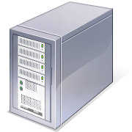



EPSRC NaaS Project: Network-as-a-Service
University of Cambridge
Imperial College London
University of Nottingham
Peter Pietzuch, Imperial College London <prp@doc.ic.ac.uk>
Funded by the UK Engineering and Physical Sciences Research Council (EPSRC)

Slide 2

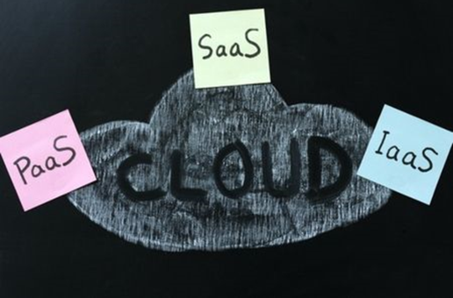
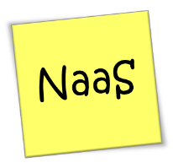
Problem Statement
Network often limits
performance of data centre applications
Modern applications have complex network requirements
Cloud data centres

Slide 3
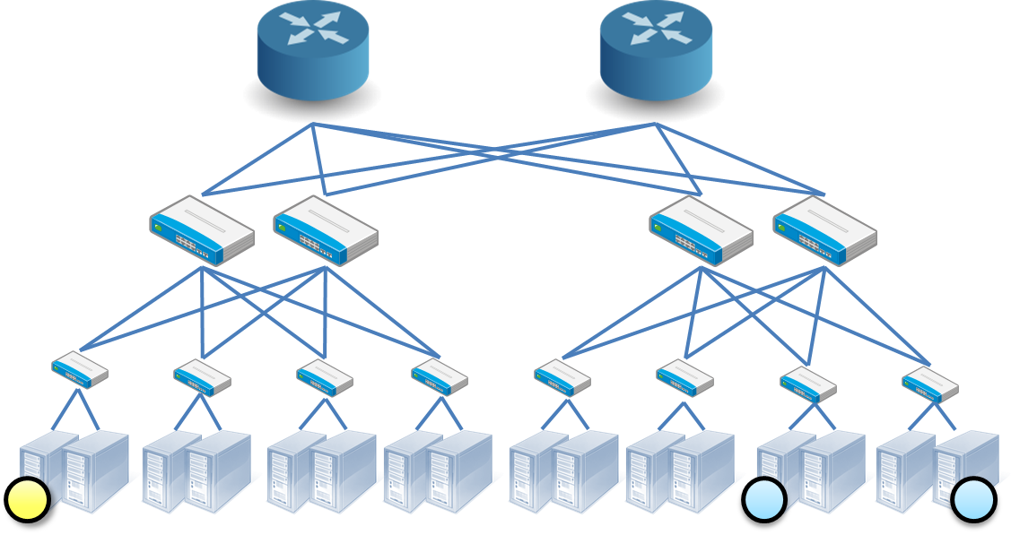

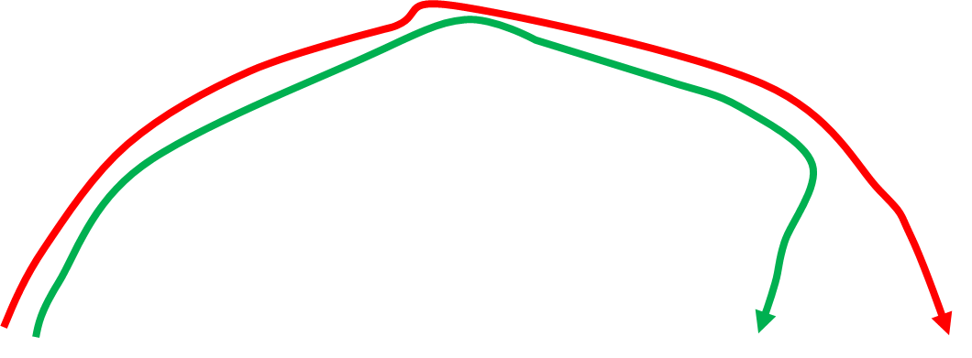
Bridging the Application/Network Gap
Application perspective
Network perspective
Applications only see IP addresses
Hard to infer locality & congestion
No control over packet routing
Network only sees packets
No insights about application requirements
Applications have little control over the network (and vice versa)
Why slow?
?
?
Are these related?
10.0.2.3
10.0.1.4

Slide 4
Letting Applications Adapt the Network
Many proposals for software-based routers and switches
e.g. OpenFlow, RouteBricks , ServerSwitch, PacketShader, NetMap,…
Programmable hardware for networking, eg NetFPGAs, ...
Focus on traditional application-agnostic network services
e.g. IPv4 forwarding, deep packet inspection, firewalls
Why don’t we implement application-specific services?
e.g. in-network aggregation, caching, load balancing, content-based routing, ...
NaaS Goal: Abstractions & mechanisms to enable applications to efficiently, easily and safely process data within the network

Slide 5



NaaS Project Vision
Exploit programmability of network devices for application-specific processing
NaaS Boxes process data at line rate in network

Slide 6
Challenges for NaaS
1. Performance & efficiency
Line rate data processing (10Gbps initially)
Efficient use of network resources
Offload to hardware when possible
2. Programmability & flexibility
Rapid development of new network services
Simple deployment, resource placement and allocation
3. Security & safety
Isolation of services within shared hardware

Slide 7

A. NaaS Box Architecture
Software platform for application-specific middlebox services
eg application-specific load-balancing, in-network computation, ...
Services written in high-level DSL compiled to C++
Services parallelised as cooperatively-scheduled task graphs across CPU cores
Services “safe by design” → safety & performance guarantees

Slide 8
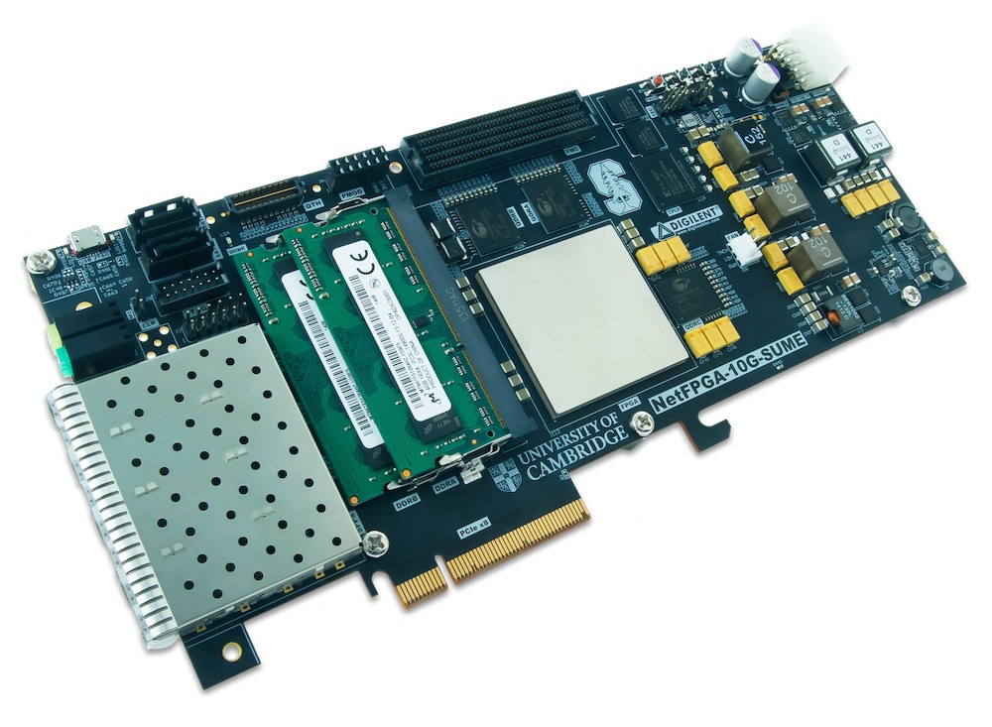
B. Hardware-Assisted NaaS Box
Hard to achieve 10Gbps line rate in software alone
→ Push certain features into hardware (NetFPGA)
NetFPGA as TCP endpoint and basic per-app processing
eg serialisation/deserialisation of payload data
Aids processing → frees CPU cores for other tasks

Slide 9




C. SDN-Controlled NaaS
Distributed, reliable, application-aware SDN controller
SDN controller redirects app traffic via appropriate NaaS box
Initially based on OpenFlow
Directs queries to appropriate NaaS box for application
Balances both traffic and load on NaaS boxes

Slide 10
Meeting Agenda
10:50 NaaS project overview (Peter Pietzuch)
11:05 Progress to date: ”NetAgg: On-path aggregation” (Paolo Costa)
11:25 Progress to date: ”Mirage/OpenFlow” (Masoud Koleini)
11:45 Industrial Partner presentations: Netronome
12:00 Industrial Partner presentations: Xilinx
12:15 Industrial Partner presentations: Citrix
12:30 Industrial Partner presentations: BT
12:45 Industrial Partner presentations: NetApp
13:00 Lunch
14:00 Ongoing: “NaaS Box: Application-specific middleboxes” (Richard Clegg)
14:30 Ongoing: “NaaS Box: Endpoint teleportation” (Nik Sultana)
15:00 Ongoing: “Mirage SDN switching and control” (Richard Mortier)
15:30 Coffee break
15:45 Progress summary/next steps (Alex Wolf)
16:30 End of meeting

