Slide 1
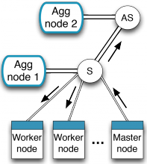





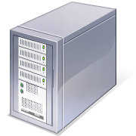



OpenFlow Switch on Mirage
University of Cambridge
Imperial College London
University of Nottingham

Slide 2
Objectives of NaaS Project
Design of a software and hardware platform with the following specifications:
Scalability
Implementing security and performance isolation
High-level programming abstraction
Efficient executing of legacy big data application
Notes:
These are the objectives of NaaS project that you have already heard from (Peter). We emphasise on these two objectives in Mirage OpenFlow project.
(Scalability: enabling multitude of NaaS processing elements)
Security: Preventing malicious or poorly written code to affect execution of other elements
Abstraction: Providing a balance between expressivity and ease-of-use
(Big data policy: )

Slide 3
OpenFlow for NaaS
Provides open, programmable and virtualised platform
Internal programmable flow tables
Separate control plane and data plane
Helps researchers to run experimental control architecture in the networks
Provides high level of abstraction to implement wide range of policies and network technologies
Notes:
OpenFlow: network communication protocol that enables remote controller to determine forwarding plane in an enterprise network.

Slide 4
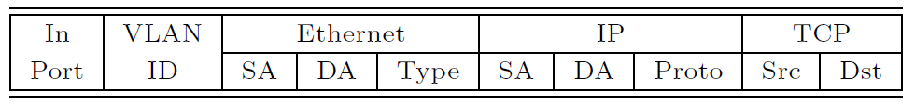
Topology of the Network
Controller
OpenFlow
switch
OpenFlow protocol
Flow
Table
OpenFlow
switch

Slide 5
OpenFlow datapath
Originally a flow table managed by a controller
Multi-table pipeline (started from OF 1.1)
Extensible match support (started from OF 1.2)
Changed from fixed length structure to type-length-value
Covers more header match types
Group table
Enhances multicast, failover and load-balancing
Table 0 Access
Control
Table 1
NAT
Table 2
Routing

Slide 6
Mirage: Unikernels
Specialised VM images compiled from the whole stack
Application code, system libraries, configuration
Contained
Simplifies deployment and management
Compact
Reduces attack surface and boot time
Efficient
Fit 10,000s onto a single host
Portable
To many compilation environments beyond Xen
A wide, and growing, range of backends
Notes:
The compiled unikernel contains all the required elements required for running.
It doesn’t have unnecessary elements, so attack surface (and therefore boot time) is reduced.

Slide 7
Mirage OCaml OpenFlow Switch
Implemented in OCaml
OCaml is a type-safe functional programming language
Can be compiled into a unikernel
Unikernel size < 10MB
It can run on Xen as a virtual machine
Implementation of OpenFlow 1.3 based on Frenetic protocol library
Implementation is in progress
Notes:
Mirage is a framework for building applications for cloud computing including data centres, which can create compact and efficient unikernels. We want to use mirage within NaaS in order to have the scalability, code compactness, and security of a Mirage unikernel, which allows OpenFlow switch to work as an stand-alone virtual machine, the same as a NaaS box.
Some common attacks are not possible on well-typed languages: stack-smashing, or format string attacks

Slide 8
Work in Progress
Enhancing the performance of switch unikernel
Optimising data structures for efficient flow handling and table lookup
Integration with hardware-based accelerators
Enhancing the throughput
Current unikernel implementation handles 60000 pps
We are working on fixing the bottlenecks in lower layers, which will considerably increase the throughput
Software switch will not be as fast as hardware-based one, but is more flexible and scalable

Slide 9
Work in Progress

Slide 10
Work in Progress
High level programming abstraction
NetKAT as a high-level programming language
Network primitives for filtering, modifying and transmitting packets
Sound and complete mathematical structure
Implementing application-specific middleboxes
Configuring middlebox to work as load balancer, firewall, and proxy server
Comparing the flexibility and performance with experimental and commercial products
Notes:
NetKAT is mathematically based on Kleene algebra

Slide 11
Future Work
Extending OpenFlow functionality
Flexibility in payload inspection
Developing techniques for application-specific packet handling
Application firewalls, load balancers, …

Slide 12
Thanks
Questions?

