Slide 1
DevOps Pipeline for Java Spring Boot using Jenkins, Docker, and AWS EC2
Step-by-Step Implementation and Project Recap
Presented by,
Muhammed Yaashwin C
Naadira Sahar N

Slide 2
Overview
This project demonstrates setting up a CI/CD pipeline using Jenkins to automate building, testing, and deploying a Java Spring Boot application. Docker is used for containerization, and the final application is deployed on an AWS EC2 instance.

Slide 3
Tools and Technologies Used
- Java Spring Boot: Web application framework.
- Jenkins: CI/CD process automation.
- Docker: Containerization.
- GitHub: Source code management.
- AWS EC2: Deployment platform.
- Maven: Java project build tool.
- YAML: Optional for pipeline configuration.
- Git: Version control.

Slide 4
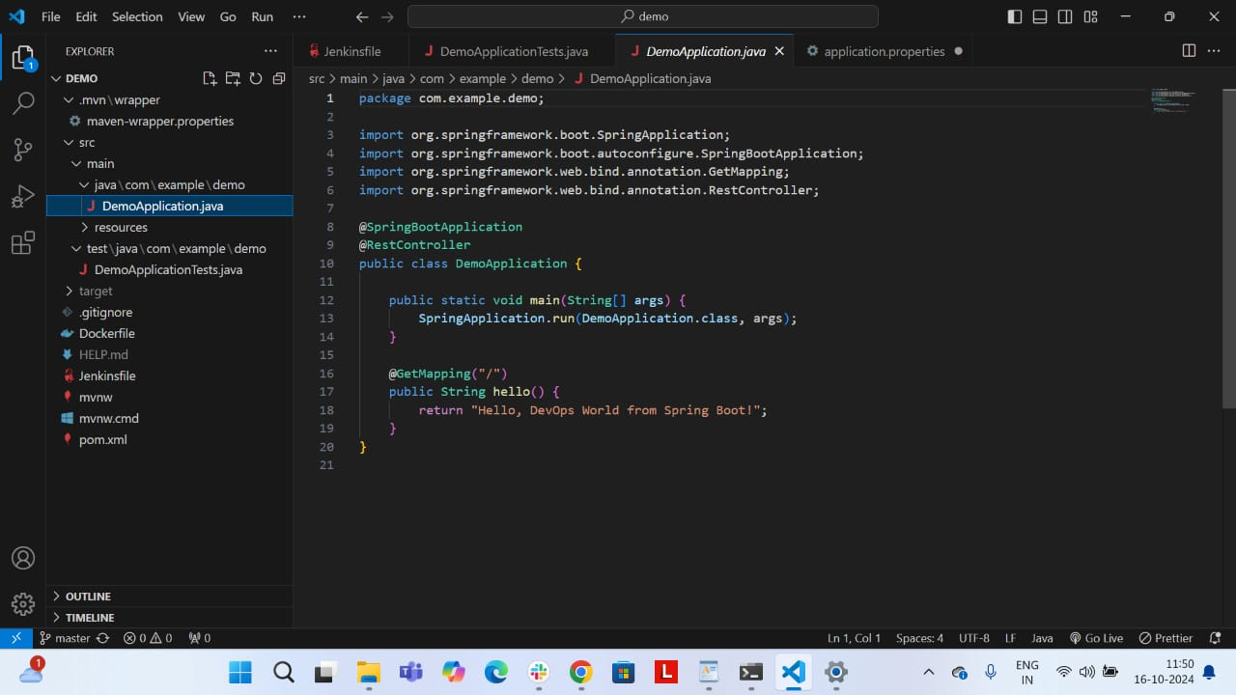
Step 1: Create a Simple Spring Boot Application
1. Generate the project using Spring Initializr with Maven and Spring Web.
2. Implement REST API in DemoApplication.java.
3. Build the project with './mvnw clean package'.

Slide 5
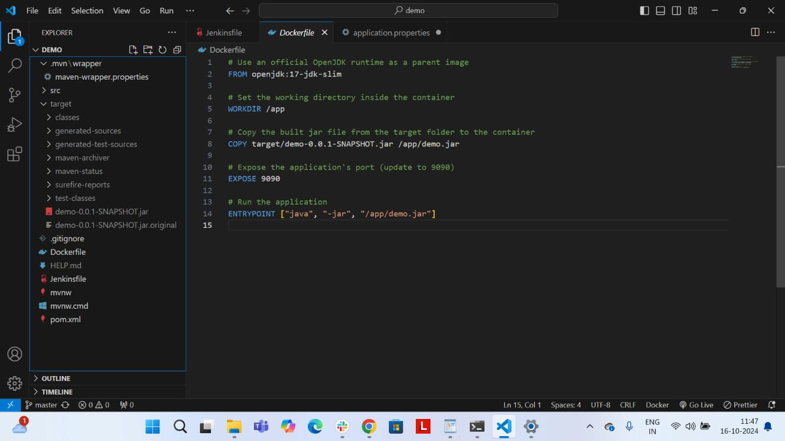
Step 2: Containerize with Docker
1. Create a Dockerfile with OpenJDK base image.
2. Build and run the Docker image locally.
3. Verify at http://localhost:8080.

Slide 6
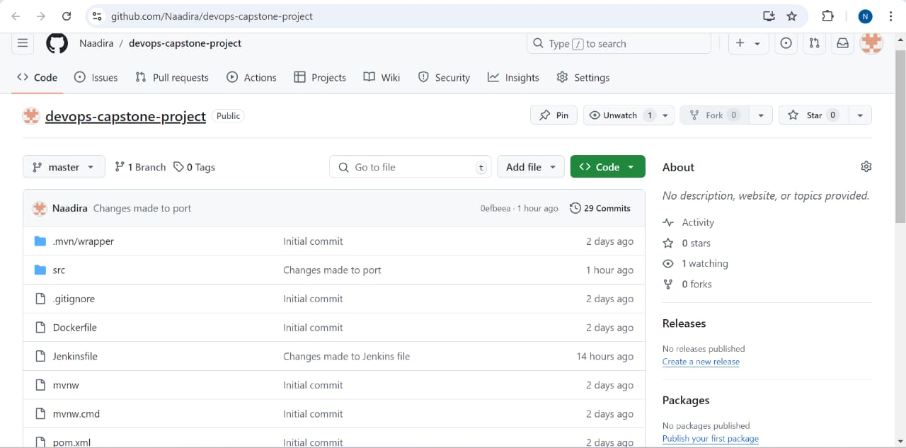
Step 3: Push Code to GitHub
1. Initialize Git and commit code.
2. Push the code to your GitHub repository.

Slide 7
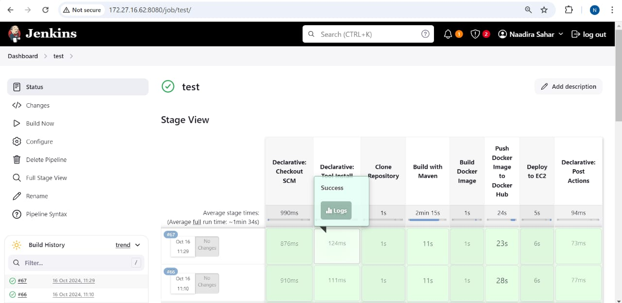
Step 4: Set Up Jenkins for CI/CD
1. Install Jenkins, Docker, and plugins.
2. Create a Jenkins Pipeline using a Jenkinsfile.
3. Automate build, test, and deployment steps.

Slide 8
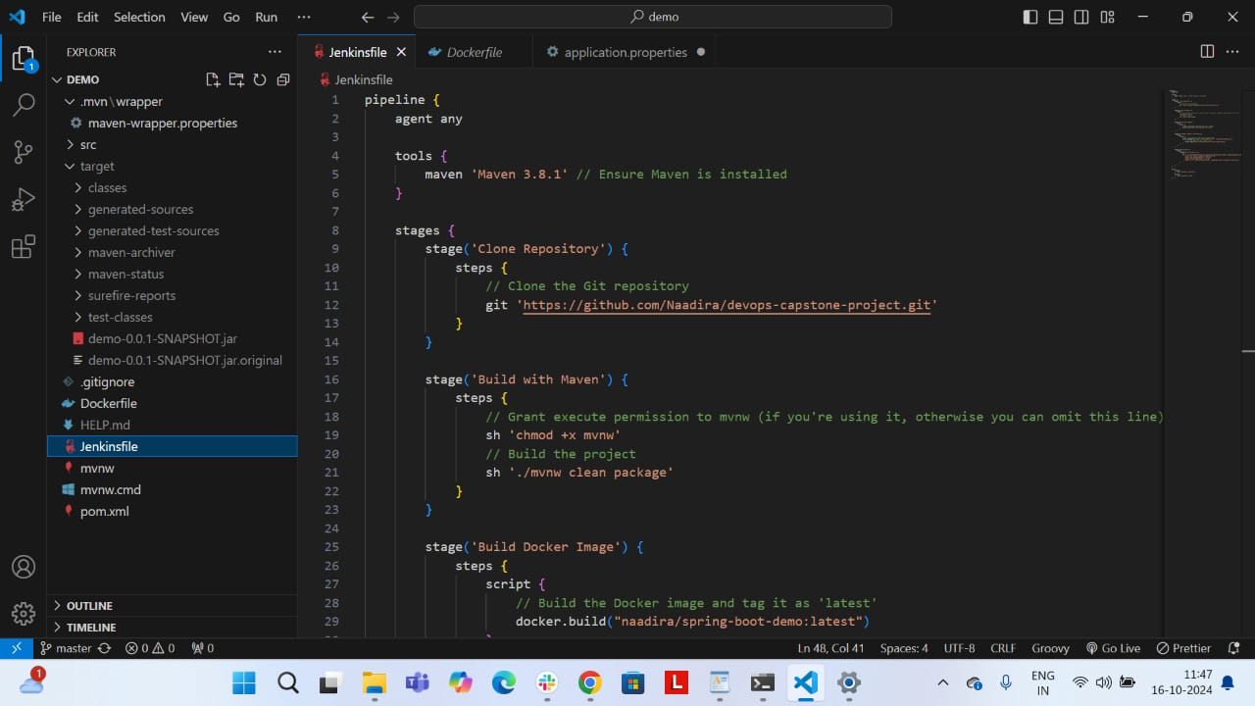
Sample Jenkins Pipeline Code
Stages:
- Clone Repository
- Build with Maven
- Build Docker Image
- Push to Docker Hub
- Deploy to EC2

Slide 9
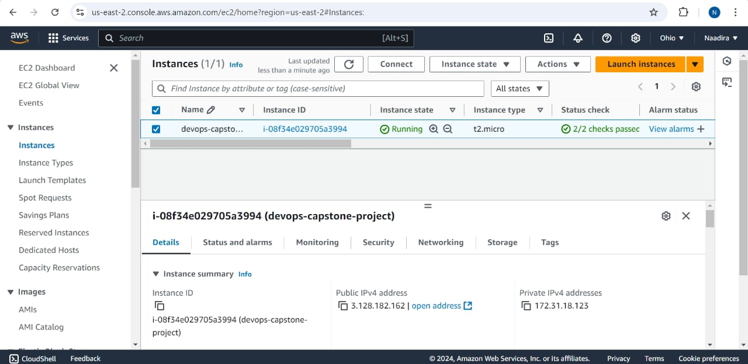
Step 5: Deploy to AWS EC2
1. Launch an EC2 instance and install Docker.
2. Use SSH Agent in Jenkins to connect to EC2.
3. Pull and run the Docker container on EC2.

Slide 10
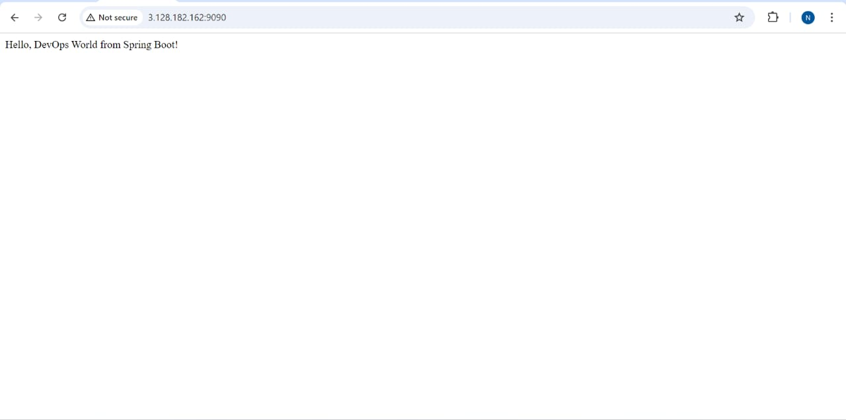
Step 6: Monitor the Application
Access the application at http://3.128.182.162:9090.
Ensure the Spring Boot application responds with 'Hello DevOps World!'.

Slide 11
Project Recap
- Java Spring Boot: Developed a RESTful API.
- Docker: Containerized the application.
- GitHub: Managed source code.
- Jenkins: Automated CI/CD pipeline.
- AWS EC2: Hosted the application in the cloud.

Slide 12


