Slide 1


NAU Mathematics & Statistics Research Showcase
Jack Tomlon, Rylan Harris, Chris Reger, Ethan Ferguson

Slide 2
Problem Statement
“The lack of a centralized, structured platform for storing and showcasing Mathematics and Statistics student research affects students, faculty, and external evaluators, resulting in diminished research visibility, ineffective knowledge-sharing, and lost academic and professional opportunities."
Students: "Where is my research stored?" (icon: student figure with question mark)
Faculty: "How do I find past projects?" (icon: professor figure searching)
External Evaluators: "What research quality exists?" (icon: magnifying glass on portfolio)

Slide 3
Our Solution: Research Showcase Platform
“The NAU Mathematics & Statistics Research Showcase provides a centralized platform for faculty to submit student research, for administrators to review and approve submissions, and for external audiences to explore department research output.”
“By making past projects easily accessible, the platform increases research visibility, enhances student portfolios, and helps faculty manage academic contributions efficiently.”

Slide 4
The Human Side: Key User Stories
Faculty Story: "As a Math Professor, I want to store student capstone projects in a central location so I can reference them easily when advising new students." (Open Sans, 18pt, in blue speech bubble)
Administrator Story: "As a department administrator, I want to review research submissions before they go public so we maintain consistent quality standards." (Open Sans, 18pt, in purple speech bubble)
Visitor Story: "As a graduate school applicant, I want to search for research by keywords and faculty advisors so I can find projects relevant to my interests." (Open Sans, 18pt, in green speech bubble)

Slide 5
Core Functional Requirements
Faculty Research Submission
Submit metadata & multiple file types
Associate with student authors
Admin Approval Workflow
Review submissions
Approve, reject, or request revisions
Role-Based Access Control
Faculty: submission privileges
Admins: approval authority
Visitors: browsing access
Advanced Search & Filtering
Filter by keyword, category, advisor
Find specific research content quickly

Slide 6
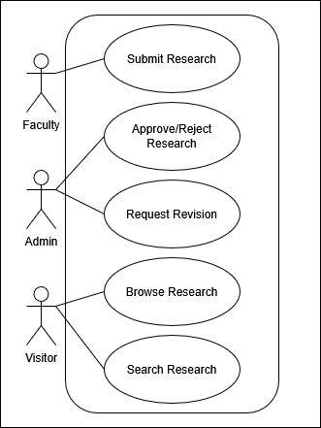
System Interactions: Use Case Diagram
Who Are the Key Actors?
Faculty:
Content contributors
Primary authenticated users
Administrators:
Content Quality control and gatekeepers
System managers
Visitors:
Students seeking examples
Graduate schools evaluating applicants
External collaborators exploring opportunities

Slide 7
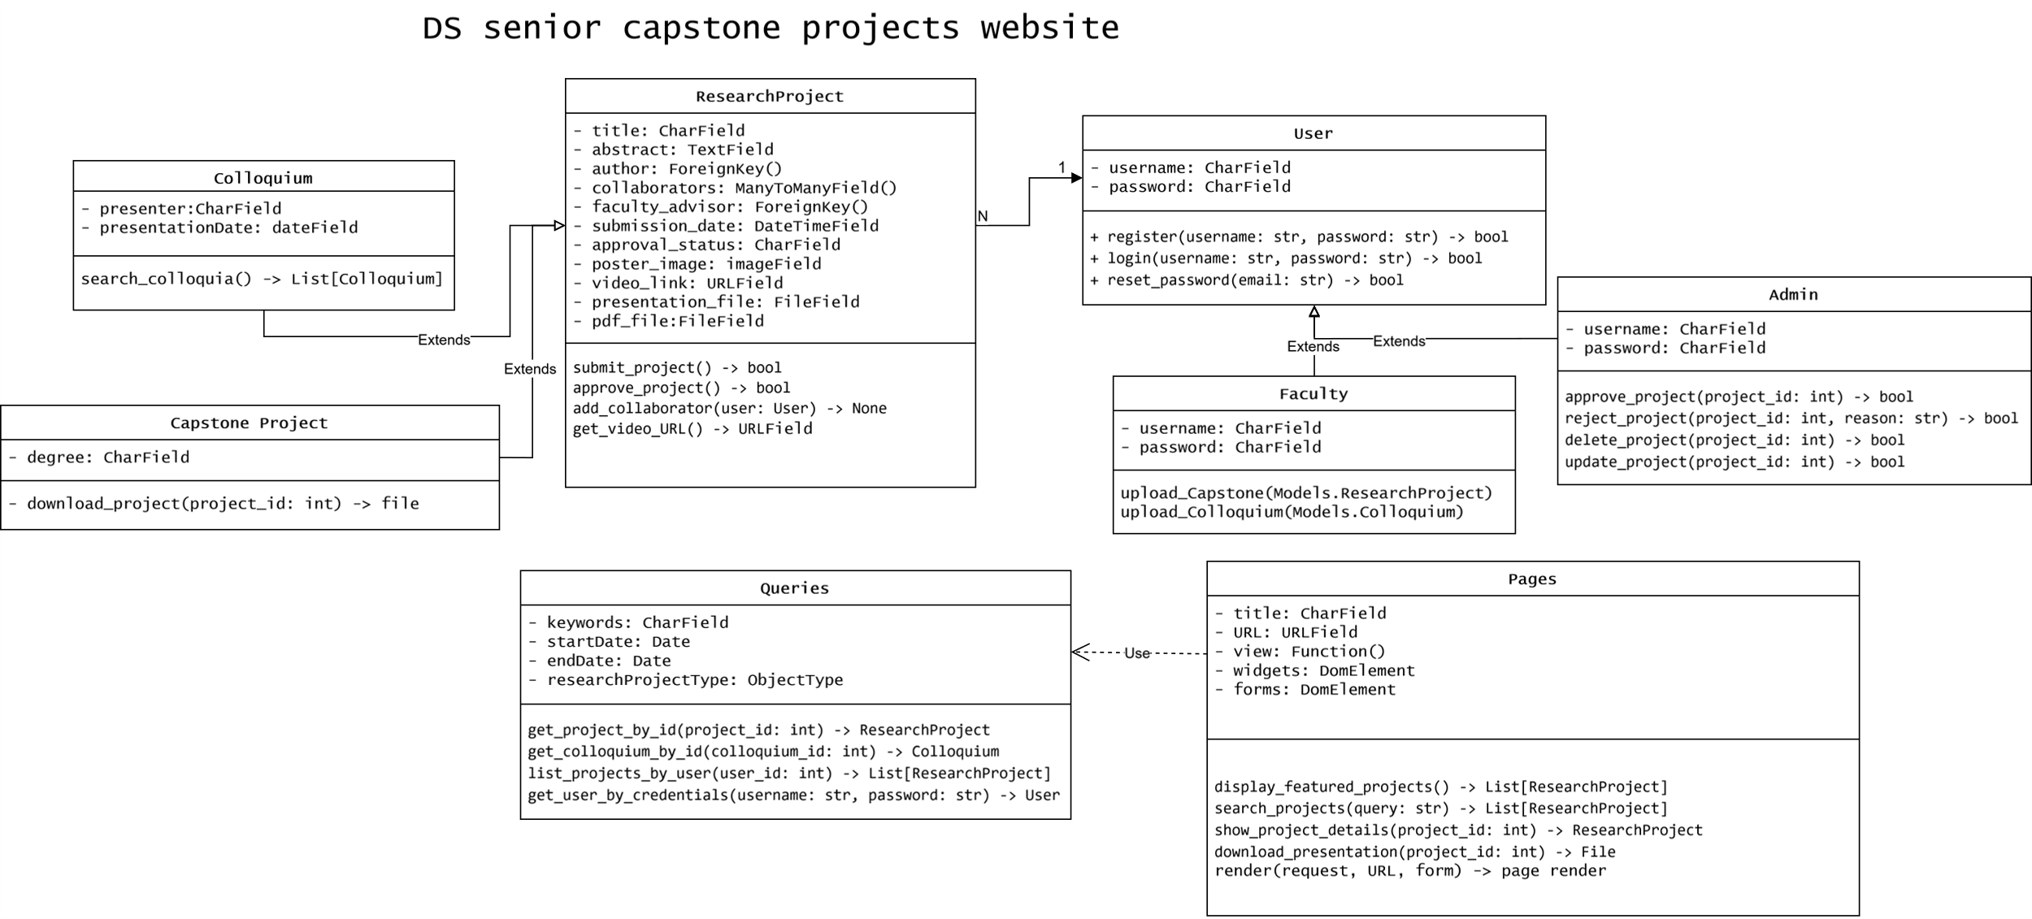
System Architecture: UML Class Diagram

Slide 8
THANK YOU
FOR MORE INFORMATION
Name | Phone | Email

