Slide 1
Road Perception: Model Results
Merged-dataset YOLOv8s detector → Road Severity Index (RSI)
VIT · Edge AI-based Adaptive Suspension System · 6 October 2026
Smooth 0.10
Normal 0.35
Rough 0.65
Pothole 0.95
Road class → RSI sent to the STSMC controller
Notes:
This deck reports the results of the road-perception model only: a YOLOv8s detector trained on RDD2022 plus a Kaggle pothole and crack dataset, whose detections are turned into the four road classes and the RSI values from the proposal.

Slide 2

86% of pothole frames are flagged
82.8%
86%
5.4×
0.66
Road-class accuracy
Pothole frames flagged
More pothole training boxes
Detector mAP50
2,378 held-out test images
and 86% of pothole flags correct
1,080 → 5,880 after merging
pothole, crack, alligator crack; validation set
Strong on potholes and rough road. Normal road is the weakest class (71% correct, up from 56%). Jetson speed and look-ahead distance are not tested yet.
Notes:
The headline: at the level the controller cares about — is there a pothole in this frame — the model catches 86% of pothole frames, and 86% of its pothole calls are right. Road class accuracy over all four classes is 82.8%. The weakest class is Normal road, which a rule fix raised from 56% to 71%.

Slide 3
Goals versus what was achieved
Goal | Status | Evidence
Detect potholes reliably | Met | 86% of pothole frames flagged; per-box recall 0.55 → 0.59
Merge several datasets | Met | RDD2022 (5 countries) + Kaggle in one pothole and crack detector
Classify road into 4 classes | Partly | 82.8% overall; Normal 71% (was 56%)
Output RSI 0–1 for the controller | Met | Proposal values 0.10 / 0.35 / 0.65 / 0.95 with smoothing
Real time on NVIDIA Jetson | Untested | ~3 ms/image on RTX 5060; no TensorRT export yet
Predictive: see defects early | Not shown | Small, distant potholes are the hardest boxes; no vehicle video yet
Notes:
Four of six goals are met or partly met. The two that matter most for the grant — real-time on Jetson and seeing defects early enough to be predictive — are not demonstrated yet.

Slide 4


Two datasets, one label space
Merged classes
RDD2022
27,823 dashcam images
Class | RDD2022 | Kaggle
pothole | D40 | pothole
crack | D00, D10 | cracks
alligator_crack | D20 | —
India, Japan, Czech, USA, China (motorbike). Norway skipped (9.9 GB, tiny damage). S3 links return 403, so taken from figshare by byte range.
Kaggle pothole & crack dataset
2,236 labelled images
Dropped RDD codes: utility covers (D44), road markings (D50), crosswalk blur (D43), repairs and rare crack sub-codes.
Close-up potholes and cracks. The data the old model was trained on.
Notes:
Both links given to us point to the same dataset, RDD2022. We combined it with the Kaggle set by mapping both onto three shared classes: pothole, crack and alligator crack. Utility covers and road markings were dropped because they are not road defects.

Slide 5


5.4× more potholes to learn from
Split | Images | Pothole boxes
Train | 20,370 | 5,880
Validation | 2,522 | 726
Test | 2,452 | 896
Dashcam frames kept together in blocks of 50, so near-duplicate frames never sit in both train and test.
Images with no defects capped at 15% of each split so they don't swamp training.
Notes:
Pothole training boxes went from 1,080 to 5,880. The split keeps consecutive dashcam frames together, otherwise near-identical frames would land in both train and test and inflate the scores.

Slide 6


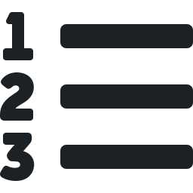


From camera frame to RSI
Camera frame
YOLOv8s
Rule
Peak-hold smoothing
STSMC gains
Road ahead of the vehicle
Boxes: pothole, crack, alligator crack
Boxes → one road class
Up instantly, down after 10 frames
RSI picks k1, k2, λ
Rule applied to each frame (boxes with confidence ≥ 0.15)
Pothole 0.95
Any pothole
Rough 0.65
Any alligator crack, or crack boxes covering ≥ 7% of the frame (overlaps counted once)
Normal 0.35
Any other crack
Smooth 0.10
No defects
Notes:
Each frame goes through the detector. A simple rule turns the boxes into one of the four road classes, each mapped to the proposal's RSI value. The peak-hold state machine from the teammate's code raises the class instantly but only lowers it after 10 frames, so the suspension doesn't soften before the wheel has passed the defect.

Slide 7
Training converged after ~40 epochs
Setup
YOLOv8s, COCO-pretrained
60 epochs, 640 px, batch 16
RTX 5060 laptop GPU, ~3.7 min/epoch
Best checkpoint: epoch 59
Incidents
Out of memory after epoch 1: restarted with 2 data workers
Stopped at epoch 51 by an app update: resumed from epoch 50, nothing lost
Notes:
The dip at epochs 2 and 3 is YOLO's learning-rate warm-up. After about epoch 40 the curve is flat, so more epochs of the same model would not help much.

Slide 8

Potholes are the hardest boxes
Why pothole boxes score low
RDD2022 dashcam frames contain many small, distant potholes. Missing some of them lowers per-box recall.
The controller needs one confident box per frame, not every box — see the frame-level results next.
Notes:
Per box, alligator cracks score best at 0.72 mAP50 and potholes are hardest at 0.60. This is driven by small potholes in the dashcam images. For suspension control what matters is whether the frame contains a pothole, which is measured on the following slides.

Slide 9
A lower threshold catches more potholes
Chosen
0.15
detection confidence, applied to every box
Pothole recall 0.82 (vs 0.74 at 0.25)
Pothole precision 0.79 (vs 0.87)
Cost: more false pothole alarms
A missed pothole is worse than a false alarm for the suspension.
Notes:
Five confidence thresholds were compared on the validation set. We picked the lowest because it gives the best pothole recall; the price is more false pothole alarms.

Slide 10
82.8% of test frames classed correctly
True ↓ Predicted → | Smooth | Normal | Rough | Pothole
Smooth | 289 | 41 | 23 | 14
Normal | 39 | 343 | 92 | 12
Rough | 32 | 57 | 962 | 36
Pothole | 22 | 8 | 33 | 375
Recall per class
Smooth
79%
Normal
71%
lowest
Rough
89%
Pothole
86%
Green = correct. Orange = largest error: 92 Normal frames called Rough.
2,378 held-out test images. The true class is computed from the labelled boxes (summed crack area ≥ 5% = Rough), not labelled by hand.
Notes:
Rough and Pothole are classified well. Normal is still the weakest class at 71%: most of its errors are frames called Rough, because the line between them is a crack-area threshold, not measured roughness. Note that the true class here is computed from boxes, not labelled by people.

Slide 11


Counting crack area once lifts Normal
Cause
Predicted crack area was ~1.8× the labelled area in Normal frames: overlapping boxes were counted twice, and the 5% line sits close to real Normal crack areas.
Fix (no retraining)
Measure the combined area the crack boxes cover, overlaps once, with a 7% line. Tuned on the validation set.
Result
Normal 0.56 → 0.71, accuracy 0.808 → 0.828. Trade-off: Rough 0.91 → 0.89. Potholes unchanged.
Notes:
Checking all 486 true-Normal test frames showed 27% were pushed into Rough because predicted crack area was overestimated. Counting the combined area of the crack boxes and moving the line to 7% fixed most of this without retraining. The true class is still defined by the original 5% rule on labelled boxes, so before and after are scored against the same answers. Adding Norway was considered: it would mainly help the 8% of Normal frames where thin cracks are missed.

Slide 12




Errors lean toward a safer, stiffer ride
Over-estimate · 9.2%
Road called worse than it is. Suspension too stiff: less comfort, still safe.
Under by 1 level · 5.4%
Slightly too soft for the road.
82.8%
correct
Under by 2+ levels · 2.6%
Worst case, e.g. a pothole treated as Smooth: 62 frames.
Missed potholes mostly still stiffen
Of 63 missed pothole frames, 33 were called Rough (RSI 0.65). Only 30 (7%) went to Smooth or Normal.
Notes:
Not all mistakes cost the same. The model over-estimates more often than it under-estimates, which means a stiffer, safer ride. The dangerous case — a pothole treated as smooth or normal road — happens in about 7% of pothole frames.

Slide 13


Small gain per box, big gain per frame
Same Kaggle validation images, per box
Per frame, pothole recall on the test set
Metric | Old (Kaggle only) | New (merged)
Pothole recall | 0.548 | 0.588
Pothole mAP50 | 0.678 | 0.681
Crack mAP50 | 0.761 | 0.744
0.84
RDD2022 dashcam
2,212 frames · data the old model never saw
0.92
Kaggle
166 frames · close-up defects
On the old benchmark the box scores barely move. Merging did not hurt the Kaggle classes.
Notes:
Fair comparison with the old Kaggle-only model: per box, pothole recall moved only from 0.55 to 0.59. The real gain is that the model now works on dashcam footage, where it flags 84% of pothole frames. Do not compare the old 0.55 with the new 0.86 — they measure different things.

Slide 14
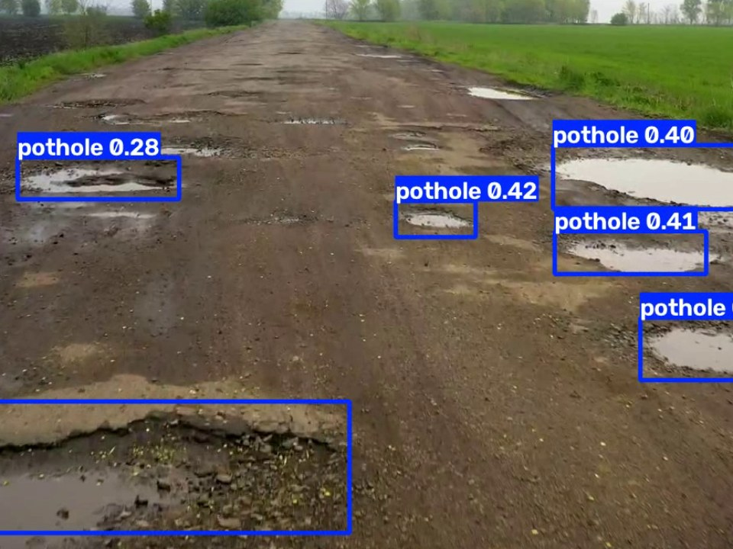
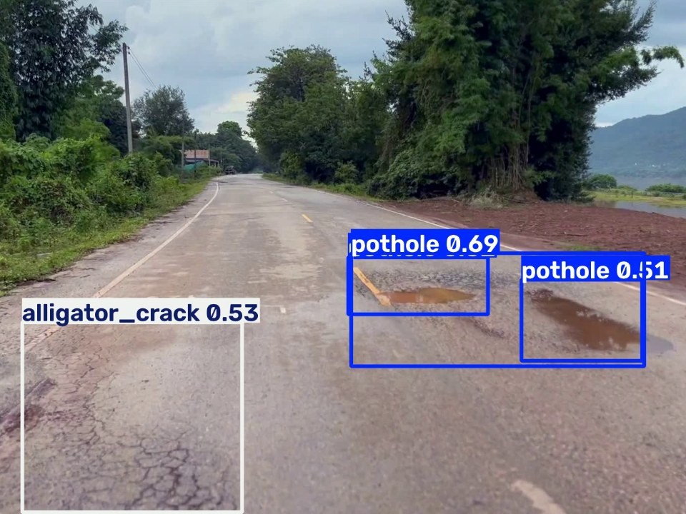
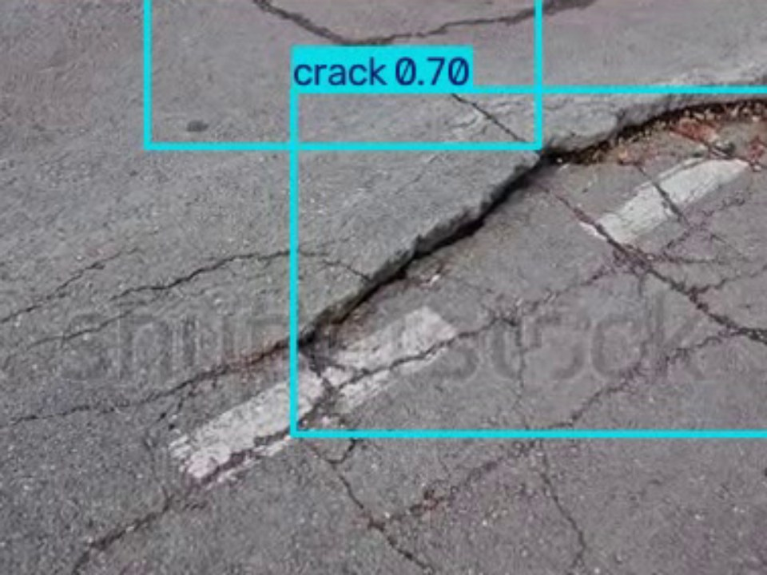

Test videos: right calls, few false alarms
Pothole
Pothole
Rough
Potholed dirt road: many potholes boxed
Wet dashcam road: alligator crack and potholes
Close-up asphalt cracks: Rough
Pothole 100% of the time
Pothole 57%, Rough 25%, Smooth 14%, Normal 3%
Rough 93%; 2 brief false potholes on a wide crack
Notes:
Frames from the three road-surface test videos with the model's boxes; the chip shows the road class the system output. Potholes and cracks are found; the only errors seen were brief false potholes on a wide crack. Only the second clip is from a dashcam, so none of these tests our own vehicle camera.

Slide 15






What is weak and what is unproven
Weak
Not proven yet
Normal vs Rough
Real time on Jetson
71% of Normal frames correct (was 56%); the line is crack area, not measured roughness
No TensorRT export or FPS measurement on the Orin
False potholes
Look-ahead distance
On wide cracks, from the low 0.15 threshold
Small, distant potholes are the hardest boxes; reaction time unknown
Computed ground truth
Own vehicle camera
Classes derived from boxes; RDD2022 misses some defects
Only one test video is dashcam; none from our vehicle
Notes:
Left: known weaknesses of the current model. Right: claims in the proposal that these results cannot yet support — real-time speed on the Jetson, how far ahead it sees, and performance on our own camera.

Slide 16
Next steps
1
Record dashcam video on local roads
Camera where it will sit on the vehicle; note when each defect is hit. Tests look-ahead and real-world accuracy.
2
Export to TensorRT and measure FPS
On the Jetson Orin, to confirm real-time operation.
3
Recalibrate Normal vs Rough
Use accelerometer data from the Quanser rig or a phone in the car.
4
Connect RSI to the STSMC scheduler
Send RSI over serial, ROS or socket; align the 0–3 vs 0.10–0.95 scales.
Notes:
The single most useful next step is our own dashcam footage: it answers how far ahead the model sees and how it performs on real roads. Jetson speed and the Normal/Rough recalibration follow, then wiring the RSI into the controller.

