Slide 1
TAMIL NADU
ASSEMBLY ELECTIONS
2 0 2 6
A Comprehensive Data Analysis
Comparing 2021 vs 2026 · 234 Constituencies · 6 Regions · 32 Districts
June 2026

Slide 2
At a Glance
Key numbers from the 2026 Tamil Nadu Assembly Election
234
108
163
39.0%
Total
Constituencies
Seats Won
(TVK)
Seats
Flipped
Avg Winner
Share 2026
14
61
6
32
Winners
> 50% Share
Winners
< 35% Share
Regions
Covered
Districts
Covered
★ Average winner vote share fell from 48.8% (2021) to 39.0% (2026) — elections became significantly more competitive.
Tamil Nadu Assembly Elections — Data Analysis 2026
Page 1 of 10

Slide 3
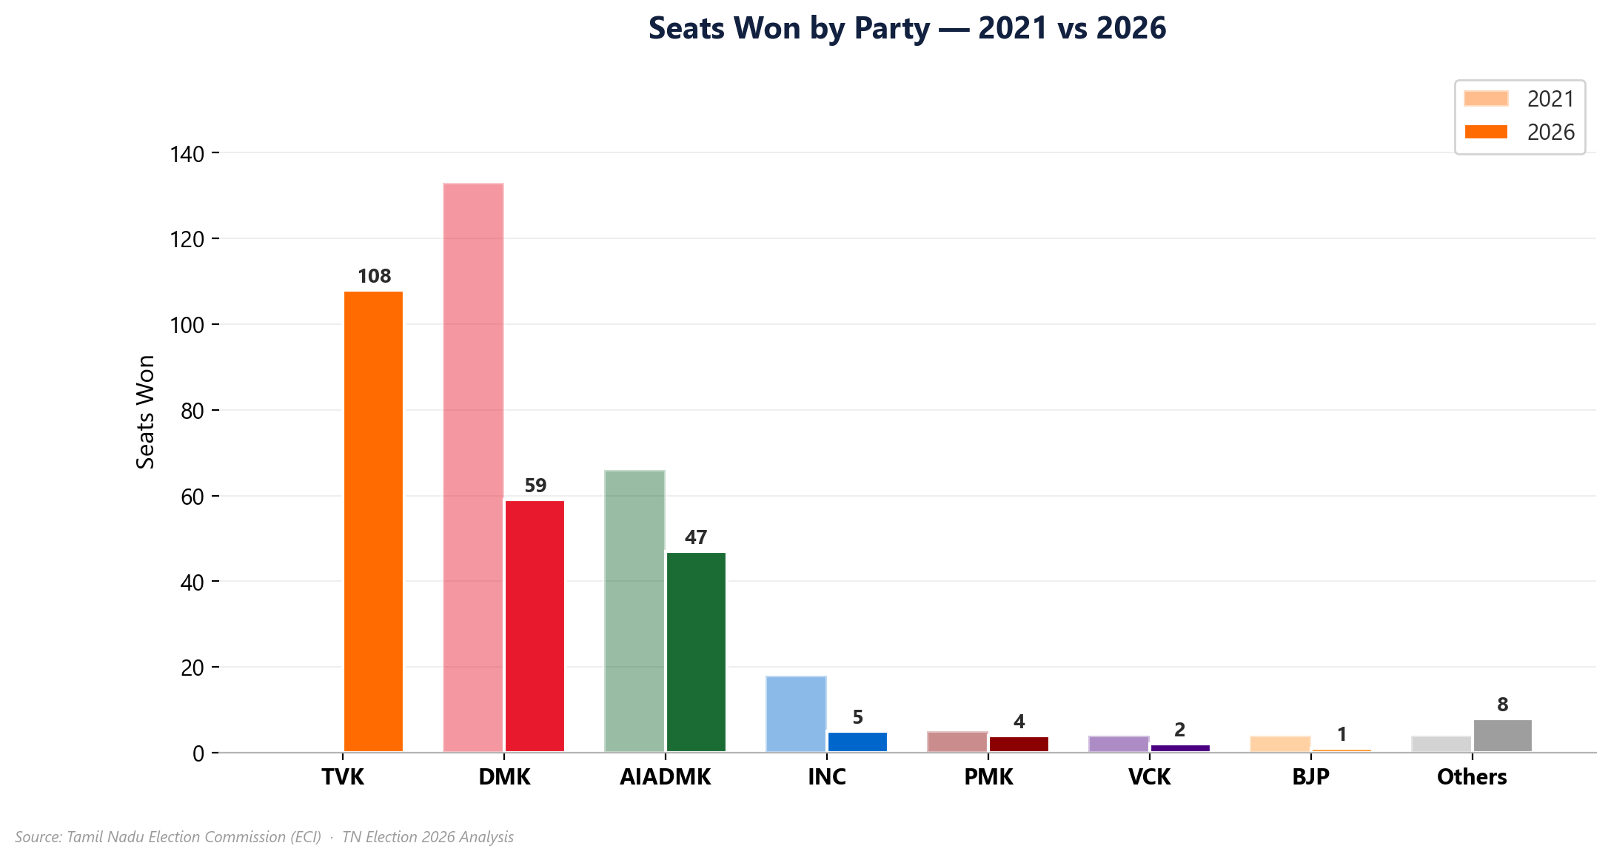
The 2026 Mandate
Seats won by party — comparison with 2021
Tamil Nadu Assembly Elections — Data Analysis 2026
Page 2 of 10

Slide 4
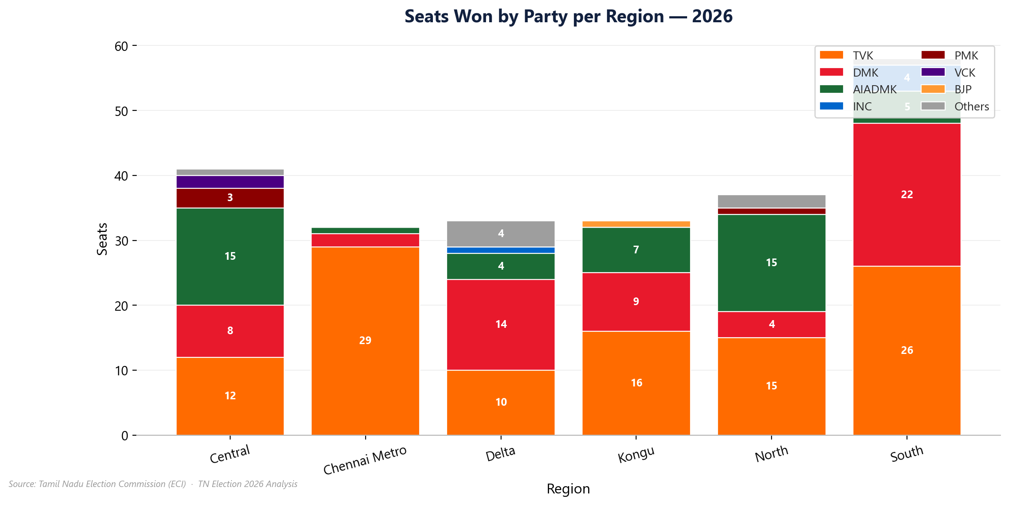
Regional Dominance
Seats won per party across Tamil Nadu's 6 regions — 2026
Tamil Nadu Assembly Elections — Data Analysis 2026
Page 3 of 10

Slide 5
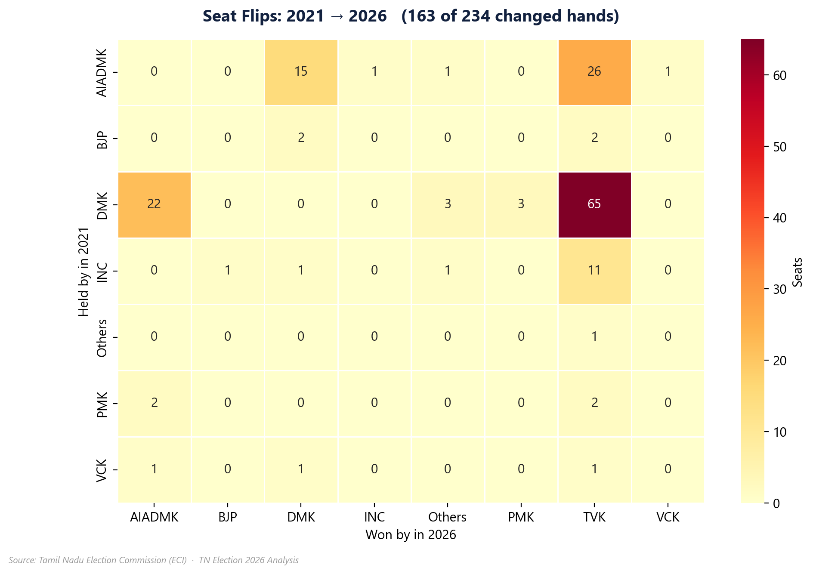
The Flip Story
163 of 234 constituencies changed hands — who gained, who lost?
Key Insights
• 163 seats (70%) changed party
• 71 seats retained same party
• Row = party that HELD seat in 2021
• Column = party that WON in 2026
• Number = seats that moved between
those two parties
• TVK made significant inroads into
seats previously held by other parties
• AIADMK was the biggest loser,
surrendering seats across regions
Tamil Nadu Assembly Elections — Data Analysis 2026
Page 4 of 10

Slide 6
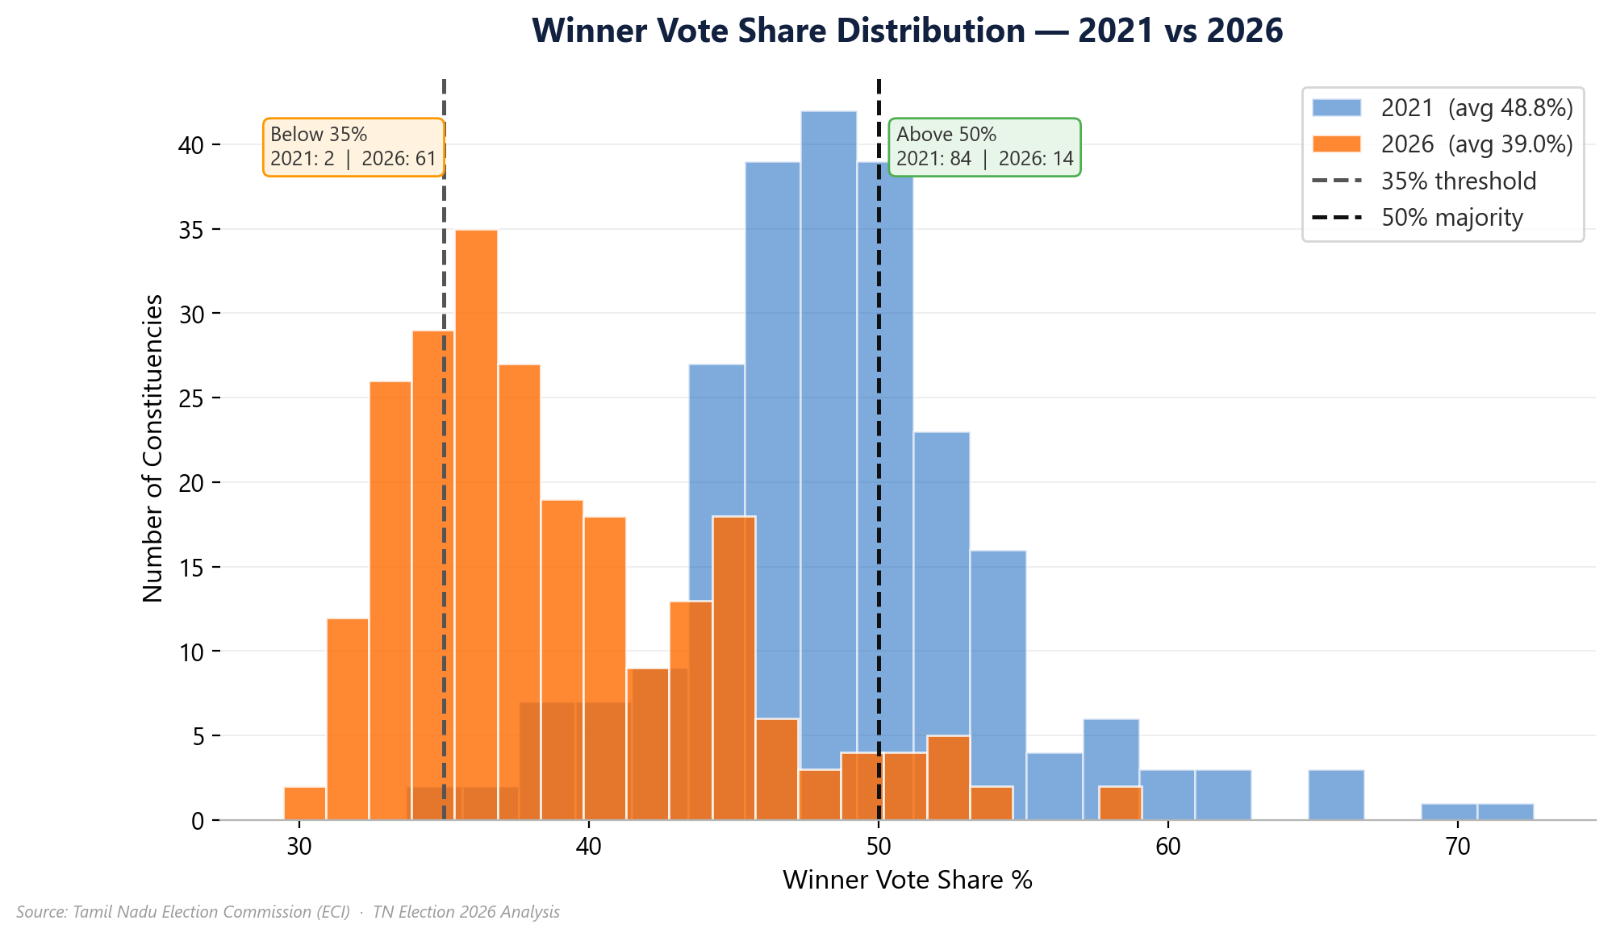
Margin of Victory
Are elections getting more competitive? Vote share distribution 2021 vs 2026
Statistics
Avg Share 2021
48.8%
Avg Share 2026
39.0%
>50% winners 2021
84
>50% winners 2026
14
<35% winners 2021
2
<35% winners 2026
61
Tamil Nadu Assembly Elections — Data Analysis 2026
Page 5 of 10

Slide 7
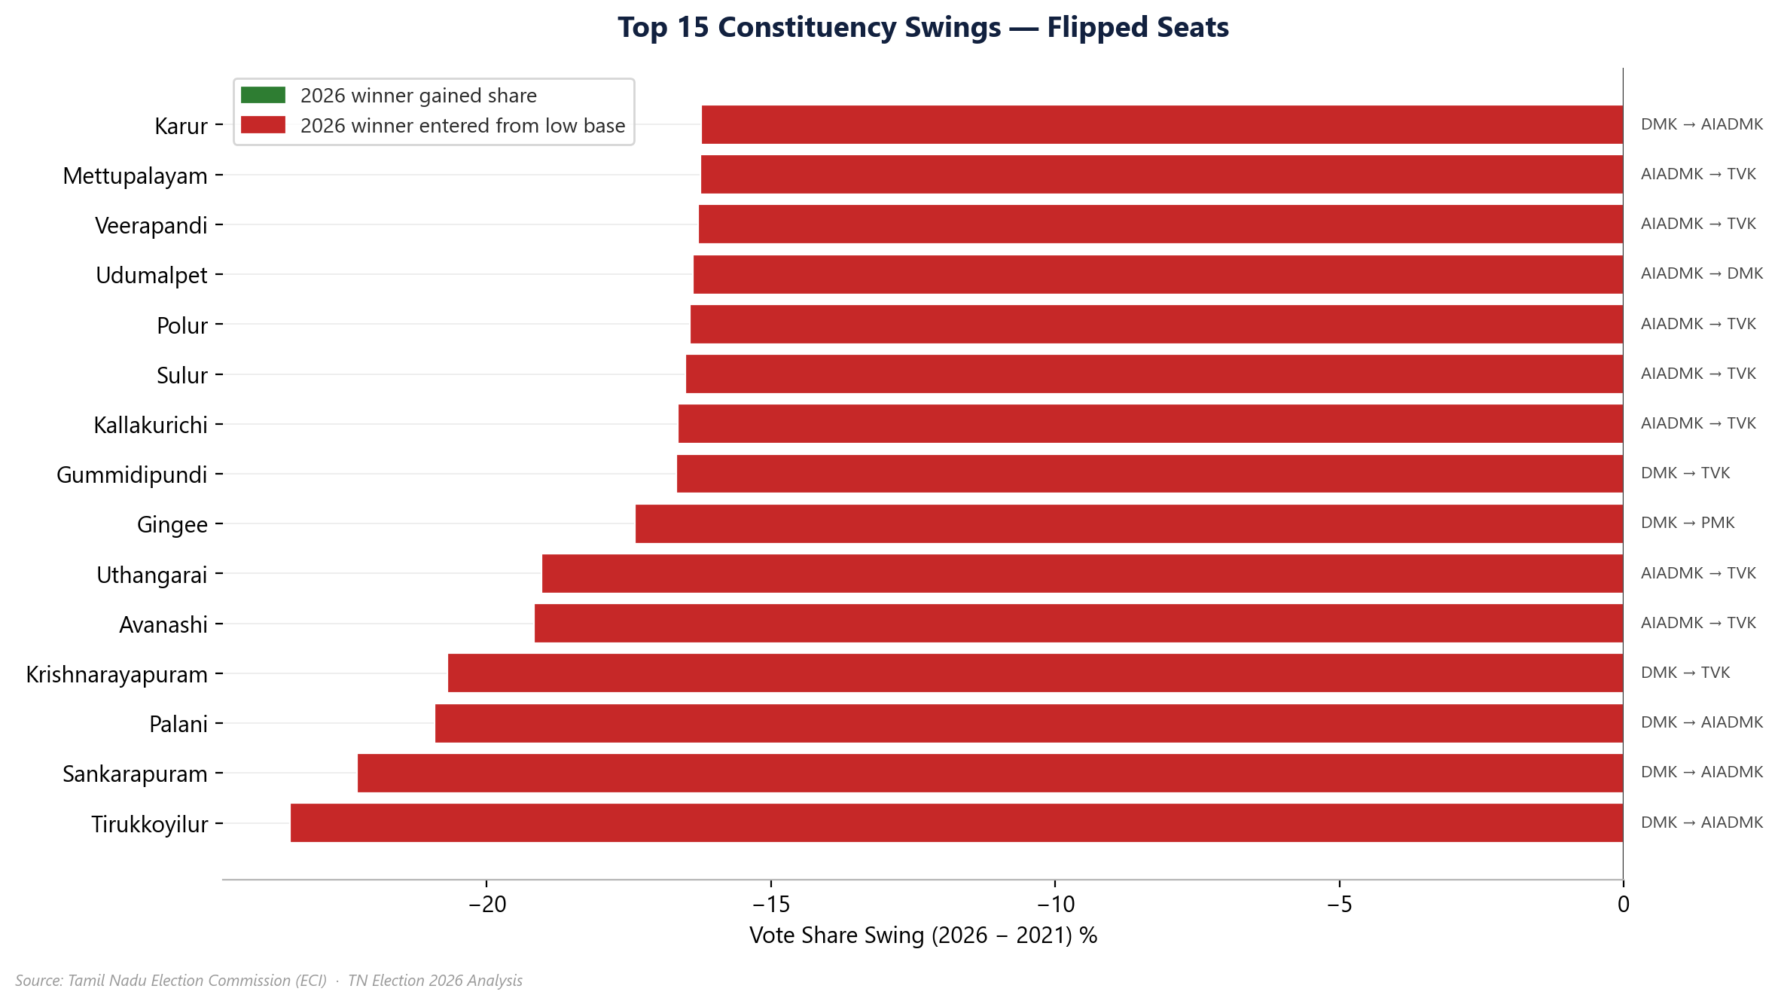
Biggest Swings
Constituencies with the largest vote-share change in flipped seats
Tamil Nadu Assembly Elections — Data Analysis 2026
Page 6 of 10

Slide 8
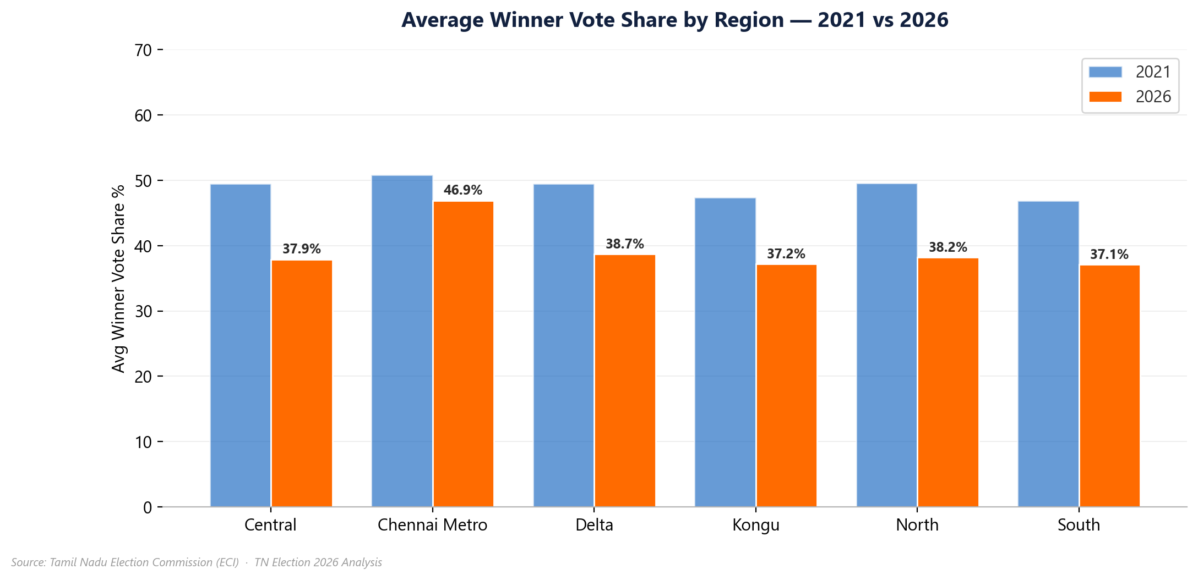
Regional Competitiveness
Average winner vote share by region — 2021 vs 2026
Tamil Nadu Assembly Elections — Data Analysis 2026
Page 7 of 10

Slide 9
Key Takeaways
Summary of findings from the 2026 Tamil Nadu Assembly Election
Electoral Shift
TVK emerged as the largest party with 108 seats, representing a significant realignment in Tamil Nadu politics.
Seat Churn
163 of 234 constituencies (70%) changed hands — indicating a strong anti-incumbency wave.
Closer Contests
Average winner vote share fell from 48.8% (2021) to 39.0% (2026), reflecting highly competitive multi-cornered contests.
Fragmented Mandate
61 winners secured victory with under 35% of the vote — a sign of vote splitting across new parties and independents.
Regional Patterns
No single party swept all 6 regions; dominance is geographically concentrated, making regional coalition arithmetic crucial.
Tamil Nadu Assembly Elections — Data Analysis 2026
Page 8 of 10

Slide 10
Thank You
Questions & Discussion
Data: Tamil Nadu Election Commission | Analysis: TN Election 2026 Dashboard | June 2026

