Slide 1
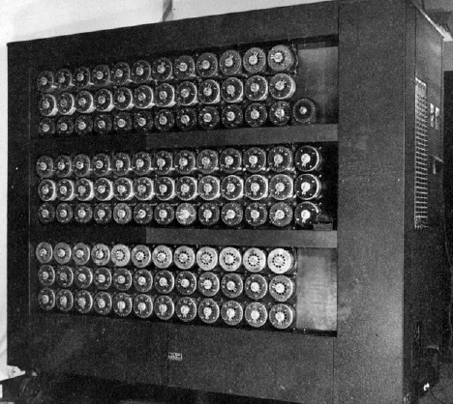
ENG4200 — Coursework 2
Predicting customer churn: A comparative study of ML pipelines
Group ID: Telco-CW2-C
Group members: Ayush Bhandge (3148137B), Prathamesh Deepak Bagal (3154253B), Karthik Mandigiri (3155271M), Nathan Sidi Bakari (3071212S), Zefu Wang (3136524W), Jiangyue Yao Zhao (3084311Z)

Slide 2
Predicting customer churn
Binary classification on the Telco Customer Churn dataset.
Goal: build rigorous ML pipelines, not chase raw accuracy.
Evaluate models along three axes:
predictive performance (F1, ROC-AUC),
computational efficiency (train + predict time),
overfitting resistance (CV gaps).
Deliver: best pipeline + interpretable fallback.

Slide 3
Dataset characteristics
7043 samples × 20 features.
Mixed feature types: charges, contract, internet service, tenure.
Clear class imbalance: 26.5% churn.
Meaningful heterogeneity → non-linear structures likely.
Business cost of false negatives (missed churners) is high.

Slide 4
Dataset characteristics
Insert plot: Churn class balance

Slide 5
Standardised ML pipeline
Identical structure for all models:
Cleaning: TotalCharges coercion, collapsing "No internet/phone service".
Preprocessing:
numeric → median impute + standardise
categorical → most-frequent + OHE (drop binary dummies)
Classifier: LR / DT / SVM / RF / GB
Ensures comparability and avoids data leakage.

Slide 6
Standardised ML pipeline
Insert diagram: Pipeline schematic

Slide 7
Five supervised learning models
Logistic Regression (L2-reg, C=0.01)
Decision Tree (depth=3)
SVM (RBF, C=0.1)
Random Forest (200 trees, depth=12)
Gradient Boosting (200 estimators, Ir=0.05)
These cover the entire supervised spectrum of the course materials: linear → kernel → tree → ensembles.

Slide 8
Accuracy & overfitting (CV)
Key observations from 5-fold CV:
Random Forest: highest mean F1 (0.639), good ROC-AUC (0.845).
Logistic Regression: stable, minimal overfitting (gap = 0.01).
Decision Tree: competitive F1 but highest overfitting (gap = 0.05).
SVM & Gradient Boosting: strong ROC-AUC but not leading F1.

Slide 9
Accuracy & overfitting (CV)
Insert table: CV results

Slide 10
Final held-out performance
On the independent test set:
Random Forest = best F1 (0.630)
Decision Tree = fastest (0.04 s)
SVM = highest cost (≥ 4 s)
Gradient Boosting = best ROC-AUC (0.846) but lowest F1

Slide 11
Final held-out performance
Insert table: Test benchmark (train time, predict time, F1, ROC–AUC)

Slide 12
Performance vs. training cost
Using the frontier logic:
A model is dominated if another is at least as fast and strictly better in F1.
Frontier contains only:
Decision Tree (fastest)
Random Forest (highest F1)
Dominated: LR, SVM, GB (all slower + worse F1).

Slide 13
Performance vs. training cost
Insert plot: F1 vs train time (efficient frontier)

Slide 14
Justification of chosen pipeline
Best F1 (0.630) and strong ROC-AUC.
Only slightly slower than the Decision Tree (fractions of a second).
Variance reduction via bagging + feature subsampling.
Learns non-linear, interaction-rich decision rules without feature engineering.
Diagnostics confirm good generalisation and no severe underfitting.

Slide 15
Random Forest diagnostics
Confusion matrix: good recall + balanced precision.
ROC curve: smooth, AUC = 0.85.
Precision-recall curve: strong performance for minority class.
Learning curve: training/validation F1 converge → moderate variance.
Feature importances: Contract, tenure, charges, fibre optic.

Slide 16
Random Forest diagnostics
Insert plots:
• Confusion matrix
• ROC + PR curves
• Learning curve
• Top-k feature importances

Slide 17
Final model recommendation
Primary model: Random Forest
best F1, strong ROC-AUC, low computational cost
robust variance behaviour
good diagnostics
Secondary (interpretable) model: Decision Tree
extremely fast
transparent rules
Structured experiment design and methodological discipline were the key.

Slide 18
Thank you!
Questions?

