Slide 1
Crashly
Accident Damage Detection and Repair Cost Estimation
BY TEAM NexVyd
Track: Optimized Insurance Solutions

Slide 2
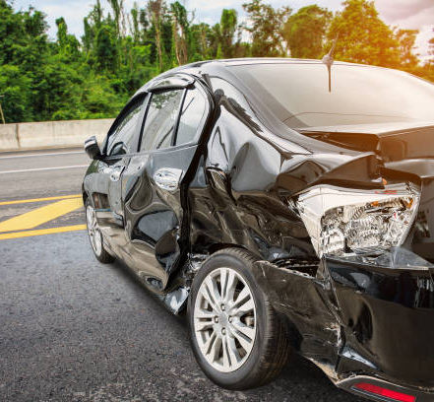
Problem Statement:
Challenges in Vehicle Damage Assessment & Insurance Claims
Manual damage assessment is time-consuming and prone to errors.
Lack of accurate repair cost estimation leads to disputes.
Insurance claim processing is inefficient and delayed.

Slide 3
Proposed Solution
Crashly - AI-Powered Accident Assessment System
Uses YOLOv8 for real-time vehicle damage detection.
Estimates repair costs based on detected damages.
Provides a user-friendly web interface for seamless experience.
Can be Integrated with insurance systems for claim processing.

Slide 4

Innovation & Creativity
AI-driven damage assessment ensures accuracy and speed.
Uses a custom-trained dataset for precise detection.
Automated cost estimation based on real-time data.
Potential integration with mobile applications & insurance databases.

Slide 5

Business Model & Market Impact
Revenue Streams:
Paid model for insurance companies.
One-time setup fee for workshops and garages.
Mobile App
Impact:
Reduces claim processing time.
Minimizes fraudulent claims.
Enhances customer experience.

Slide 6

How Crashly Works
User selects car model and uploads an image of the damaged vehicle.
YOLOv8 detects damaged parts (bonnet, bumper, windshield, etc.).
System estimates repair costs based on the car model and parts damaged
Results are displayed in real-time with highlighted damages with OpenCV
Data is stored in MySQL for future reference & claim processing.

Slide 7
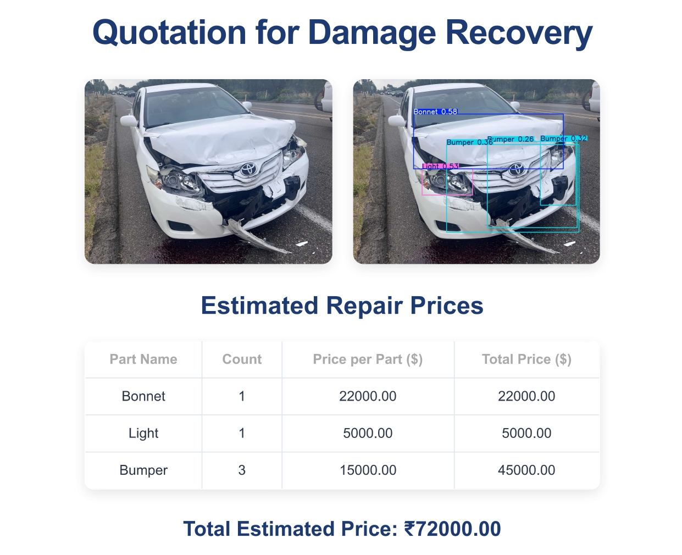

Slide 8
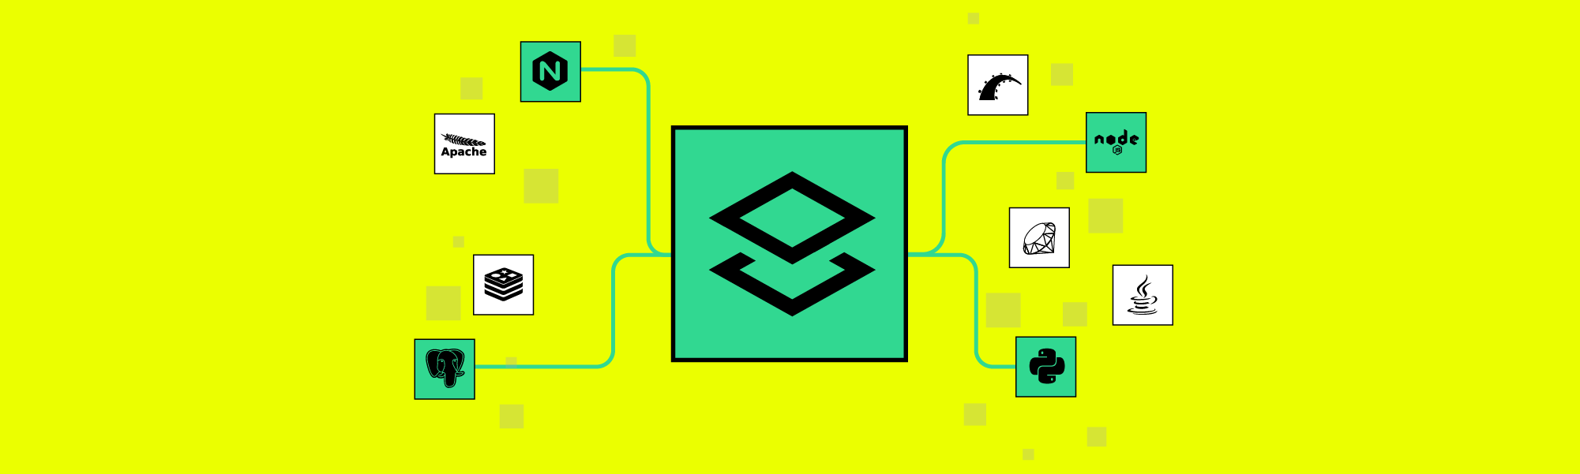
Tech Stack Behind Crashly
Backend:
Flask (Python web framework)
YOLOv8 (for object detection)
MySQL (for database management)
Frontend:
HTML/CSS (for user interface)
JavaScript (for frontend logic)
Libraries:
OpenCV (for image processing)
Matplotlib (for image visualization)
Ultralytics (YOLOv8 integration)

Slide 9
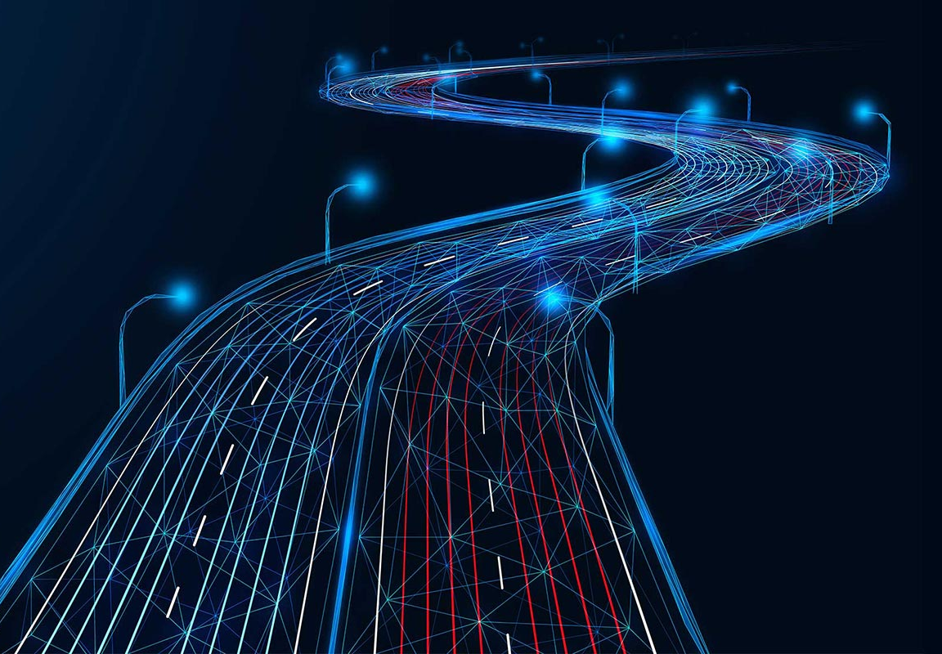
Future Improvements
Mobile App Development for on-the-go damage detection.
Damage Severity Analysis for better cost accuracy.
Integration with Insurance Providers for claim automation.

Slide 10
Thank You! Team NexVyd

