Slide 1
Pokhara Engineering College Phirke-8,Pokhara
“I RESERVE”
Presented by:-
Nabaraj Ghimire
9 March, 2018

Slide 2
Project Summary
It is a complete website for online seat reservation,
Admin can view all reservation request from user,
After reservation user get their confirmation.

Slide 3
Project Objectives
To provide web based Reservation System "I RESERVE" to online reservation of seat.

Slide 4
Front End Development
Popular web technologies like HTML(Hyper Text Markup Language), CSS(Cascading Style Sheets), JavaScript, etc are applied to develop the front end of the project.

Slide 5
Back End Development
Project utilizes two of the most powerful web development tools PHP(Hypertext Pre-Processor) and Mysql for the database.

Slide 6
Section and Modules
User Section
User can reserve required number of seats,
User got their confirmation after reservation,
User can give feedback about system.

Slide 7
Contd…
Admin Section
Admin can see user reservation request,
Admin can add route,
Admin can see user’s feedback,
Admin can update login details.

Slide 8
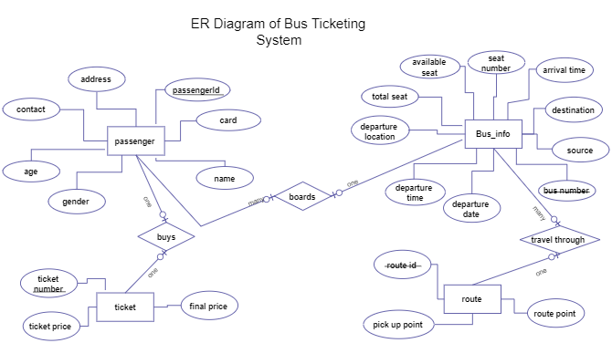
ER-Diagram

Slide 9
Limitation
No facilities to online payment,
This is for reservation only so user should go to contact office for ticket,
Request auto cancelled if ticket is not taken Three hour before departure.

Slide 10
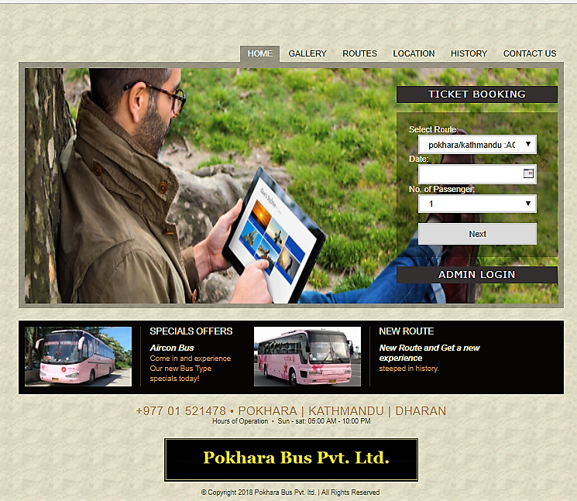
Index Page

Slide 11
Conclusion
This type of software can have good market in the contest of Nepal,
With the use of PHP language this system is fast proceed,
It requires minimal hardware port and it is GUI based so.

Slide 12
Thank You !!!

