Slide 1
Pokhara Engineering College phirke, Pokhara
A final presentation on
Employee Manager Plus
Presented by:-
Nabaraj Ghimire(16070326)
Dinesh Subedi(16070318)
B.E. Computer, 4th Semester
31 Jan, 2018

Slide 2
Introduction
It is a complete web based platform for managing employee details with in office,
It will replace traditional Register Copy system,
The salary system of employee can be handled.

Slide 3
Project Objectives
To provide web based employee details, insert a new record, delete the record, update operation and salary records anywhere from entire world.

Slide 4
Front End Development
Popular web technologies like HTML(Hyper Text Markup Language), CSS(Cascading Style Sheets), JavaScript, etc are applied to develop the front end of the project.

Slide 5
Back End Development
Project utilizes two of the most powerful web development tools PHP(Hypertext Pre-Processor) and Mysql for the database.

Slide 6
Section and Modules
Manager Section
Validated manager can only enter in the system,
Manager can add new employee,
Manager can see record of employee,
Manager can delete the employee,
Manager can pay salary for employee,
Manager can alter his validation details.

Slide 7
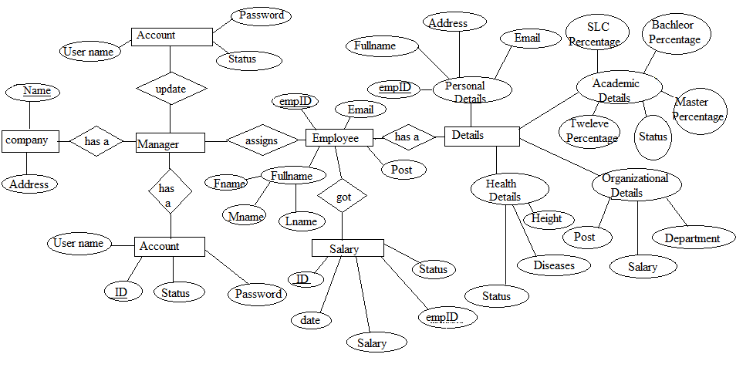
ER-Diagram

Slide 8
Limitations
No facilities to store records of daily attendance,
Salary payment is not online.

Slide 9
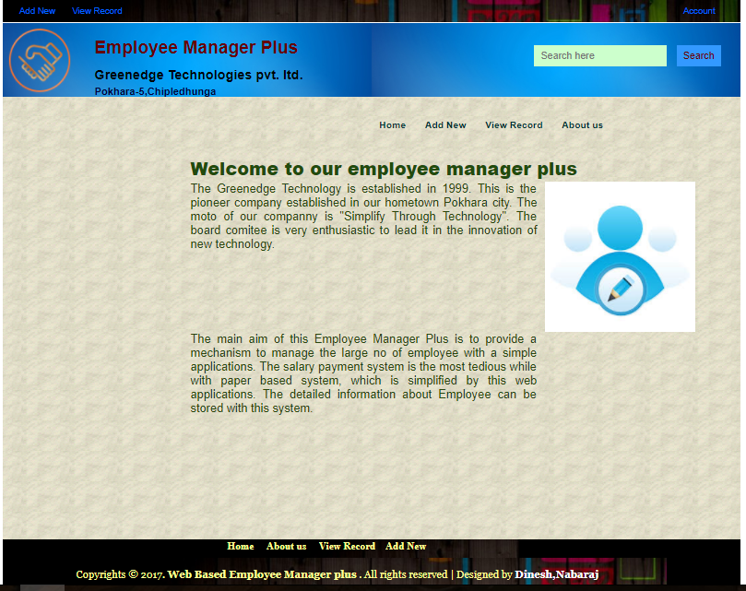
Home Page

Slide 10
Conclusions
This type of software can have good market in the contest of Nepal,
With the use of PHP language this software is fast proceed,
It requires minimal hardware port and it is GUI based so.

Slide 11
Thank You!!

