Slide 1
E-Kalaa
-Anzila Gurung
-Nabaraj Ghimire
-Sanjib Sharma

Slide 2
E-Kalaa
‘an E-commerce website which is aimed to provide online selling and buying of Arts, Sculptures, Sketches and Crafts’

Slide 3
Project Objective
The main objective of our project is to provide a reliable way for the customers to buy arts, sketches, sculptures through our website
‘E-Kalaa’ .

Slide 4
Front end development
Popular web technologies like HTML(Hyper Text Markup Language), CSS(Cascading Style Sheets), JavaScript, etc are applied to develop the front end of the project.

Slide 5
back end development
Project utilizes two of the most powerful web development tools PHP(Hypertext Pre-Processor) and Mysql for the database.

Slide 6
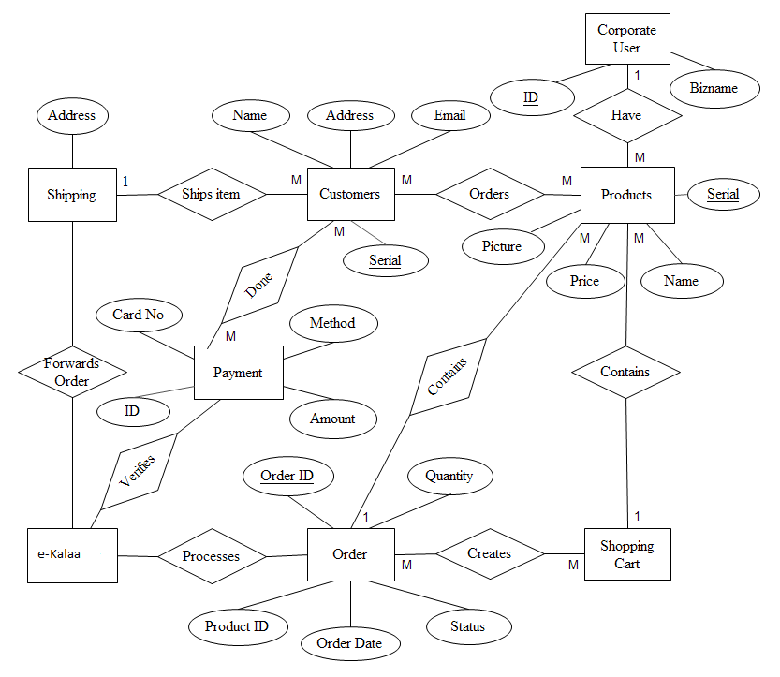
E-r diagram

Slide 7
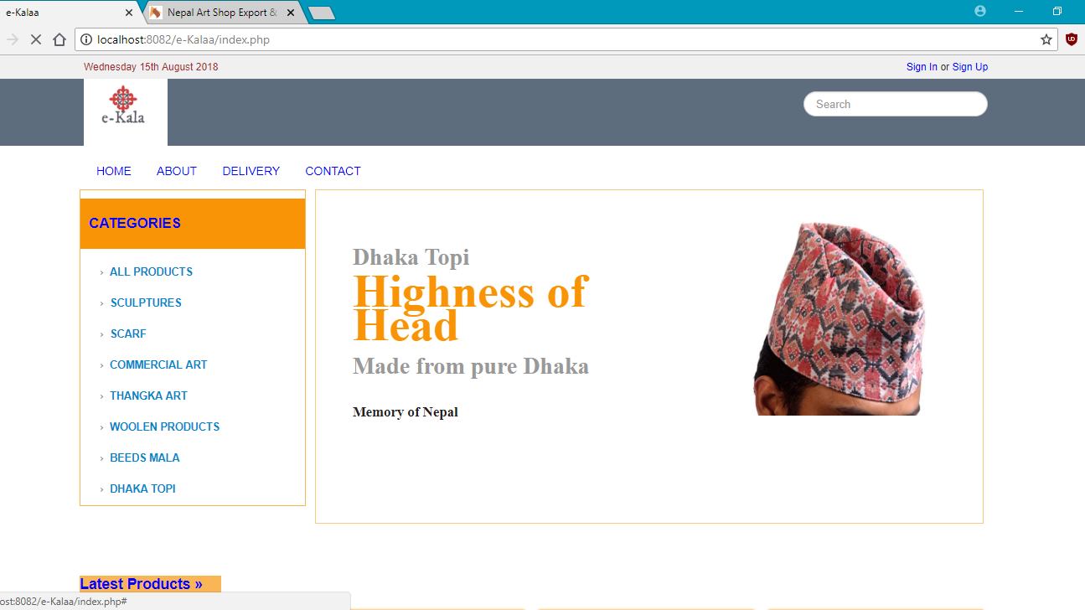
HOME PAGE

Slide 8
Limitations
There is no other payment gateway except Khalti.
There is no facility of email subscription.

Slide 9
Conclusion
This type of software can have good market in the contest of Nepal,
With the use of PHP language this software is fast proceed.
It requires minimal hardware port and it is GUI based so.

Slide 10
thank you

