Slide 1
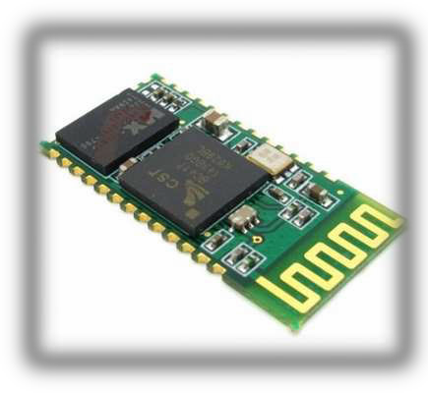
INTERFACING BLUETOOTH WITH ARDUINO

Slide 2
HIGHLIGHTS OF HC-05 BLUETOOTH MODULE
1.8 to 3.6V Input/Output.
Uses Bluetooth SPP (Serial Port Protocol).
Supports baud rate: 9600,19200,38400,57600,115200,230400,460800.
UART interface with programmable baud rate.
Range is approximately 10 Meters (30 feet).
2.4GHz radio transceiver and baseband.

Slide 3
MODIFY THE HC-05 BLUETOOTH MODULE DEFAULTS USING AT COMMANDS:
WIRING
HC-05 GND --- Arduino GND Pin.
HC-05 VCC (5V) --- Arduino 5V.
HC-05 TX --- Arduino Pin 10 (software RX).
HC-05 RX --- Arduino Pin11 (software TX).
HC-05 Key (PIN 34) --- Arduino Pin 9.

Slide 4
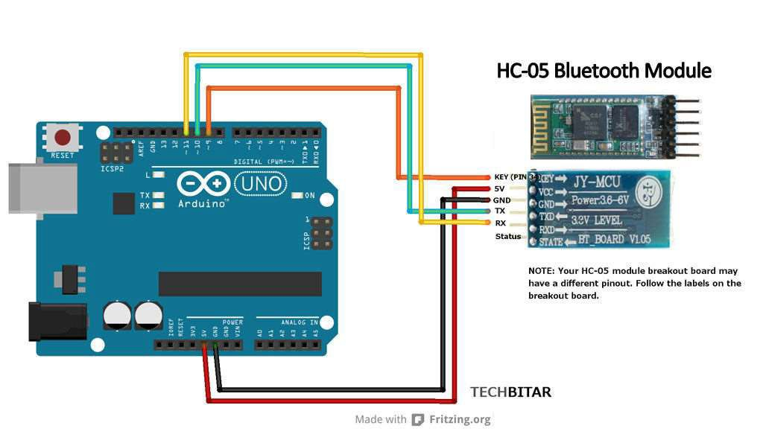
SCHEMATIC DIAGRAM

Slide 5
THE ARDUINO CODE FOR HC-05 COMMAND MODE
The Arduino program does two things.
It takes the AT commands you enter from the Arduino IDE Serial Monitor and sends those commands to the HC-05.
The program then reads the output of the HC-05 and displays
it on the Arduino IDE Serial Monitor.
The Arduino communicates with the HC-05 using the SoftwareSerial ports while the Arduino communicates with the user via the Serial Monitor.

Slide 6
STEPS TO SWITCH THE HC-05 INTO COMMAND MODE
For the HC-05 module to switch to AT command mode, the HC-
05 pin 34 (Key pin) needs to pulled HIGH as explained below.
When the HC-05 enters the AT command mode, it will communicate at 38400 baud rate.
In Arduino IDE Also change "no line ending " to "both NL & CR" found just beside the baud rate.

Slide 7
FOLLOW THESE STEPS IN THE STATED
ORDER TO SWITCH TO THE HC-05 TO AT COMMAND MODE.
Wire the HC-05 and Arduino Uno per instructions.
BEFORE YOU CONNECT THE ARDUINO TO THE USB remove the VCC (power) red wire from the HC-05 so it's not getting any power from the Arduino. All other wires are still connected.
Now connect the Arduino Uno to the USB cable extended from your PC.
Make sure the HC-05 module is NOT PAIRED with any other Bluetooth device.
Holding the push button on HC-05 re-connect the Arduino Uno 5V wire to the HC-05's VCC (5V power) pin.
The HC-05 LED will blink on and off at about 2 second intervals. Now the HC-05 is in AT command mode ready to accept commands to change configuration and settings.
7. To test if everything is wired correctly,
open the Serial Monitor from the
Arduino IDE and type "AT" and click SEND. You should see an "OK"
8. If you don't see an "OK" check your wiring.

Slide 8
HC-05 AT COMMANDS
To return HC-05 to mfg. default settings: "AT+ORGL"
To get version of your HC-05 enter: "AT+VERSION?"
To change device name from the default HC-05 to let's say MYBLUE enter: "AT+NAME=MYBLUE"
To change default security code from 1234 to 2987 enter:
"AT+PSWD=2987"
To change HC-05 baud rate from default 9600 to 115200, 1 stop bit, 0 parity enter: "AT+UART=115200,1,0"

Slide 9
SENDING AND RECEIVEING DATA THROUGH BLUETOOTH
Connect Rx of HC-05 to Tx of Arduino, and Tx of HC-05 to Rx of Arduino
Similar to the Serial monitor, we need to initialize the Serial to a certain baud rate.
First, Check the availability of Serial.
Serial.read: to read data from device connected to the HC-05.
Serial.print and Serial.write: to send data to a Bluetooth device connected to the HC-05.

