Slide 1

Machine Learning Based String Matching
Author – Nabarko Roy
This Photo by Unknown Author is licensed under CC BY

Slide 2
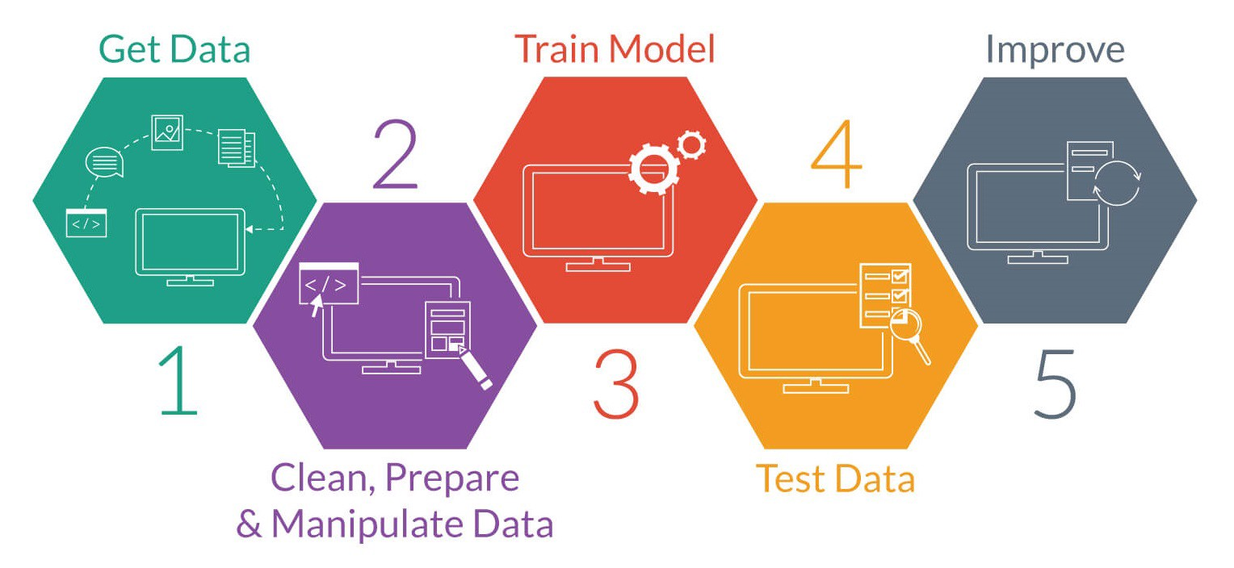

Project Training Approach
Model Storage FS/Container/Database

Slide 3
Data Transformer
Levensthien Distance
Cosine Similarity
Collated Data & Columns
Fuzzy Similarity
Fuzzy Abbv Similarity
Prediction
Part
{
"source" : {
"formatName": "supplier1Format",
"formatFields": [ "BATCH_REFERENCE", "TRANSACTION_REFERENCE",
"BUYER_NAME", "SUPPLIER_NAME" ,
"INVOICE_REFERENCE", "PO_REFERENCE",
"INVOICE_DATE", "INVOICE_AMOUNT", "INVOICE_CURRENCY",
"MATURITY_DATE", "PAYMENT_DATE", "TENOR", "NET_AMOUNT",
"GROSS_AMOUNT", "DISCOUNT_AMOUNT",
"ADJUSTMENT_AMOUNT", "ADJUSTMENT_REASON_CODE",
"PAYMENT_TERM", "STATUS", "NOTES"
]
},
"target" : {
"formatName": "buyer1Format",
"formatFields": [ "batchReference", "transactionReference", "buyerName",
"supplierName", "invoiceReference", "poReference",
"invoiceDate", "invoiceAmount", "invoiceCurrency", "maturityDate",
"paymentDate", "tenor", "netAmount", "grossAmount",
"discountAmount", "adjustmentAmount",
"adjustmentReasonCode", "paymentTerm", "status", "notes"
]
}
}
Cleaning up the data/strings & Forming Column wise Mapping
Adding a Match Column
Only valid for Learning Part

Slide 4
Algorithms
Algorithms Tried
Decision Trees
Random Forests *
XgBoost *
MLP (Multi-layer Perceptron)
* Tried but haven’t saved due to worst performances.

Slide 5






Solution Overview
Models
Lev Distance Similarity
Fuzzy Similarity
User
Data Mapper
Json O/P Mapper
Query Mapper
Fuzzy Abbv Similarity
Confidence Score
Post Query
Prediction Unit
Cosine Similarity
{
"source" : {
"formatName": "supplier1Format",
"formatFields": [ "BATCH_REFERENCE", "TRANSACTION_REFERENCE",
"BUYER_NAME", "SUPPLIER_NAME" ,
"INVOICE_REFERENCE", "PO_REFERENCE",
"INVOICE_DATE", "INVOICE_AMOUNT", "INVOICE_CURRENCY",
"MATURITY_DATE", "PAYMENT_DATE", "TENOR", "NET_AMOUNT",
"GROSS_AMOUNT", "DISCOUNT_AMOUNT",
"ADJUSTMENT_AMOUNT", "ADJUSTMENT_REASON_CODE",
"PAYMENT_TERM", "STATUS", "NOTES"
]
},
"target" : {
"formatName": "buyer1Format",
"formatFields": [ "batchReference", "transactionReference", "buyerName",
"supplierName", "invoiceReference", "poReference",
"invoiceDate", "invoiceAmount", "invoiceCurrency", "maturityDate",
"paymentDate", "tenor", "netAmount", "grossAmount",
"discountAmount", "adjustmentAmount",
"adjustmentReasonCode", "paymentTerm", "status", "notes"
]
}
}
Data Transformer Block

