Slide 1




Project title: skill-bridge tech

Slide 2
Group Members:
Nabeeha Shoaib 2025-CS-190
Alishba Bibi 2025-CS-203
Isma Wasif 2025-CS-226
Kainat Nasir 2025-CS-232
Anfaal Abbas 2025-CS-233

Slide 3
Objectives:
To provide students with web development skills using HTML, CSS, JavaScript, and modern frameworks.
To help learners build real-world websites and practical projects.
To develop strong programming skills in C++, Python, and problem-solving.
To strengthen students’ technical foundations through hands-on learning.
To support career readiness by offering projects, guidance, and industry-relevant skills.
To prepare students for real job opportunities in the tech industry.

Slide 4
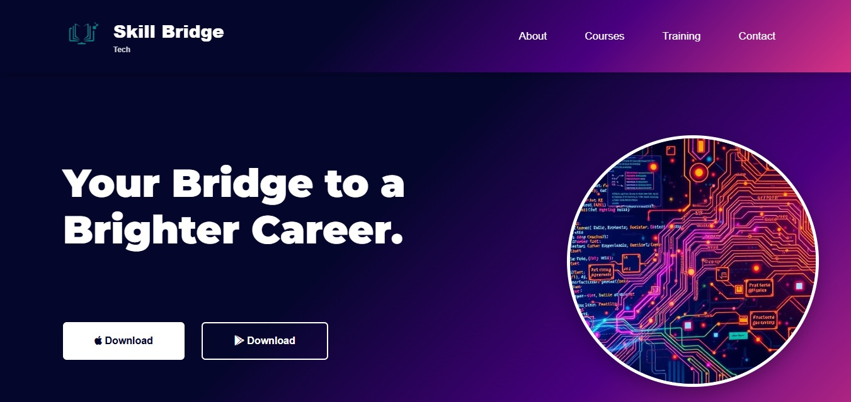
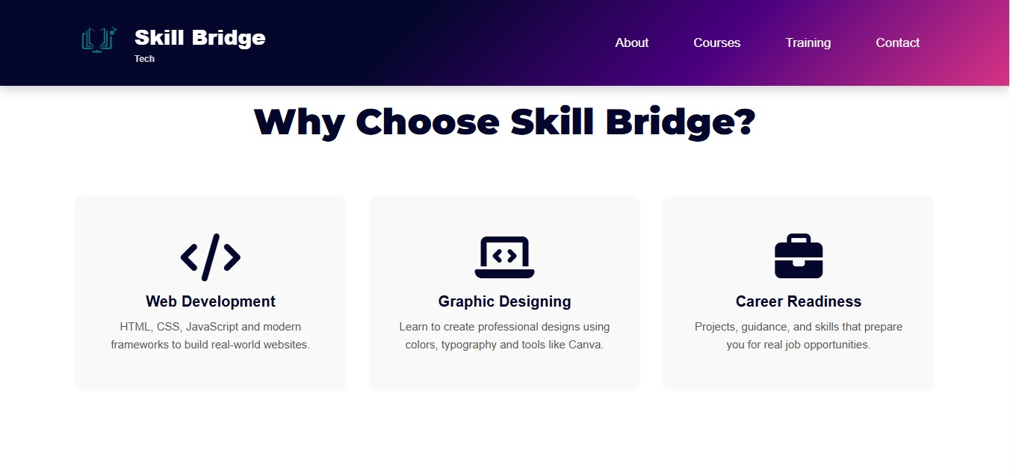
Home Page:

Slide 5
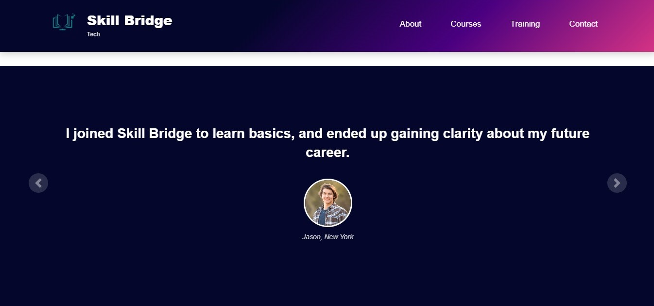
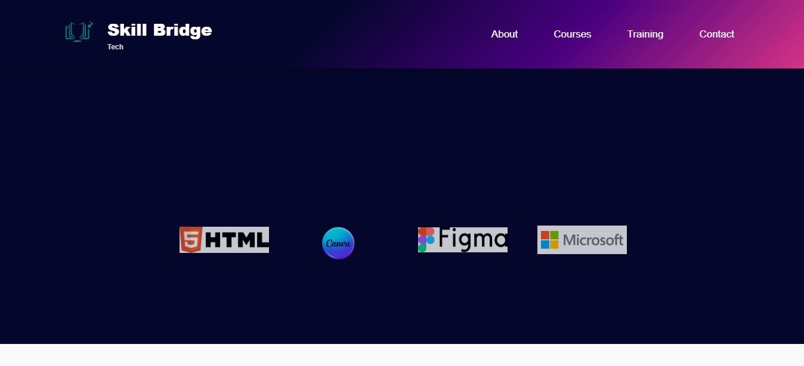

Slide 6
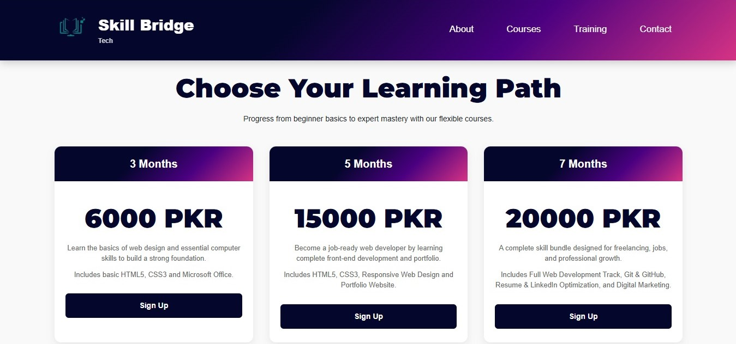
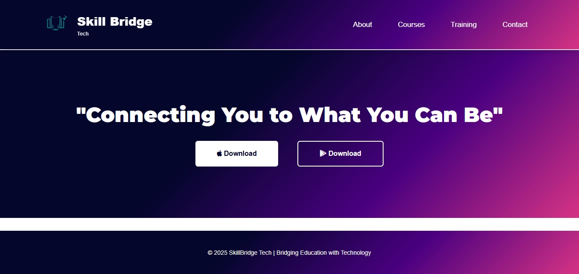

Slide 7
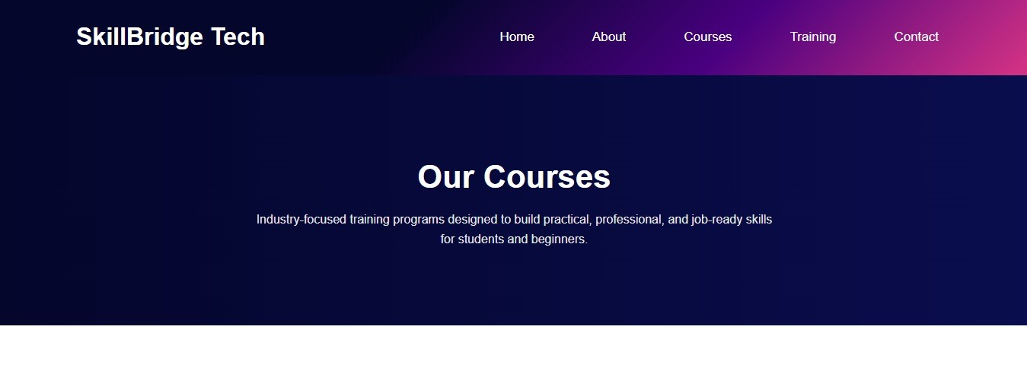
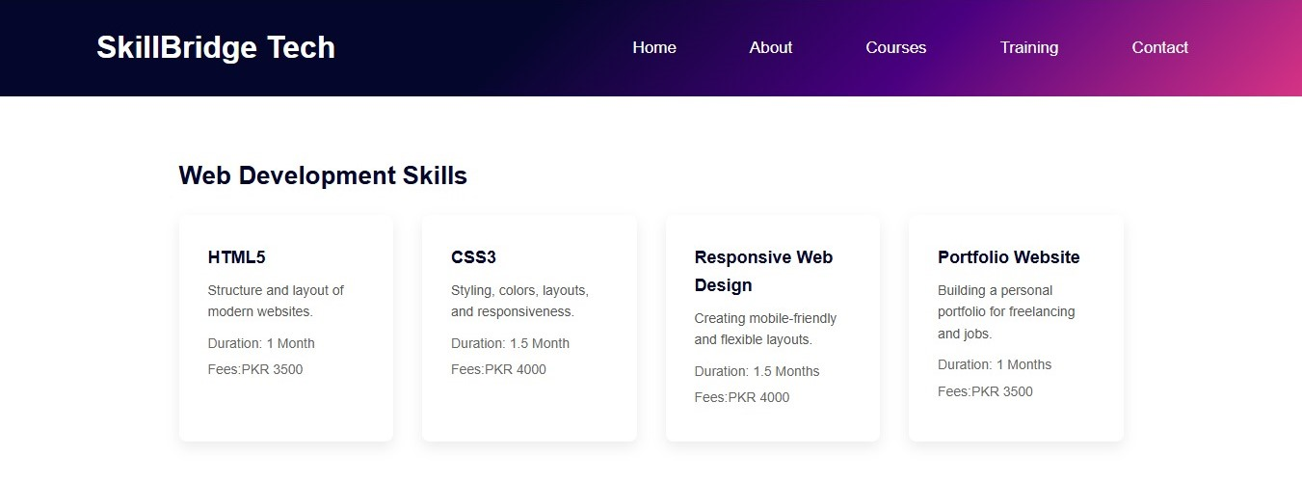
Courses Page:

Slide 8
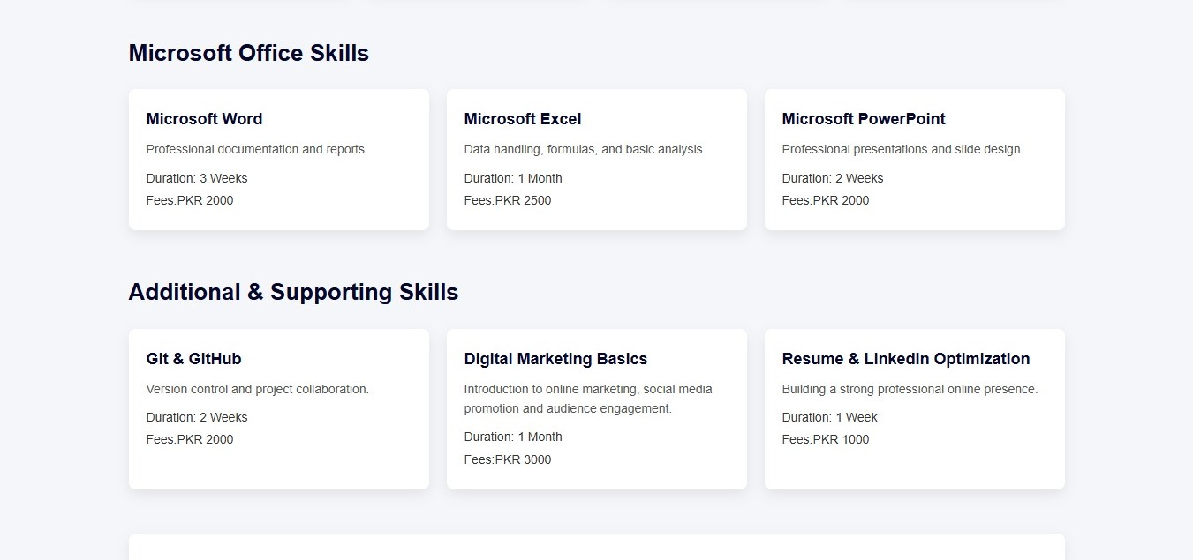
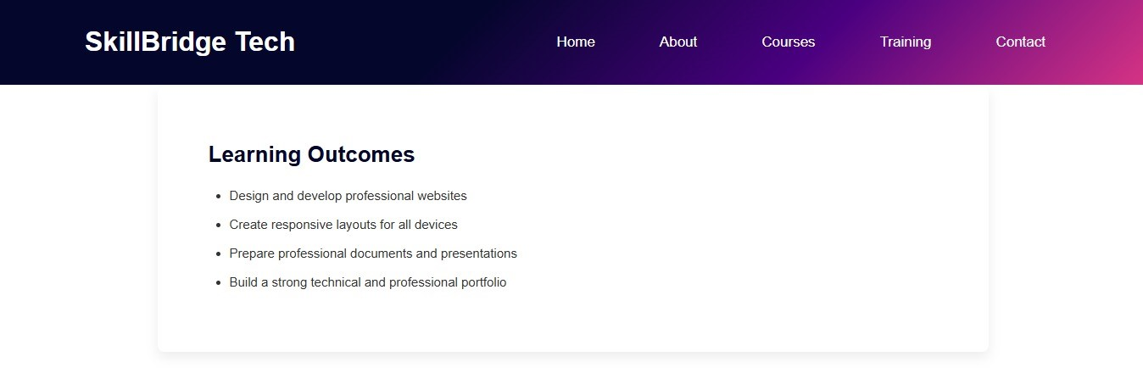

Slide 9
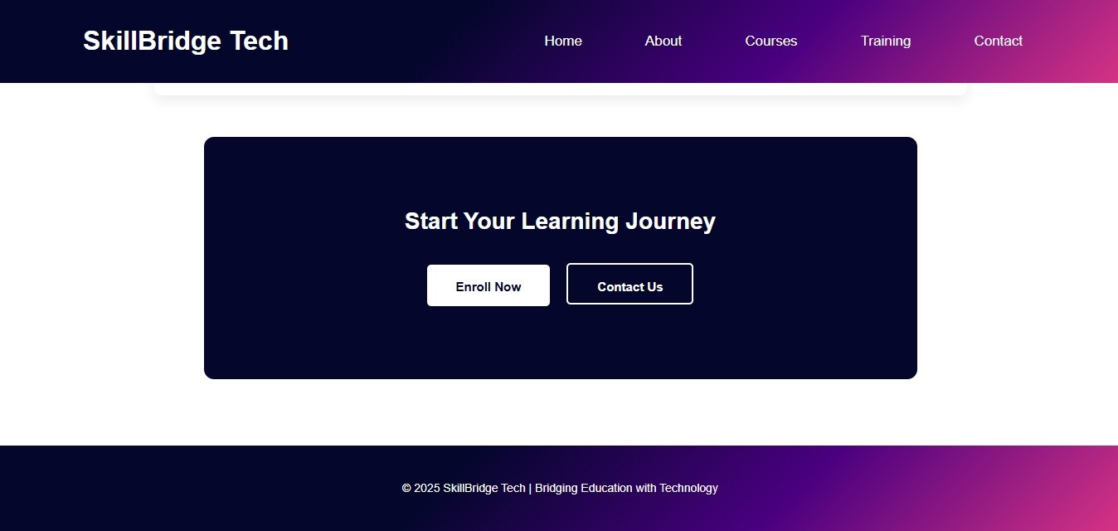

Slide 10
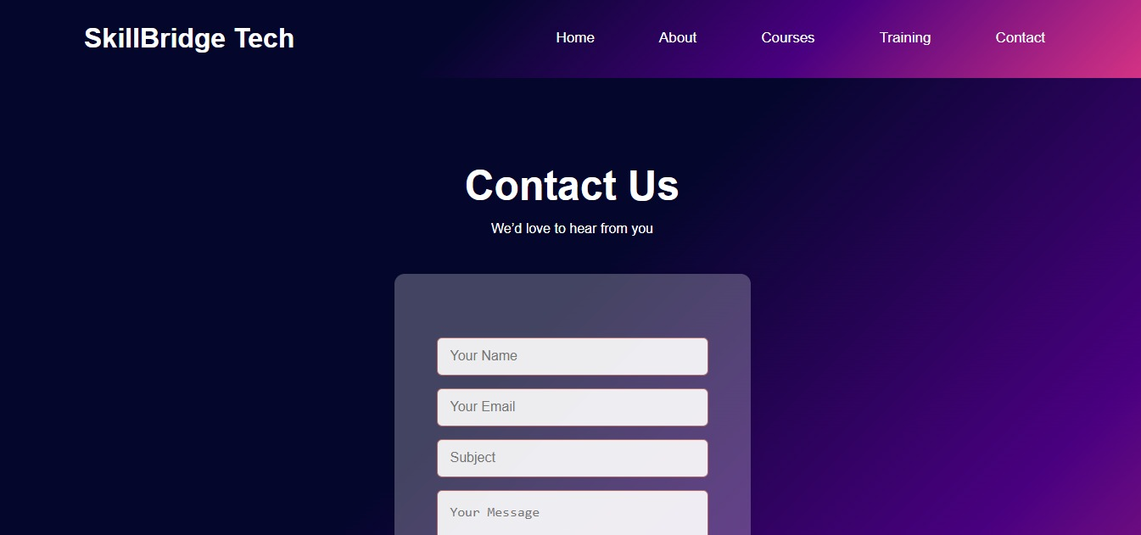
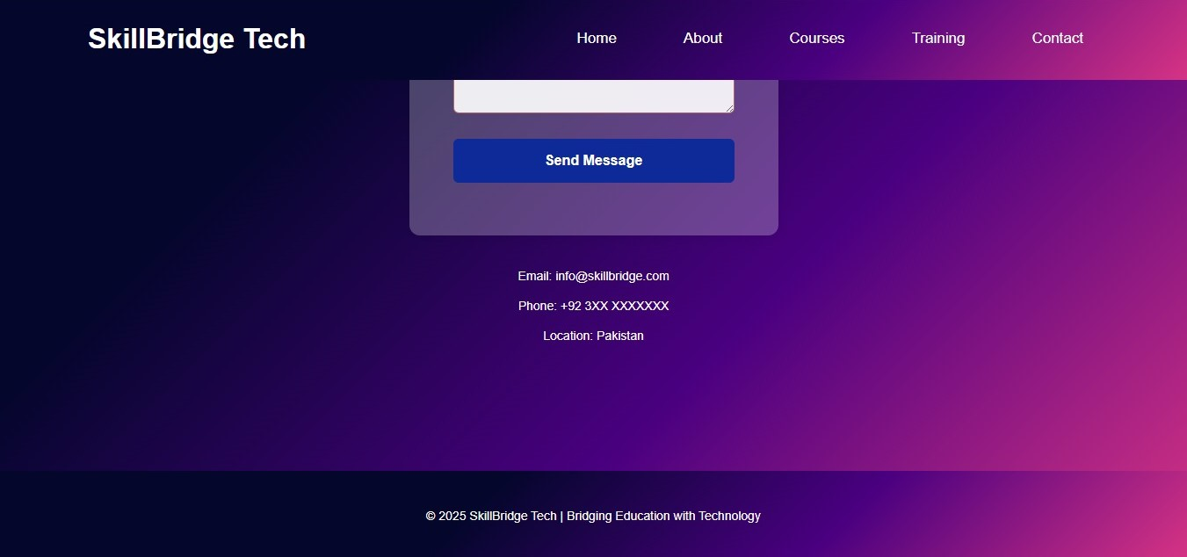
Contact Page:

Slide 11
Reflection:
Students have gained practical tech skills in web development, programming, and problem-solving.
Hands-on projects have helped learners apply skills to real-world scenarios.
Career guidance has increased students’ confidence and job readiness.
The company has successfully bridged the gap between education and industry demands.

Slide 12
Next steps:
Expand advanced tech courses and frameworks.
Introduce certifications recognized by the industry.
Partner with companies for internships and placements.
Launch mentorship programs and online assessments.

Slide 13
Data Summary – Student Enrollment Analysis (Column Chart)
HTML: 8 students (highest enrollment)
CSS: 7 students
Git & GitHub: 7 students
Microsoft Office: 6 students
Digital Marketing: 6 students
LinkedIn: 4 students (lowest enrollment)

Slide 14
Overall insights:
Enrollment is strongest in web development basics (HTML, CSS).
Git & GitHub also shows high interest, equal to CSS.
Microsoft Office and Digital Marketing have moderate enrollment.
LinkedIn has the least number of students, indicating lower interest compared to other courses.

Slide 15
Data Summary – Student Revenue by Course (Pie Chart)
HTML: 21% (highest revenue contribution)
CSS: 18%
Git & GitHub: 18%
Microsoft Office: 16%
Digital Marketing: 16%
LinkedIn: 11% (lowest revenue contribution)
Overall insights:
HTML generates the highest share of revenue.
CSS and Git & GitHub contribute equally and form the second-highest revenue group.
Microsoft Office and Digital Marketing provide moderate revenue.
LinkedIn contributes the least to overall student revenue.

Slide 16
Data Summary – Average Fee per Course
CSS: 3928.57 (Most expensive course)
Html: 3437.50
Digital Marketing: 3166.67
Microsoft Office: 2500.00
LinkedIn: 1000.00
Git & GitHub: 571.43 (Least expensive course)
Overall Average (Total): 2434.03

Slide 17
Overall Insights:
Highest Average Fee:
CSS has the highest average fee, with HTML slightly behind, showing strong demand for web development skills.
Pricing Gap:
There is a clear difference in pricing between technical web courses and basic tools; CSS costs almost 7 times more than Git & GitHub.
Mid-Range Courses:
Digital Marketing and Microsoft Office are moderately priced and sit close to the overall average.

Slide 18
Lowest Average Fee:
Git & GitHub is the cheapest course, but its high enrollment makes it a strong revenue contributor.
Benchmark Value:
The overall average fee is around 2434, which is useful for comparing expensive and affordable courses.

Slide 19
Design Decisions:
1. Dark Background with High-Contrast Text
Used a deep, dark background paired with bright white text.
Creates a modern, tech-focused aesthetic.
Improves readability and reduces eye strain during prolonged learning sessions.
2. Full-Width Hero Banner
Implemented a full-width banner on the header section.
Centered tagline “Your Bridge to a Brighter Career” to make it the first visual priority.
Ensures immediate brand recognition and clear messaging.
.

Slide 20
3. Clean and Simple Navigation
Designed a minimal top navigation menu.
Includes logically grouped sections: About, Courses, Training, Contact.
Enhances usability and allows users to find information quickly.
4. Typography Choice – Arial with Fallback
Chose Arial as the primary font for all headings (h1, h2, h3) because it is a modern, professional, and suitable for digital screens.
Included Helvetica and sans-serif as a fallback font to ensure consistent text appearance if the Arial font fails load, maintaining compatibility across different browsers and devices.

Slide 21
5. Modern Gradient Styling
Applied a CSS linear gradient to the hero section and the header/footer of all pages except the signup and login pages.
Gradient used:
linear-gradient(135deg, #04062c 40%, #4a0080 70%, #d63384 100%)
Adds visual interest while maintaining a professional and modern look.
Live Demo (Website):
https://nabeehashoaib.github.io/SkillBridge-Tech-AICT-Project/
GitHub URL:
1-https://github.com/NabeehaShoaib/SkillBridge-Tech-AICT-Project
2-SkillBridge-Tech-Project

Slide 22
Thank You!

