Slide 1
DSA GROUP PROJECT
SMART TRAFFIC
SURVEILLANCE SYSTEM
Automated Red-Light Violation Detection · License Plate Recognition · Real-Time Analysis

Slide 2
01 / PROBLEM & OBJECTIVE
Why This System?
THE PROBLEM
OUR SOLUTION
Red-light violations cause thousands of accidents annually
Manual officer monitoring is slow, costly and error-prone
Existing CCTV cameras cannot detect or log violations automatically
No automated plate capture means no evidence trail for enforcement
YOLOv8s detects vehicles and traffic lights in real time
Custom plate detector model localises license plates precisely
EasyOCR extracts plate text from cropped detections
User-drawn stop line flags any vehicle crossing it on RED

Slide 3
02 / SYSTEM ARCHITECTURE
How It All Works Together
01
02
03
04
05
VIDEO INPUT
YOLOV8s
PLATE DETECTOR
EASYOCR
VIOLATION LOG
Upload .mp4
or Live Camera (DroidCam)
Vehicle & traffic
light detection
(track, persist)
plate_detector.pt
custom model
Text extraction
2× upscale
min 4 chars filter
Stop-line cross
on RED light
CSV + snapshot
Backend: FastAPI + WebSocket · OpenCV for frame processing · Served via Uvicorn

Slide 4
03 / KEY COMPONENTS
How the Detection Works
YOLOv8s
Plate Detector
EasyOCR
Detects vehicles and traffic lights per frame using object tracking (persist mode) for stable IDs
Custom model (plate_detector.pt) localises license plates inside each detected vehicle crop
Reads plate text from 2x upscaled crops. Min 4-char filter removes noise and false reads
Stop-Line Logic
Light Detection
User draws a line on the frame. Any vehicle bounding box edge that crosses it on RED triggers a violation
HSV colour analysis on traffic light crops with temporal smoothing to reduce false colour reads

Slide 5
04 / LIVE DEMO — USER FLOW
Two Modes of Operation
MODE A — VIDEO UPLOAD
MODE B — LIVE CAMERA
① Upload .mp4 video — first frame loads as preview
② Draw stop line by clicking and dragging on the frame
③ Enable Virtual Traffic Light (VTL) if needed, then START
④ Violations flagged live — plates read and logged per frame
⑤ Download output video and CSV when analysis completes
① Enter camera IP address and click CONNECT
② Draw the stop line on the live preview frame
③ Press START — live detection begins immediately
④ Violations detected in real time; ABORT to stop early
⑤ Download violations CSV at any point during or after

Slide 6
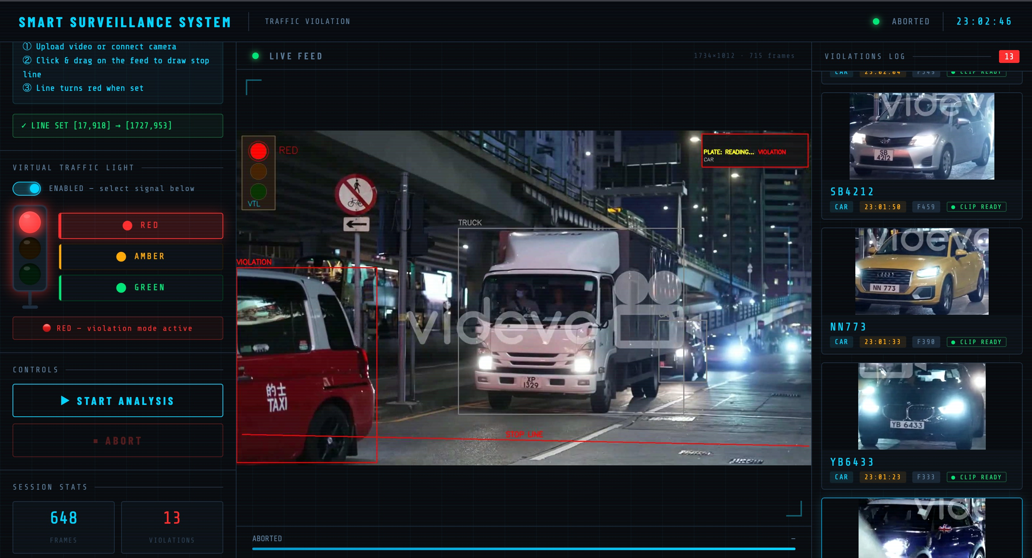
05 / SYSTEM IN ACTION
Live Detection Dashboard
Stop Line drawn
by user
Live traffic light
color detection
Vehicle bounding
boxes + labels
Violations log
+ plate crops
Red bounding box = VIOLATION · Cyan text = Plate number · Right panel = Live violations log

Slide 7
06 / CONCLUSION
What We Built & What's Next
WHAT WE ACHIEVED
FUTURE IMPROVEMENTS
Real-time vehicle detection and red-light violation flagging per frame
Automatic license plate reading for every flagged violation
Traffic light colour detection using HSV analysis with temporal smoothing
User-defined stop line via mouse drag — flexible for any camera angle
Dual-mode: pre-recorded video and live IP camera support
Photo evidence captured and CSV log exported for every violation
Automatic stop-line detection — no manual drawing required
Cross-camera re-identification to track plates across multiple feeds
Bird’s-eye view projection for accurate position detection
Improved night-time detection with low-light model tuning
Multi-lane polygon zones replacing single stop line
Speed estimation using inter-frame vehicle displacement

