Slide 1


A Purposeful Walk Down Wallstreet
Michael Shields, Nabeel Asghar, Shojib Miah, Michael Chen

Slide 2
What Have we Accomplished?
We have completed:
Functionality for macroeconomic variables
2 new algorithms using macroeconomic variables
Visualized the forecasted price generated from new algorithms
Implemented functions to test accuracy of previous algorithms
2

Slide 3


Macroeconomics Data Fetch
Able to draw macroeconomic variables from Quandl
Upgraded original function to be dynamic and extensible
Upgraded original function to grab more variables from Yahoo Finance
3
Notes:
Originally application only able to handle data from Yahoo Finance
Application now able to draw Macro Economic Variables from Quandl data source
Adding a new Quandl data set simply involves simply updating a single MySQL insert statement
Function is also able to grab Macro Economic Variables from Yahoo

Slide 4
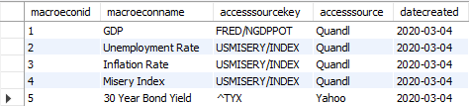
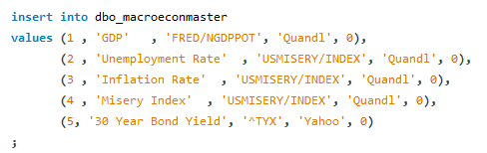
Macroeconomics Data Fetch Cont.
4

Slide 5
The MSF1 and MSF2
The MSF1 uses all the macroeconomic variable average % changes individually to forecast the price points of a specific instrument per quarter for n quarters
The MSF2 uses the % change of GDP, Inflation Rate, Unemployment Rate, and Misery Index to forecast the price points of a specific instrument per quarter for n quarters
5

Slide 6
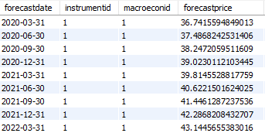
The MSF1
S_{i+1} = S_{i} (MEV + 1)
S = Stock Price
S_{i} = Average stock price over n days
MEV = Macroeconomic Variable percentage change over n days
6

Slide 7
The MSF2
MEV = (GDP × 1.9) – (UR × 0.4 + IR × 0.3) – MI²
MEV = Macroeconomic Variable percentage change over n days
GDP = Gross Domestic Product Percent Change
UR = Unemployment Rate Percent Change
IR = Inflation Rate Percent Change
MI = Misery Index Percent Change
7

Slide 8
The Demo
We will now take a look at the application itself
8

Slide 9
Old Algorithm Accuracy
 | Price Prediction Trend | ARIMA Trend | Random Forest Trend | SVM Trend | Xgb Trend
GM | 51.79% | 91.76% | 50.33% | 48.47% | 49.93%
PFE | 48.34% | 94.02% | 49.8% | 48.21% | 47.81%
SPY | 50.07% | 92.16% | 51.66% | 49.8% | 49.67%
XPH | 51.13% | 94.02% | 50.86% | 50.86% | 49.67%
CARZ | 49.93% | 90.57% | 47.28% | 48.74% | 49.00%
^TYX | 46.68% | 92.51% | 47.86% | 30.56% | 49.47%
Average | 49.66% | 92.51% | 49.63% | 46.11% | 49.26%
9

Slide 10
What do we plan to do next?
Implement function to test accuracy of new algorithms
Visualize macroeconomic statistics along with new algorithms
Add functionality to pull from other data sources
Improve accuracy of new algorithms
Improve UI elements of new algorithms in Tableau
DHL Indicator
10

