Slide 1
GM FinTech A Purposeful Walk Down Wall Street – Exploring Advanced Data Analytics in Financial Markets
Aalem Singh
Mohamad Saab
John Gettel
Abdul Ahmad
GTA : Shaofeng Shu
Wayne State University
September 11, 2019

Slide 2
A look at General Motors
• Fortune 8 company
• 2017 sales of 9 million vehicles and revenue >USD $145 Billion
• 181,000 employees globally
• Goal: To earn customers for life
• Produce vehicles in 30 countries
• 7 million OnStar (4G LTE) subscribers
• 170 vehicle assembly, metal stamping, tool and die, propulsion, components and battery assembly manufacturing facilities
• 20 customer care & aftersales (CCA) facilities
• 29,000 outbound vehicles shipped daily
• 65,000 tons of materials
• GM’s average vehicle has 100 million lines of code

Slide 3
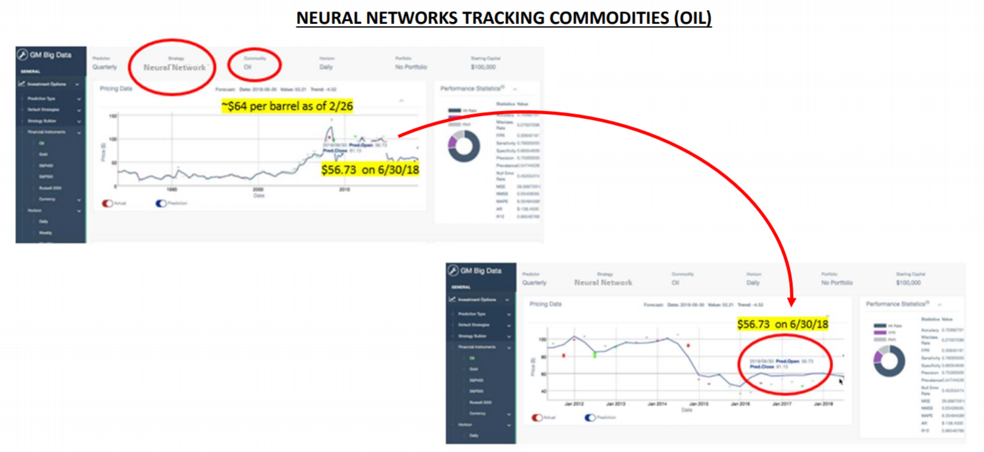
Purpose
Financial markets are constantly impacted by events happening around the world
Crude Oil, Steel etc.
This project will attempt to predict price movements in various global financial markets using financial technologies
Enhancements to the current system will be implemented to improve descriptive and predictive analytics
The ultimate goal is to create highly accurate ‘buy’ and ’sell’ signals for financial portfolios
Joshua Feinstein
Global Data Strategy, AI, & Advanced Analytics
General Motors

Slide 4
Deliverables
Work with Financial Instruments and greatly enhance the accuracy of GMs platform
Investigate and build on our existing Trading Strategies
Integrate these trading strategies into a platform that gives us the ability to ‘buy’ and ‘sell’ financial instruments with the potential for maximizing return on investment

Slide 5

Deliverables(continued)
Develop new strategies and ‘Models’ based on approved proposals from the student team
Leverage the tool to create and track ‘Assets Under Management’ and prove out the accuracy and viability of the platform
Leverage a front-end client and appropriate delivery mechanisms to allow the end-user to perform tasks within the system and analyze results.

Slide 6
Technologies
Relational Database Management Systems
Tableau
Python
SQL
Trading algorithms and strategies based on AI and ML algorithms
Project Management : Agile/RUP/RAD iterative methodology

