Slide 1
GM FinTech
A Purposeful Walk Down Wall Street – Exploring Advanced Data Analytics in Financial Markets
Mohamad Saab
Aalem Singh
John Gettel
Abdul Ahmad
Wayne State University
September 30, 2019
1

Slide 2
Back-End: Database Conversion
Old Database:
Microsoft SQL Server
The existing database structure is redundant and has scalability overhead
Creates a new set of 18 tables for each ticker symbol (including financial strategy and algorithm tables)
New Database:
MySql (Client Request)
Work started to convert all new ticker symbols to new structure
Formerly implemented strategies and algorithms will stay in the current database structure

Slide 3
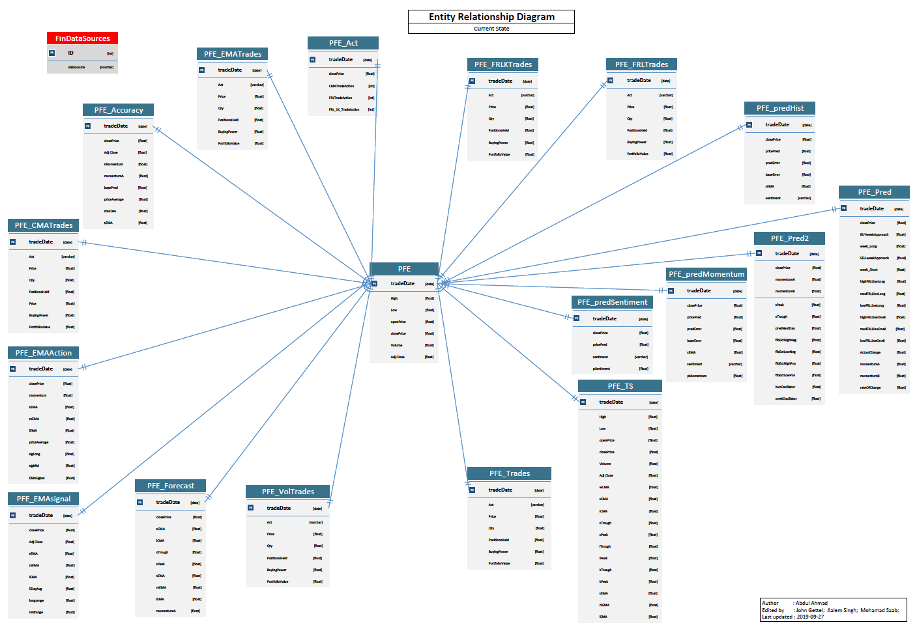
Existing Database Structure
3

Slide 4
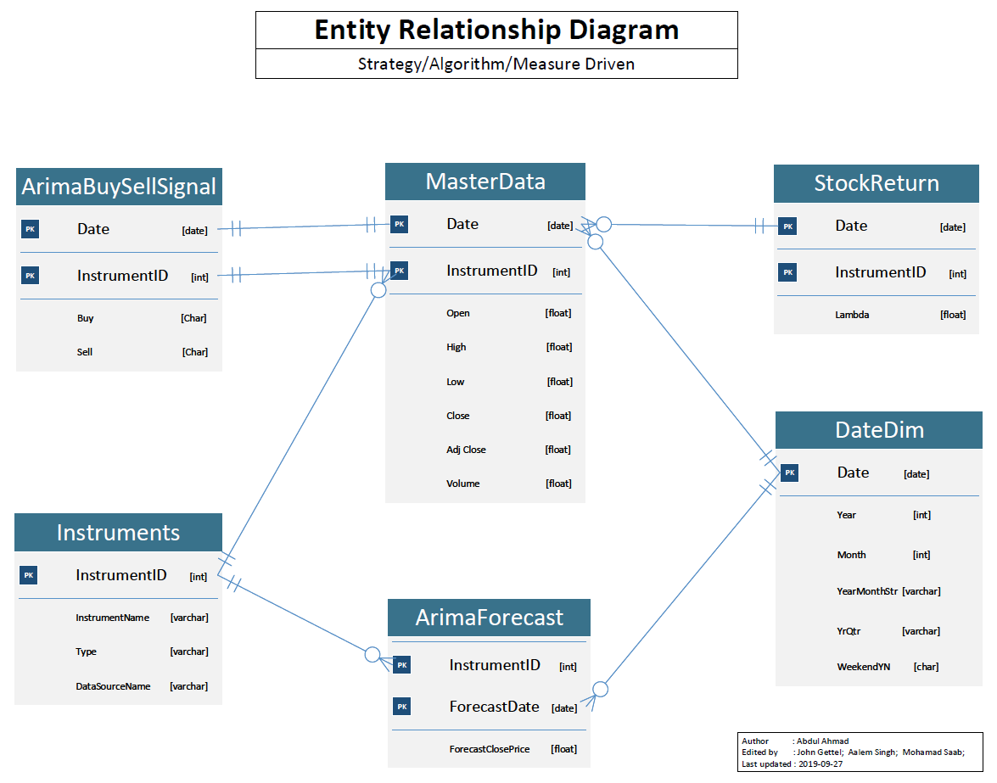
New Database Structure

Slide 5
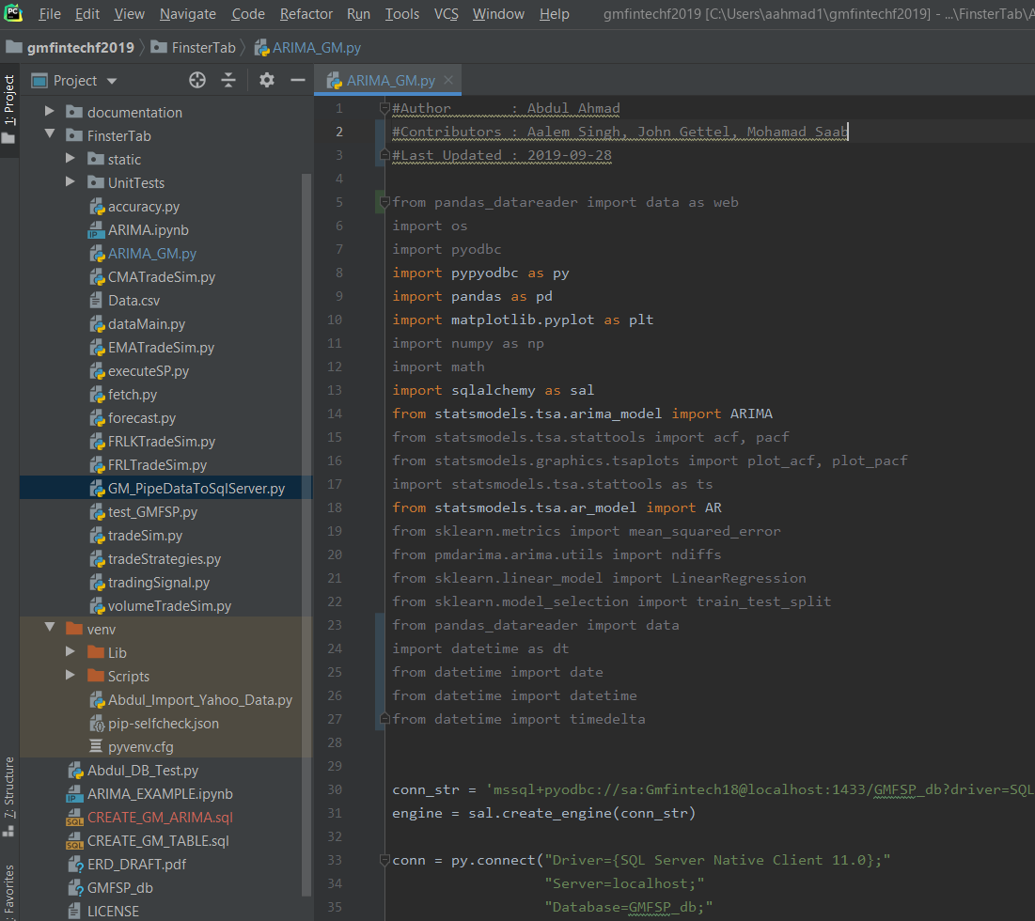
Middle Layer: Algorithms Codebase
Python
Our design of the middle layer will be similar to the existing one
Each algorithm will have its own set of tables
Transformed and Processed measures will be Loaded to database tables
Database tables will then be read by Tableau
Screenshot of Python Codebase

Slide 6
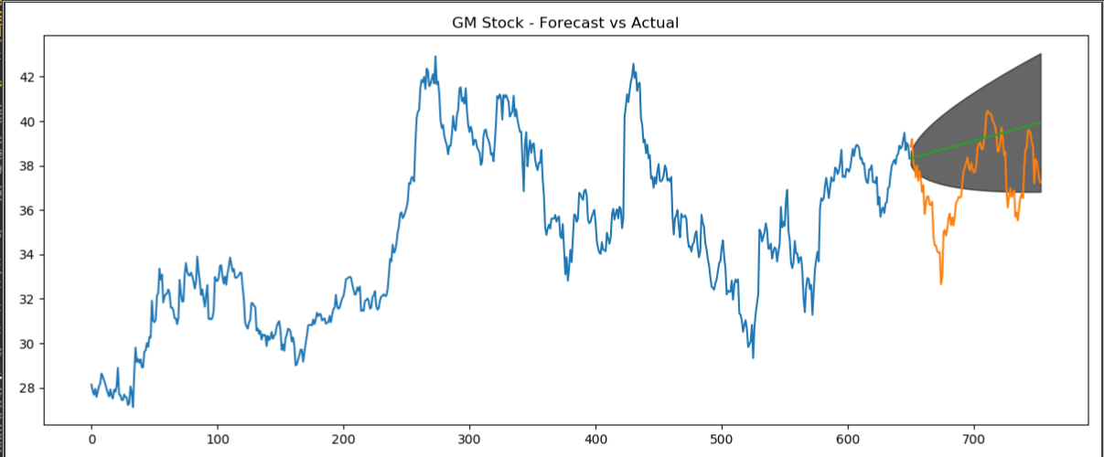
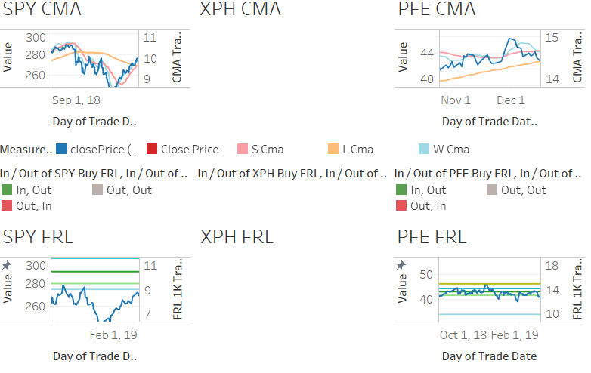
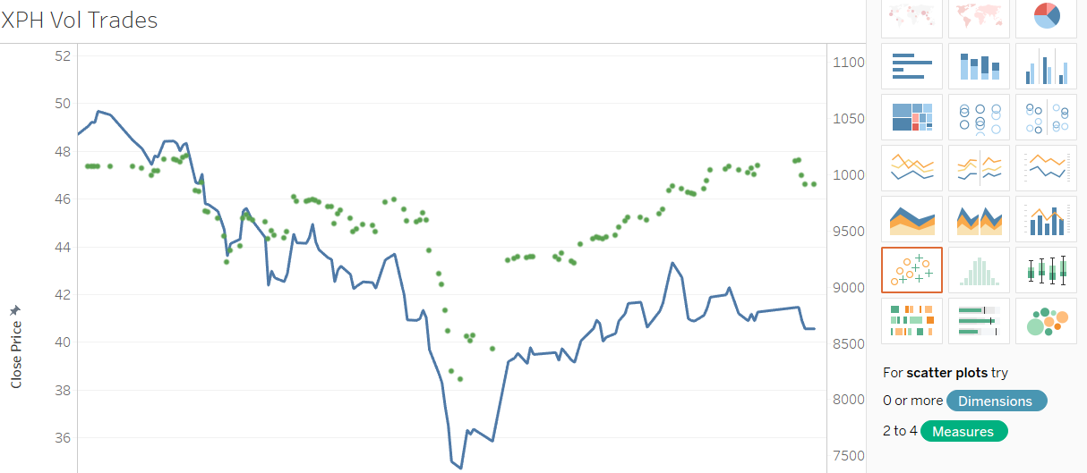
Front-End: User Interface
Tableau
Our design of the UI will be similar to the
existing one
(client requirement)
1 tab/ticker or 1 tab/strategy
(work in progress)
We made a recommendation to the client to consolidate sheets in Tableau as a stretch goal
Screenshots of Actual Current Tableau Graphs
GM Stock Forecast, Algorithm comparisons, and Buy/Sell signals

