Slide 1
GM FinTech
A Purposeful Walk Down Wall Street – Exploring Advanced Data Analytics in Financial Markets
Software Requirements Specification
Mohamad Saab
Aalem Singh
John Gettel
Abdul Ahmad
Wayne State University
October 7, 2019
1

Slide 2
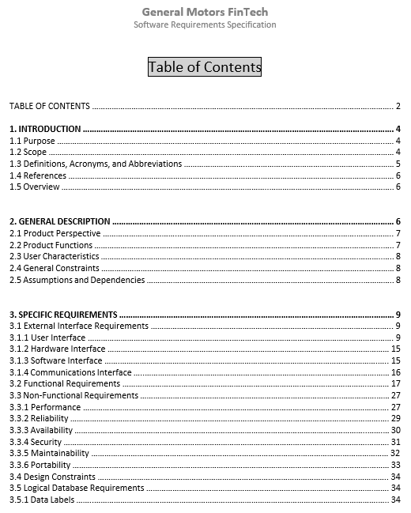
Whats on the agenda today?
Go over the Software Requirements Specification(SRS) Document
Overview of all sections of the SRS
Functional Requirements
Non-Functional Requirements
Design Constraints
Build Strategy
Preview of the SRS document if needed
Snapshot of our SRS document TOC page

Slide 3
Product Perspective
User Interface
Ease of Use
Human Interface
Zoom In-Out
User Characteristics
Basic knowledge of BI tools
Application is not designed to catch errors
A human analyst will interpret the data

Slide 4
Product Functions
Client selected stock symbols/instruments
Automotive
Pharmaceuticals
S&P 500 (Standard & Poor)
More, per client’s choice
How we deliver the information?
Fully automated & optimized data load
3 years of data
Radio button to toggle stocks
Buy/Sell Signals

Slide 5
General Constraints
Reasonable internet speed / 10 Mbps+
Access to a free trading data exchange
Data element formats

Slide 6
Assumptions & Dependencies
Execution : System setup is sensitive to how steps are executed
Tableau : 2018 or later
Local Database : SQL Server 2016 or later (MySQL later)
Python : PyCharm, Anaconda, other Python IDE

Slide 7
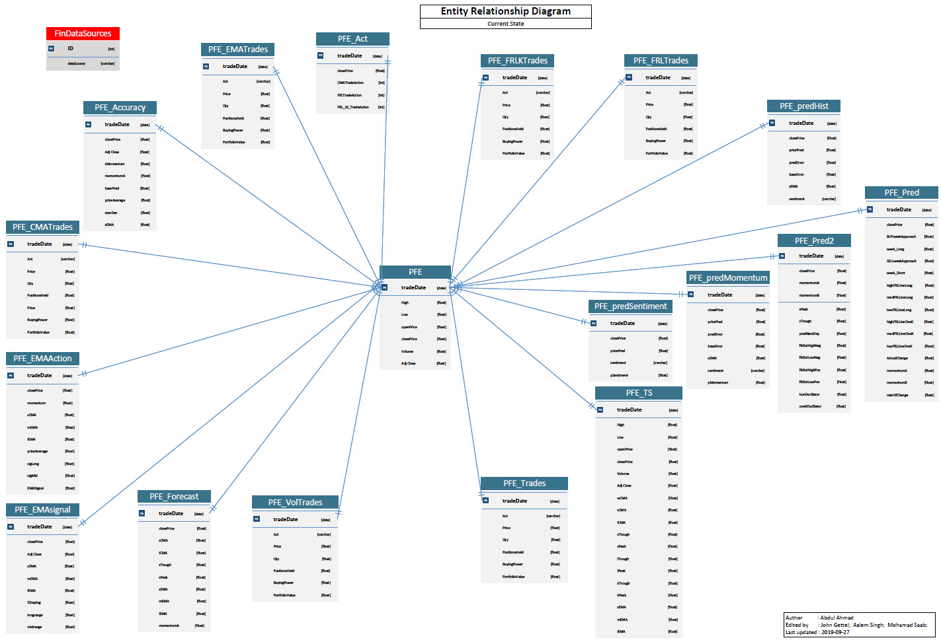
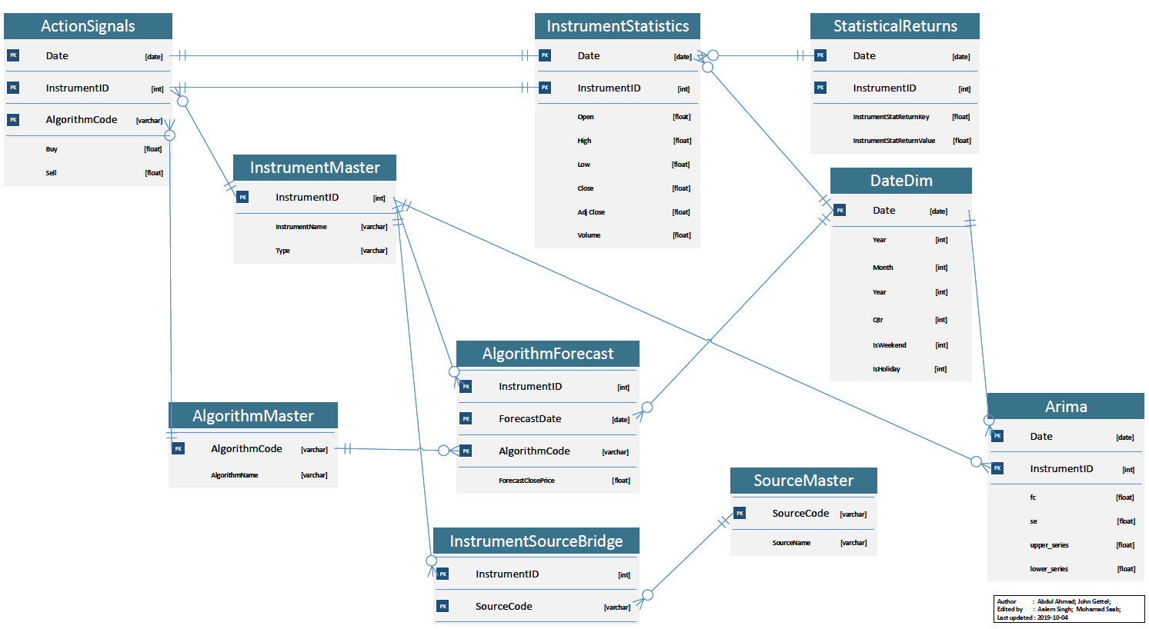
Functional Requirements : FR-1 Database Structure
Current State
Future State

Slide 8


Functional Requirements : FR-2 Database Management
Convert
to
Google images, property of Microsoft Corporation
MySQL.com : property of Oracle Corporation

Slide 9
Functional Requirements : FR-3 Improve Predictions
Improve the prediction in existing algorithm
Directional Price Accuracy* = 50.6471% (Adjusted Close)
Absolute Mean Percentage Error Rate** = 4.3793%
Absolute MPE Formula = Absolute ( (Actual Close Price – Forecast Close Price) / Actual Close Price ) *100
Our Team also built a custom formula for prediction rate movement which will be validated by client tomorrow
* Independent Work Report by Sahil Madge, Spring 2015
** https://www.axsiumgroup.com/the-absolute-best-way-to-measure-forecast-accuracy-2/

Slide 10
Functional Requirements : FR-4 New Stocks/Instruments
Introduce new stock symbols such as GM, CARZ and others as proposed by the client
Our database and python scripts are robust enough to load data for any symbol automatically once its loaded to ‘InstrumentMaster’
Script is available to speed up addition of symbols

Slide 11
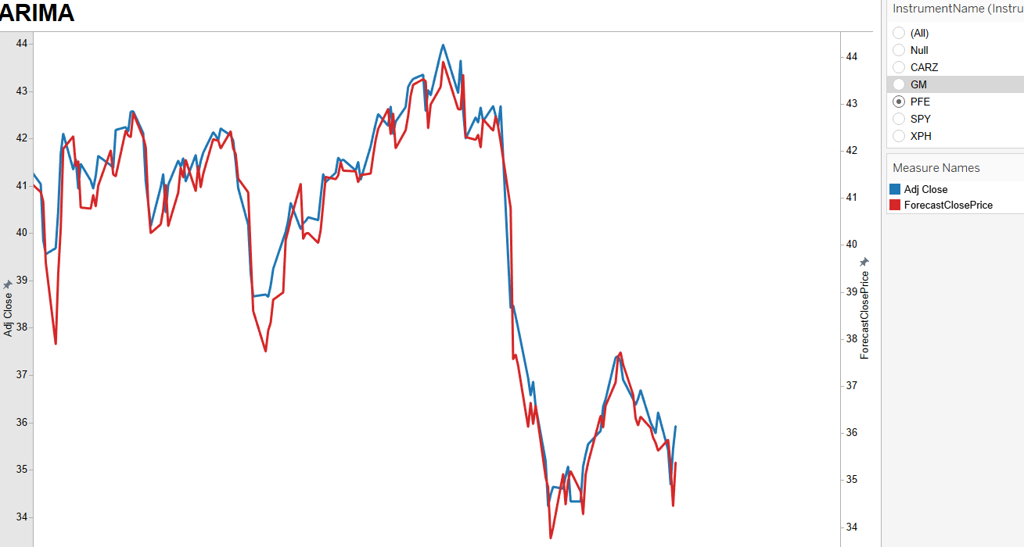
Functional Requirements : FR-5 Introduce New Algorithms
Add new algorithms with predictive capabilities
Use Adjusted Closed price as requested by client
Adjusted Close → prices after dividends are paid, prices prior to 10 days are adjusted to reflect the dividend distribution
We have already implemented ARIMA with daily predictions and Buy/Sell signals
ARIMA output from our application

Slide 12
Functional Requirements : FR-6 ---- FR-20 Preexisting
Our task is to keep the previously implemented algorithms alive
Port the calculations and records over to MySQL
Preserve the existing database structure

Slide 13
Non-Functional Requirements : NFR-1 ---- NFR-10
Performance
Notifications, user must be aware
Data-Sources
Graphs & Visualizations
Information preservation
Dual Graphs
Reliability
Seamless data updates
Availability
Available to use
Internet connectivity
Database connectivity
Security
Design based security
User access control

Slide 14
Non-Functional Requirements : NFR-11 ---- NFR-13
Maintainability
Database architecture flexibility
Python scripts flexibility to add new algorithms
Modular design
Portability
Must function on all PCs with Windows and required software installed
Tableau compatible web browsers

Slide 15
Design Constraints
Database structure
Software dependency (Tableau, MySQL)
Python libraries
Gitlab
Stable and fast internet connection
Financial Statistics Data Exchange availability(setup with a free exchange)
Database size
Buy, sell or hold signals are provided only as a guidance, a human must make the final decision

Slide 16
