Slide 1
GM FinTech
A Purposeful Walk Down Wall Street – Exploring Advanced Data Analytics in Financial Markets
Product Design Specification
Mohamad Saab
Aalem Singh
John Gettel
Abdul Ahmad
Wayne State University
October 21, 2019
1

Slide 2
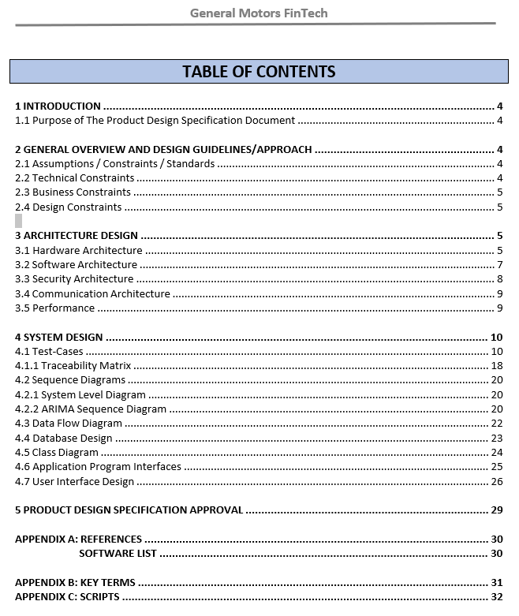
Whats on the agenda today?
Go over the Product Design Specification(PDS) Document
Overview of all sections of the PDS document
Purpose
Assumptions
Technical Constraints
Design Constraints
Hardware, Software and, Security Architecture
Performance
Review of the PDS
Snapshot of our PDS document TOC page

Slide 3
Purpose of the Product Design Specification Document
Essential Information for developers
Assist the new or future developers to understand the design
Effective and detailed architecture
Use cases

Slide 4

Assumptions
Tableau installed
User’s familiarity with data
Internet Connection
Proper configuration

Slide 5


Technical Constraints
Database Management System
Python
Pandas
Python Libraries
MySQL.com : property of Oracle Corporation

Slide 6
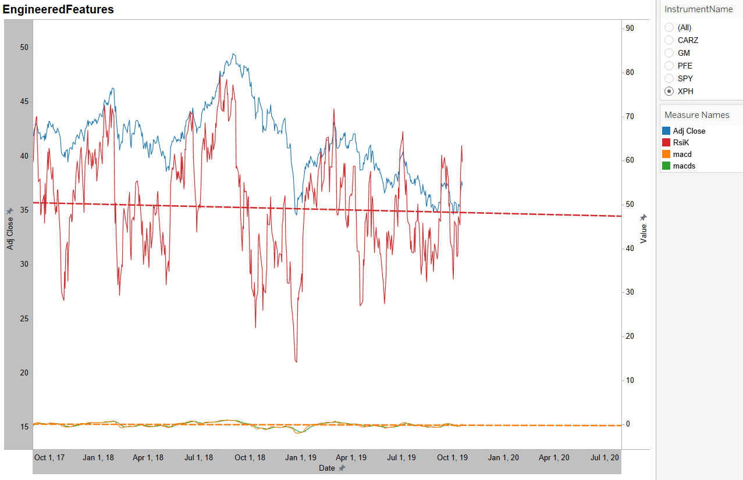
Design Constraints
Data loaded into the new structure
Comprehensive display on the UI
Data Integrity
Snapshot of Engineered Features Sheet

Slide 7
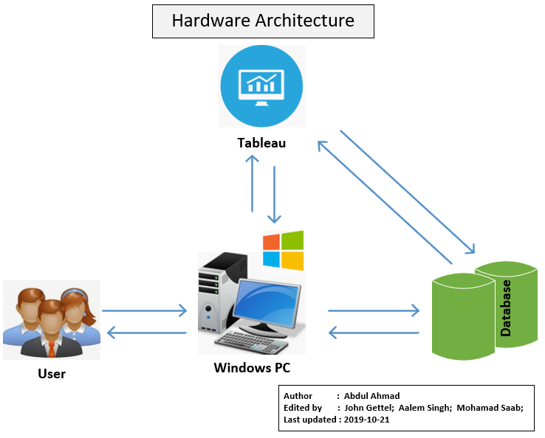
Hardware Architecture
Local PC (required specs)
Database (local/server)

Slide 8
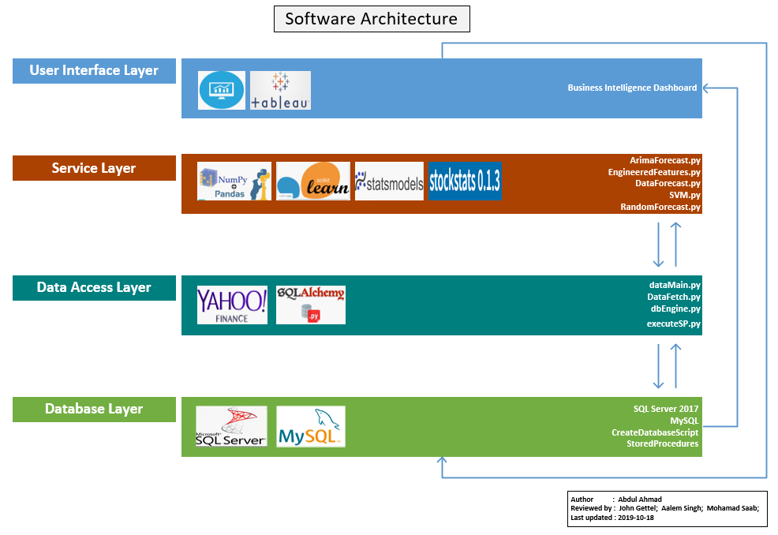

Software Architecture
Front-End
Middle-Layer
Back-End

Slide 9
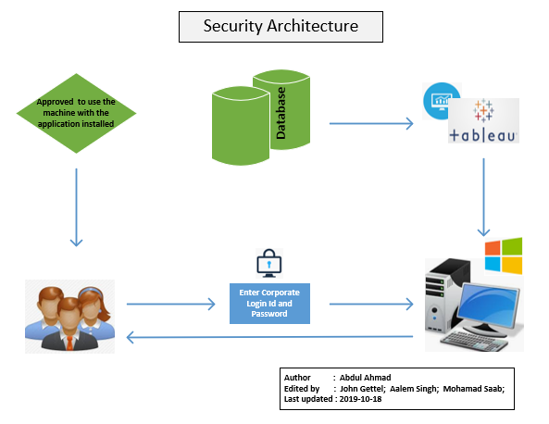
Security Architecture
Internally installed on corporate machine(s)
Not Extranet or Internet security
Not a direct responsibility of the developers
YAHOO Data Exchange is only a dependency

Slide 10
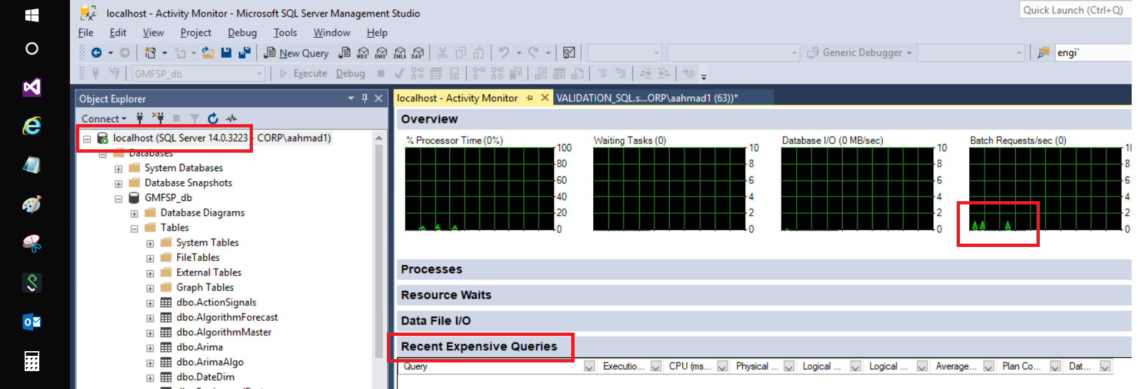
Performance
Local PC (required specs)
Database (local/server)
YAHOO Financial Data Exchange Server
Snapshot of SSMS Activity Monitor showing an actual project code run

Slide 11
Let’s glance @ Product Design Specification Document

Slide 12
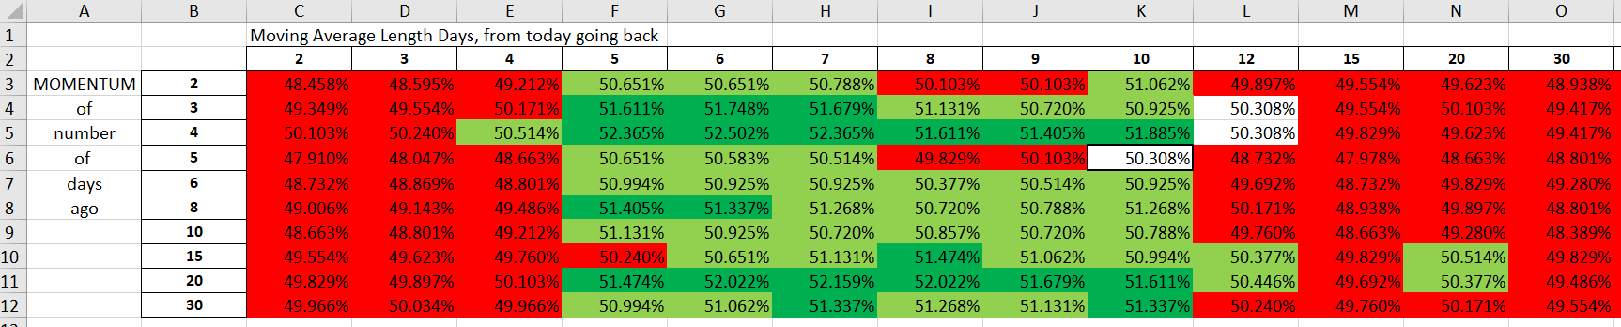
What are we working on?

