Slide 1
GM FinTech
A Purposeful Walk Down Wall Street – Exploring Advanced Data Analytics in Financial Markets
Prototype 2
Mohamad Saab
Aalem Singh
John Gettel
Abdul Ahmad
Wayne State University
October 28, 2019

Slide 2

What’s on the Agenda today?
Back-End
Middle-Layer
Front-End
Project Status
Demo
back-end
middle-layer
front-end
Accuracy Analysis and Improvements
Property of https://www.dreamstime.com :Royalty Free Vector

Slide 3


Back-End : Database
MySQL
SQL Server decommissioned
(old and new structure migrated to MySQL 100%)
MySQL.com : property of Oracle Corporation
Via Google images, property of Microsoft Corporation

Slide 4

Middle-Layer : Computing Layer using Python
Optimized previous group’s code
Refactored, cleaned, removed redundant functions
All new code’s classes and functions separated
Property of JetBrains

Slide 5

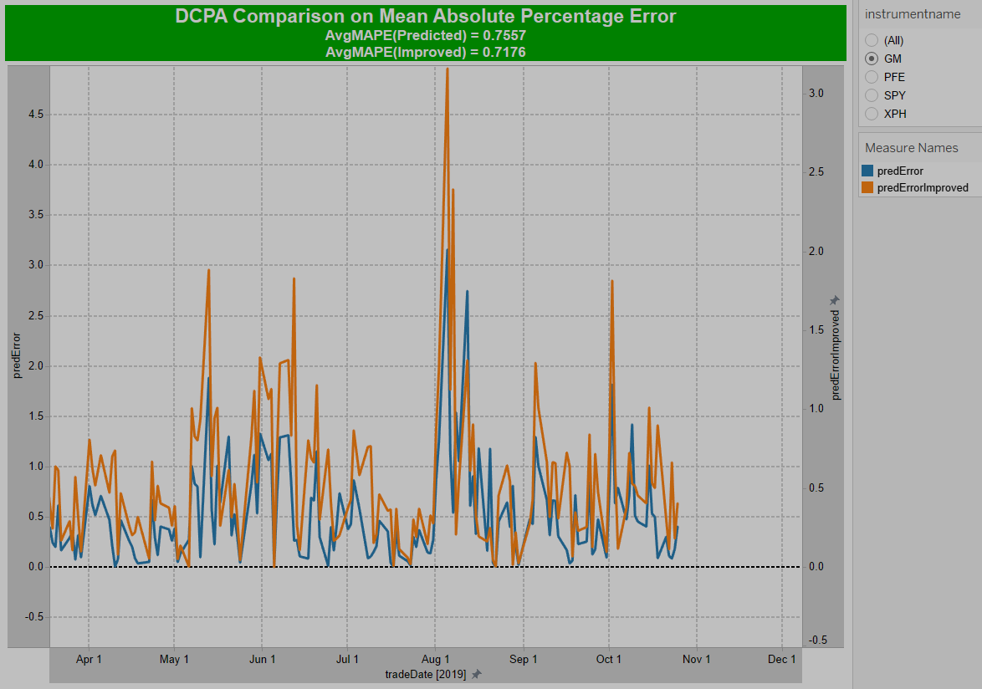
Front-End : User Interface in Tableau
Tableau (2019.3.0 64 bit)
Improved User Interface
Consolidation of redundant sheets
Data fetch using new SQL scripts
24 sheets in previous design (only 3 stocks)
We will end-up with 8-10
(60% reduction)
Actual snapshot from our DCPA MAPE Comparison sheet in Tableau

Slide 6
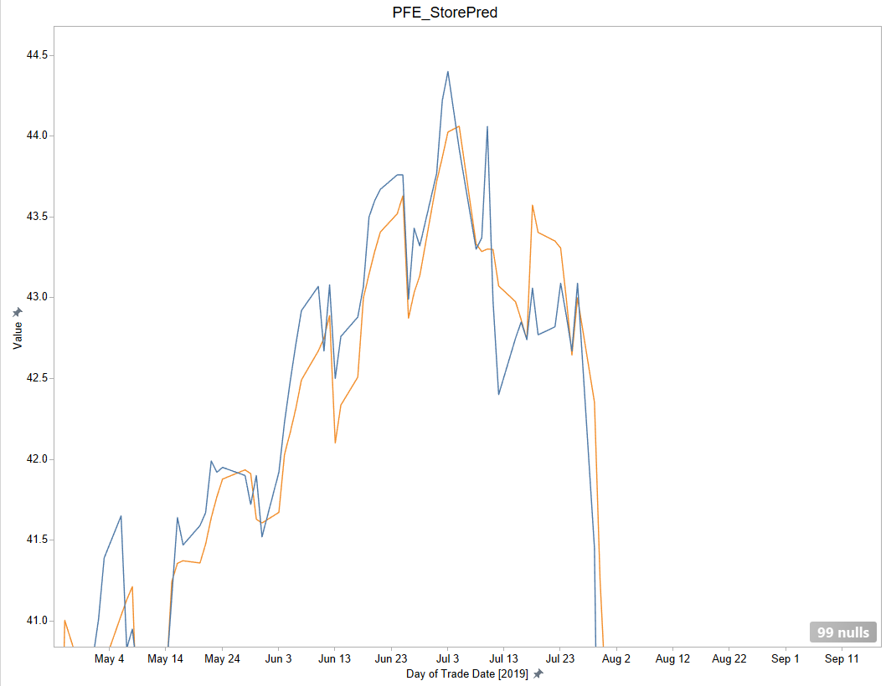
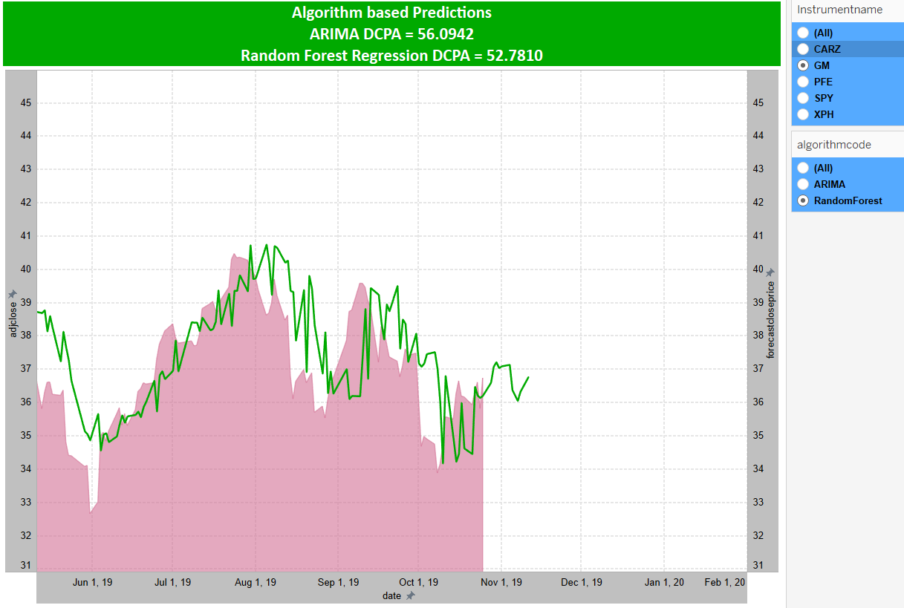
Front-End : User Interface Comparison
to
Past
Now

Slide 7
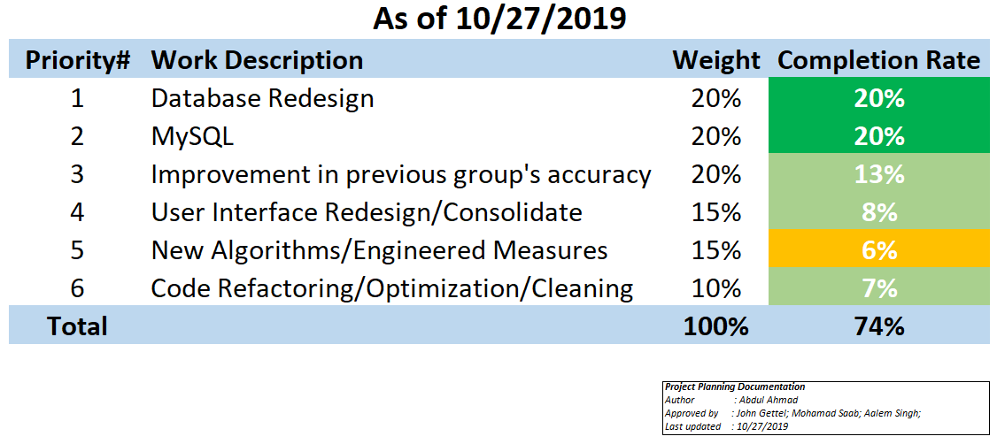
Status Report : Core Requirements

Slide 8
Let’s look @ GM FinTech Application

Slide 9
Prediction Calculation :
Momentum = [Today’s Price] - [Previous Available Price]
‘n’ = [number of days]
If Momentum > 0
Predicted Price = [‘n’ days Moving Avg(Close Price)] + [(‘n’ days Close Price Standard Dev/SQRT(‘n’)) * 2.576]
If Momentum < 0
Predicted Price = [‘n’ days Moving Avg(Close Price)] - [(‘n’ days Close Price Standard Dev/SQRT(‘n’)) * 2.576]

Slide 10
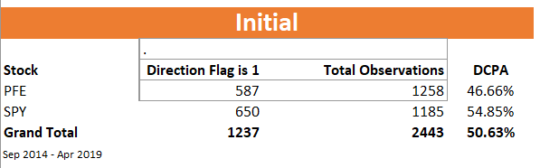
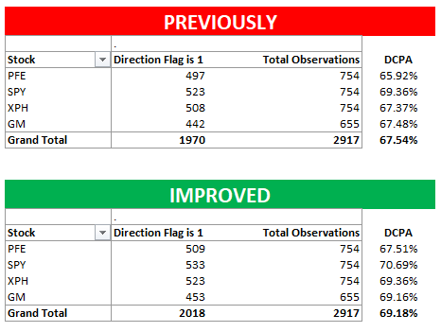
DCPA : Directional Close Price Accuracy
Initial Calculation : 50.64%
- Inaccurate close prices
- Data manipulation errors in functions
With Clean Data : 67.54%
- Correct close prices
- Refactored functions
Improved : 69.18%
- Correct close prices
- 4 day momentum
- 8 day moving average of close price

Slide 11
