Slide 1
GM FinTech
A Purposeful Walk Down Wall Street – Exploring Advanced Data Analytics in Financial Markets
Prototype 3
Mohamad Saab
Aalem Singh
John Gettel
Abdul Ahmad
Wayne State University
November 18, 2019

Slide 2

What’s on the Agenda today?
Completion Status
Stretch Goals Status
System Demo
Back-End
Middle Layer
Git-Repo
Front-End
Property of https://www.dreamstime.com :Royalty Free Vector

Slide 3
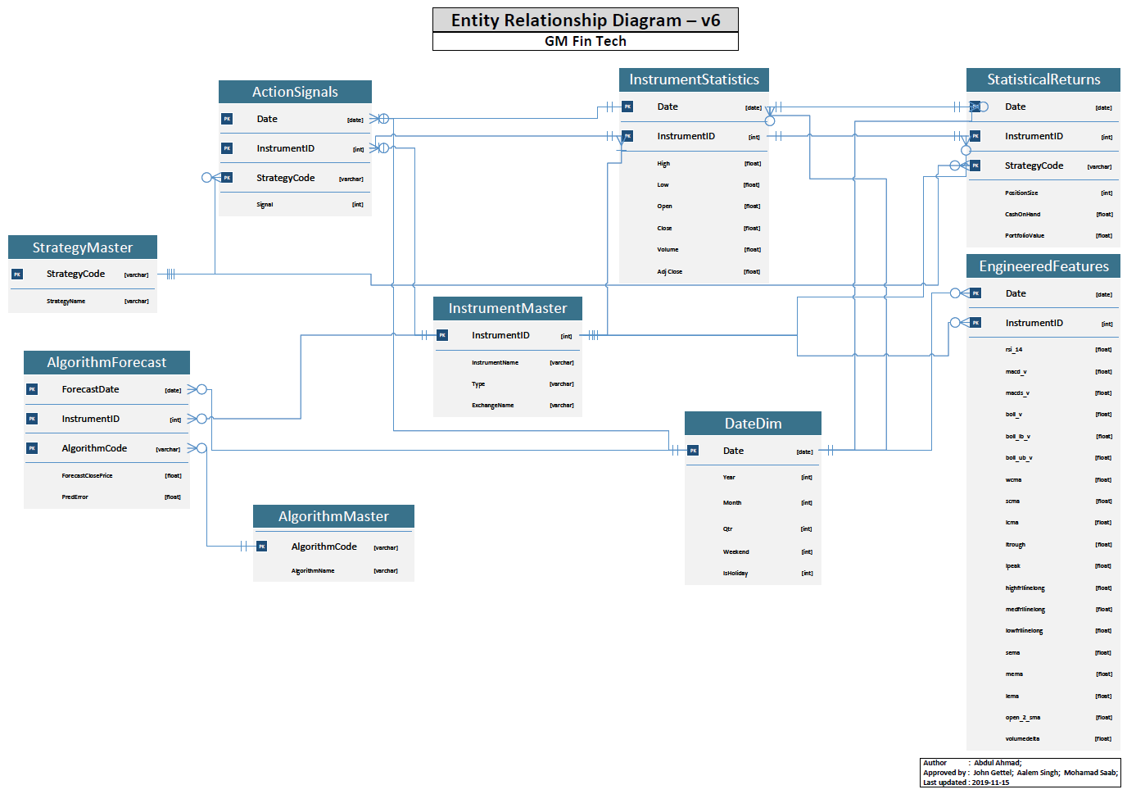

Slide 4
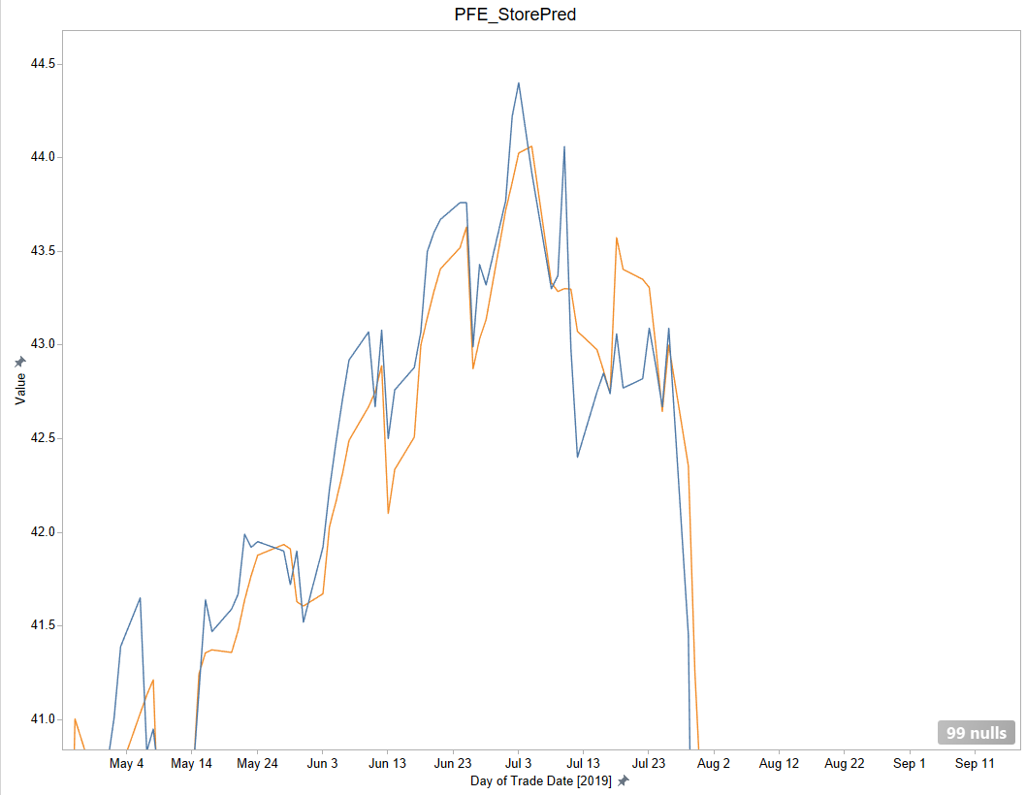
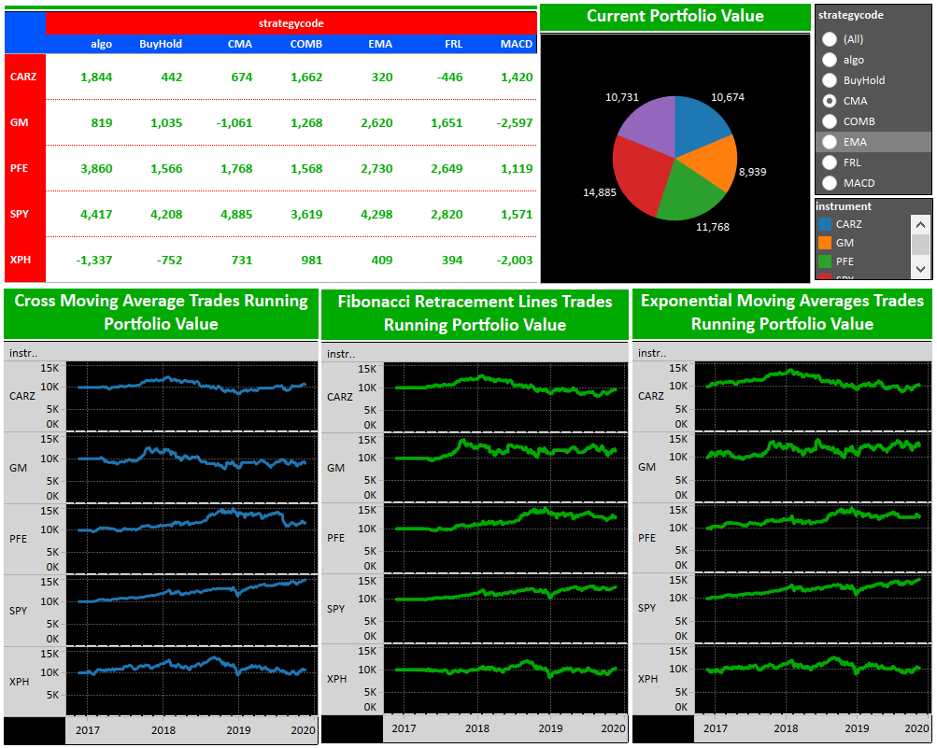
Front-End : User Interface Comparison
to
Past
Now

Slide 5
Stretch Goals : New Requirements 11/5
CMA and FRL (improved returns)
Trading Simulation with our new idea (Same Day Signal using custom strategy )
Merge Previous Groups Database
All Tableau Tabs to be Redesigned

Slide 6
Completed Items : without Stretch Goals
Database Completely Redesigned
MySQL
Improvements in previous group’s algorithms
User Interface Redesigned
New Algorithms for Forecasting
Engineered Measures
Code Refactoring/Optimization/Cleaning
74%
99%

Slide 7
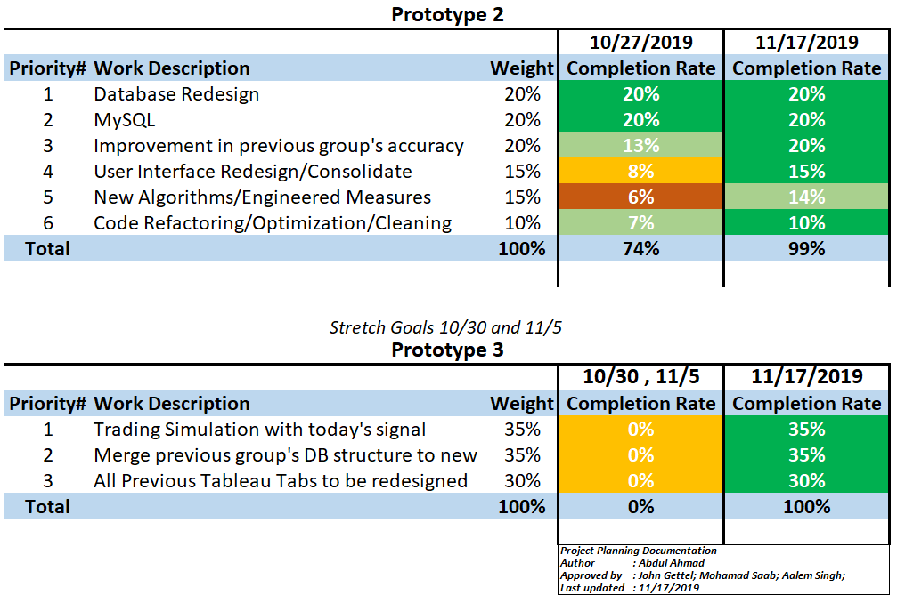
Status Report :

Slide 8
Let’s look @ GM FinTech Application

Slide 9
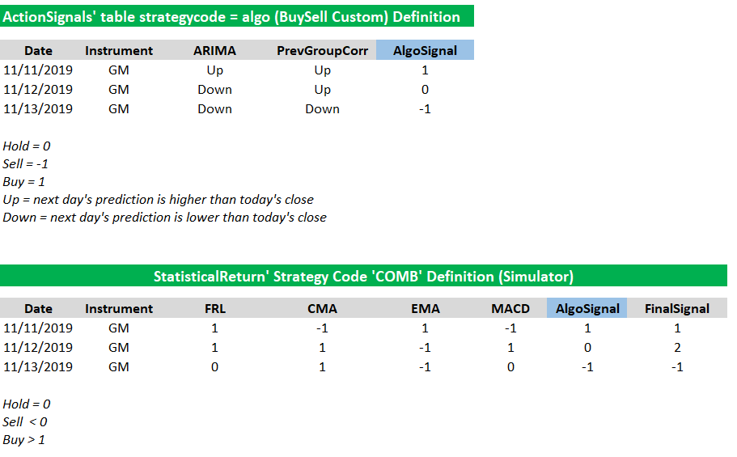

Slide 10
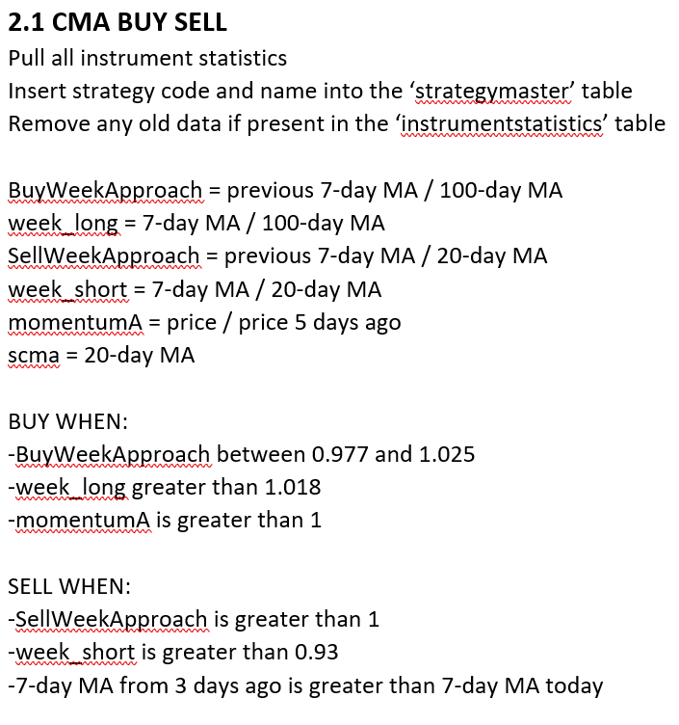

Slide 11
