Slide 1
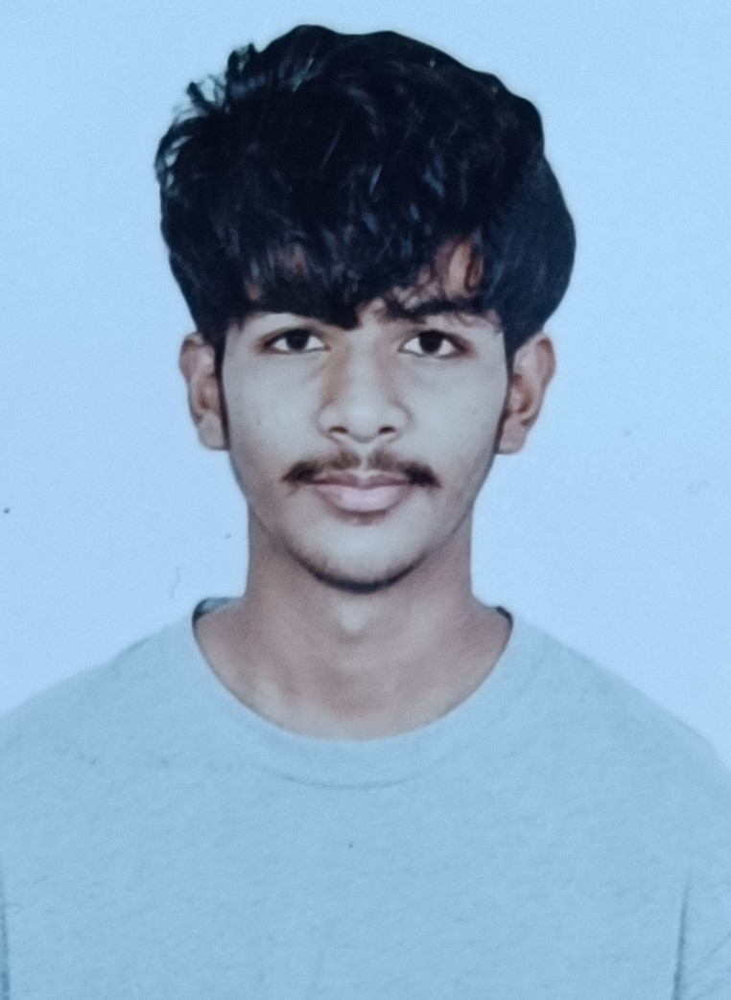
T Nabeel Pasha
I am a BCA graduate student with hands-on experience in SAP Build Process Automation and DAP IRPA, SAP Build Apps. I have also been part of a mental health awareness project. I enjoy creating various automations and exploring new technologies
I developed a Mental Health Awareness project with my team, utilizing Python and Django for the backend to create a robust and scalable application. We also used HTML, CSS, and JavaScript for the frontend to ensure a user-friendly and visually appealing interface.
Hands-on experience with SAP Build Process Automation tools, having worked on multiple PoCs to streamline and automate processes, such as Excel automation, web automations, etc.
I have also been part of another project called Blood Sure, which aims to connect universities and blood banks directly. Through this initiative, a student donor receives a certification that they can exchange for blood in the future.
I have hands-on experience in developing Build Apps, including the R1333 Automation data display in the Build Apps dashboard dynamically. Additionally, I have developed a To-Do List app for task assignment and other related functionalities and also Reusable coponents App.
PROFESSIONAL EXPERIENCE
BACKGROUND
Education
REVA University (Bengaluru):-Bachelor of Computer Application
CERTIFICATIONS
SPECIALIZATION
Cyber Security Ethical Hacking Certification
English Speaking Certification
SAP Build Process Automation
SAP Build Apps​
HTML , CSS​ and Java Script
Python
Dango (Beginner)
Power Bi (Tool)

