Slide 1
DocScore: Doctor Rating Insights
Nabeel Bahrawi - Jeffery Liu - Jacky Jiang
Notes:
Briefly introduce the team and the project.

Slide 2
Table of contents
01
02
03
04
Introduction
Architecture
Visualization
Conclusion

Slide 3
01
Project Intro

Slide 4
Introduction
Choosing a medical provider could be a lifelong commitment and an important decision. Our project aims to unlock important insights for people and providers to make informed decisions.
Notes:
Highlight the importance of finding qualified medical providers.
State the problem: Difficulty in analyzing and comparing doctor ratings across different sources.
Briefly mention potential benefits for healthcare organizations (improved patient experience).

Slide 5
Who We Are
A company that evaluates doctor ratings through
Utilization
Research
Data Warehouse
Our goals include
providing insights/services
improving client experiences
streamlining information

Slide 6
Who Is This For?
Patients/Clients
Healthcare Providers
Insurers
Administrators
To evaluate or choose new healthcare providers
To understand their reputation and learn from reviews
To decide which healthcare providers can be insured
To analyze their organizations’ performance

Slide 7
Our Impact
Better Healthcare
Patient Satisfaction
reassurance of quality
transparency
Improved Quality
encourages high standards
reinforces competition

Slide 8
Project Goals
Acquire Credible Data
Visual Insights
Informed Decisions
Continuous Refinement
Find and utilize credible data sources
Produce an interface that visualizes the data
Allow users to make data-driven decisions
Create a feedback loop and continue to refine the tool
Notes:
Project Goal
Introduce the web application that gathers insights on medical provider ratings across the US.
Explain how the app benefits healthcare organizations and patients (improved decision-making).
Emphasize how the web app empowers users to:
Easily access and compare medical provider ratings.
Make informed healthcare decisions.
Gain insights into regional trends (optional: with geolocation data).

Slide 9
Major Milestones
Acquire data and define tools and frameworks
Produce a dashboard that meets all requirements and goals
Technical Architecture
Final Product
4
2
1
3
Define the project
Actionable Data
Define business case, requirements and set goals
Transform raw data into actionable data and warehouse it
Notes:
Project Major milestones
Diagram showing 4 major milestones

Slide 10
02
DW Architecture & Data Profiling

Slide 11
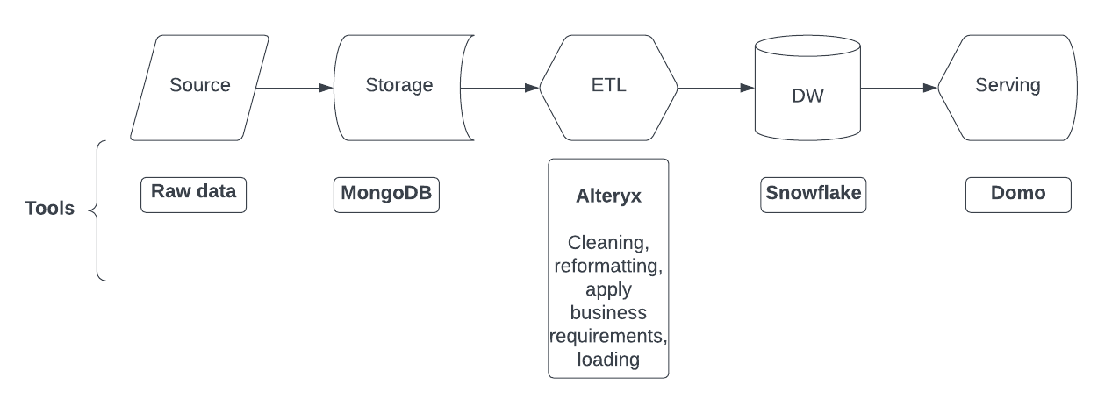
Architecture
Workflow visualizing how we plan to move, process, and serve our data.
Data tool illustrates what tools are used in each process.
Notes:
Project Architecture
From github

Slide 12
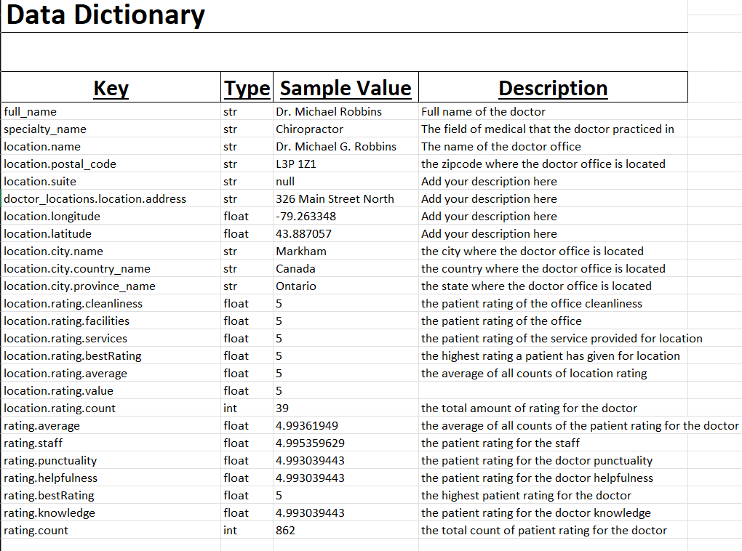
RateMD: Data Source
Data Details:
2.2 million record (approx)
2.39 GB (approx)
Data Dictionary
Key values (columns name)
Data type
Sample value
Description of the data
Data Usage:
Data Extraction & Aggregation
Data Transformation
Final Product
Notes:
Explain the data source: RateMDs doctor ratings.

Slide 13
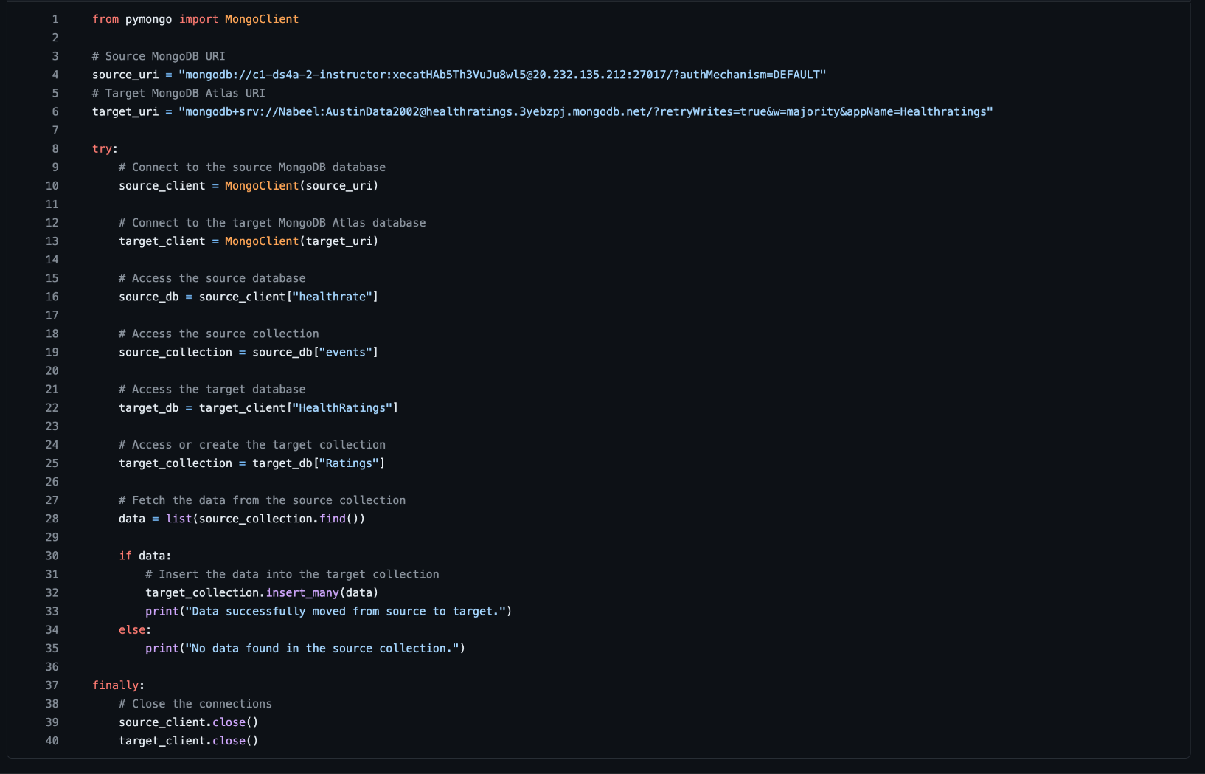
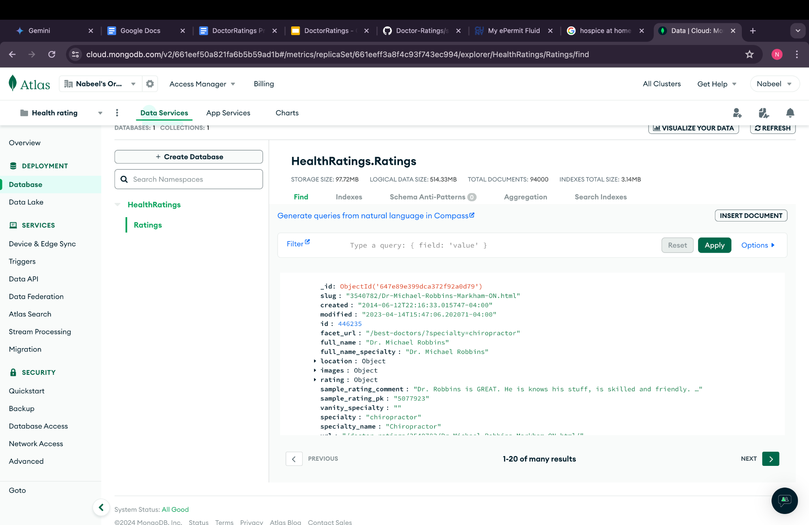
Data Acquisition
Notes:
Explain the chosen data storage solution (MongoDB).
Briefly discuss data profiling and cleaning steps (handling missing values, duplicates, and inconsistencies).
Emphasize data quality and preparation for further analysis.

Slide 14
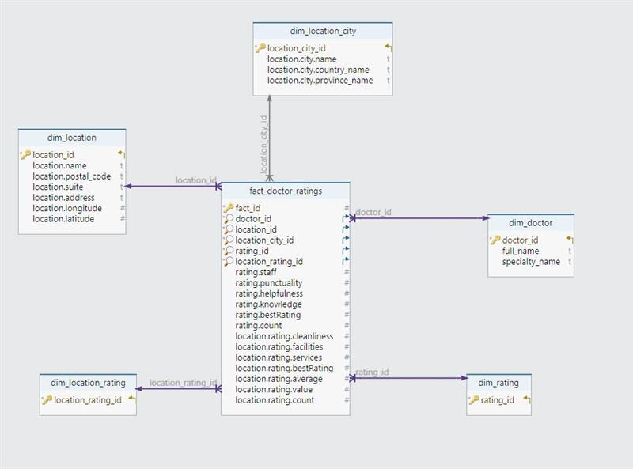
Data Model
Structuring the Data Warehouse:
Star Schema
5 Dimensions
doctor
rating
location
location city
location rating
Fact Table
dimensions as foreign keys
aggregable ratings as facts
Notes:
Introduce the concept of dimensional modeling for data warehousing.
Explain the chosen schema (star) and its benefits.
Highlight the key dimensions (doctors, patients, ratings) and facts (average rating).
Briefly mention potential incorporation of geolocation data for deeper insights.

Slide 15
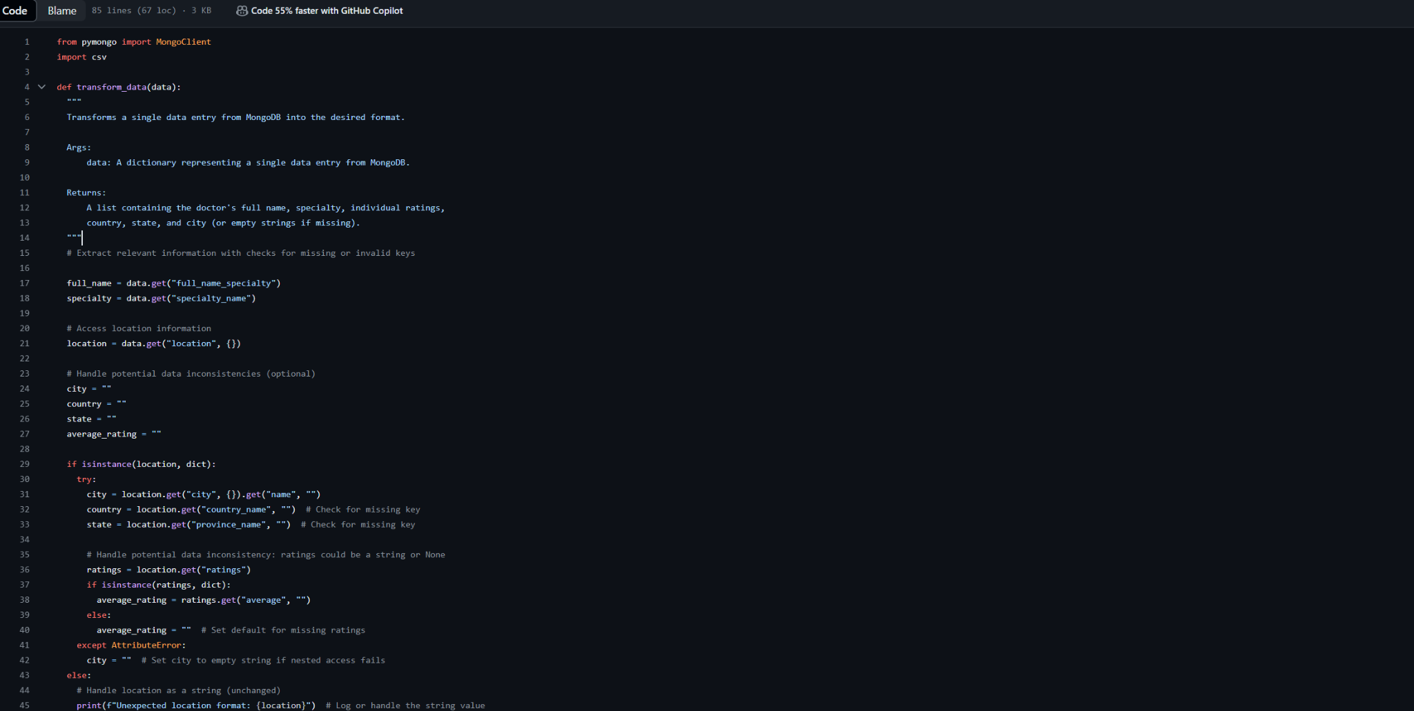
ETL Pipeline

Slide 16
03
Visualization

Slide 17
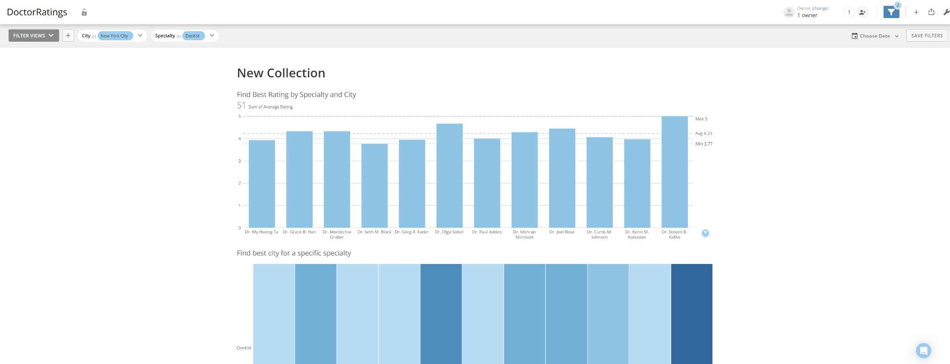
Key Visuals(Main View)

Slide 18
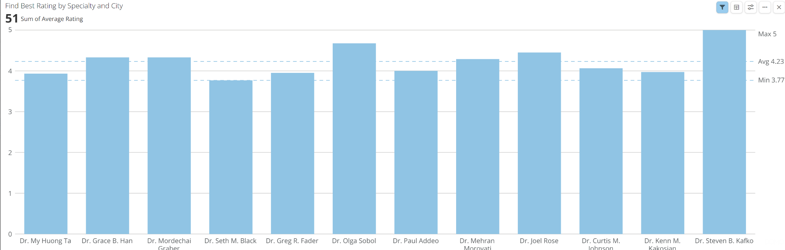
Key Visuals(Users)

Slide 19
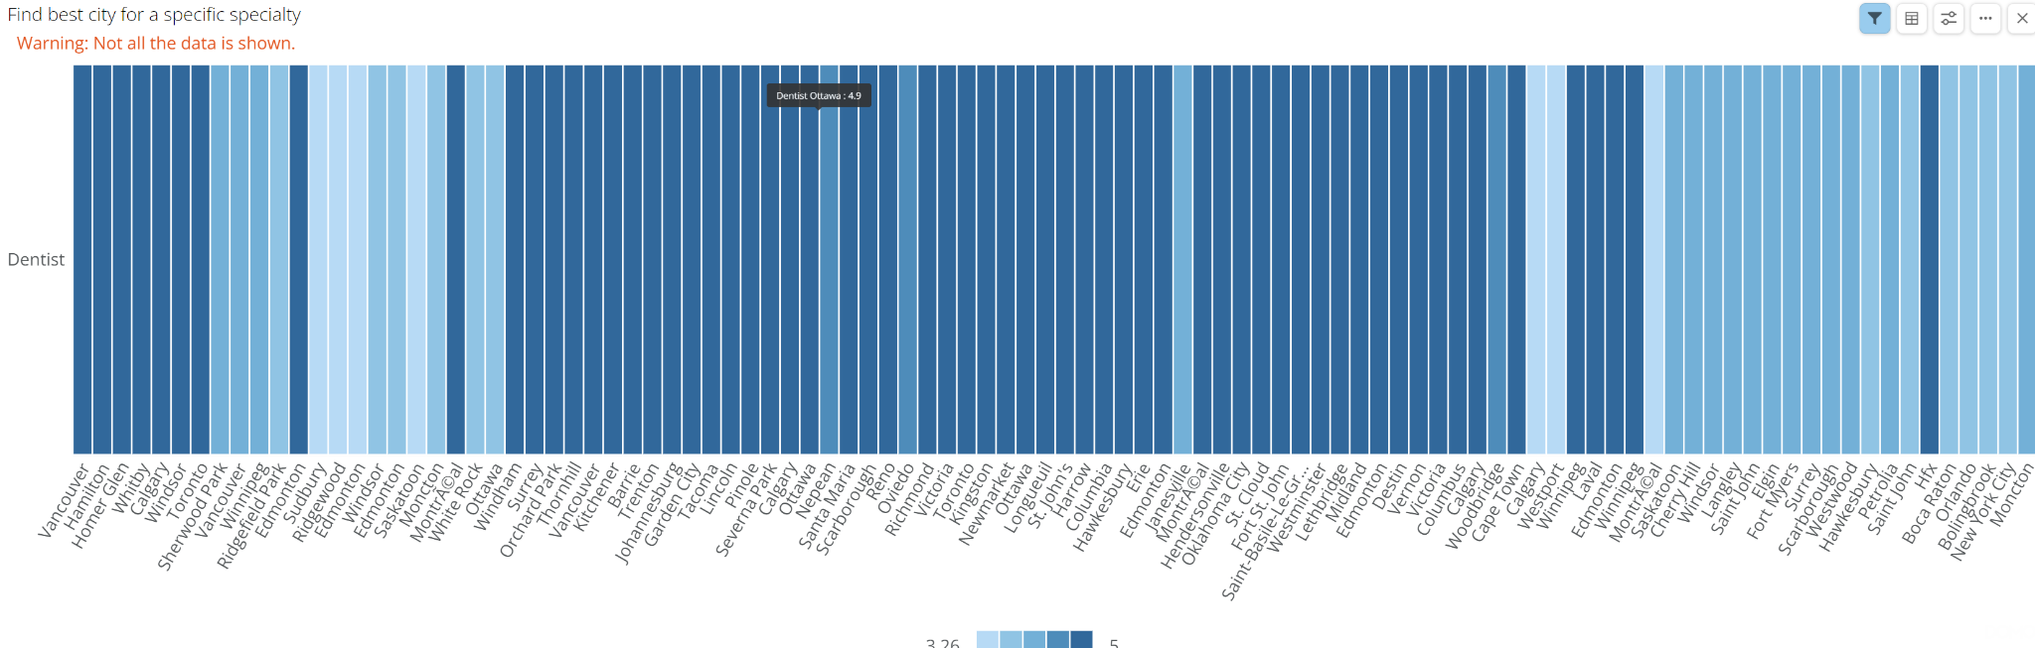
Key Visuals(Users)

Slide 20
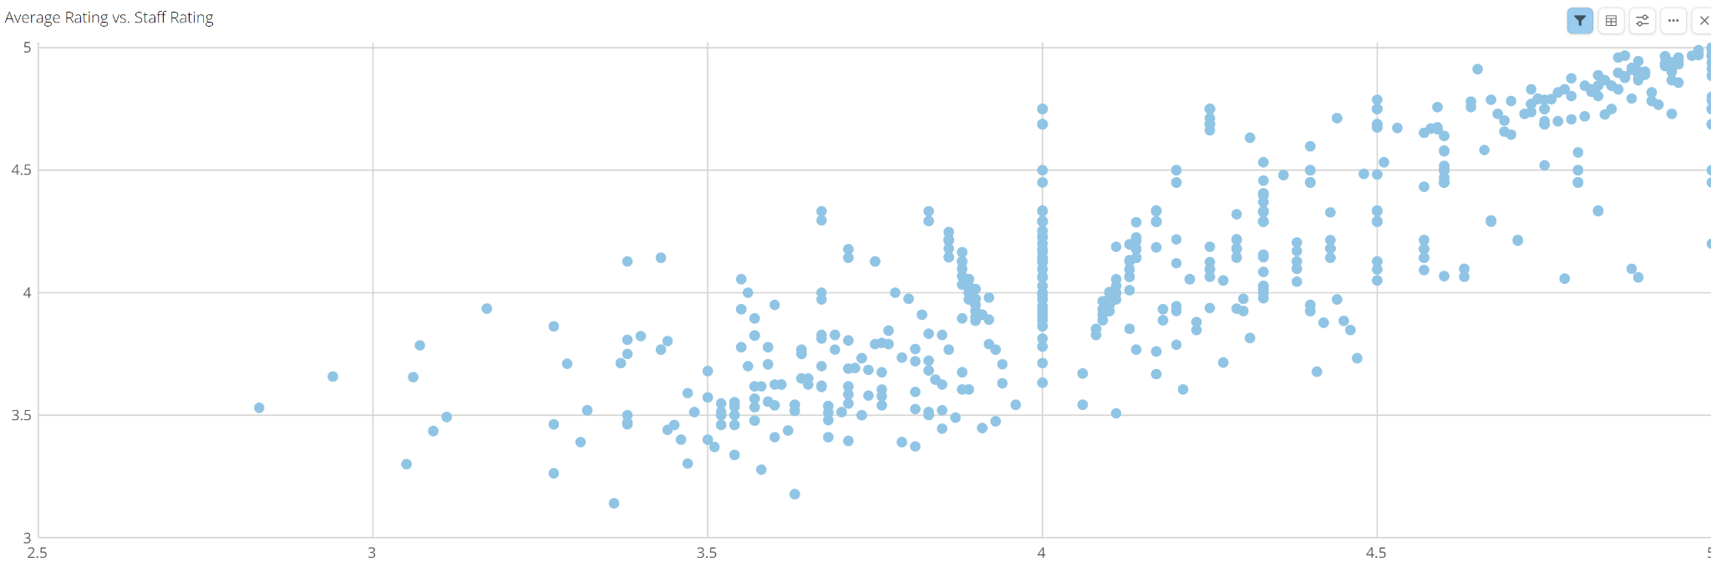
Key Visuals (Providers)

Slide 21
04
Conclusion

Slide 22
Conclusion and Next Steps
Conclusion
Next Steps
We are a company delivering insights on healthcare providers. By developing a data warehouse and an interface, we are able to streamline information to clients for improved decision-making.
In correspondence to new healthcare providers, we will continue integrating new data and data sources. It is also integral to continue monitoring and optimizing the performance of our data warehouse.

Slide 23
Thank You
Nabeel Bahrawi - Jeffery Liu - Jacky Jiang

