Slide 1




AI IMAGE
IDENTIFIER
Team members:
Tharanesh-2023115053
Mohammed Nabeel Ahmed-2023115006
Dasari Chinna Tirumanideep-2023115134

Slide 2

PROBLEM STATEMENT
AI-generated images are increasingly realistic and widespread.
People struggle to tell real from fake images.
This can lead to misinformation, scams, and misuse in job applications or news.
Reliable systems are needed to detect real vs. AI-generated images.
Such systems are crucial for maintaining trust in digital content.
02

Slide 3
SOCIAL RELEVANCE
Promotes awareness: Helps people know whether an image is real or AI-generated.
Supports professionals: Useful for journalists, moderators, and investigators to check images.
Prevents misuse: Stops fake images from spreading in politics, jobs, and online scams.
Can be integrated: Works with news sites, social media, and educational platforms.
Builds trust: Shows AI-generated images clearly, keeping things transparent
03

Slide 4
Objectives
Identify whether an uploaded image is real or AI-generated.
Extract and analyze EXIF metadata for authenticity clues.
Use heatmap visualization to highlight AI-manipulated regions.
Provide an easy-to-use web interface for users.
04

Slide 5
Literature Survey / Background
Studies show deepfake and AI-image detection using CNNs, GAN detectors, and metadata analysis.
EXIF data helps track original source and device details.
Heatmap techniques (e.g., Grad-CAM) help visualize AI alterations.
Inspired by existing models like DeepFake Detection Challenge, FakeFinder, etc.
05

Slide 6
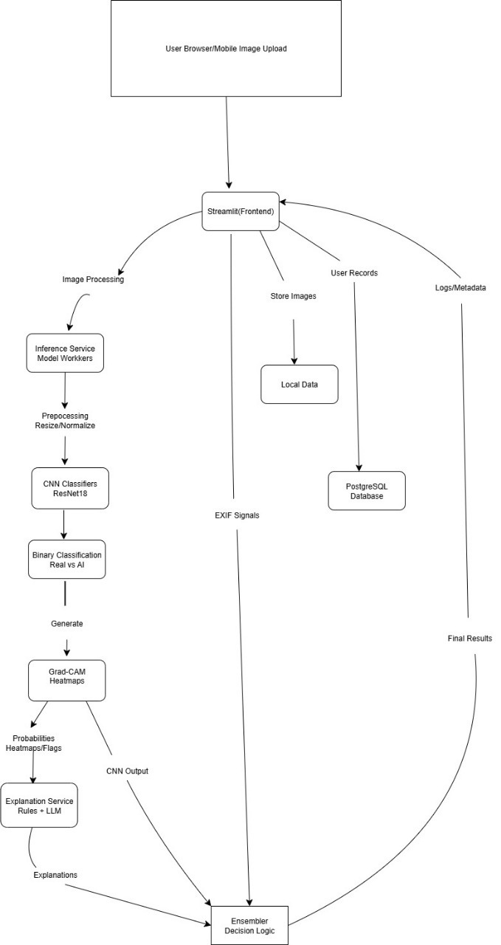
System
architecture
06

Slide 7
TOOLS & TECHNOLOGIES
Software: Python, PyTorch, CNN, TorchVision, OpenCV, Streamlit for front-end.
Database: PostgreSQL for storing user login.
Data: ~104k images (AI-generated + Real) for model training and evaluation.
Frameworks & Libraries: ResNet18 for binary classification, Grad-CAM.
07

Slide 8

Implementation
Binary Image Classification: ResNet18 to detect AI vs Real images.
Grad-CAM Visualization: Highlights regions influencing AI classification.
EXIF Metadata: Provides image details for verification.
User Authentication: Secure login using postgres database.
AI Chatbot: Helps users understand AI detection results using TinyLlama
08

Slide 9
Results / Outcomes
09

Slide 10
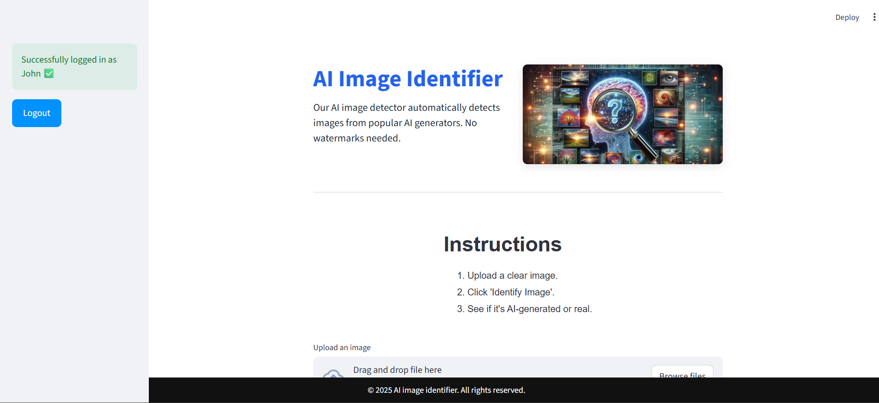
Home page

Slide 11
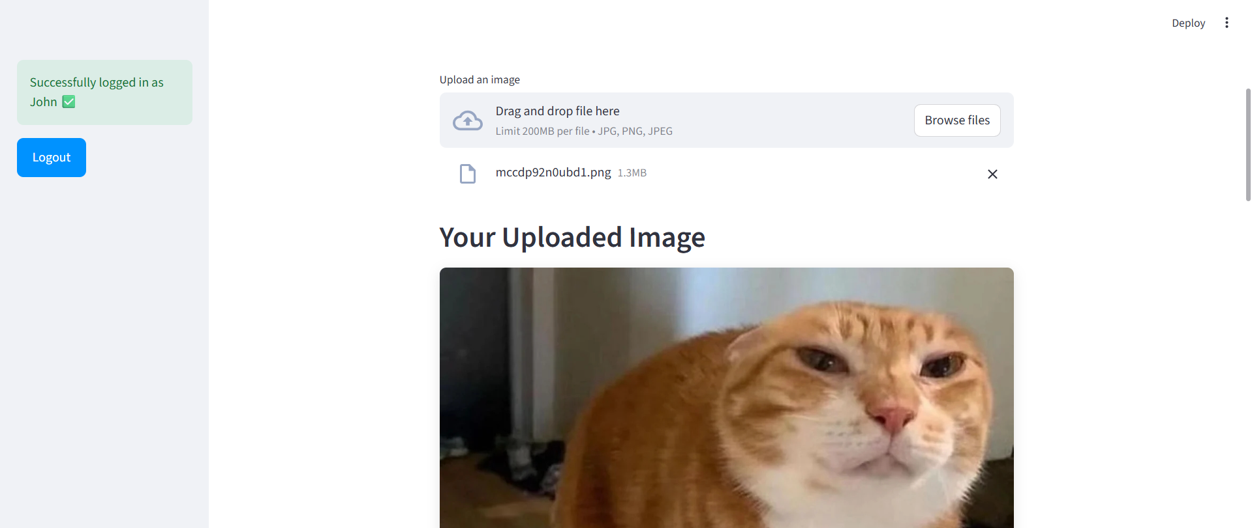
Adding image

Slide 12
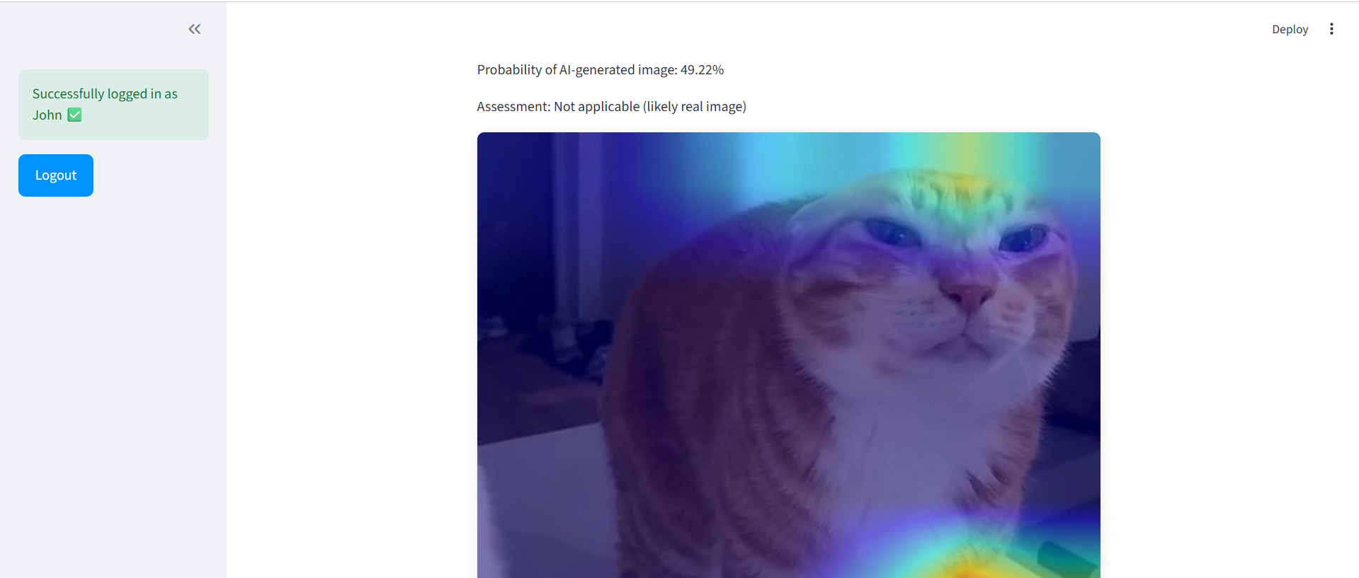
Image analysis

Slide 13
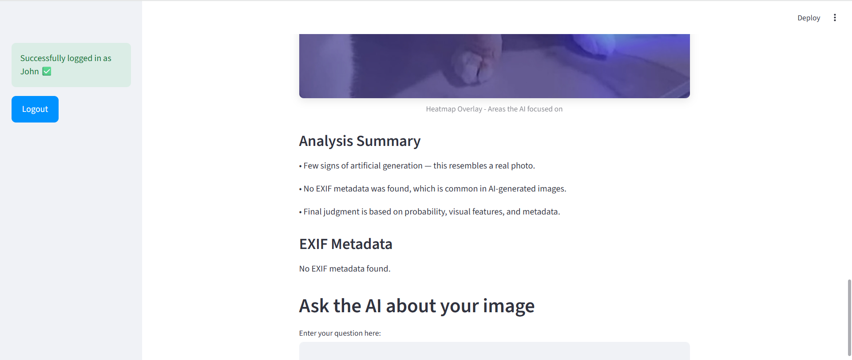
Extensive analysis

Slide 14
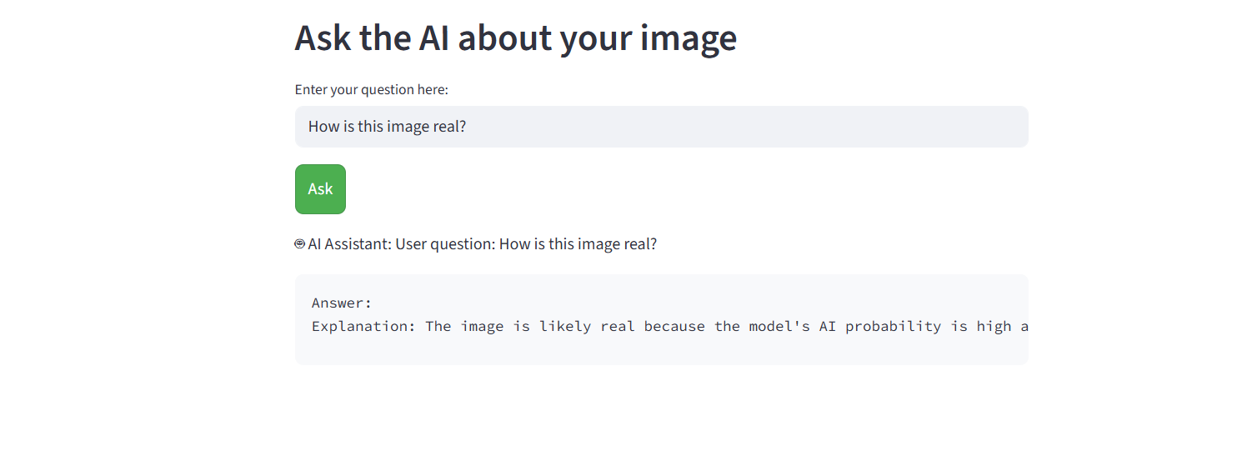
AI chatbot

Slide 15
Challenges Faced
Difficulty in finding a balanced dataset (AI vs. real images).
Variations in EXIF data formats across devices.
Heatmap generation took high computation time.
Integrating Streamlit UI with backend model.
10

Slide 16
Conclusion
Developed a functional AI Image Identifier web app.
Combines metadata analysis and visual pattern recognition.
Helps promote authenticity and trust in digital content.
11

Slide 17
Future Work
Improve detection accuracy with deep learning models.
Add detection for AI-generated videos.
Integrate with job portals or verification systems.
Deploy as a mobile or cloud-based API service.
12

