Slide 1


Software Architecture Part 3
Code It Up Online Vol. 11

Slide 2
For LIVE questions
Check The Link In The Description
Resources https://github.com/ivaylokenov/Software-Architecture-Series

Slide 3
Live stream troubleshooting
Sometimes issues happen during a live stream…
And sometimes disasters happen, this is how memes are born…
If my Internet goes down and the stream stops:
Wait for 5 minutes, I have another one on a different network
If YouTube is showing “stream ended”:
I will post a new link in the comments section below this video
If something else happens unexpectedly:
Well, I will add a solution to this slide during my next event… ☹
If a major showstopper is happening – no electricity, for example
I will create a new event and we will schedule a new live stream…
In any case – write to wewritesoftware@gmail.com

Slide 4
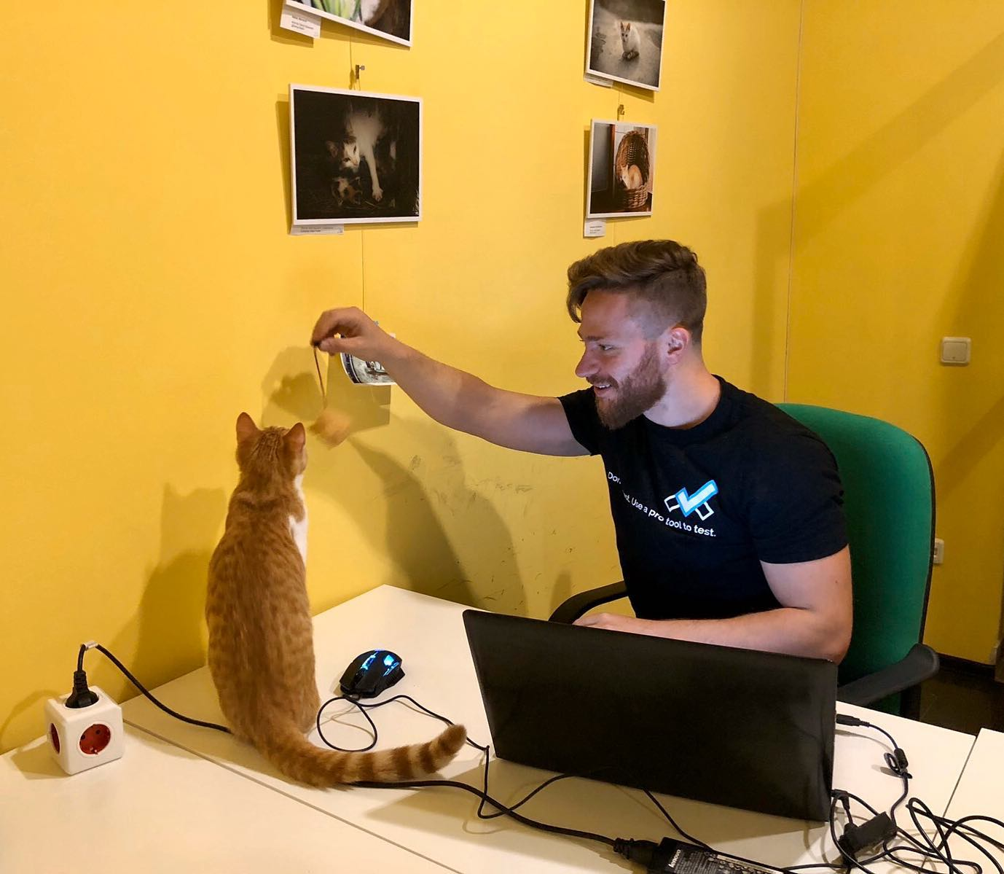
The Presenter
Ivaylo Kenov – Quality Code Advocate
Various job titles at the same time:
Organizer & Speaker @ Code It Up
CTO @ SoftUni
Full Stack Technical Trainer @ Everywhere
Code General @ https://docs.mytestedasp.net/
Meme Copy Machine @ Daily Programming Fun
{Insert Job Title Here}
Contacts
https://github.com/ivaylokenov
https://facebook.com/ivaylo.kenov
https://linkedin.com/in/kenov
https://www.instagram.com/ivaylokenov/
YouTube & Blog
https://www.youtube.com/c/CodeItUpWithIvo
https://codeitup.today/

Slide 5
Sponsors
This lecture is free thanks to our sponsors
Which will interrupt the lecture here and there
Because it takes quite a lot of personal time to prepare the materials
You will help the initiative a lot if you visit their web sites
And consider their propositions to you
I personally select various premium jobs to present them during the talk
These are the current ones:
INDEAVR - https://indeavr.com
Americaneagle.com - https://www.americaneagle.com
SmartIT - https://smartit.bg

Slide 6
ABOUT CODE IT UP

Slide 7
Code it up
The Code It Up initiative:
Aims to provide detailed knowledge on advanced software development topics
Aimed at people with at least 1 year of programming experience (mostly C#)
Sort of acquired by SoftUni last year
Code It Up Online
Free live-streamed online events (2+ hours long)
Led by me – mainly .NET, architecture, and infrastructure
We have 6 more lectures before the initiative ends
Code It Up Workshop
Paid events containing theory & practical exercises for the attendees
No more paid lecture planned for now

Slide 8
Thankful if you share a story
You can be extremely helpful to the initiative
Just share a story on Facebook or Instagram during the lecture
Make sure you tag me so that I can reshare your post - @ivaylokenov
Bonus – add the #codeitup hashtag
Thank you! You rock!

Slide 9
ABOUT The Series Of Events

Slide 10
About This SERIES Of Code It Up Events
Theoretical lectures on software architectures
Widely-used design patterns and concepts in production
Depending on your level, you may be familiar with some of the topics
A real-life project example
A practical guidebook for architecting various solutions
3 real-life projects on more than 70 pages
Legacy systems, vast data load, lots of concurrent users, working with critical data, and more
Please report to wewritesoftware@gmail.com, if you find any “bugs” in the book!
And I have a lot more to add in the future!
You receive free updates of the book!
MOST IMPORTANTLY – HUGE THANK YOU! <3

Slide 11
The Content Of The Series – A Free Course
Why Software Architecture
What Is Software Architecture?
Unified Modeling Language
Designing Solution Architectures
Common Technology Stacks
Architecture Design Patterns
Choosing The Right Patterns
Architecture Quality Attributes
System-Wide Considerations
Deployment Considerations
Monolithic Architecture
Domain-Driven Design
Microservices
Event Sourcing
The Architecture Document
The Architect And The Team
What Makes A Great Architect
Designing A Real-Life Solution

Slide 12
in The previous parts
What Is Software Architecture?
Designing Solution Architectures
Common Technology Stacks
Architecture Design Patterns
Choosing The Right Patterns
It is not required to watch the parts in order
But it is strongly advised!
Get the previous recordings from here:
https://www.eventbrite.com/o/code-it-up-29733808833

Slide 13
in this part
Choosing The Right Database
Choosing The Right Patterns
Common Design Choices
URL Shortening System Design
Don't Forget The Optional But Practical Guide-Book
3 Real-World Scenarios
70+ Pages
Free Updates
Get It From The Event's Page or write to wewritesoftware@gmail.com
https://www.eventbrite.com/e/software-architecture-common-design-choices- code-it-up-online-vol-11-registration-251121690737

Slide 14
About this topic
HUGE DISCLAIMER! THIS TOPIC IS LIKE THE LITTLE PRINCE BOOK!
There are a lot of things to know about software architectures
You may or may not recognize some of the patterns
And we most probably will not mention all of them
If you are a beginner, just try to absorb what you can
The technology world is moving very fast
Some of the examples shown here may be considered anti-patterns in the future
But the overall concept and process stays the same
As all my other topics – this one is super intense too!
Even though the lectures will be a bit shorter
So, give yourself time and if you get the book – finish it!
And don’t worry! The knowledge provided here will save you weeks of reading!

Slide 15
INDEAVR – The EVENT’s DIAMOND SPONSOR
They provide technology services focused on the Digital, Data, Cloud and Advanced Software Engineering expertise.
They are always in search for creative and passionate people with the combination of a sharp strategic mind, emotional maturity, entrepreneurial instincts, and the ability to deliver results.
https://www.indeavr.com/en/technology/application-services
https://www.indeavr.com/en/careers

Slide 16
Designing Solution Architectures

Slide 17
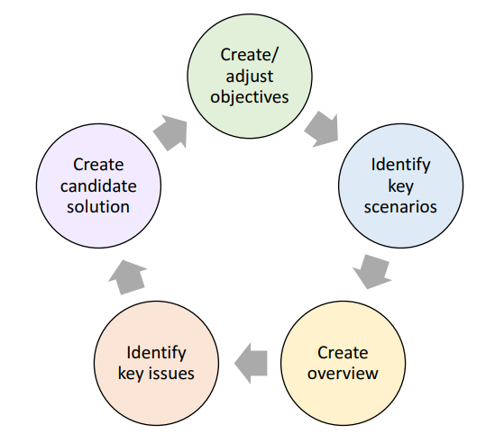
The Process For Designing Architectures

Slide 18
Choosing The Right Database

Slide 19
Database Considerations
Database technology should be one of your last decisions in your initial design
Because you may hit the "golden hammer" scenario
The business logic should be the main factor for the architecture
However, choosing the right storage solution always requires some consideration
Keep in mind most functional requirements can be achieved with any database
But at the cost of a huge performance hit
Or at an expensive price
Key factors:
Structure of the data
Query patterns
Data volume
Scale you need to handle

Slide 20
Database techniques
Indexing
Helper table, created from a particular column or group of columns
Improves read queries but speed of write operations declines
Replication
Removes the "single point of failure" issue
Higher complexity in terms of consistency and correctness
Difficult to design and manage on a high scale
Non-relational databases incorporate replication "out of the box"
Partitioning (Sharding)
Separates the data based on a predefined and specific rule
Introduces complexity but it is a first-class feature in non-relational database
Partitioning can also be used for the application logic

Slide 21
Caching solution
If you have:
Frequent database calls
High latency independent services
You may want to cache some data
You may use Redis, Memcached or other technologies
Redis is the most popular choice
Caching has downsides:
Stale data
Overhead
Complexity of logic
"There are only two hard things in Computer Science: cache invalidation and naming things!"

Slide 22
File Storage Solution
If you store files and not structured data, you most probably do not need a database
You use database for information which you want to query
And files are not queried, they are delivered directly
In such scenarios, you use blob storage
Like Amazon S3, for example
Blob storage allows you to store files
And usually, for greater scale, you would use a CDN
To reduce the latency for your geographical location

Slide 23
Text Search Solution
If you want to build a search functionality, you need a search engine
Like Elasticsearch
In such scenarios you want to support "fuzzy search"
Where typos are also matched, for example "airprot" search shows "airport" results
The search engines are not databases and you do not use them as a primary one
They guarantee fast and relevant results, not a storage solution
Normally, you load the search engine data from another database

Slide 24
Time Series Solution
Time series databases are not randomly updated like normal ones
You add data in "append only" format
Server metrics
Performance monitoring
Network data
Sensor data
And many more…
They are perfect for queries which include a time period
InfluxDB is such database

Slide 25
Data Warehouse Solution
Data warehouse is used where you just put all your data in one place
And then perform analytics over it
It is used for offline reports and business decisions
This solution is not used for regular everyday transactions
It will be too slow on scale
Hadoop is a very commonly used data warehouse solution
But you can use other databases, if you think they will be good enough

Slide 26
SQL or NoSQL
You can use a relational database, if:
You have structured data
You need atomicity, consistency, isolation, durability (ACID)
Otherwise, you can use a non-relational database
Consider Amazon products – they all have different attributes
Then you need to consider the query pattern of your use case
If you have vast variety of queries and attributes, you can use a NoSQL database
You can use a wide-column database like Cassandra
If you have small variety of attributes but huge data volume
In this case you have huge scale of queries, but their variety is small

Slide 27
Straightforward example
You have an Uber like application, and you want to fetch driver's information
If you use Cassandra, you can partition it on driver's ID and easily find results
What about customer's ride on a specific date?
In such case the above solution will be slow, you need to check every partition
But you can easily replicate the data to another "table" partioned by customer ID
Cassandra have huge scale if the queries are of a similar type
Otherwise, replication will be too complex
And a database like MongoDB may be a better choice

Slide 28
Happy cases?
All the previous slides show happy cases
Relational database when we have structured data and ACID requirements
Non-relational database when we have vast variety of data properties and complex queries
Wide-column database when we have huge scale with simpler data and less variety of queries
However, in real-world requirements are not that simple
An example is Amazon:
If multiple users try to buy the last item in stock, we need ACID
But the products have vast variety of attributes
And need huge scale
Additionally, we need reporting of sales
How do we solve that?

Slide 29
The real world solutions are complex
To guarantee the ACID requirement, we will store unfinished orders in PostgreSQL
Or another relational database
After the order is completed, we can move it to Cassandra for a permanent store
Partitioned by seller ID for the seller panel
And partitioned by customer ID for the customer panel
Finally, we can store the order in a MongoDB database too
Because we have reporting requirements
And reporting requires complex queries with variety of options
And for different scenarios, you can use a combination of the databases:
For example, you get the order IDs from the MongoDB
Then load the rest of the data from Cassandra
Rome was not built in a day! Amazon too! It evolved!

Slide 30
What about redis?
We introduced Redis as a key-value database
However, it is much more powerful and capable than a simple cache
It can be used for:
Distributed transactions
Bounded contexts
Asynchronous messaging
Transactional outbox
Telemetry
We will cover these concepts in the series during some of the next lessons
More information explained here:
https://thenewstack.io/how-redis-simplifies-microservices-design-patterns/

Slide 31
What about big data?
Big data consists of datasets which are either:
Too large in size
Too complex in structure
Come to our system at a high rate
Big data exceeds the capacity of a traditional application
Characteristics
Volume – terabytes per day
Google Search, Medical health monitoring, Real-time security
Variety – large variety of unstructured data from multiple sources
Social media behavior
Velocity – large scale or high frequency of events
Online store with millions of users, Internet of Things

Slide 32
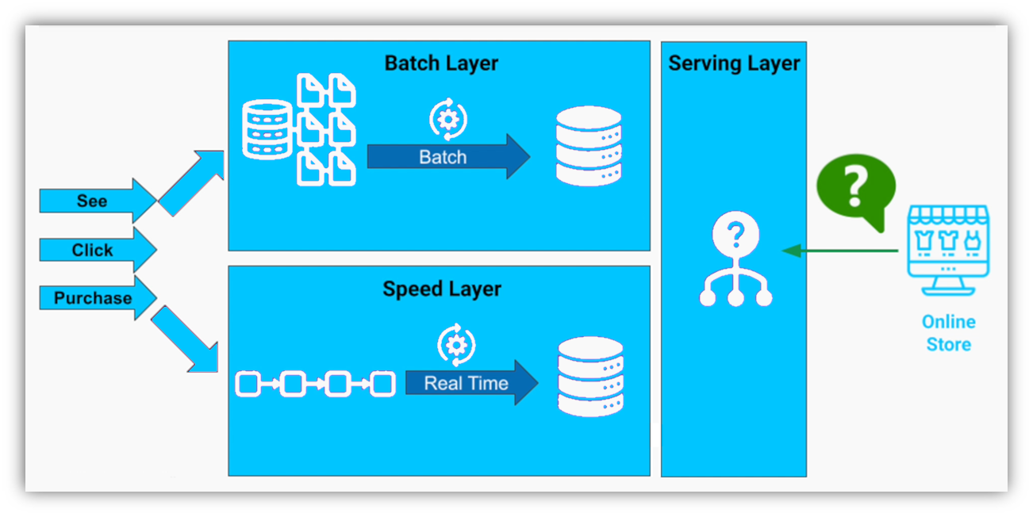
Processing big data with lambda architecture

Slide 33
BEFORE WE CONTINUE…

Slide 34
Huge THANKS for your support & TRUST!
Everyone who got a paid ticket – 72 people in total! Thank you!
Top supporter – Aleksandar Evangelatov – 80 BGN! Thank you, you rock! <3
Thanks to – Pavel, Georgi, Aneliya, Nikolay, Vladimir, Mariyana, Svetoslav, Miroslava, Ivan, Hristina, Калин, Рая, Petar, Daniel, Teodor, Stoil, Dimitar, Diana, Alexander, Svilen, Petar, Kiril, Kalin, Radoslav, Свилен, Veselin, Julia, Pavel, Robert, Mira, Albena, Dinyo, Elena, Elitsa, Ivaylo, Zlatko, Sonya, Dimitar, Hristo, Dobromir, Hristo, Dobromir, Zlatin, Nikolay, Valentin, Borislava, Plamen, Aleksandar, Sonya, Milcho, Lazar, Martin, Борислав, Borislav, Borislav, Lyubozar, Mariyan, Vladimir, Boryana, Teodor, Nikolay, Blagovest, Plamen, Anelia, Iva, Viktor, Ventsislav, Plamen, Nikolay, Dimitar, Yavor, Rosen
And everyone who supported the initiative during the years!

Slide 35
These events are not Exactly free
I prefer to call them “Pay what you want”
Depending on how much you value the provided knowledge
It takes me a considerable amount of free time to prepare these lectures
And I want them to be perfect and complete!
I put my soul in them!
For this reason, I will be extremely thankful, if you decide to support me and my projects!
It is never expected, but always appreciated!
The easiest way is via
PayPal: http://paypal.me/ivaylokenov
Revolut: @ivaylokenov

Slide 36
Choosing the Initial patterns

Slide 37
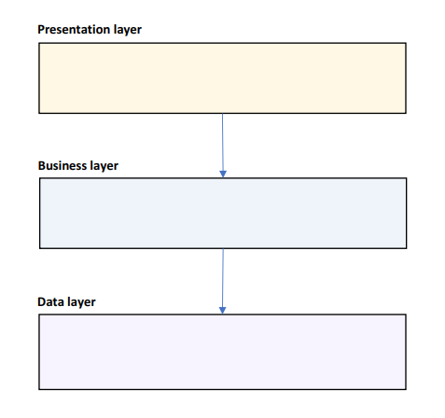
The Layered Pattern
Good starting point
Create 3 layers:
UI / Presentation – visualization concerns
Business – business logic and domain
Data – data access layer
If you expect a long-term project, you may choose Domain-Driven Design with Clean Architecture
Presentation – visualization concerns
Application – business logic
Infrastructure – infrastructure details
Domain – business entities
Add a Service layer if you plan to expose an API

Slide 38
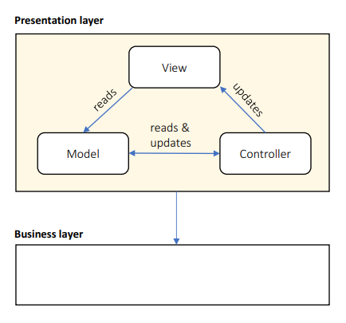
The Presentation Layer
Use Components for:
Containers
Reuse
3rd parties
Declarative rendering
Like WordPress – with widgets
Or with visual designer
Lots of dynamic interactions
Use MVC for lots of UI pages
Or MVVM if the technology support data binding
Remove this layer, if you designing an API
Without any UI

Slide 39
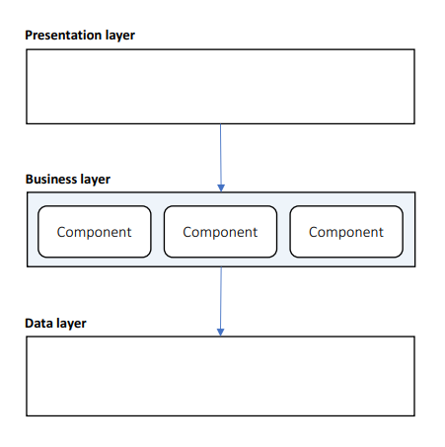
The Business Layer
Use Components:
Modular functionality
Plugin support
Business entity abstraction
For each entity – create a component
Declarative configuration:
Visual workflows – like a flow chart for the business rules
Business rules – collection of if/then/else rules
If you don’t need the above, use an object-oriented architecture

Slide 40
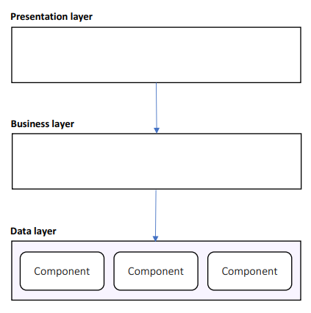
The Data Layer
Use Components:
Handling diverse data sources
SQL Server, Redis, MongoDB, etc.
Increased abstraction
Declarative configuration
Easily replace connection string, data storages and other mechanisms

Slide 41
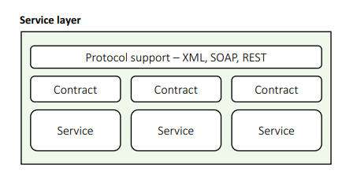
The service Layer
Use Components:
Contract management
Containers
Declarative configuration
Choose Microservices if your system is composed mostly of interlocking APIs
Never start with Microservices, unless you are completely sure
Always choose a monolithic application with Microservices in mind
Use Domain-Driven Design and Clean Architecture to separate contexts
Extract microservices when necessary
Add Message Bus if all services alter state on a common message

Slide 42
Designing Layered Architectures

Slide 43
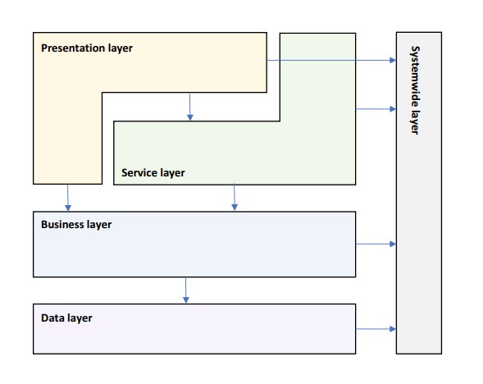
Logical Layered Design

Slide 44
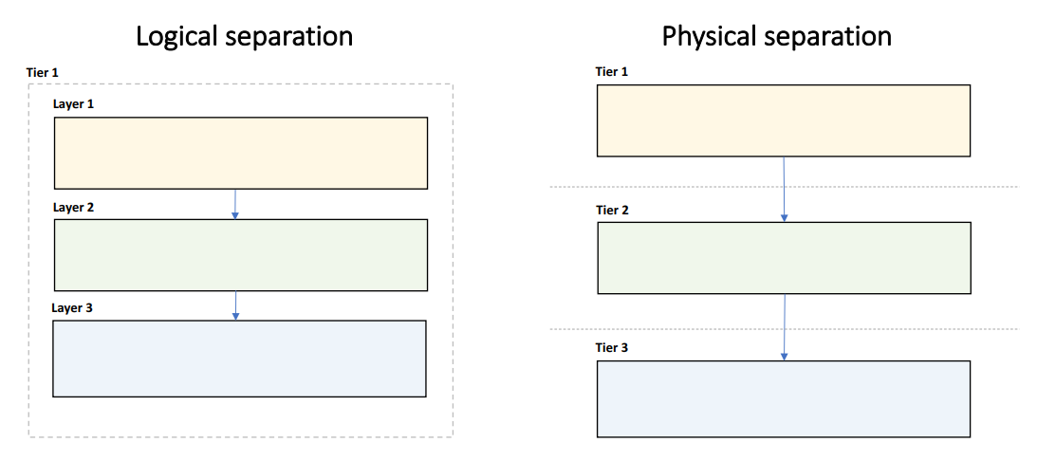
Choose Layering Strategy

Slide 45
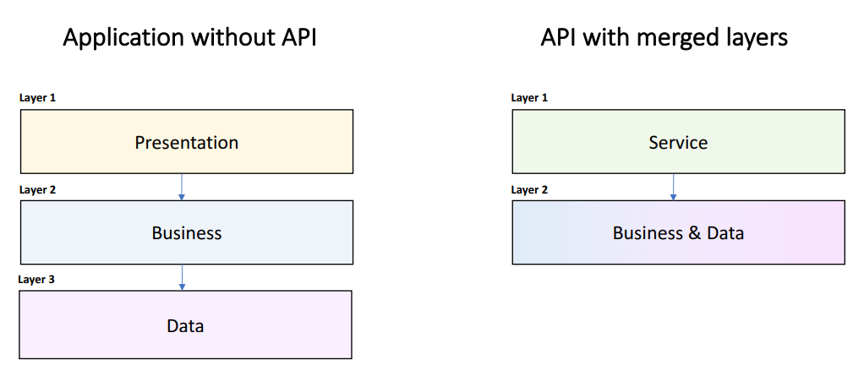
Remove, Split & Merge Layers

Slide 46
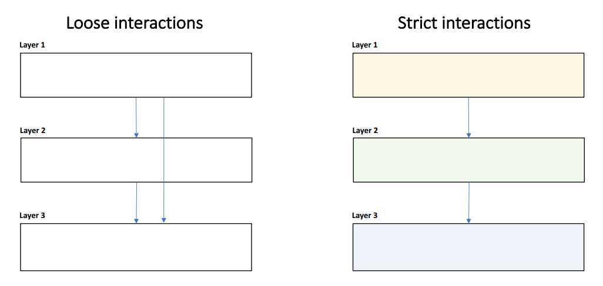
Determine Layer Interactions

Slide 47
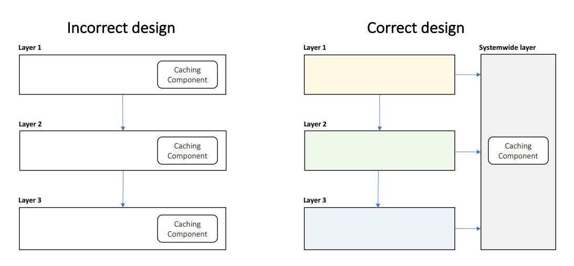
Identify Systemwide Concerns

Slide 48
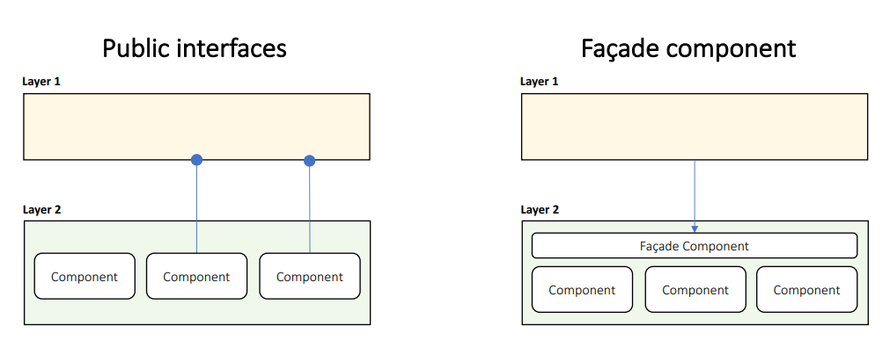
Define Layer Interfaces

Slide 49
Designing Low-level Components

Slide 50
General Guidelines
Always choose a set of rules to control the inevitable chaos
SOLID is a good starting point but do not get too excited about it
Components should be highly cohesive with clear purpose
Components should have loose coupling and strict communication
Components should be encapsulated with well-defined interfaces
Define clear code style rules
Classes, interfaces, methods, variable, constants, etc.
Learn low-level Domain-Driven Design
It will help you understand separation of concerns and development scalability
And provide you with a great set of rules to achieve the above goals

Slide 51
Low-level Design patterns
Design patterns are micro-architecture
Make sure your developers are familiar with them
Commonly useful design patterns:
Factory – remove the "new is glue" syndrome from your code
Repository – only if you really need it, may serve as anti-corruption layer
Façade – hide complexity in your business logic
Command – encapsulate actions in objects
Strategy – supports open/close principle
Learn all of them!
But use only the ones you need!

Slide 52
Designing Service-Oriented Architectures

Slide 53
Software Services
Software services are self-contained modules
They reflect the idea of describing specific logic through a well-defined interface
Service-oriented applications are developed as independent sets
Interacting with each other
Using the principle of loose coupling
Web services
Self-describing, self-contained software module
Available via a network
Completes specific tasks and solves specific problems
Can be dynamically found
Can be accessed programmatically

Slide 54
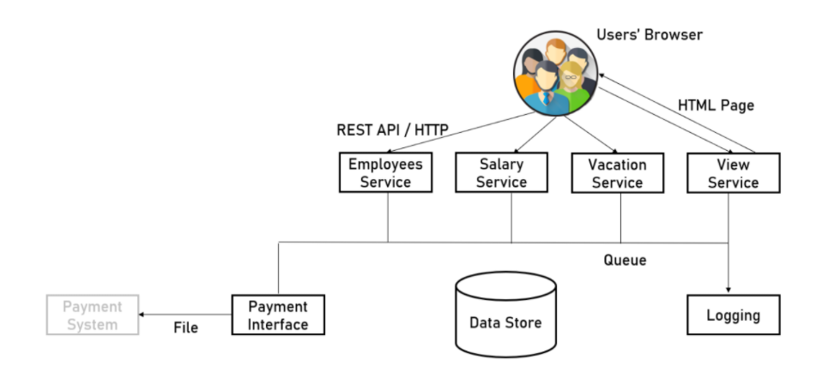
Software Services example

Slide 55
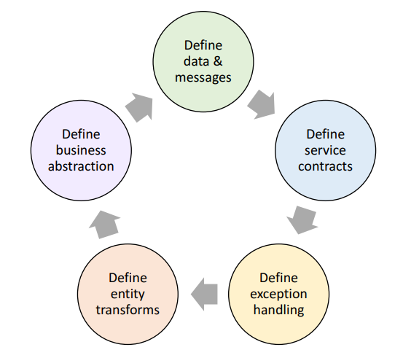
The Service Design Process
Separate logical services
Define data & messages
Define service contracts
Plan exception handling
Define how business entities are transformed to messages
Define how business functions are abstracted to services

Slide 56
Define Service Messages
Request/Response, Fire & Forget, or Bi-Directional
Command, Query, Document, Entity, Event, Message…
Avoid large messages
Add expiration & diagnostic info
Define in a Class Diagram

Slide 57
Define Service Contracts
CRUD or RPC
Stateful/Stateless
Transaction Management
Handle invalid calls:
Timeouts
Duplicate calls
Calls out of order
Define in a Component Diagram

Slide 58
Plan Exception Handling
Only catch what you can handle
Use meaningful messages:
Business explanation
Technical information
Retry instructions
Introduce fault tolerance
Return fault metadata
Log everything you can without introducing too much pollution
Notify exception subscribers

Slide 59
Define Business Abstraction
Business layer abstractions:
Call the Façade directly
Call Business Components
(Re)Start a Workflow
Log a Business Event
Considerations:
Long-running workflows
State management
Transactions

Slide 60
Questions for the learning system
We can now move within a new cycle and create our first candidate solution
Objectives and key scenarios stay the same but let's refine the architecture
1a. Are we happy with our layers? Remove or merge layers? Their communication?
1b. Revisit the key issues and the system-wide layer. Are we happy with them? Our third-party tools?
2a. Are we happy with our presentation layer? Do we want to add presentation entities?
2b. Are we happy with our business layer?
2c. Are we happy with our data layer and the level of abstraction?
3a. Start designing and extracting the application services. Choose exception handling strategy.
3b. Describe service messages. Create a new UML class diagram describing public properties.
3c. Describe the service contracts and their public interfaces.
3d. Decide how the services layer will communicate with each other.
3e. Decide how you will do diagnostics. 4. Bonus – forward engineer a skeleton solution.

Slide 61
Architecture styles

Slide 62
Even more Styles & Patterns
We covered two of the most popular architecture styles
N-tier and Service-Oriented (or Microservices)
But there are way more
https://docs.microsoft.com/en-us/azure/architecture/guide/architecture-styles/
Other architectural design patterns also exist
For data management
For design and implementation
For communication
https://docs.microsoft.com/en-us/azure/architecture/patterns/
We will cover lots of them in this series
Popular ones like CQRS and Event Sourcing
As well as some of the antipatterns

Slide 63
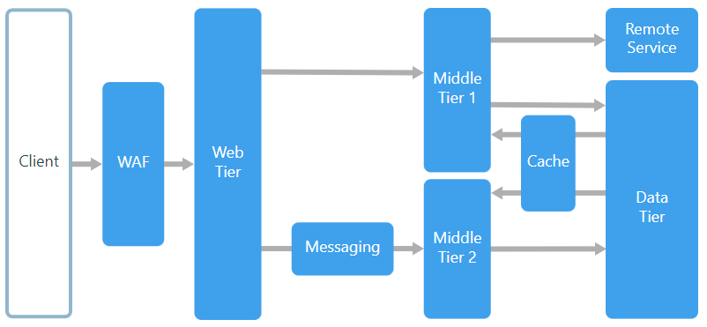
N-Tier Overview

Slide 64
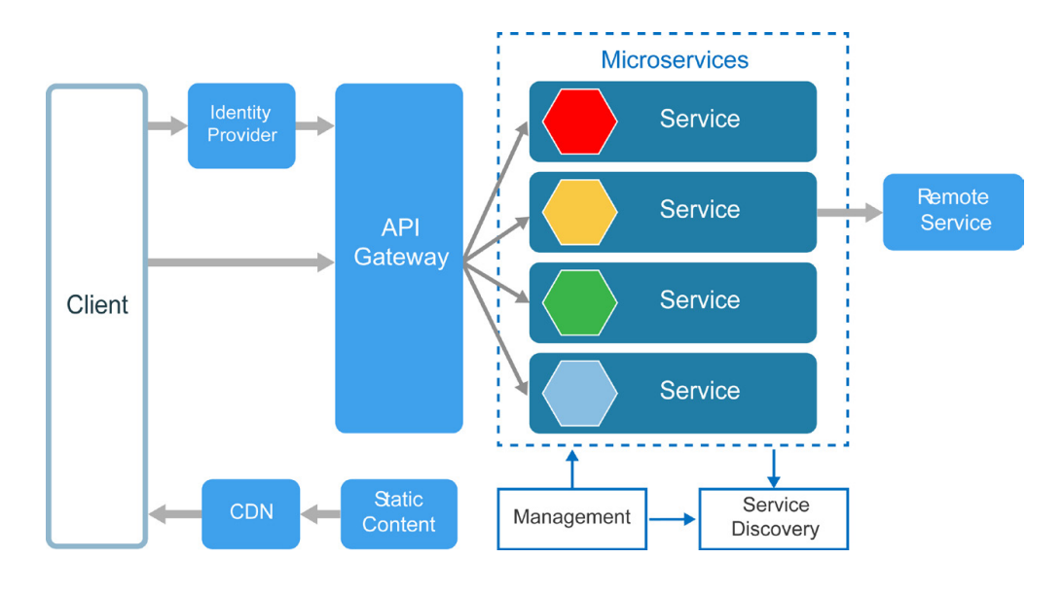
Microservices Overview

Slide 65
URL Shortening System Design

Slide 66
Theoretical solution
We will design a theoretical solution for a commonly asked system design on interviews
We will make lots of assumptions since we do not have the full picture
In the real-world, you will do similar calculations
But will adjust them when you have more users and production load data
It is a constant process of improving and designing
Remember – Amazon was not built in a day!
But first – let's warm-up with some real-world scenarios!
Judge system design and evolution
E-commerce product data mining

Slide 67
URL Shortening System Requirements
Functional requirements:
Ability to get a short URL from a longer one
Redirect to the long URL when a user tries to access the short equivalent one (with analytics)
Non-functional requirements:
Very low latency for URL redirection
Very high availability because all URLs will not function in case of failure
It is our job to ask specific questions:
How many URLs we might expect to shorten per second?
100 million per month or ~40 per second
For how long do we need to support these URLs?
Indefinitely, they will remain forever in the system
Do we support custom URL paths?
Yes, we do. Maximum character limit of 16. Paid feature.

Slide 68
Initial considerations
Traffic:
We generate ~40 URLs per second
Assuming each link is clicked ~200 on average, we will have ~8000 redirects per second
Storage:
We can assume the lifetime of the service to be 100 years
That is 100 million * 100 years * 12 months = 120 billion records in total
Assuming the data object to be ~500 bytes, we will have ~60TB of data in total
Memory:
If we follow the Pareto principle, we will have 80% of the requests for 20% of the data
With ~8000 requests per second, we will have ~700 million requests per day
Caching 20% of these requests will require ~70GB of memory

Slide 69
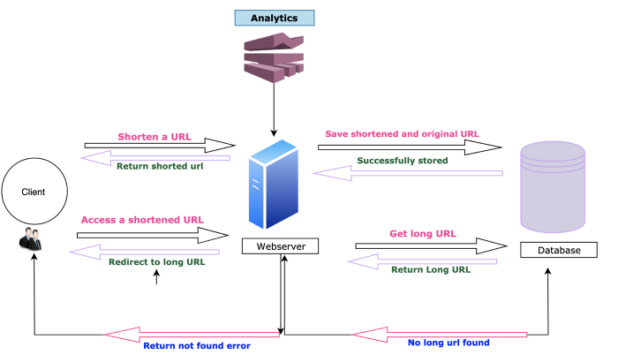
Layered high level design
We can start with the traditional 3-layer design:

Slide 70
Initial design problems
Here are the problems we will face with the initial design:
There is one web server which is a single point of failure
The system does not scale
There is a single database which may not be enough for our needs
The above limitations can be fixed by:
Adding a load balancer in front of the web servers
Introducing sharding to the database
Introducing a cache system to reduce the database load
We will cover these concepts in the series during some of the next lessons

Slide 71
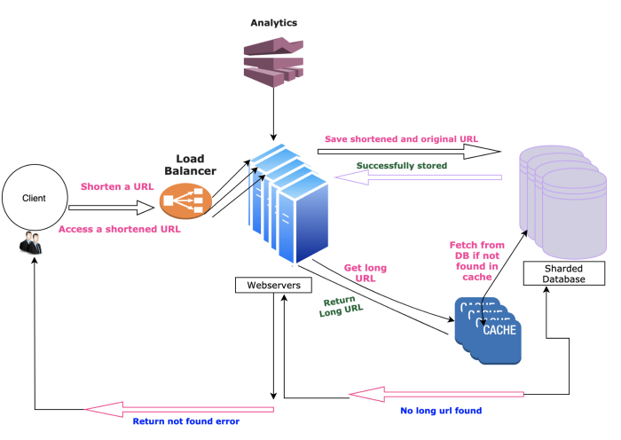
Improved high level design
Adding the fixes will give us an improved design:

Slide 72
Low level details
Let's analyze the API:
We have a create (POST) endpoint and a redirect (GET) endpoint
The GET one should return 302 status code for analytics purposes
The database schema is quite simple:
User – ID, name, email, creation date
Short URL – unique short URL, original URL, user ID, creation date
Shortening solutions:
Random generation
URL encoding with base62
URL encoding with MD5
Key generation service

Slide 73
Short URL Length
Calculating the minimum length of the short URL
If we use numbers and letters, we will have 62 symbols in total
0-9, a-z, A-Z
Also known as "base62"
Checking the possible short URL lengths:
URL with length of 5 – 62^5 = ~916 million
URL with length of 6 – 62^6 = ~56 billion
URL with length of 7 – 62^7 = ~3500 billion
Our requirement is 120 billions URLs, so we will use length of 7

Slide 74
Shortening Algorithms
Random generation of short URL
And check the database for collisions
This is a poor solution but can work with scaled databases
URL encoding with base conversion
We can convert numbers from base 10 to base 62
Here is an example tool for that: https://jalu.ch/coding/base_converter.php
We can start with a large number, for example 100000000000
And increment it on every URL generation
The challenge here is storing the counter consistently and reliably
URL encoding with MD5
Generate MD5 from the long URL and take the first 7 symbols
If the result already exist in the database – use the next 7 symbols

Slide 75
Shortening Algorithms
With any of these shortening algorithms, we cover part of the design goals
The storage of 120 billion links
The short URL is as short as possible
But what about scalability and availability?
For the web server, we can introduce a load balancer, as we said
But our next challenge is the database
What kind of database to use?
Can we use a relational one?
The database can be different depending on the shortening solution
But in any case, we have structured data
And small variety of queries without any join operations

Slide 76
Database Scalability
Random generation of short URL
We can use MongoDB or Cassandra
And partition them with their built-in hash strategy
We can add an index on the short URL column to speed up r
URL encoding with base conversion
Here we can even use a SQL database with the counter as primary ID
We can create our own partitioning strategy based on the counter
This approach is possible but more difficult to maintain
We can store the counter on a Redis cluster, but it is a bit complex
So, it may be still better to use MongoDB or Cassandra
URL encoding with MD5
The MongoDB or Cassandra solution is good enough here again

Slide 77
Key generation service
We may decide to extract the short link generation to a separate service
It can generate lots of random seven-letter strings before-hand
Whenever we want a short URL, we will take one of the already-generated ones
This approach will be simple and fast
No collisions
No run-time URL encoding
What are the disadvantages?
Concurrency
Single point of failure

Slide 78
Key generation service
Concurrency problems solved:
KGS can use two tables to store keys
One for unused ones and one for all the used
KGS can keep some keys in memory to make sure it delivers them fast
And marks them in the used table as soon as the keys are loaded in memory
If KGS dies, we can afford losing some keys because we have ~3500 billion combinations
KGS must synchronize (lock) the in-memory data structure holding the keys
Single point of failure solved:
We can have stand-by replicas of the KGS
Whenever the primary server dies, we have another one waiting to take over

Slide 79
Caching
Each application server can cache some keys upfront from the KGS
And if it dies, we will lose them, but again – it is acceptable
This way the KGS server will not be under a heavy load
We can use a Redis database here to store the pair of URLs
And the application servers can easily check it
We can start with 20% of the daily traffic and react accordingly
A modern server can have 256GB of memory
We can fit the estimated ~70GB easily in one big or multiple smaller servers
We can use cache replication to lessen the load
And every time we refresh the cache, we update all the replicas simultaneously
The cache eviction policy should be "Least Recently Used"
The Redis sorted set data structure is perfect for that

Slide 80
Number of web servers
We have ~8000 requests/second on average
Our servers will not do lots of calculations
Because our KGS will provide the short URLs
And the cache will provide the redirects
We can deploy a web server and load test it to get an average response time
Let's say it is ~0.04 seconds/request/core or ~25 requests/second/core
This means we will need ~320 cores
Or ~40 replicas with 8 CPUs
These are average calculations
We can easily use autoscaling infrastructure
On Kubernetes or a cloud

Slide 81
Other Considerations
Load balancers in the system:
Between clients and application servers
Between application servers and database servers, if we use a custom sharding strategy
Between application servers and cache servers, if we replicate them
Round-robin initial strategy
Custom short URLs
Since this is a paid feature, we can use separate servers and databases
The general load will be a lot less
Analytics
Every time we perform a redirect, we can send a message to a message broker
Kafka will be ideal for this highly loaded scenario
Then on the other side of the queue – we can have a separate service
It will store and provide analytics data for its UI

Slide 82
FINAL WORDS before Q & A

Slide 83
Summary
Choosing The Right Database
Choosing The Right Patterns
Common Design Choices
URL Shortening System Design From Scratch
Don't Forget The Optional But Practical Guide-Book
3 Real-World Scenarios
70+ Pages
Free Updates
Get It From The Event's Page or write to wewritesoftware@gmail.com
https://www.eventbrite.com/e/software-architecture-common-design-choices- code-it-up-online-vol-11-registration-251121690737

Slide 84
In the next part
Quality Attributes
Performance & Scalability
System-Wide Concerns
Register here:
https://www.eventbrite.com/e/software-architecture-quality-attributes- code-it-up-online-vol-12-registration-256029329617
Don't Forget The Optional But Practical Guide-Book
3 Real-World Scenarios
70+ Pages
Free Updates
Get It From The Event's Page or write to wewritesoftware@gmail.com
https://www.eventbrite.com/e/software-architecture-common-design-choices- code-it-up-online-vol-11-registration-251121690737

Slide 85
Other Goodies
You can check the Code It Up blog and subscribe:
https://codeitup.today
You can watch some of the free videos:
https://www.youtube.com/CodeItUpwithIvo
Clean code & The art of testing
Docker, CI/CD, Redis, Elasticsearch
And many more…
The source code in all free lessons is available on Patreon:
https://www.patreon.com/ivaylokenov
Unrelated to the IT sector but check out my art T-Shirts:
https://way-ve.com/
Use CODE10 during checkout for 10% discount

Slide 86
Past Code It Up Events
You can get the recordings of the past C# events from the event page:
C# Async-Await In Detail
The C# ORM Battle
Docker – From ABC To XYZ
Identity Server Demystified
Eventual Consistency Done Right
Let's Get Functional With C#
C# API Scenarios – REST, GraphQL & gRPC
Past workshops are also available:
C# Multithreading
Domain-Driven Design With ASP.NET Core
Kubernetes For Web Developers
If interested, you can write to wewritesoftware@gmail.com

Slide 87
ANY QUESTIONS?
You can support me and my projects:
Via PayPal: http://paypal.me/ivaylokenov
Via Revolut: @ivaylokenov
On Patreon: https://www.patreon.com/ivaylokenov
On Open Collective: https://opencollective.com/mytestedaspnet
Via Buy Me A Coffee: http://buymeacoff.ee/ivaylokenov
Crypto: http://bit.ly/ik-sponsors
Never expected, always appreciated!
Make sure you check my sponsors!
INDEAVR - https://indeavr.com
Americaneagle.com - https://www.americaneagle.com

Slide 88
Thank You!
Resources: https://github.com/ivaylokenov/Software-Architecture-Series

