Slide 1


Software Architecture Part 1
Code It Up Online Vol. 9

Slide 2
For LIVE questions
Check The Link In The Description
Resources https://github.com/ivaylokenov/Software-Architecture-Series

Slide 3
Live stream troubleshooting
Sometimes issues happen during a live stream…
And sometimes disasters happen, this is how memes are born…
If my Internet goes down and the stream stops:
Wait for 5 minutes, I have another one on a different network
If YouTube is showing “stream ended”:
I will post a new link in the comments section below this video
If something else happens unexpectedly:
Well, I will add a solution to this slide during my next event… ☹
If a major showstopper is happening – no electricity, for example
I will create a new event and we will schedule a new live stream…
In any case – write to wewritesoftware@gmail.com

Slide 4
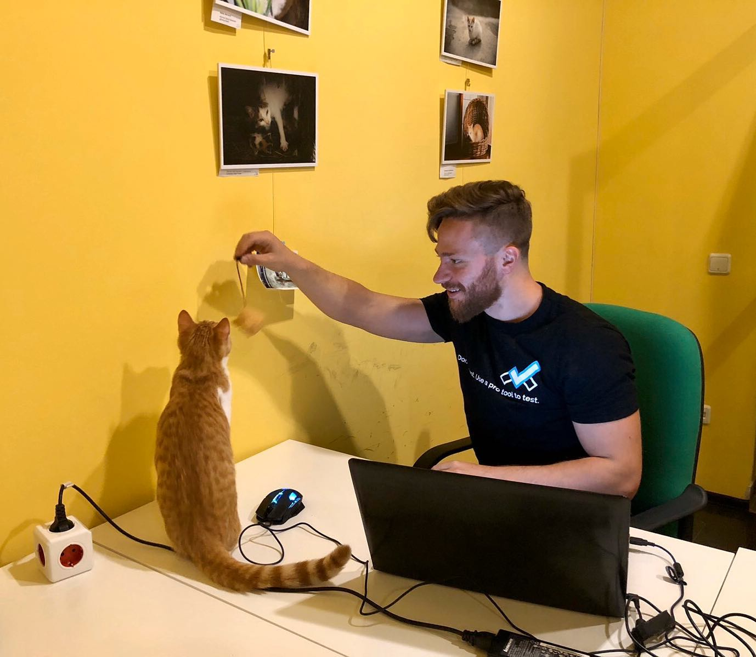
The Presenter
Ivaylo Kenov – Quality Code Advocate
Various job titles at the same time:
Organizer & Speaker @ Code It Up
CTO @ SoftUni
Full Stack Technical Trainer @ Everywhere
Code General @ https://docs.mytestedasp.net/
Meme Copy Machine @ Daily Programming Fun
{Insert Job Title Here}
Contacts
https://github.com/ivaylokenov
https://facebook.com/ivaylo.kenov
https://linkedin.com/in/kenov
https://www.instagram.com/ivaylokenov/
YouTube & Blog
https://www.youtube.com/c/CodeItUpWithIvo
https://codeitup.today/

Slide 5
Sponsors
This lecture is free thanks to our sponsors
Which will interrupt the lecture here and there
Because it takes quite a lot of personal time to prepare the materials
You will help the initiative a lot if you visit their web sites
And consider their propositions to you
I personally select various premium jobs to present them during the talk
These are the current ones:
INDEAVR - https://indeavr.com
Americaneagle.com - https://www.americaneagle.com
SmartIT - https://smartit.bg

Slide 6
ABOUT CODE IT UP

Slide 7
Code it up
The Code It Up initiative:
Aims to provide detailed knowledge on advanced software development topics
Aimed at people with at least 1 year of programming experience (mostly C#)
Sort of acquired by SoftUni last year
Code It Up Online
Free live-streamed online events (2+ hours long)
Led by me – mainly .NET, architecture, and infrastructure
We have 7 more lectures before the initiative ends
Code It Up Workshop
Paid events containing theory & practical exercises for the attendees
No more paid lecture planned for now

Slide 8
Thankful if you share a story
You can be extremely helpful to the initiative
Just share a story on Facebook or Instagram during the lecture
Make sure you tag me so that I can reshare your post - @ivaylokenov
Bonus – add the #codeitup hashtag
Thank you! You rock!

Slide 9
ABOUT The Series Of Events

Slide 10
About This SERIES Of Code It Up Events
Theoretical lectures on software architectures
Widely-used design patterns and concepts in production
Depending on your level, you may be familiar with some of the topics
A real-life project example
A practical guidebook for architecting various solutions
3 real-life projects on more than 70 pages
Legacy systems, vast data load, lots of concurrent users, working with critical data, and more
Please report to wewritesoftware@gmail.com, if you find any “bugs” in the book!
And I have a lot more to add in the future!
You receive free updates of the book!
MOST IMPORTANTLY – HUGE THANK YOU! <3

Slide 11
The Content Of The Series – A Free Course
Why Software Architecture
What Is Software Architecture?
Unified Modeling Language
Designing Solution Architectures
Common Technology Stacks
Architecture Design Patterns
Choosing The Right Patterns
Architecture Quality Attributes
System-Wide Considerations
Deployment Considerations
Monolithic Architecture
Domain-Driven Design
Microservices
Event Sourcing
The Architecture Document
The Architect And The Team
What Makes A Great Architect
Designing A Real-Life Solution

Slide 12
in this part
Why Software Architecture
What Is Software Architecture?
Unified Modeling Language
Designing Solution Architectures
Don't Forget The Optional But Practical Guide-Book
3 Real-World Scenarios
70+ Pages
Free Updates
Get It From The Event's Page or write to wewritesoftware@gmail.com
https://www.eventbrite.com/e/software-architecture-fundamentals- essentials-code-it-up-online-vol-9-registration-222550182587

Slide 13
About this topic
HUGE DISCLAIMER! THIS TOPIC IS LIKE THE LITTLE PRINCE!
There are a lot of things to know about software architectures
You may or may not recognize some of the patterns
And we most probably will not mention all of them
If you are a beginner, just try to absorb what you can
The technology world is moving very fast
Some of the examples shown here may be considered anti-patterns in the future
But the overall concept and process stays the same
As all my other topics – this one is super intense too!
Even though the lectures will be a bit shorter
So, give yourself time and if you get the book – finish it!
And don’t worry! The knowledge provided here will save you weeks of reading!

Slide 14
INDEAVR – The EVENT’s DIAMOND SPONSOR
They provide technology services focused on the Digital, Data, Cloud and Advanced Software Engineering expertise.
They are always in search for creative and passionate people with the combination of a sharp strategic mind, emotional maturity, entrepreneurial instincts, and the ability to deliver results.
https://www.indeavr.com/en/technology/application-services
https://www.indeavr.com/en/careers

Slide 15
Why Software Architecture

Slide 16
Why this topic
A little back-story, first…
5-6 years ago, I was on interview for a tech lead or a software architect
Depending on my skills and knowledge
And after the interview, they told me "you are great, but you need a little bit more to become an architect"
I was both disappointed and motivated
So, I started researching a lot about software architectures and patterns
I purchased lots of courses, read lots of articles and books
Started analyzing how the big guys are doing it – StackOverflow or Netflix, for example
These lectures are the culmination of the story above! Enjoy!

Slide 17
Why solution architects
Why do we need solution architects?
If we have a perfect tech lead?
And very skilled developers?
Consider constructing a building…
Imagine if there is no design and architecting plans
Just the workers and their team leader coming every day to work
It is the same with software development!
We need an architect to design and lead our high-level solution!

Slide 18
Reasons to become architects
It is interesting!
You will have way more variety of work to do!
You will solve different challenges!
Career path and visibility!
You will meet powerful people – CEOs and CTOs!
You learn a lot from such individuals!
Money!
Software architects may earn double the salary of senior developers!
And if they are skilled enough, they can beat some of the executives!

Slide 19
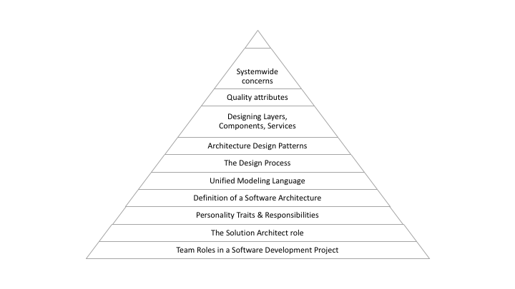
The knowledge path

Slide 20
What Is Software Architecture?

Slide 21
Software architecture
Structured solution to address all common software attributes:
Meets all the requirements
Performance optimized
Security in check
Manageability for developers
Scalability for business growth
Accessibility for easier user experience
Major requirements:
User requirements – the way end-users interact with the system
Business requirements – cheaper, faster, better than competitors
IT system requirements – infrastructure requirements

Slide 22
What composes an architecture?
The structural elements and interfaces composing the system
Objects – the low-level building blocks of the system
How these elements behave in collaboration
How communication is done in the architecture
The composition of elements into larger subsystems
How the elements are mapped to trees or graphs – the high-level data structure
The architectural style that guides this composition

Slide 23
What composes an architecture?
Additionally, our design should cover:
Functionality
Usability
Resilience
Performance
Economic and technology constraints
Trade-offs and aesthetic concerns
The goal is to:
Document high-level structure
Do not go into implementation details
Minimize complexity
Address all requirements
Be compatible with all use cases and scenarios

Slide 24
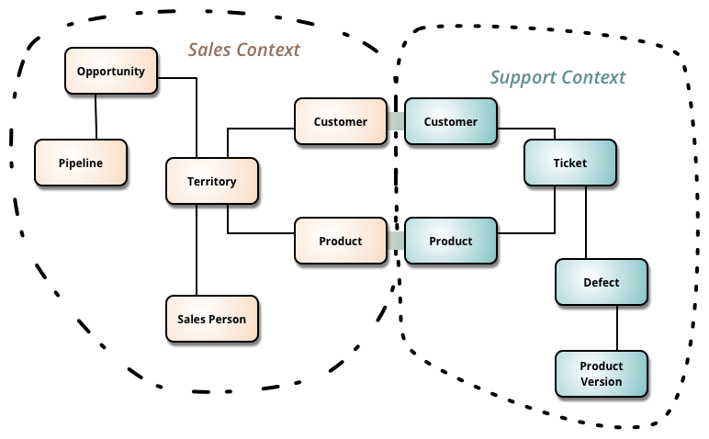
Our architecture needs
Separation of Concerns
Encapsulation
Dependency Inversion
Explicit Components
Single Responsibility
Don’t Repeat Yourself
Persistence & Infrastructure Ignorance
Presentation Ignorance
Bounded Contexts
Testability

Slide 25
Architecture abstraction
Layers:
System, Sub-systems, Layers, Components, Classes, Data and Methods
Bad Architecture:
Complex, Incoherent, Brittle, Untestable, Unmaintainable
Good Architecture:
Simple, Understandable, Flexible, Testable, Maintainable

Slide 26
Software Architecture Design Tips
Build to change instead of building to last
You are going to change your solution multiple times
Create around modularity and flexibility
Use models, but only to analyze and reduce risk
The models should be more abstract, otherwise you are taking the role of a developer
Use visualizations to communicate and collaborate
Your architecture is going to be a large diagram
Identify and research critical points of failure
Put in work in research in everything advanced
Security, scalability, resiliency

Slide 27
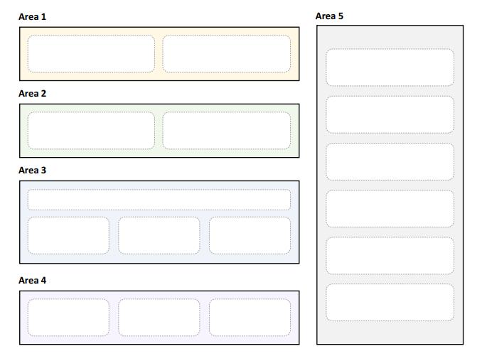
Areas Of Software Architectures
The goal of a software architect is to minimize complexity
This can be accomplished by separating the design into different areas of concern
Also known as modules (or components)

Slide 28
Key Principles Of Software Architectures
Separation of concerns
Each object and module should be in its own concern and context
Single responsibility principle
Elements in our design must have a single purpose
Principle of least knowledge
Components do not know about the internals of other components
Done through interfaces
Don’t repeat yourself
Don't have multiple components with the same purpose
Minimize upfront design
Try to design the minimum architecture so that developers can work
You will polish the next sections later

Slide 29
General Guidelines
Use consistent patterns in each layer
If you decide to use MVC pattern in the presentation layer – stick to it
If you use CQRS in the application layer – stick to it
Do not duplicate functionality
Do not have a caching component in all layers
Prefer composition over inheritance
It is complicated to create huge hierarchies
Work with the Lead Developer here
Establish a code convention
Define the code style and preferably automate it
Work with the Lead Developer here

Slide 30
Layer Guidelines
Separate areas of concern
Each layer should have one role only
Define communication between layers
How does the presentation layer communicate with the business layer?
Use abstraction to loosely couple layers
Use interfaces for every communication
Objects should not be tight to a particular platform or technology
Don’t mix different types of components in a layer
Use a consistent data format within a layer

Slide 31
Component Guidelines
No component should rely on the internals of another
Components should be black boxes
Do not mix roles in a single components
Web controllers should not have business logic
Business layer should not have HTTP concerns
Define clear contracts for components
All public methods and properties should be scoped in advance
Abstract system wide components away from other layers
As soon you have a component which is accessible in multiple layers
Put it in a system-wide area of concern

Slide 32
BEFORE WE CONTINUE…

Slide 33
Huge THANKS for your support & TRUST!
Everyone who got a paid ticket – 156 people in total! Thank you!
Top supporter – Nikolay Stoychev – 80 BGN! Thank you, you rock! <3
Thanks to – Valentin, Nikolay, Borislava, Georgi, Пламен, Stefan, Dimitar, Plamen, Ivelin, Ивайло, Ivan, Teodor, Rosen, Георги, Ivan, Kristian, Deyan, Nikolay, Tsvetelin, Valentin, Kiril, Volen, Andrey, Diana, Дончо, Petar, Mincho, Elitsa, Цветан , Stanimir, Lyubomir , Veselin, Dobromir, Kristiyan, Nikolai, Борислав, Vladimir, Stefan, Valeri, Rostislav, Raya, Ivan, АЛЕКСАНДЪР, Kristian, Petko, Rosen, Todor, Diana, Pavel, Val, Радослав, Petar, Alexander, Mariyana, Ани, Emiliyan, Иван, Ivaylo, Petar, Vasil, Ivo, Irina, Stanislav, Vanya, Ivan, Julia, Kamen, Ivan, Bobi, Hristina, Zlatko, Maria, Ilcho, Vladimir, Svilen, Dinyo, Daniel, Pavel, Veselin, Petar, Hristo, Pavel, Plamen, Ivaylo, Калин, Sonya, Ivan, Krassimir, Zhelyazko, Chika, Pirin, Hristo, Dimitar , Ivaylo, Georgi , Albena, Svetoslav, Vladimir , Zlatin, Mira, Venelin, Dimitar, Iliya, Vanya, Kiril, Dobromir, Grigoris, Miroslav, Boris, Marin, Мирослава, Mariyan, Andrey, Galya, Teodor, Momchil, Simon, Plamen, Iva, Martin, Kosta, Hristo, Evgeniya, Nikolai, Ivo, Viktor, Tsvetan, Miroslav, Hyusein, Mira, Tanya, Zhivko, Dimitar, Ivaylo, Kalina, Emil, Ivaylo, Dimitar, Zhivko, Alexander, Denis, Denitsa, Boyan, Hristo, Donika, Georgi, Lyuboslav, Ilia, Stefan, Nikola, Valentin, Borislav, Teodor, Svetoslav, Veselin
And everyone who supported the initiative during the years!

Slide 34
These events are not Exactly free
I prefer to call them “Pay what you want”
Depending on how much you value the provided knowledge
It takes me a considerable amount of free time to prepare these lectures
And I want them to be perfect and complete!
I put my soul in them!
For this reason, I will be extremely thankful, if you decide to support me and my projects!
It is never expected, but always appreciated!
The easiest way is via
PayPal: http://paypal.me/ivaylokenov
Revolut: @ivaylokenov

Slide 35
Unified Modelling language

Slide 36
What is UML?
From Wikipedia:
“A general-purpose, developmental, modeling language that is intended to provide a standard way to visualize the design of a system”
Main attributes:
Visual – it is easy to see the representation of the architecture
Abstract – it stays away from implementation details
Descriptive – shows the complete representation
Standard – UML is the world standard
Supports Code Generation – specific sections can be converted to code
Supports Reverse Engineering – create UML from code
You should know it in case the client wants it
But can easily avoid it

Slide 37
UML design elements
Models
Container for the design
Are you looking at the entire system? A subsystem? A feature?
Views
A way to look at the system
Is it an external view? Or the internal structure?
Diagrams
Specific drawings that illustrate the architecture

Slide 38
UML Model Types
Business System Model
Non-technical model
External View
Looking at the system as a black box
Internal View
A lot more details
IT System Model
Specifically looks at technology
Static View (Structure View)
How the different elements fit together
Dynamic View (Behavioral View)
How these elements call each other

Slide 39
UML Diagram Types
Component Diagram
Class Diagram
Sequence Diagram
State Diagram
Activity Diagram
Layer Diagram
Use Case Diagram
There are others...

Slide 40
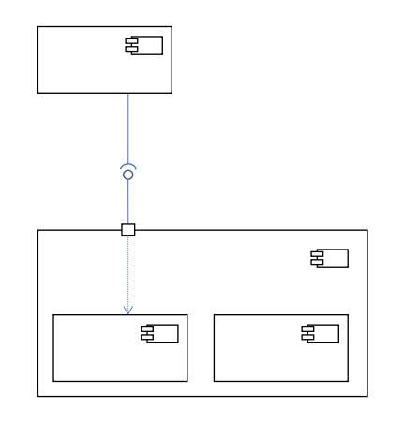
The Component Diagram
Shows components
Modular building blocks
Shows implemented and required interfaces
Components can be nested
If you decide to describe your architecture with a component diagram, you will have a very descriptive image

Slide 41
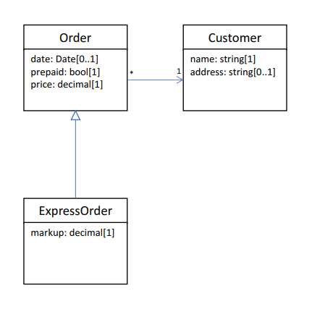
The Class Diagram
Shows classes
Shows methods and fields
Shows associations, generalizations, and cardinality
Quite detailed in terms of implementation
The Lead Developer should do this

Slide 42
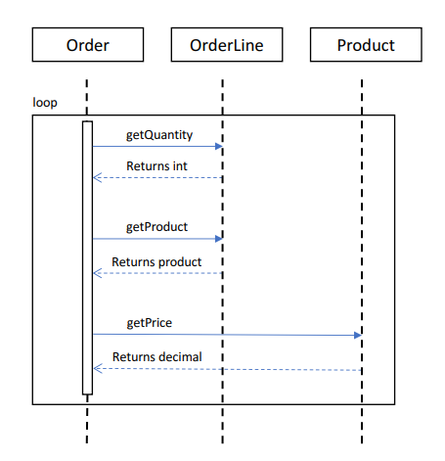
The Sequence Diagram
Shows call sequence
Shows calling class, called method, and return data type
Can depict loops

Slide 43
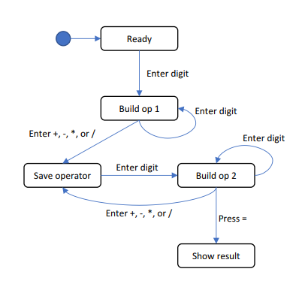
The State Diagram
Shows states or activities
Shows allowed transitions
Can be nested
Can depict internal activities

Slide 44
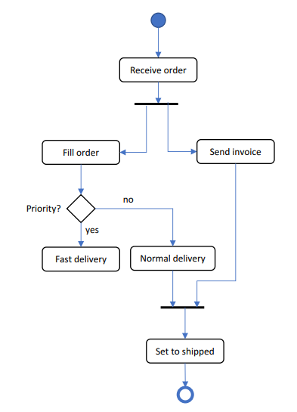
The Activity Diagram
Shows process or workflow
Like the famous flow charts
Can be nested
Can show concurrent actions
Can have swim lanes

Slide 45
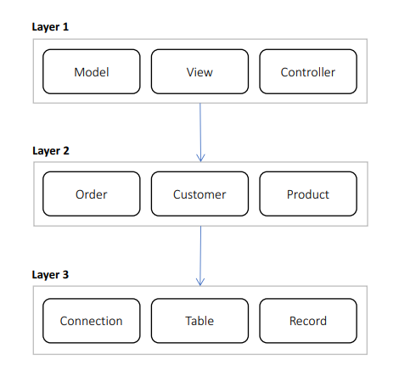
The Layer Diagram
Non-standard, invented by MS
Shows areas of concern
Shows references between areas
Can be validated

Slide 46
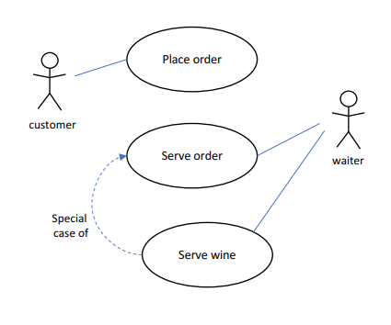
The Use Case Diagram
Shows actors
Shows use cases
Binds actors to use cases
Can depict generalizations

Slide 47
Designing Solution Architectures

Slide 48
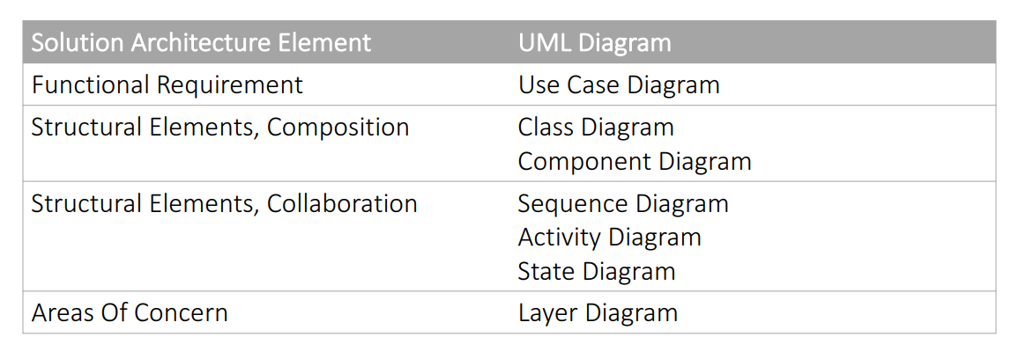
UML Diagrams In Architectures

Slide 49
UML Design Strategies
UML as Sketch
Intended for brainstorming and general loose guidelines
UML as Blueprint
Very detailed, you can write code based on the diagrams
Forward Engineering - use diagram to generate code
Reverse Engineering - build diagram from existing code
UML as Validation
Validate implementation against diagram

Slide 50
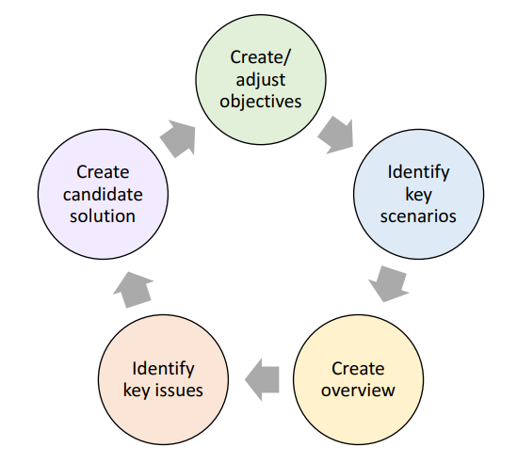
The Process For Designing Architectures

Slide 51
Create Or Adjust Objectives

Slide 52
Create Or Adjust Objectives
Identify scope of architecture
What are the high-level objectives and requirements?
New technologies? Server? Client? Proof of concept?
Estimate time to spend
Do you have months? Do you have weeks?
Identify audience
CEO? Developers? Functional Analyst?
Identify technical, usage and deployment constraints
What are the available technologies?
How many people use the system simultaneously?
How many servers do you have? Cloud? On premise?
These requirements are super important!

Slide 53
Identify Key Scenarios

Slide 54
Identify Key Scenarios
Key scenarios:
Significant unknown/risk – promo codes on scale
Significant use case – payments integration
Intersection of quality/function – clashing of these two attributes
Tradeoff between attributes – consider the trade offs
Significant use cases:
Business-critical – part of the core business domain
High impact – very important for the end-users
Create Use Case Diagrams

Slide 55
Two types of requirements
Functional
Business flows
What the user should do
User interfaces
And many more…
Non-functional
Performance
Load
Data volume
Concurrent users
SLA
These are the most common ones

Slide 56
Performance requirements
"What is the required performance of the system?"
"SUPER FAST!"
Always talk in numbers!
For example, if you have an end user – each task should complete in less than a second!
Think about latency
How much time does it take to perform a single task?
How much time will it take to store a user in the database?
Think about throughput
How many tasks can be performed for a given time unit?
How many users can be saved in the database in a minute?

Slide 57
Performance numbers Example
Let's say we have a task
Storing a user in database
And its latency is 1 second
This is quite slow, but it is just a demonstrational number
What is the throughput for 1 minute then?
In a well-designed system – more than 1000 users
In a badly designed system – around 60 users
Both attributes are important!

Slide 58
Load requirements
Load is quantity of work without crashing
In a Web API – how many concurrent requests could the server handle without crashing
Difference with throughput:
Throughput – 100 requests/second
Load – 500 requests without crashing
Users can tolerate a bit slow system
But they hate crashing ones!
Best practice is to always plan for the most extreme cases!
For example – Black Friday in an e-commerce site!

Slide 59
Data volume requirements
How much data the system will accumulate over time
This requirement dictates:
The database type
Designing queries in the database
Storage planning
Two aspects:
Data required on "day one"
For example – initially we need 1 GB of data
Data growth
For example – our database grows annually with 2 TB of data

Slide 60
Concurrent users requirements
How many users will use the system simultaneously
It is different than the load requirements
Concurrent users have "dead times"
They read the page, watch something on it, but do not make requests
Load requirements consider the actual requests
The rule of thumb is to take the load requirements
And multiple them by 10!
But this depends on the system type

Slide 61
Service Level Agreement requirements
What is the required uptime for the system in percentage
For example, 99.99% uptime
This is translated to ~1 hour of downtime in a year
It would be quite impressive!
It is the solution's architect to manage the clients' expectations
If the expected uptime is 99.999%
Just tell them that we will need at least five different data centers
On independent continents
With variety of power supplies
And multiple Internet providers
This answer usually brings them down to Earth ☺

Slide 62
Who defines these requirements?
The Functional Analysts and the CEO usually provide a well documented business and functional requirements of the system
But who defines the non-functional ones?
It is the Solution's Architect job to frame them
By starting discussions
And asking the right questions
And keeping the expectations realistic and meaningful
There is no need to fight for every millisecond
The users will not notice that
Never design a system without the non-functional requirements!

Slide 63
FINAL WORDS before Q & A

Slide 64
Summary
Why Software Architecture
What Is Software Architecture?
Unified Modeling Language
Designing Solution Architectures
Don't Forget The Optional But Practical Guide-Book
3 Real-World Scenarios
70+ Pages
Free Updates
Get It From The Event's Page or write to wewritesoftware@gmail.com
https://www.eventbrite.com/e/software-architecture-fundamentals- essentials-code-it-up-online-vol-9-registration-222550182587

Slide 65
In the next part
Common Technology Stacks
Architecture Design Patterns
Choosing The Right Patterns
Register here:
https://www.eventbrite.com/e/software-architecture-technology- patterns-code-it-up-online-vol-10-registration-244365432587
Don't Forget The Optional But Practical Guide-Book
3 Real-World Scenarios
70+ Pages
Free Updates
Get It From The Event's Page or write to wewritesoftware@gmail.com
https://www.eventbrite.com/e/software-architecture-fundamentals- essentials-code-it-up-online-vol-9-registration-222550182587

Slide 66
Other Goodies
You can check the Code It Up blog and subscribe:
https://codeitup.today
You can watch some of the free videos:
https://www.youtube.com/CodeItUpwithIvo
Clean code & The art of testing
Docker, CI/CD, Redist, Elasticsearch
And many more…
The source code in all free lessons is available on Patreon:
https://www.patreon.com/ivaylokenov
Unrelated to the IT sector but check out my art T-Shirts:
https://way-ve.com/
Use CODE10 during checkout for 10% discount

Slide 67
Past Code It Up Events
You can get the recordings of the past C# events from the event page:
C# Async-Await In Detail
The C# ORM Battle
Docker – From ABC To XYZ
Identity Server Demystified
Eventual Consistency Done Right
Let's Get Functional With C#
C# API Scenarios – REST, GraphQL & gRPC
Past workshops are also available:
C# Multithreading
Domain-Driven Design With ASP.NET Core
Kubernetes For Web Developers
If interested, you can write to wewritesoftware@gmail.com

Slide 68
ANY QUESTIONS?
You can support me and my projects:
Via PayPal: http://paypal.me/ivaylokenov
Via Revolut: @ivaylokenov
On Patreon: https://www.patreon.com/ivaylokenov
On Open Collective: https://opencollective.com/mytestedaspnet
Via Buy Me A Coffee: http://buymeacoff.ee/ivaylokenov
Crypto: http://bit.ly/ik-sponsors
Never expected, always appreciated!
Make sure you check my sponsors!
INDEAVR - https://indeavr.com
Americaneagle.com - https://www.americaneagle.com

Slide 69
Thank You!
Resources: https://github.com/ivaylokenov/Software-Architecture-Series

