Slide 1


Software Architecture Part 5
Code It Up Online Vol. 13

Slide 2
For LIVE questions
Check The Link In The Description
Resources https://github.com/ivaylokenov/Software-Architecture-Series

Slide 3
Live stream troubleshooting
Sometimes issues happen during a live stream…
And sometimes disasters happen, this is how memes are born…
If my Internet goes down and the stream stops:
Wait for 5 minutes, I have another one on a different network
If YouTube is showing “stream ended”:
I will post a new link in the comments section below this video
If something else happens unexpectedly:
Well, I will add a solution to this slide during my next event… ☹
If a major showstopper is happening – no electricity, for example
I will create a new event and we will schedule a new live stream…
In any case – write to wewritesoftware@gmail.com

Slide 4
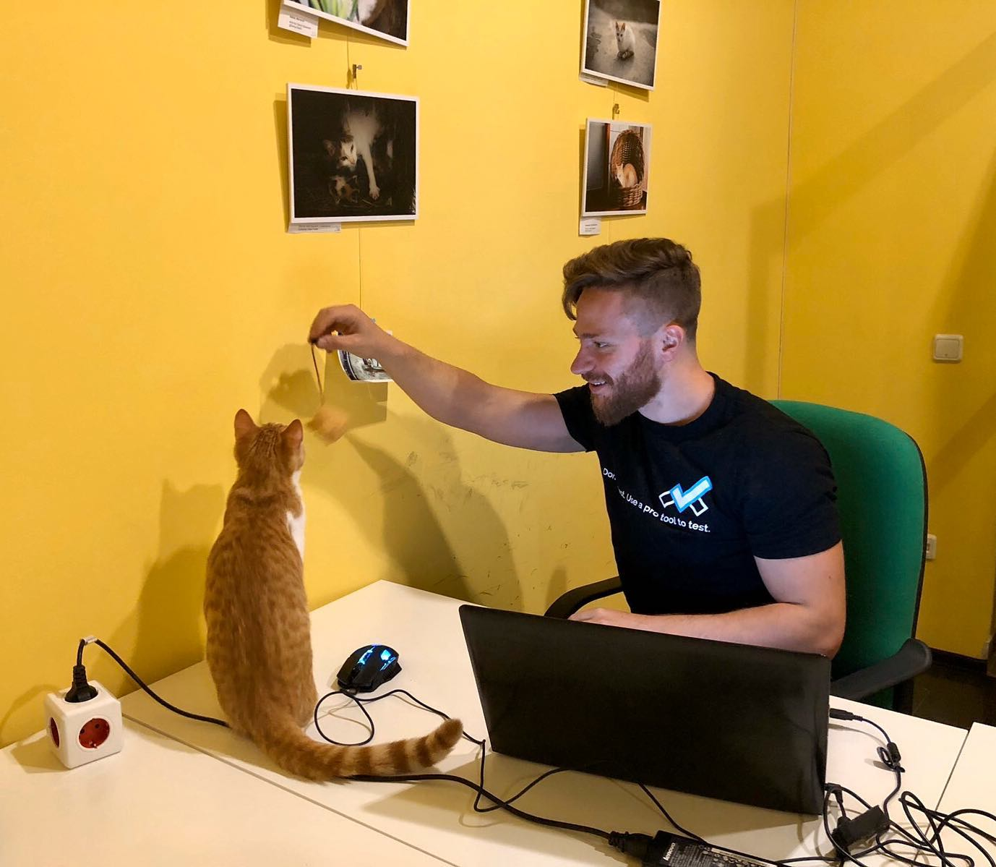
The Presenter
Ivaylo Kenov – Quality Code Advocate
Various job titles at the same time:
Organizer & Speaker @ Code It Up
CTO @ SoftUni
Full Stack Technical Trainer @ Everywhere
Code General @ https://docs.mytestedasp.net/
Meme Copy Machine @ Daily Programming Fun
{Insert Job Title Here}
Contacts
https://github.com/ivaylokenov
https://facebook.com/ivaylo.kenov
https://linkedin.com/in/kenov
https://www.instagram.com/ivaylokenov/
YouTube & Blog
https://www.youtube.com/c/CodeItUpWithIvo
https://codeitup.today/

Slide 5
Sponsors
This lecture is free thanks to our sponsors
Which will interrupt the lecture here and there
Because it takes quite a lot of personal time to prepare the materials
You will help the initiative a lot if you visit their web sites
And consider their propositions to you
I personally select various premium jobs to present them during the talk
These are the current ones:
INDEAVR - https://indeavr.com
Americaneagle.com - https://www.americaneagle.com
SmartIT - https://smartit.bg

Slide 6
ABOUT CODE IT UP

Slide 7
Code it up
The Code It Up initiative:
Aims to provide detailed knowledge on advanced software development topics
Aimed at people with at least 1 year of programming experience (mostly C#)
Sort of acquired by SoftUni last year
Code It Up Online
Free live-streamed online events (2+ hours long)
Led by me – mainly .NET, architecture, and infrastructure
We have 6 more lectures before the initiative ends
Code It Up Workshop
Paid events containing theory & practical exercises for the attendees
No more paid lecture planned for now

Slide 8
Thankful if you share a story
You can be extremely helpful to the initiative
Just share a story on Facebook or Instagram during the lecture
Make sure you tag me so that I can reshare your post - @ivaylokenov
Bonus – add the #codeitup hashtag
Thank you! You rock!

Slide 9
ABOUT The Series Of Events

Slide 10
About This SERIES Of Code It Up Events
Theoretical lectures on software architectures
Widely-used design patterns and concepts in production
Depending on your level, you may be familiar with some of the topics
A real-life project example
A practical guidebook for architecting various solutions
3 real-life projects on more than 70 pages
Legacy systems, vast data load, lots of concurrent users, working with critical data, and more
Please report to wewritesoftware@gmail.com, if you find any “bugs” in the book!
And I have a lot more to add in the future!
You receive free updates of the book!
MOST IMPORTANTLY – HUGE THANK YOU! <3

Slide 11
The Content Of The Series – A Free Course
Why Software Architecture
What Is Software Architecture?
Unified Modeling Language
Designing Solution Architectures
Common Technology Stacks
Architecture Design Patterns
Choosing The Right Patterns
Architecture Quality Attributes
System-Wide Considerations
Deployment Considerations
Monolithic Architecture
Domain-Driven Design
Microservices
Event Sourcing
The Architecture Document
The Architect And The Team
What Makes A Great Architect
Designing A Real-Life Solution

Slide 12
in The previous parts
What Is Software Architecture?
Designing Solution Architectures
Common Technology Stacks
Architecture Design Patterns
Quality Attributes & Considerations
It is not required to watch the parts in order
But it is strongly advised!
Get the previous recordings from here:
https://www.eventbrite.com/o/code-it-up-29733808833

Slide 13
in this part
Responsibilities Decomposition
Domain-Driven Low-Level Design
Clean Architecture & Vertical Slices
Advanced Patterns & Anti-Patterns
Don't Forget The Optional But Practical Guide-Book
3 Real-World Scenarios
70+ Pages
Free Updates
Get It From The Event's Page or write to wewritesoftware@gmail.com
https://www.eventbrite.com/e/software-architecture-monolithic-approaches- code-it-up-online-vol-13-registration-257838059577

Slide 14
About this topic
HUGE DISCLAIMER! THIS TOPIC IS LIKE THE LITTLE PRINCE BOOK!
There are a lot of things to know about software architectures
You may or may not recognize some of the patterns
And we most probably will not mention all of them
If you are a beginner, just try to absorb what you can
The technology world is moving very fast
Some of the examples shown here may be considered anti-patterns in the future
But the overall concept and process stays the same
As all my other topics – this one is super intense too!
Even though the lectures will be a bit shorter
So, give yourself time and if you get the book – finish it!
And don’t worry! The knowledge provided here will save you weeks of reading!

Slide 15
INDEAVR – The EVENT’s DIAMOND SPONSOR
They provide technology services focused on the Digital, Data, Cloud and Advanced Software Engineering expertise.
They are always in search for creative and passionate people with the combination of a sharp strategic mind, emotional maturity, entrepreneurial instincts, and the ability to deliver results.
https://www.indeavr.com/en/technology/application-services
https://www.indeavr.com/en/careers

Slide 16
Responsibilities Decomposition

Slide 17
System decomposition
Identifying system components is called system decomposition
Correct decomposition is critical
The easiest way is functional decomposition
It is fast, mechanic and straightforward
But it is wrong in many situations
Requirements change, so does the architecture
The client often starts orchestrating the services
And services need to have some sort of order
Just ask two teams to design the best possible and the worst possible system
Many people do functional decomposition but they rarely meet deadlines or the budget
Domain decomposition is the same as the functional

Slide 18
Physical vs Software
In software you can paint the house before you build the walls
And that is the main problem
Software systems have too little constraints
Without any visible product waste
The complexity of the software worlds is way too high
Compared to the physical world with nature laws
And such complexity can go out of control quickly
Without using proper engineering practices
Consider building a house or a car?
Does functional or domain decomposition work there?
Will you fire a person who builds first the whole kitchen?
And then the whole bathroom?

Slide 19
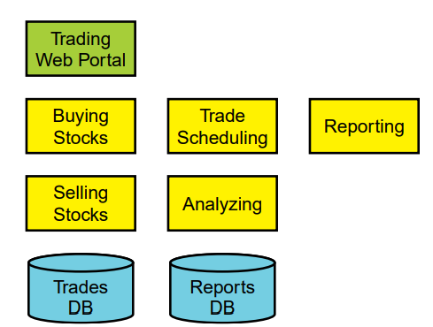
Functional trading system

Slide 20
Volatility-based decomposition
It is better to decompose based on areas of potential change
Then encapsulate these areas into services
The required behaviors is just interaction between these areas
Changes will be just implementation detail of each module
Volatility is having changes or risks that have ripple effects across the whole system
Variability, on other hand, can be implemented with conditional statements
Often solutions masquerade as requirements
Consider "cooking", "feeding" and "wellbeing" in a house design
A good way to start decomposing is to create a volatilities list
Another useful technique is to try to design for a competitor

Slide 21
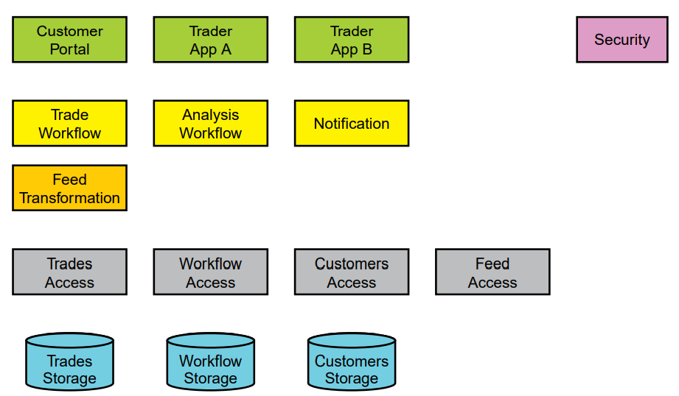
Volatility-based trading system

Slide 22
Composable design
In any system, not all use cases are distinct and unique
Most of them are variations
We need to find the core use cases
The once representing the essence of the system
These are not explicit in the requirements
It is always some sort of abstraction
These will not change the architecture
A simple example is the human body
The requirements back in the day were hunting
Now the requirements are architecture design
But the core use cases are surviving and evolving

Slide 23
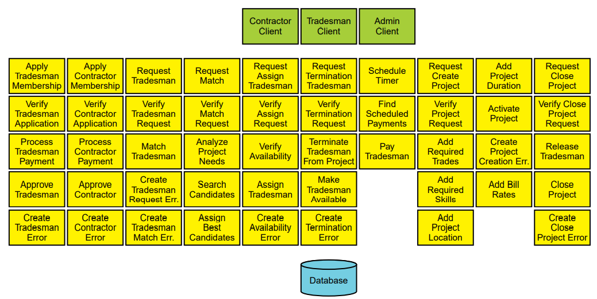
Invalid design examples

Slide 24
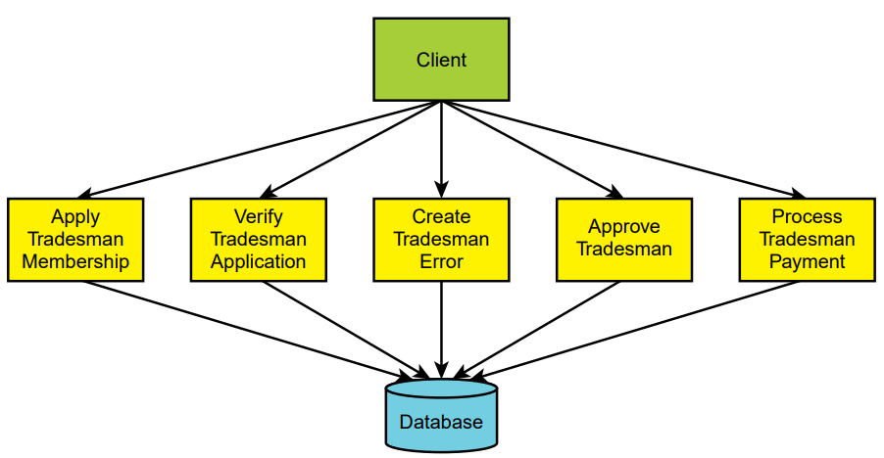
Invalid design examples

Slide 25
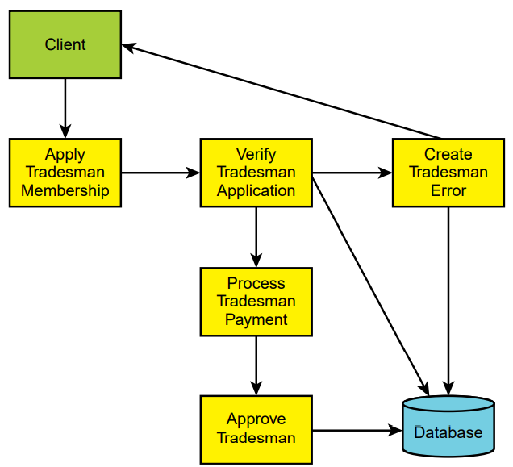
Invalid design examples

Slide 26
The bounded context
Central pattern in Domain-Driven Design and Microservices
Its focus is dealing with large models by dividing them into logical groups – Bounded Contexts
The logical groups should be very explicit about their relationships
Each Bounded Context has
Unrelated concepts – such as support ticket in a customer support context
Related concepts – products and customers
Different context may have completely different models of common concepts
But may share the same data identity
One bounded context should not be developed by more than 1 team!

Slide 27
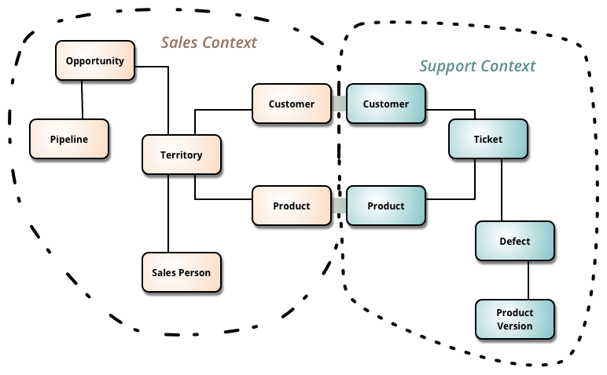
The bounded context

Slide 28
Low-level Architecture

Slide 29
Our architecture needs
Separation of Concerns
Encapsulation
Dependency Inversion
Explicit Components
Single Responsibility
Don’t Repeat Yourself
Persistence & Infrastructure Ignorance
Presentation Ignorance
Bounded Contexts
Testability

Slide 30
The Classic Patterns Are great but
Server-side technologies are providing us only a simple “front-end” pattern
So, we decide to abstract the business logic
By extracting business logic to services
However, solutions with lots of business logic will get “spaghetti” in no time
Controllers/Components/Services with thousands lines of code
No concepts and strong separation
We often separate the HTTP logic from the business logic, but that’s it
We need to concentrate on the business logic
And do not care about infrastructure & presentation details
We need scalable solutions
Scalable in terms of development teams, not in terms of throughput

Slide 31
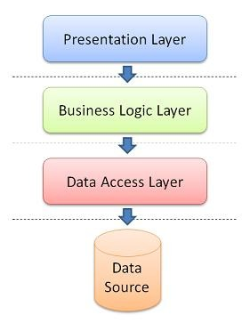
Database-centric Architecture
Database is the center of the application
The business domain and services are built around the database
It usually has the following layers
Presentation – Views or API
Business logic – external services or data-oriented
Data access layer – database-specific logic
The database is designed first
Application code comes secondary

Slide 32
Database-centric Architecture IS NOT BAD
Pros
Easy to learn
Most people understand it well
It covers most of our architecture needs
Cons
It is not flexible
It was designed for single presentation application (before smartphones)
It does not scale well – extracting microservices is a difficult task
All dependencies are towards the database
Use it when the business logic in a service is simple enough

Slide 33
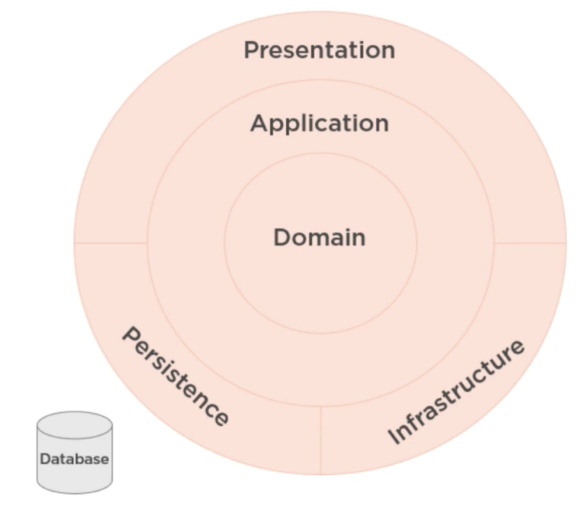
Domain-Driven Design
Business domain comes first
You do not care about the database
It is just a detail
You do not care about the presentation
We communicate with domain experts to design
A history of success with complex projects
Steps are:
Solve problems, understand client needs, and then write the code!

Slide 34
Benefits
Very flexible
Customer’s vision/perspective of the problem
Path through a very complex problem
Well-organized and easily tested code
Business logic lives in one place
Many great patterns to leverage

Slide 35
Drawbacks
Time and Effort
Discuss & model the problem with domain experts
Isolate domain logic from other parts of application
Learning curve (why this workshop was a success)
New principles
New patterns
New processes
Only makes sense when there is complexity in the problem
Not just CRUD or data-driven applications
Not just technical complexity without business domain complexity

Slide 36
DOMAIN-DRIVEN design IS SUPERIOR
Pros
Scalable in terms of development
Code has even better separation
It covers all our architecture needs
Improved patterns and flexibility
Cons
Usable when the business logic is complex
Time-consuming as it needs more classes and relationships between them
Use it when the business logic in a service is complex enough

Slide 37
Domain-driven design is about code
Writing code is only part of the solution
We need to speak to domain experts
And use the same language in our code
Our domain model should “scream” the business requirements
Our classes and methods should describe the actual process
If possible, our code will force us to use the right design
Here is a good C# example which we will use as a reference:
https://bit.ly/ddd-code

Slide 38
BEFORE WE CONTINUE…

Slide 39
Huge THANKS for your support & TRUST!
Everyone who got a paid ticket – 63 people in total! Thank you!
Top supporter – Georgi Kermekchiev – 100 BGN! Thank you, you rock! <3
Thanks to – Nikolay, Georgi, Pavel, Albena, Nikolay, Diana, Aneliya, Teodor, Mira, Robert, Borislav, Stoil, Diana, Svilen, Radoslav, Emiliyan, Калин, Mariyana, Svetoslav, Dinyo, Nikolai, Daniel, Lyuboslav, Georgi, Рая, Petar, Иван, Teodor, Veselin, Zlatko, Hristina, Dimitar, Свилен, Stoyan, Ivaylo, Hristo, Dobromir, Georgi, Simona, Elizabet, Борислав, Иво, Vladimir, Petar, Miroslava, Georgi, Simeon, Iva, Stoyan, Viktor, Ivaylo, Ivan, Veselin, Dobromira, Ivana, Diana, Stoil, Borislav, Aneliya, Nikolay, Ivan, Emil, Radostin
And everyone who supported the initiative during the years!

Slide 40
These events are not Exactly free
I prefer to call them “Pay what you want”
Depending on how much you value the provided knowledge
It takes me a considerable amount of free time to prepare these lectures
And I want them to be perfect and complete!
I put my soul in them!
For this reason, I will be extremely thankful, if you decide to support me and my projects!
It is never expected, but always appreciated!
The easiest way is via
PayPal: http://paypal.me/ivaylokenov
Revolut: @ivaylokenov

Slide 41
The domain model

Slide 42
The domain model
Problem Domain
The problem your software is trying to solve
Core Domain
The part of the business that must be perfect, and cannot be outsourced
Sub-Domains
Separate business problems which can work isolated in theory
Bounded Context
A specific responsibility, with specific boundaries that separate it from other parts of the solution
Shared Kernel
Part of the model, which is shared by two or more teams

Slide 43
Domain Model e-commerce Example
Problem Domain
We need a system for an online store
Core Domain
Obviously, the business cannot exist without products and billing
Sub-Domains
Reporting, customer data, support, etc.
Bounded Context
Shopping cart needs a Product, catalog too, but these models are different
Shared Kernel
Clients are part of all domains

Slide 44
Domain Model Pet clinic Example
Problem Domain
We need a system for a pet clinic
Core Domain
Obviously, the business cannot exist without examinations and surgeries
Sub-Domains
Appointments, billing, visit records, medical records, etc.
Bounded Context
Appointments will need a Patient model, medical records too, but they are different
Shared Kernel
Clients are part of all domains

Slide 45
Let’s dive further into the appointments
We need to talk with the client to understand the business needs
Clients (people) schedule appointments for patients (pets)
Appointments may be either office visits or surgeries
Office visits may be an exam requiring a doctor, or a tech visit
Office visits depend on exam room availability
Surgeries depend on operational and recovery space availability, and can involve different kinds of procedures
Different appointment types and procedures require different staff

Slide 46
The appointments Model
Main models:
Client can schedule a Patient (pet)
Schedule is for Appointment or Surgery
Appointment requires a Doctor and Exam Room
Surgery requires a Doctor, an Operational Room and a Recovery Room
The above models define the appointments bounded context
The medical records bounded context will also require a Patient model
But with different properties and operations

Slide 47
The domain model in the code
The domain models are the heart of the software
They are not bound by technology
Pure classes with logic, following the SOLID principles
Contain the business logic and business rules
Behaviors should follow the ubiquitous language
Create behaviors that business domain experts will understand
Anemic vs Rich domain models:
Anemic domain objects are dull – they lack business logic, and contain only data
Good for CRUD only
Rich domain models – different kinds of objects, the classes have behaviors
Our models should be persistence ignorant!

Slide 48
Domain objects

Slide 49
Types of equality
Identifier equality
Objects are equal, if their ID is equal
Structural equality
Objects are equal, if all their properties are equal
Reference equality
Objects are equal, if they use the same memory address

Slide 50
Identifier strategies
Database Identity
Usually integers, autoincremented
Works great, but you cannot have the value before saving the entity
GUIDs
Slower than Identities
Use them if the code is problematic and you need the values before saving the entities
You should have a separate indexed column
Hi/Lo
Sequences
Works like identities, but the database is called less frequently
You know the values before saving the entity

Slide 51
entities
Entities are all objects which have an ID
Entities are considered equal, if their ID is equal
These objects are mutable
Keep entities encapsulated with private setters
Mutability is done through methods and behaviors
Public constructors should create objects in valid state
Collections should be read only and immutable

Slide 52
Entities relationship
Do not use two-way relationships except in cases where it makes business sense
A bidirectional relationship means that the objects can live only together
Use one-way relationships and use only foreign keys, if you cross bounded contexts
This simplifies the design, and makes sure associations make business sense
Think which way of the relationship has a better meaning
For example:
Appointment has a Doctor, Patient, and Client
Client has a Patient

Slide 53
Value objects
Measures, quantifies, or describes a thing in the domain
Identity is based on composition of values
Immutable
Compared using all values
No side effects
For example:
.NET String
Appointment – start and end date (range)
Products has price and currency (worth)

Slide 54
Domain objects anti-patterns
Plain POCO classes
Too much value object granularity
Missing validation or encapsulation
Unnatural responsibilities
Too much logic in entities
Looking for information in external sources
Communicate with external layers
Throwing generic exceptions
Referencing objects in other bounded contexts

Slide 55
Domain services
Domain logic, which cannot be put in the domain classes directly
Don’t communicate with the outside world
They should be stateless
They should have interfaces
Do not use DTOs, use only the domain models
For example:
Transfer money from one account to another
Process shopping cart and save it as an order
No Database, Files, Mails, or other infrastructure logic
No JSON/HTTP or other presentation logic

Slide 56
Aggregates

Slide 57
Aggregates
An aggregate is cluster objects which have different types
An aggregate is treated as a single unit
Aggregates have a root – the only object with which communication is done
The root is the only one, who has a connection to the outer world
The design should consider invariants
Conditions which must be true for the application state to be valid

Slide 58
Aggregates
Aggregate Roots:
Saved & retrieved a single unit
Should maintain self-integrity & validity
Responsible for sub entities/objects
Works as a transactional boundary
Should be serializable
Two approaches for communication:
Reference only by IDs – easier to decouple in the future, use it to cross bounded contexts
Reference by full object – more business-oriented, use it within a single bounded context

Slide 59
Aggregates
Consider the following design:
Appointment is the aggregate root
Client, ExamRoom, Patient, and Doctor are aggregates below it
But there is this invariant in our business rules:
Two appointments should not overlap one another
So, we change the design:
The aggregate root becomes a new entity called Schedule
It contains a collection of appointments
Every appointment logic goes through the Schedule root
It validates the state of the application is valid

Slide 60
Aggregates
Some rules to follow when designing aggregates
Try to use value objects as much as possible without being too granular
Do not make huge aggregates as it leads to performance issues
Separate them when possible
Entities in an aggregate root should be very cohesive & with single purpose
Change boundaries when you have more information

Slide 61
FACTORIES, REPOSITORIES & Services

Slide 62
Factories
Business domain objects often become too complex
Remember that domain objects cannot be in an invalid state
So, constructors tend to become quite large and difficult to use
In some cases, a static factory method may be good enough
But for bigger solutions – builder factories are better
Mark constructors as internal or hidden to prevent misuse
You may mark all aggregate roots with an interface to force the domain usage
Create a factory for each aggregate root
Creating objects should be only possible through IoC and DI or factories

Slide 63
repositories
Repositories serve as an anti-corruption layer
Repositories must be created only for aggregate roots
You can force that through interfaces if your language supports them
You may separate repositories to domain only repositories and query repositories which map domain models to DTOs
Prefer using specific repositories instead of generic repositories
Specific repositories communicate with the business language
Never return partially instantiated entities!
Repositories should be the only public part of your storage API
All other classes should be hidden or internal

Slide 64
Services
Services contain any other logic for doing various tasks required by workloads
Basically:
Factories create objects
Repositories store and retrieve data
Services do any other work or logic
Examples:
Identity JWT generation
Excel parsing
HTML to PDF conversion

Slide 65
Bounded Contexts

Slide 66
The bounded context
Each bounded context should have:
Its own domain model
Its own factories
Its own repositories
Its own services
It should not use objects meant for another bounded context
For example, appointments repository should not use a billing domain model
In a perfect scenario bounded contexts will not be linked with a relationship
The bounded context span across all layers of the architecture!
You may have multiple bounded contexts in a service!

Slide 67
Database design with bounded contexts
Different databases for every context
This allow you to scale easily to microservices, but it may be an overengineering at the beginning
Foreign keys are fictional without any relationship (like in a microservice approach)
One database, different interfaces for each context
This way you will have the architecture, and just need to migrate the data
Just make sure to not mix the interfaces
Foreign keys are real, but you are not allowed to use domain classes from another context
One database for the whole service/application
This approach is easier, but the code complexity and business logic may become so mixed up that it will be difficult to extract later
Foreign keys are real, and you are allowed to use domain classes from another context

Slide 68
How to update data in multiple contexts
A lot of times the business logic requires to update objects from multiple bounded contexts
For example:
A client makes an appointment, and must pay in the next 3 days
If a payment is not processed, the appointment should be deleted
Domain events to the rescue
Instead of mixing business logic from both contexts, you can just fire and forget an event
Then a handler will catch the event and update the other entity
Decoupling, better communication between entities or contexts
If you wire the event logic with your ORM – it will be atomic and transactional
Only in monolithic applications
For microservices – you need to implement eventual consistency patterns

Slide 69
Domain events guidelines
Use past tense – AppointedScheduledEvent
Include as little data as possible
Do not use domain models
Use as many primitive types as possible
Use IDs when possible
Include full information, if completely necessary
Domain events should be created by the domain layer
But the infrastructure layer should know how to dispatch them

Slide 70
Types of Physical isolation
Same assemblies
You define different contexts in different folders
Separate assemblies
You define different contexts in different assemblies
Separate processes
With separate deployments
The more you separate – the more maintenance overhead!
Be pragmatic and start with the easiest one for each service!

Slide 71
Domain-driven design summary
Focus on the business logic
Talk to domain experts
The domain model is the first-class citizen in the application
Every other layer communicates with it
Classes are encapsulated and validated
Communication with outer layers is done through gateways like factories and repositories
Bounded contexts define the boundaries of different business “units”
Communication between contexts is done through events
Break the DDD rules only for performance reasons!

Slide 72
CLEAN ARCHITECTURE

Slide 73
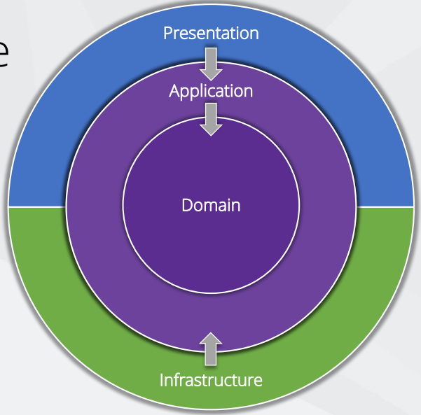
CLEAN ARCHITECTURE
Domain and use cases are important
Infrastructure and presentation are details
Independent of frameworks
Independent of UI
Independent of database
Independent of anything external
Testable
Have many other names throughout history

Slide 74
CLEAN ARCHITECTURE
Pros
Focus on business logic
Less coupling
Allows DDD
Cons
Requires more though
Initial higher cost

Slide 75
KEY CONCEPTS
Domain contains enterprise-wide logic and types
Application contains business-logic and types, uses interfaces
Infrastructure contains all external concerns, uses implementations
Presentation and Infrastructure depend only on Application
Infrastructure and Presentation components can be replaced with minimal effort
We pass data between layers with input/output models

Slide 76
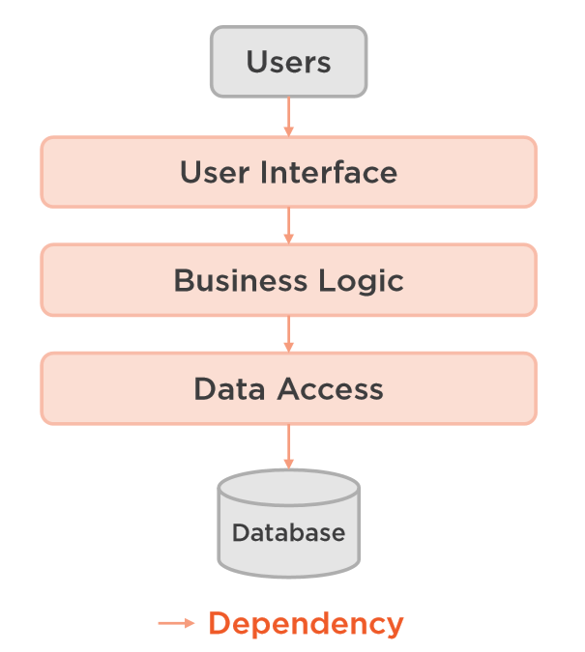
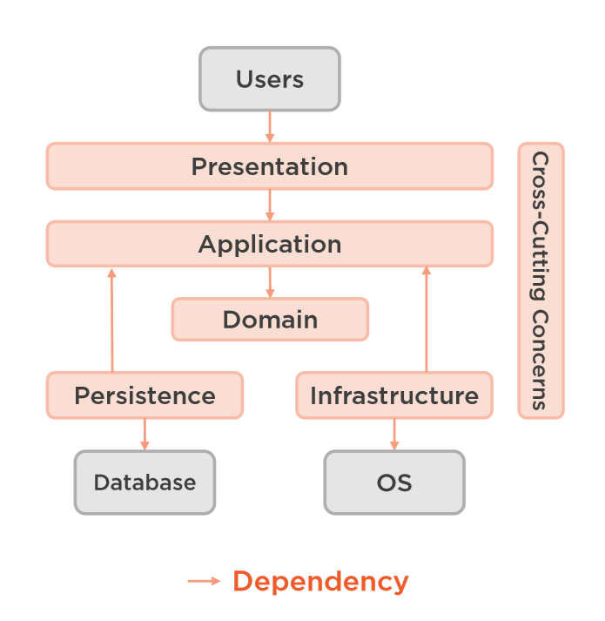
design

Slide 77
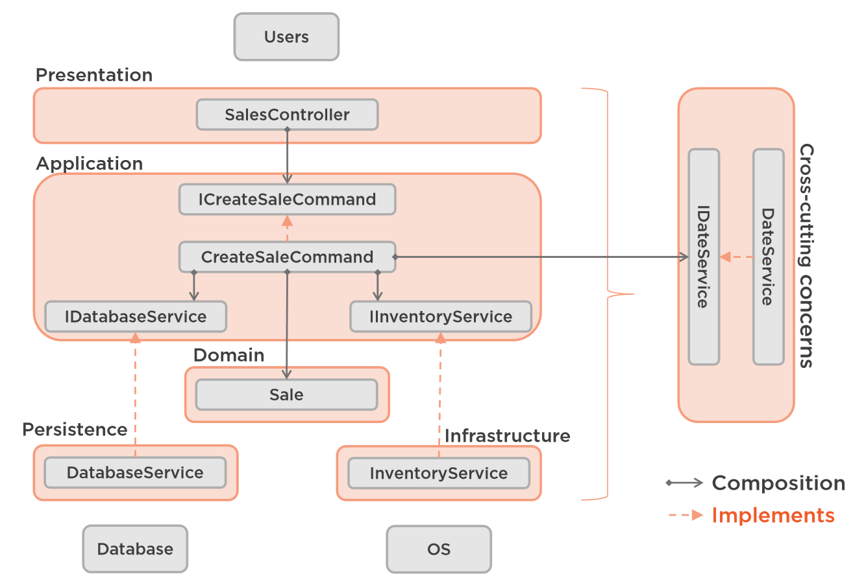
design

Slide 78
tests
Domain layer – unit tests – domain logic
Application layer – unit tests – commands & queries logic
Infrastructure layer – integration tests – each testable component
Web layer – integration tests – every request
Do not overdo unit tests for simple logic, they tend to become time wasters
Prefer using the same project for tests, development is easier

Slide 79
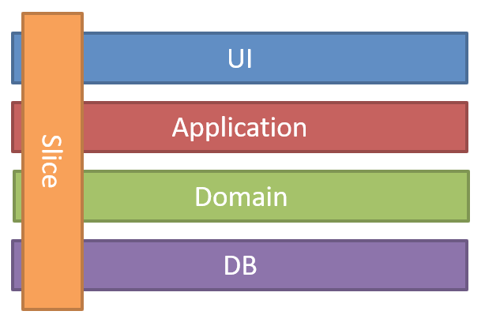
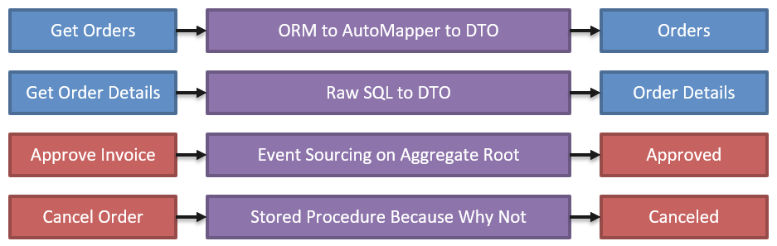
Vertical slices
The opposing design to Clean Architecture is Vertical Slice Architecture
Instead of horizontal technical layers it splits the architecture to vertical features
This way each slice may have its own implementation

Slide 80
Best of both worlds
You can combine horizontal layering with vertical slices
Just use each Bounded Contexts as a separate slice
You will get the benefits from both architectures
It gives you quite a lot of constraints in the code
Which help a lot with design and implementation as discussed earlier
And errors or boundary crossing is easier to spot in code reviews
You can easily extract separate services from such solutions
Numerous projects are having great success with such approach

Slide 81
Business logic Flow Summary
Requests are mapped to controller actions via routing in the presentation layer
Actions send request data to a query or a command (CQRS) in the application layer
The application layer is just a pure manager for workflows
Defines the business logic through interfaces
Factories create objects, repositories store data, services do work
The infrastructure layer implements some of the interfaces internally
The domain layer encapsulates domain objects and implement the other interfaces
Bounded contexts provide composability and vertical slices

Slide 82
A word on CQRS
CQRS is a design pattern separating the read and write functionality in a component
Commands update data and queries read data
Commands may be places in a queue processing
For a greater isolation, you can physically separate the write data from the read one
Main motivation comes from the fact that queries occur much more frequently than commands
In such case the read database may be optimized for specifically for the queries
Keeping both data stores in sync requires eventual consistency and event-driven architecture
CQRS can be efficiently used with event sourcing
Maximizes performances and scalability on the write store
But increases design and implementation complexity

Slide 83
FINAL WORDS before Q & A

Slide 84
Summary
Responsibilities Decomposition
Domain-Driven Low-Level Design
Clean Architecture & Vertical Slices
Advanced Patterns & Anti-Patterns
Don't Forget The Optional But Practical Guide-Book
3 Real-World Scenarios
70+ Pages
Free Updates
Get It From The Event's Page or write to wewritesoftware@gmail.com
https://www.eventbrite.com/e/software-architecture-monolithic-approaches- code-it-up-online-vol-13-registration-257838059577

Slide 85
In the next part
Microservices Architecture
Eventual Consistency
Distributed Transactions
Register here:
https://www.eventbrite.com/e/software-architecture-microservices- code-it-up-online-vol-14-registration-262477656737
Don't Forget The Optional But Practical Guide-Book
3 Real-World Scenarios
70+ Pages
Free Updates
Get It From The Event's Page or write to wewritesoftware@gmail.com
https://www.eventbrite.com/e/software-architecture-monolithic-approaches- code-it-up-online-vol-13-registration-257838059577

Slide 86
Other Goodies
You can check the Code It Up blog and subscribe:
https://codeitup.today
You can watch some of the free videos:
https://www.youtube.com/CodeItUpwithIvo
Clean code & The art of testing
Docker, CI/CD, Redis, Elasticsearch
And many more…
The source code in all free lessons is available on Patreon:
https://www.patreon.com/ivaylokenov
Unrelated to the IT sector but check out my art T-Shirts:
https://way-ve.com/
Use CODE10 during checkout for 10% discount

Slide 87
Past Code It Up Events
You can get the recordings of the past C# events from the event page:
C# Async-Await In Detail
The C# ORM Battle
Docker – From ABC To XYZ
Identity Server Demystified
Eventual Consistency Done Right
Let's Get Functional With C#
C# API Scenarios – REST, GraphQL & gRPC
Past workshops are also available:
C# Multithreading
Domain-Driven Design With ASP.NET Core
Kubernetes For Web Developers
If interested, you can write to wewritesoftware@gmail.com

Slide 88
ANY QUESTIONS?
You can support me and my projects:
Via PayPal: http://paypal.me/ivaylokenov
Via Revolut: @ivaylokenov
On Patreon: https://www.patreon.com/ivaylokenov
On Open Collective: https://opencollective.com/mytestedaspnet
Via Buy Me A Coffee: http://buymeacoff.ee/ivaylokenov
Crypto: http://bit.ly/ik-sponsors
Never expected, always appreciated!
Make sure you check my sponsors!
INDEAVR - https://indeavr.com
Americaneagle.com - https://www.americaneagle.com

Slide 89
Thank You!
Resources: https://github.com/ivaylokenov/Software-Architecture-Series

